Slide 1

Unit 1: Home and Places
Lesson 1c: Vocabulary
Page 26

Slide 2
Lesson Outline
Warm-up
Vocabulary
Listening
Consolidation
Wrap-up

Slide 3
Objectives
By the end of this lesson, students will be able to…
Learn vocabulary and pronunciation about places in the town.
Know announcements and messages in public places.
Know how to ask and give directions to someplace.
Learn signs.
Read the map and give directions.

Slide 4

WARM-UP

Slide 5
Game: miming
Use your action to let your friends know what places you are trying to reveal.
school
post office
restaurant
theatre
library
toy shop
hospital
supermarket

Slide 6

It’s time to learn …

Slide 7

Speaking

Slide 8

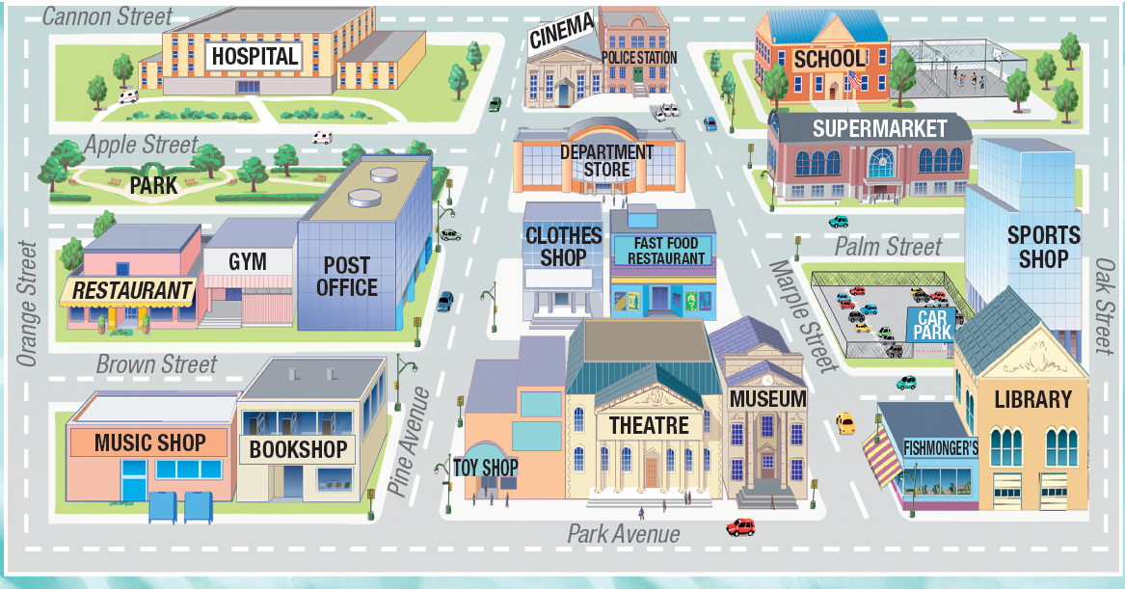
Pre-speaking
Look at the map, then listen and repeat.

Slide 9
Vocabulary:
- hospital /ˈhɒspɪtl/ (n): bệnh viện
- cinema /ˈsɪnəmə/ (n): rạp chiếu phim
- police station /pəˈliːs ˌsteɪʃn/ (n): đồn cảnh sát
- school /skuːl/ (n): trường học
- park /pɑːk/ (n): công viên
- department store /dɪˈpɑːtmənt ˌstɔː/(n) cửa hàng bách hoá
- supermarket /ˈsuːpəˌmɑːkɪt/ (n): siêu thị
- restaurant /ˈrestrɒnt/ (n): nhà hàng
- gym /dʒɪm/ (n): phòng tập thể hình
- post office /ˈpəʊst ˌɒfɪs/ (n): bưu điện
Notes:
Focus on words/ phrases that maybe challenging to your students. Review/ go through quickly those your students are familiar with.

Slide 10
Vocabulary:

- hospital /ˈhɒspɪtl/ (n): bệnh viện

- cinema /ˈsɪnəmə/ (n): rạp chiếu phim

- police station /pəˈliːs ˌsteɪʃn/ (n): đồn cảnh sát
- school /skuːl/ (n): trường học
- park /pɑːk/ (n): công viên

- department store /dɪˈpɑːtmənt ˌstɔː/(n) cửa hàng bách hoá

- supermarket /ˈsuːpəˌmɑːkɪt/ (n): siêu thị

- restaurant /ˈrestrɒnt/ (n): nhà hàng
- gym /dʒɪm/ (n): phòng tập thể hình

- post office /ˈpəʊst ˌɒfɪs/ (n): bưu điện
Notes:
Focus on words/ phrases that maybe challenging to your students. Review/ go through quickly those your students are familiar with.

Slide 11
- clothes shop /ˈkləʊðz ʃɒp/ (n): cửa hàng quần áo
- fast food restaurant /ˌfɑːst ˈfuːd ˌrestərɒnt/ (n.p) nhà hàng đồ ăn nhanh
- car park /ˈkɑːˌpɑːk/ (n): chỗ đậu xe
- sports shop /ˈspɔːts ʃɒp/ (n): cửa hàng đồ thể thao
- music shop /ˈmjuːzɪk ʃɒp/ (n): cửa hàng âm nhạc
- bookshop /ˈbʊkʃɒp/ (n): tiệm sách
- toy shop /ˈtɔɪ ʃɒp/ (n): cửa hàng đồ chơi
- theatre /ˈθɪətə/ (n): nhà hát
- museum /mjuːˈziːəm/ (n): viện bảo tàng
- fishmonger’s /ˈfɪʃˌmʌŋɡərz/ (n): cửa hàng bán cá
- library /ˈlaɪbrəri/ (n) thư viện
Notes:
Focus on words/ phrases that maybe challenging to your students. Review/ go through quickly those your students are familiar with.

Slide 12

- clothes shop /ˈkləʊðz ʃɒp/ (n): cửa hàng quần áo

- fast food restaurant /ˌfɑːst ˈfuːd ˌrestərɒnt/ (n.p) nhà hàng đồ ăn nhanh

- car park /ˈkɑːˌpɑːk/ (n): chỗ đậu xe

- sports shop /ˈspɔːts ʃɒp/ (n): cửa hàng đồ thể thao

- music shop /ˈmjuːzɪk ʃɒp/ (n): cửa hàng âm nhạc

- bookshop /ˈbʊkʃɒp/ (n): tiệm sách

- toy shop /ˈtɔɪ ʃɒp/ (n): cửa hàng đồ chơi

- theatre /ˈθɪətə/ (n): nhà hát

- museum /mjuːˈziːəm/ (n): viện bảo tàng

- fishmonger’s /ˈfɪʃˌmʌŋɡərz/ (n): cửa hàng bán cá

- library /ˈlaɪbrəri/ (n) thư viện
Notes:
Focus on words/ phrases that maybe challenging to your students. Review/ go through quickly those your students are familiar with.

Slide 13

2. Tell your partner which places are/aren’t near your house.
While-speaking
E.g. Near my house, there is a cinema, a gym, and a park. There isn’t a toy shop.

Slide 14
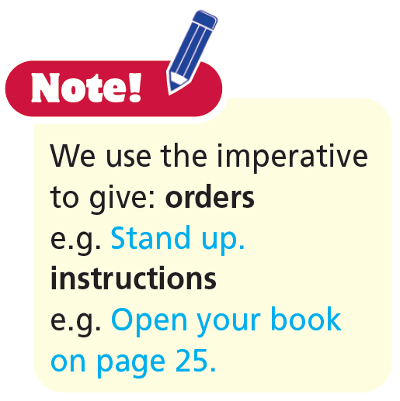
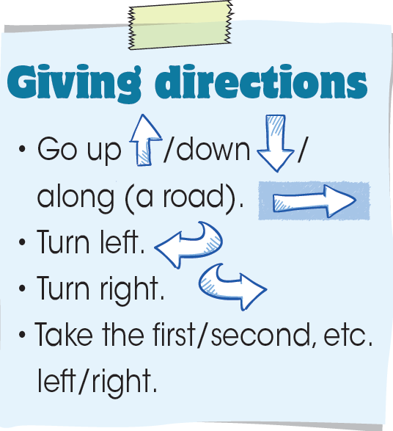
3. Use the phrases in the box and the map to give directions from:
- the school to the bookshop
E.g:
A: Can you tell me how to get to the bookshop, please?
B: Certainly. First, go down Marple Street and turn right into Park Avenue.
the fishmonger’s to the hospital
the police station to the library
the gym to the museum
the restaurant to the police station

Slide 15
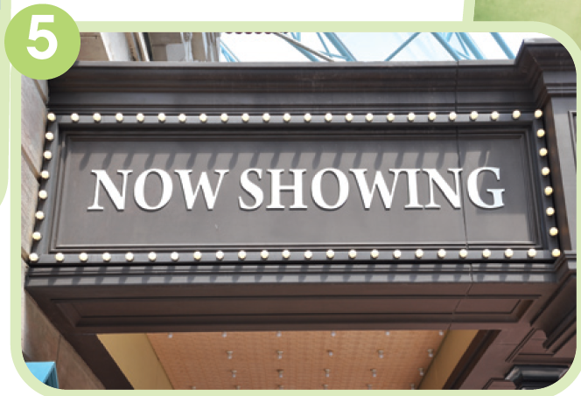

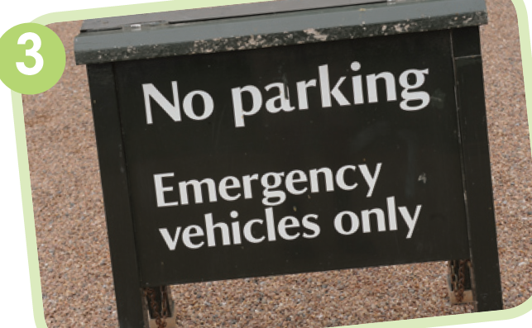
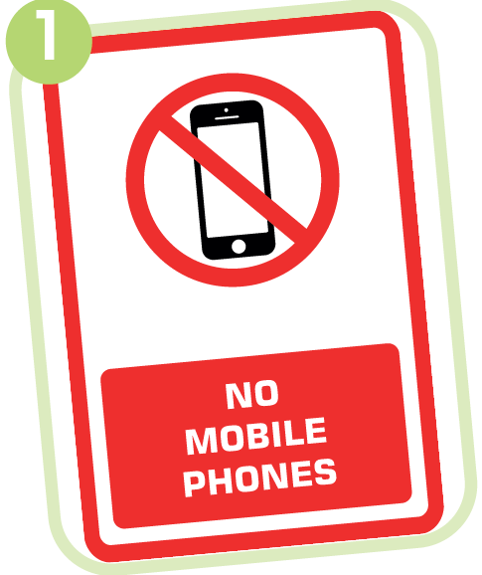
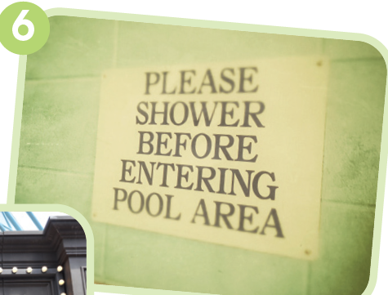
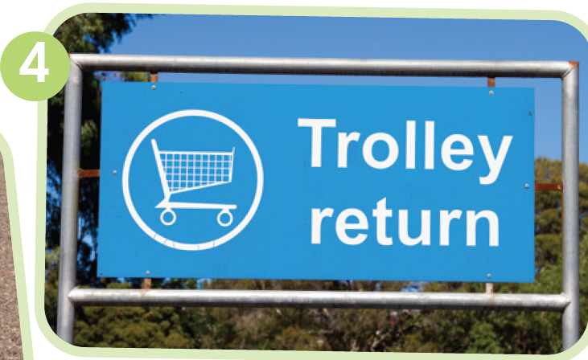
4. Look at the pictures below. In which of the places in Exercise 1 can you see them? What do they mean?

Slide 16
4. Look at the pictures below. In which of the places in Exercise 1 can you see them? What do they mean?
1. library – do not use your mobile phone
2. park – do not walk on the grass

Slide 17
4. Look at the pictures below. In which of the places in Exercise 1 can you see them? What do they mean?
3. hospital – only emergency vehicles can park here
4. supermarket – please return your trolley here

Slide 18
4. Look at the pictures below. In which of the places in Exercise 1 can you see them? What do they mean?
5. cinema – the film showing at the moment
6. gym – shower before you use the pool

Slide 19
Post-speaking
Work in pairs.
Imagine that you are standing in front of your school gate and a stranger come and ask you the way to somewhere.

Slide 20

More Practice

Slide 21
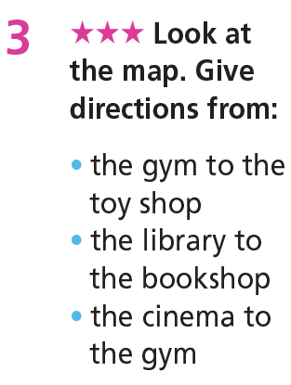
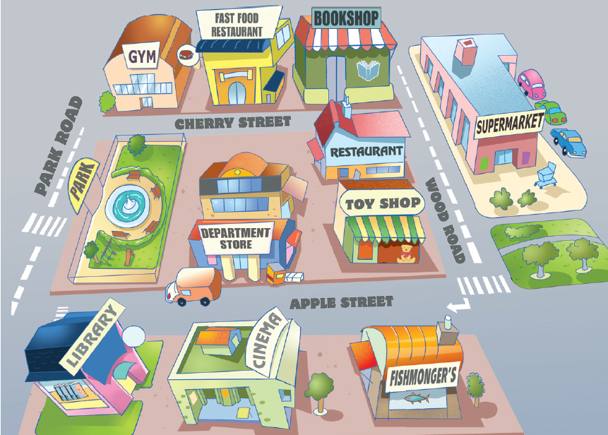

Slide 22

CONSOLIDATION

Slide 23
Write a short paragraph (about 40-60 words) to describe your hometown.

Slide 24

WRAP-UP

Slide 25
Today’s lesson
Vocabularies
- Vocabulary about places in the town.
- Announcements and messages in public places.
Grammar
- Asking and giving directions to some places.

Slide 26
Homework
Practise the vocabularies and structures and make sentences using them.
Do the exercises in TA 6 Right on WB (p. 14).
Do the exercises in TA 6 Right on Notebook (p. 15).
Prepare the next lesson (p. 27 SB).

Slide 27

Enjoy your day!

