Slide 2

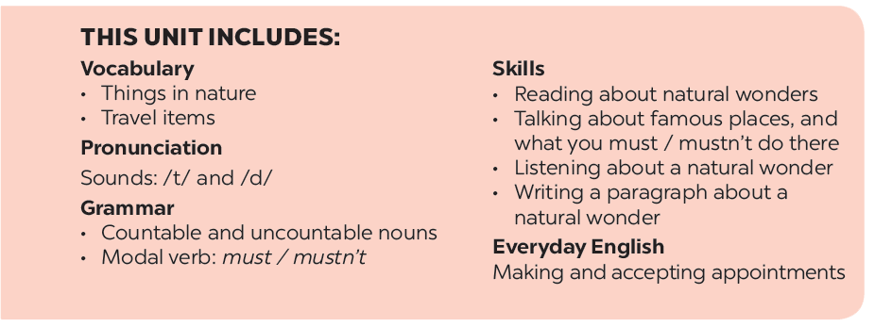

Slide 3






Listening
Writing
Work in groups. Discuss the question.
Fill each blank in the network with the information about a travel attraction you know.
Listen again and tick () T (True) or F (False).
Use the notes in 3 to write a paragraph of about 50 words.

Slide 4
Listening

Slide 5


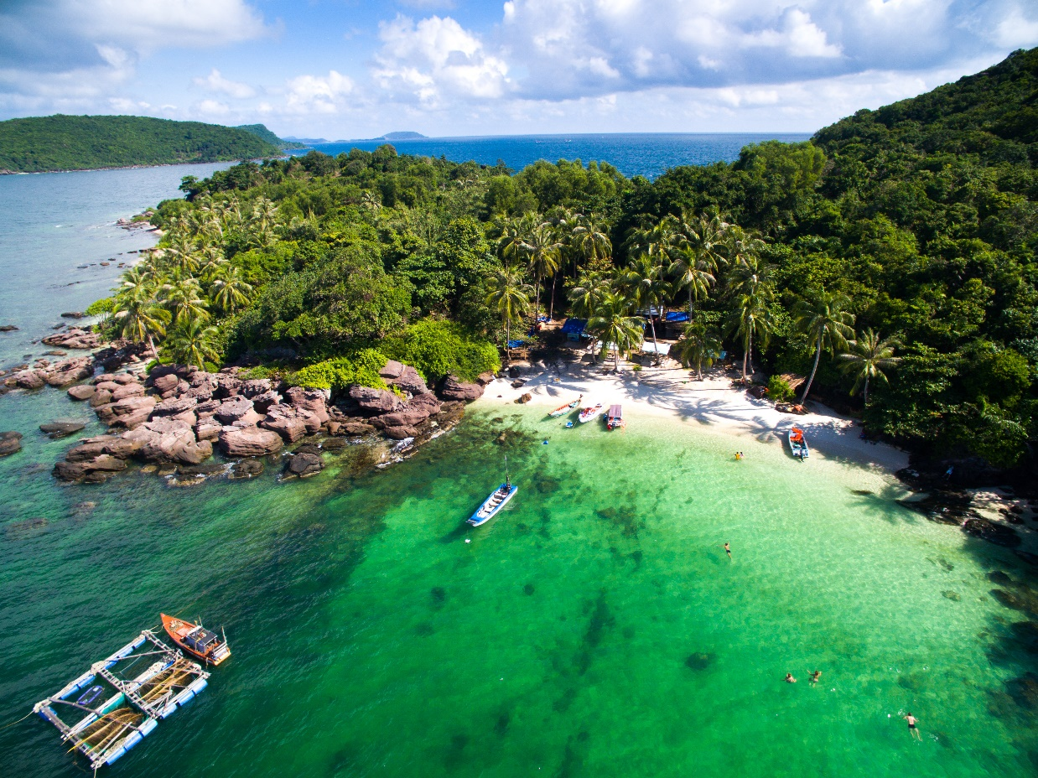

Work in groups. Discuss the question.
What do you know about Phu Quoc Island?
Listen to the talk and check your answers.
Audio script

Slide 6
AUDIO SCRIPT
Phu Quoc is a very beautiful island in Viet Nam. It is in Kien Giang. It has beautiful beaches and green forests. It also has resorts, hotels, and bars. The people here are friendly. Phu Quoc has an international airport, and travelling there is easy. Tourists can visit fishing villages, national parks, pagodas and temples. They also like to eat the seafood here. It is delicious. Sailing and fishing are popular water sports. You can buy interesting things at the markets on the island.

Slide 7

Listen again and tick () T (True) or F (False).
 |  | T | F
1. | Phu Quoc is a very beautiful island in Viet Nam.
2. | There are no green forests in Phu Quoc.
3. | Tourists can visit fishing villages and national parks there.
4. | You cannot play water sports in Phu Quoc.
5. | People sell interesting things at the markets.





Audio script

Slide 8
AUDIO SCRIPT
Phu Quoc is a very beautiful island in Viet Nam. It is in Kien Giang. It has beautiful beaches and green forests. It also has resorts, hotels, and bars. The people here are friendly. Phu Quoc has an international airport, and travelling there is easy. Tourists can visit fishing villages, national parks, pagodas and temples. They also like to eat the seafood here. It is delicious. Sailing and fishing are popular water sports. You can buy interesting things at the markets on the island.

Slide 9
Writing

Slide 10

Fill each blank in the network with the information about a travel attraction you know.
(2) Where is it?
(3) How can you go there?
(1) Name of the attraction
(5) What can you do there?
(4) What is special about it?

Slide 11


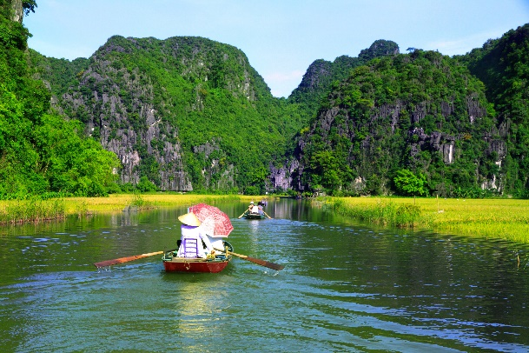
Use the notes in 3 to write a paragraph of about 50 words.
I am writing about
It is in

Slide 12






Website: hoclieu.vn
Fanpage: facebook.com/www.tienganhglobalsuccess.vn/

