Slide 1


Slide 2

Hello!
I’m Bart Simpson.
Let’s meet
my family…

Slide 3
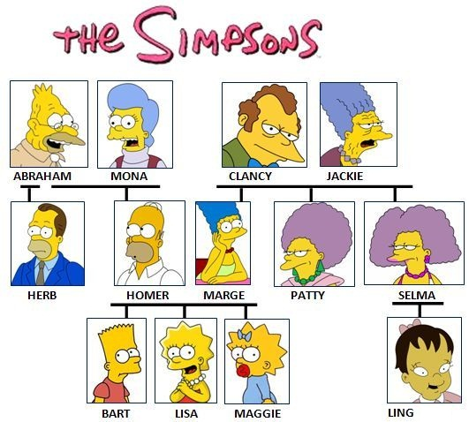

Slide 4
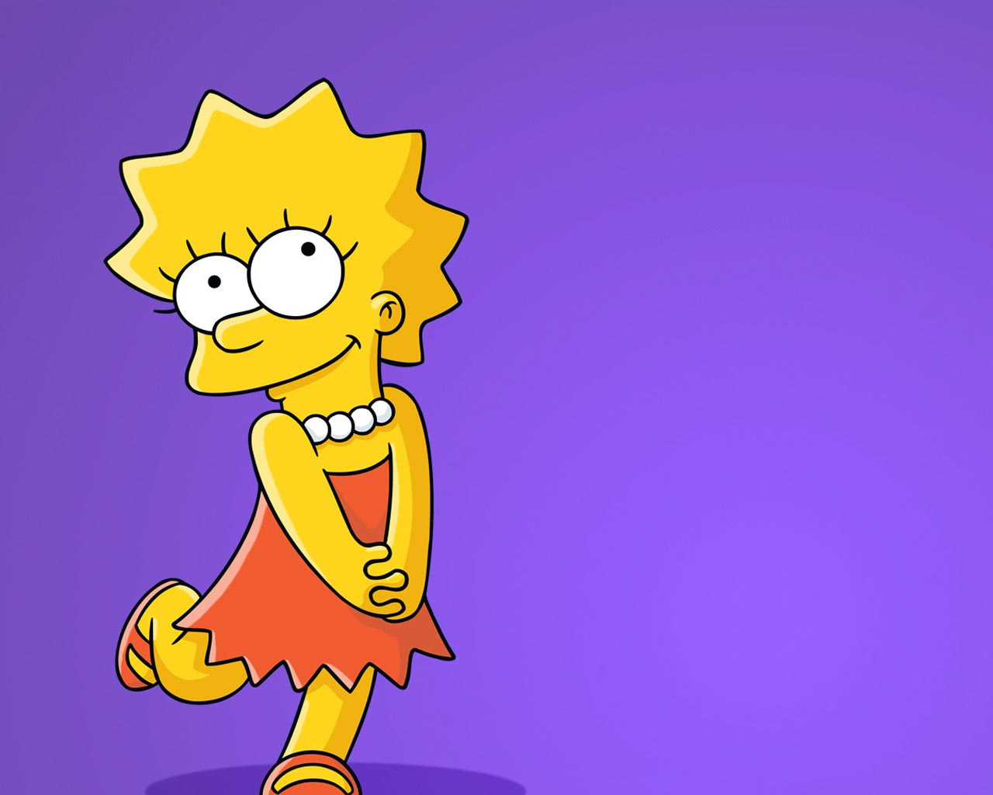
This is Lisa.
She is my sister.

Slide 5
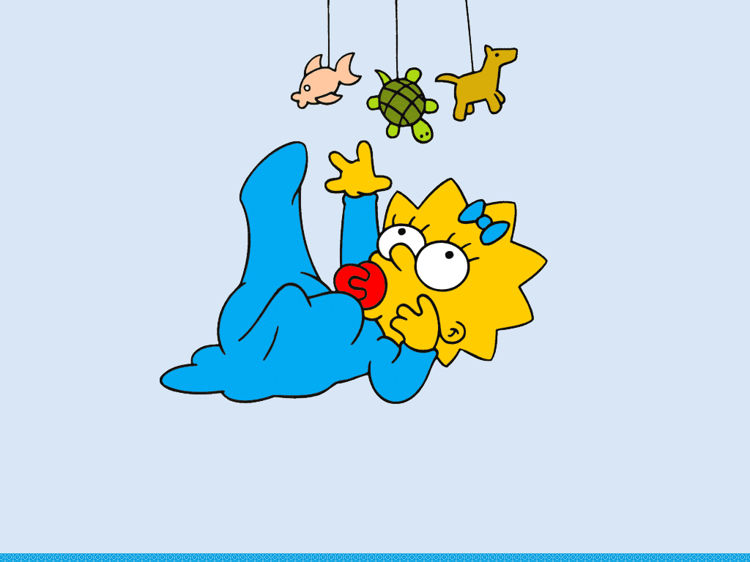
This is Maggie.
She is my baby sister.

Slide 6
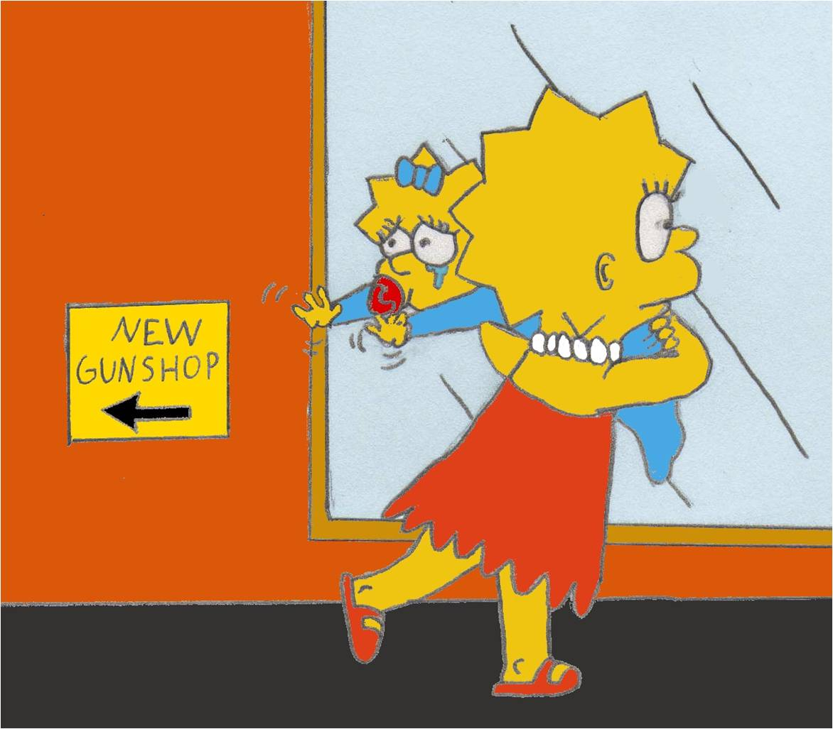
They are my sisters.

Slide 7
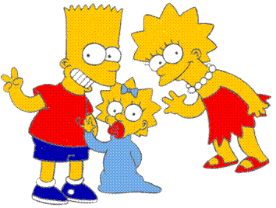
I am their brother.

Slide 8
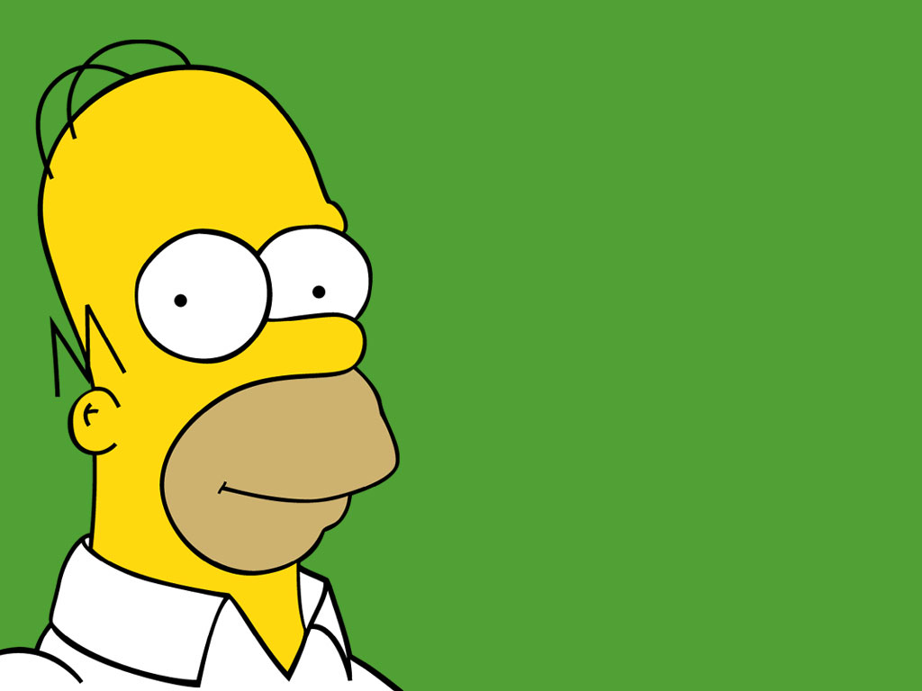
This is Homer Simpson.
He is our father (dad).

Slide 9
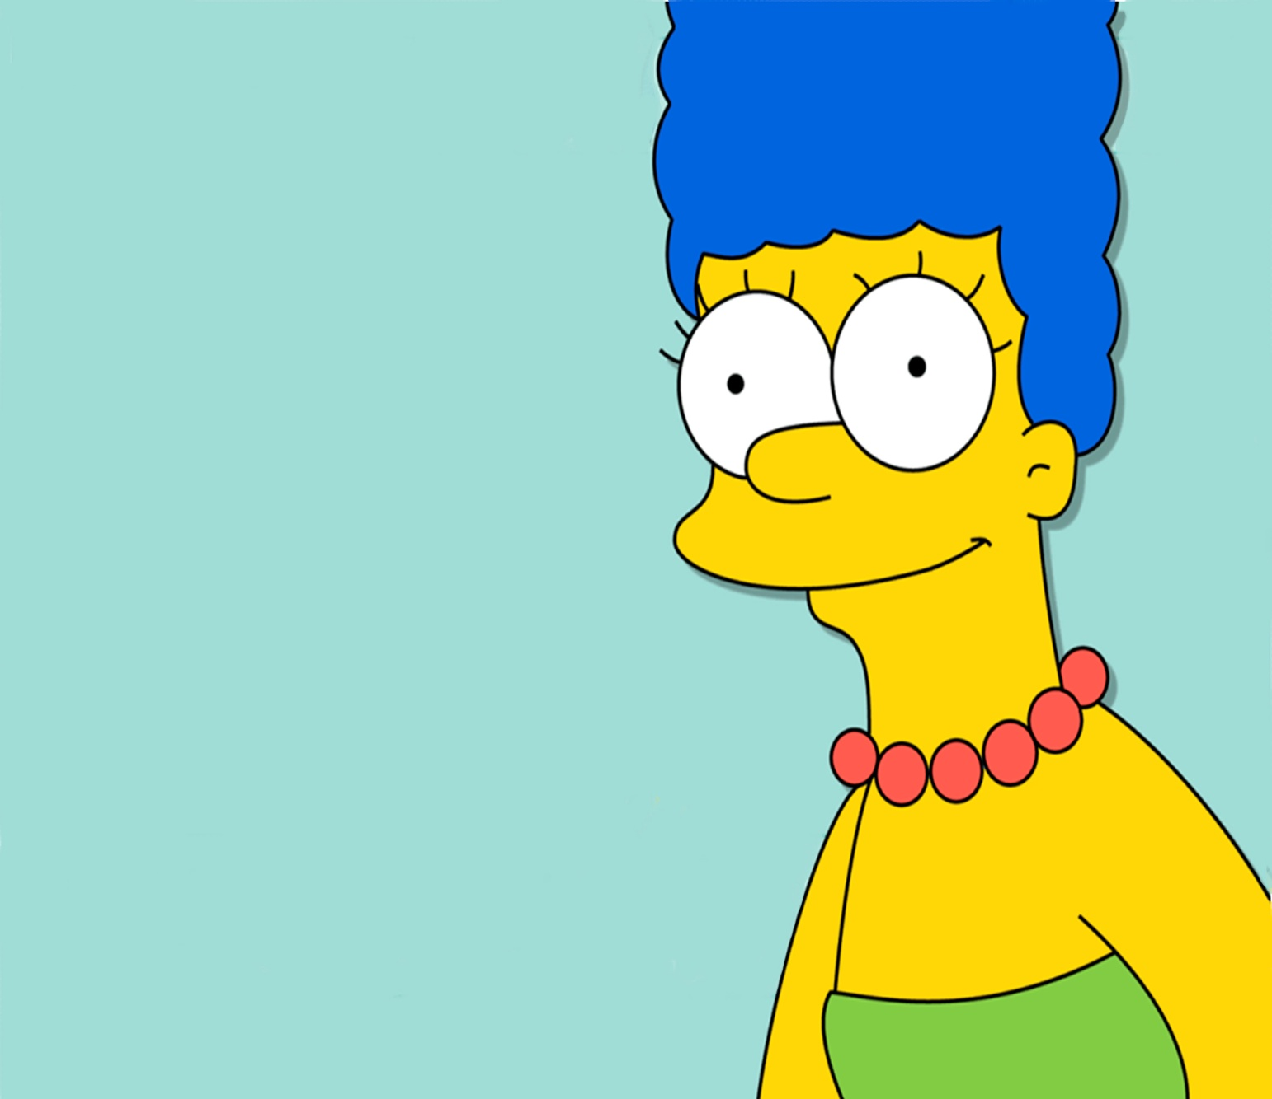
This is Marge Simpson.
She is our mother (mum).

Slide 10
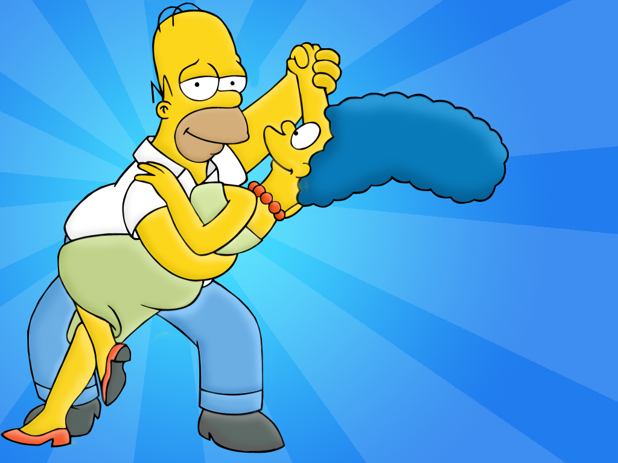
They are our parents. I’m their son.
Lisa and Maggie are their daughters.
We are their children.

Slide 11
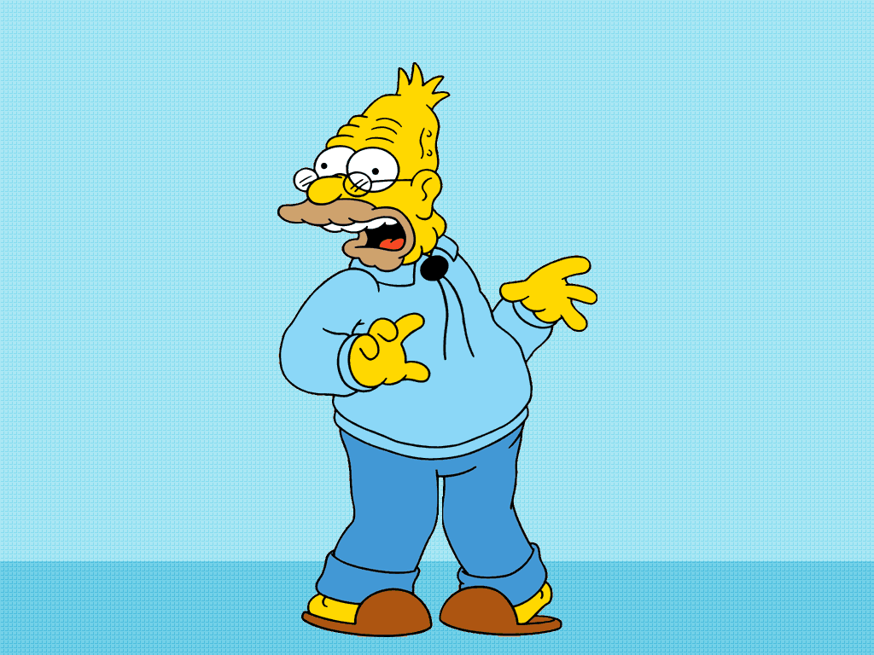
This is Abraham Simpson. He is our dad’s father. He is our grandfather.

Slide 12
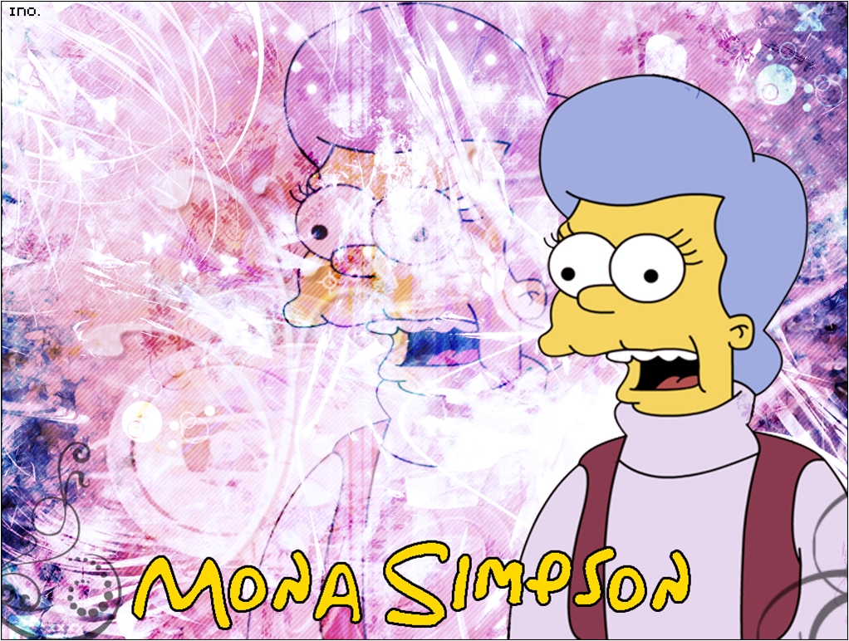
This is Mona Simpson.
She is our grandmother.

Slide 13
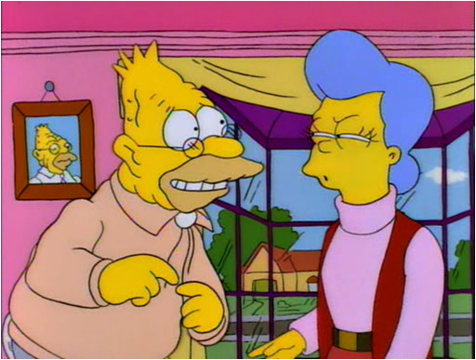
They are our grandparents.
I’m their grandson.
My sisters are their granddaughters.
We are their grandchildren.

Slide 14
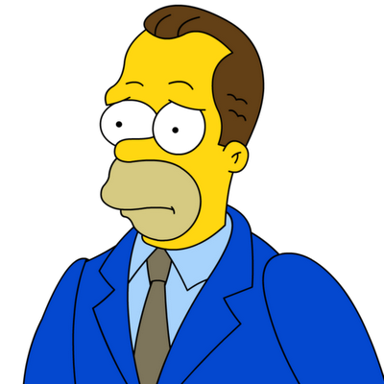
This is Herb Powell.
He is our dad’s brother.
He is our uncle. I’m his nephew.
My sisters are his nieces.

Slide 15

This is Clancy Bouvier*.
He is our mum’s father.
He is our grandpa.
* deceased

Slide 16
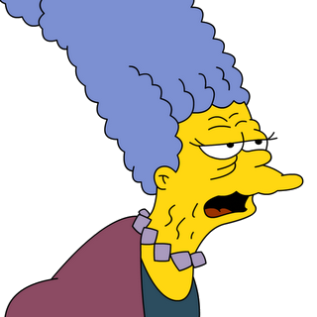
This is Jackie Bouvier.
She is our mum’s mother.
She is our grandma.

Slide 17
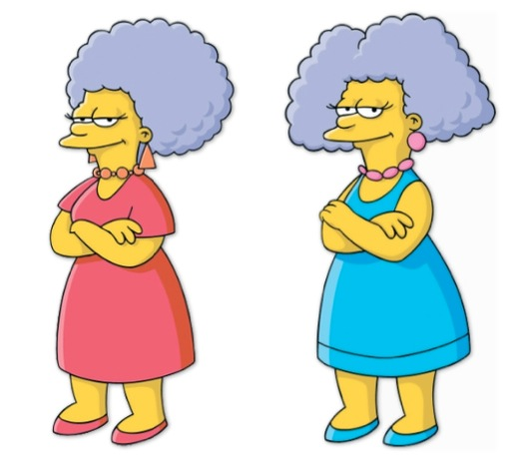
These are Patty and Selma Bouvier.
They are our mum’s sisters.
They are our aunts.

Slide 18
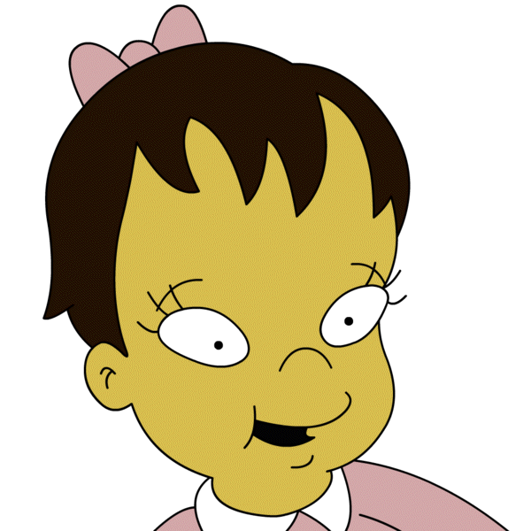
This is Ling Bouvier.
She is Selma’s stepdaughter.
She is our cousin.

Slide 19
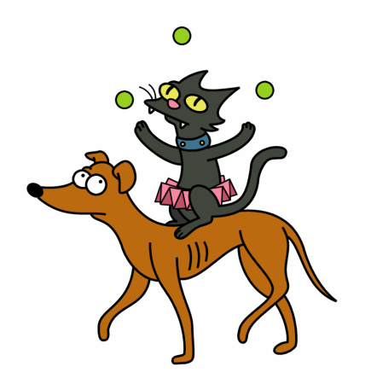
These are Santa’s Little Helper and Snowball II. They are our pets.

Slide 20
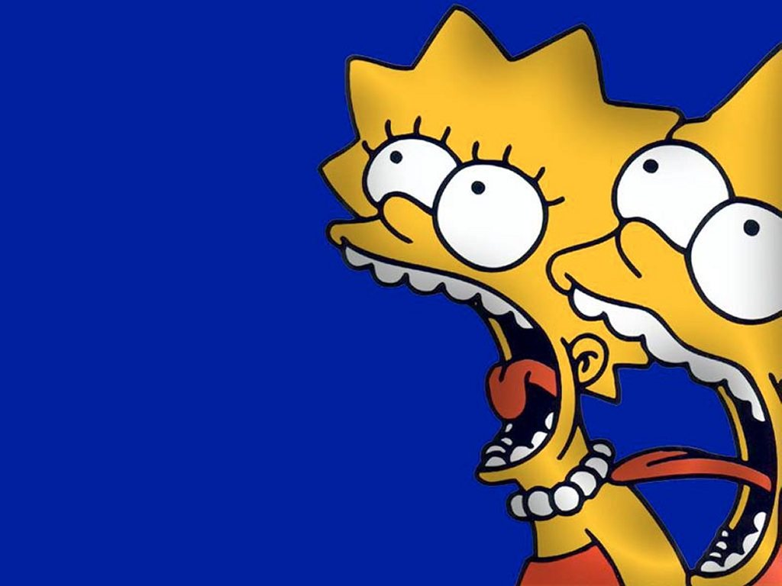
We love
our family!

Slide 21
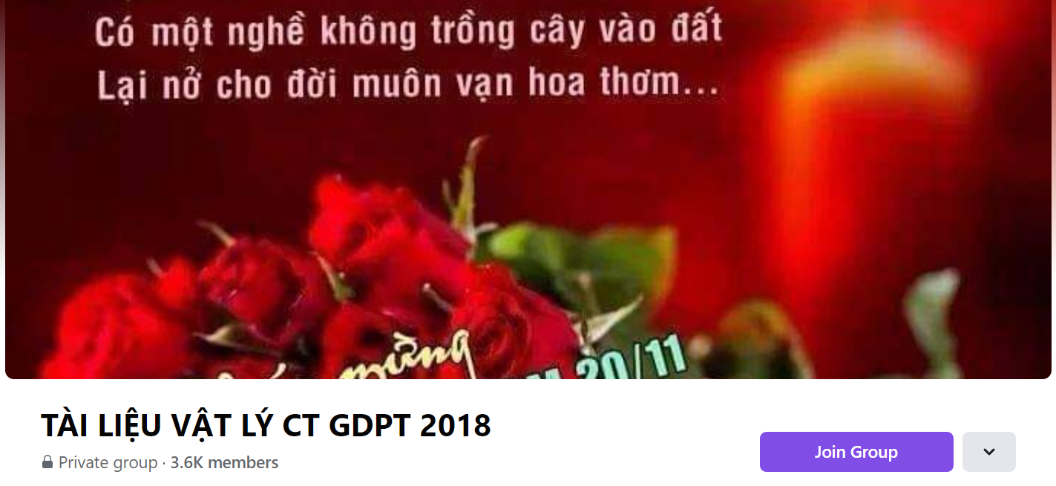
SƯU TẦM: ĐOÀN VĂN DOANH, NAM TRỰC, NAM ĐỊNH
LINK NHÓM DÀNH CHO GV BỘ MÔN VẬT LÝ TRAO ĐỔI TÀI LIỆU VÀ CHUYÊN MÔN CT 2018
https://www.facebook.com/groups/299257004355186

