Slide 1

Unit 2: Every Day
Lesson 2d: Everyday English
Page 43

Slide 2
Lesson Outline
Warm-up
Speaking
Pronunciation
Consolidation
Wrap-up

Slide 3
Objectives
By the end of this lesson, students will be able to…
make invitations, accepting and refusing invitations.
pronounce /ð/ and /θ/ correctly.

Slide 4

WARM-UP

Slide 5
Pair work
Ask and answer about free time activities
Do you often hang out with your friends?
Where do you usually go? When?

Slide 6

It’s time to learn …

Slide 7

Speaking

Slide 8
1 Complete the dialogue. Use the sentences (A-E).
Helen Hi, Nat!
Nat 1) ____________________________
Helen I’m OK. And you?
Nat 2) ____________________________
Helen I think so. Why?
Nat 3) ____________________________
Helen Sure. I’d love to. What time?
Nat 4) ____________________________
Helen Sorry, I can’t make it at 4:00. I have football practice at school until 5:00
Nat 5) ____________________________
Helen 5:30 is fine. See you!
E Hi, Helen. How are you?
D I’m fine, thanks. Hey, are you free this afternoon?
A Can we go to the mall?
A Can we go to the mall?
B Let’s meet at 4 o’clock.
C How about 5:30 then?
D I’m fine, thanks. Hey, are you free this afternoon?
E Hi, Helen. How are you?
B Let’s meet at 4 o’clock.
C How about 5:30 then?

Slide 9
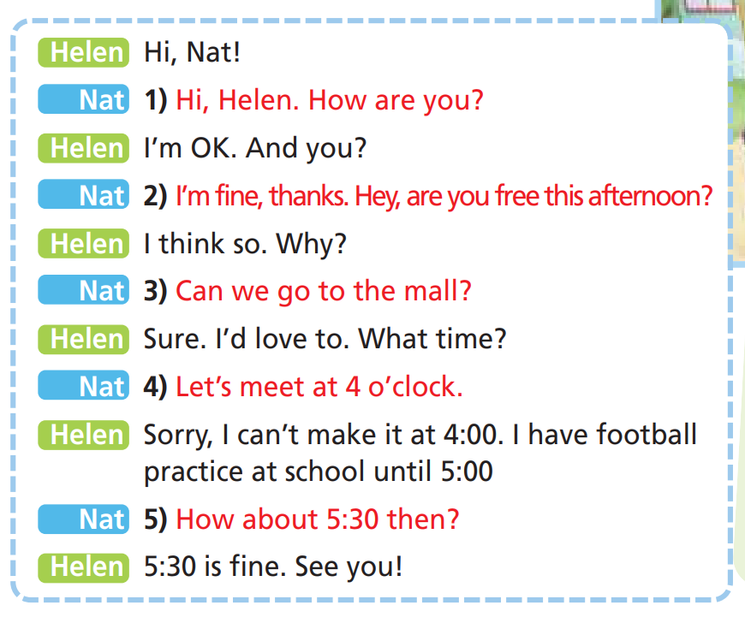

2 Listen and check. Act out the dialogue in pairs.

Slide 10
Making invitation:
Would you like + to Verb (infinitive)?
Let’s + Verb (bare infinitive).
How about + noun/V-ing?
Ex: Would you like to go to the theatre tonight?
Let’s play football after school.
How about watching a movie this weekend?
Accepting
Great. That’s a good idea.
Sure, I’d love to.
Refusing
I’m sorry. I can’t make it.
I’m afraid I can’t.

Slide 11
3 Complete the exchanges with the sentences below.
• Is 3:00 OK with you? • I can’t make it.
• How about 7:00 then? • I’d love to.
1 A: ________________________
B: Yes, that’s fine with me.
2 A: Let’s go to the park.
B: Sure. ____________________________________
3 A: Would you like to meet this Saturday?
B: Sorry. ______________________________________
4 A: ______________________________________
B: I’m afraid I can’t.
Is 3:00 OK with you?
I’d love to.
I can’t make it.
How about 7:00 then?

Slide 12
Match the sentences (1-4) to the sentences (a-d).
Are you free this Thursday? 1
Let’s meet at 5 o’clock. 2
Can you come to my house? 3
How about 7:00? 4
a Sorry, I can’t make it at 5:00.
b 7 o’clock is fine.
c I think so. Why?
d Sure. I’d love to.

Slide 13
Circle the correct response.
1 A: How about 6 o’clock, then?
B: a 6 o’clock is fine. b I’m free this morning.
2 A: What time?
B: a Sorry. I can’t make it at 7:00. b Let’s meet at 7:00.
3 A: How are you?
B: a I’d love to. b I’m OK. And you?

Slide 14
Complete the dialogue. Then read it aloud. Mind the intonation.
Sarah Hi Eddie!
Eddie Hi Sarah! How 1) ………………………………?
Sarah I’m great, thanks. And you?
Eddie I’m fine, thanks. 2) …………………… this Thursday?
Sarah I think so. Why?
Eddie 3) ………………………………… to my house?
Sarah Sure. I’d love to. What time?
Eddie 4) …………………………………….. 7 o’clock.
Sarah Sorry, I can’t make it at 7:00.
Eddie 5) …………………………. 8:00 then?
Sarah 8 o’clock is fine. See you then.
are you
Are you free
Can you come
Let’s meet at
How about

Slide 15
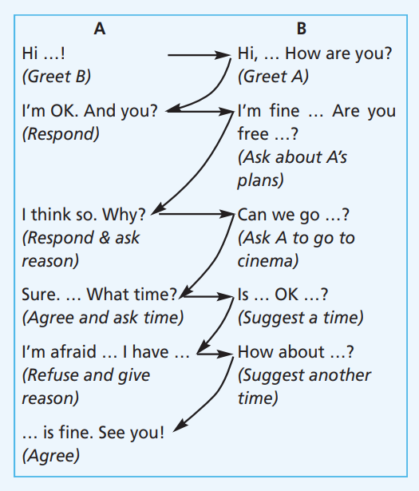
4. You want to go to the cinema this Saturday with your friend. Act out a dialogue similar to the one in Exercise 1. Mind the sentence stress.
A: Hi James!
B: Hello Rachel. How are you?
A: I’m great, thanks. Are you free on Saturday?
B: I think so. Why?
A: Can we go to the cinema?
B: I’d love to. What time?
A: Is 5:30 p.m. OK with you?
B: I’m afraid I can’t make it. I have basketball practice until 6:00 p.m.
A: How about 7:00 p.m. then?
B: 7:00 p.m. is fine. See you!

Slide 16
Pronunciation

Slide 17
Pronunciation
Th: /ð/ and /θ/
Listen and tick (✓). Listen again and repeat.
 | /ð/ | /θ/ |  | /ð/ | /θ/ |  | /ð/ | /θ/
three |  |  | then |  |  | think
that |  |  | thanks |  |  | there
✓
✓
✓
✓
✓
✓

Slide 18
Tick (✓) the correct column.
 | /ð/ | /θ/ |  | /ð/ | /θ/
this |  |  | third
month |  |  | with
the |  |  | they
Maths |  |  | teeth
theatre |  |  | Thursday
✓
✓
✓
✓
✓
✓
✓
✓
✓
✓
✓

Slide 19

CONSOLIDATION

Slide 20
Make a dialogue with your friend, inviting him/her to do something fun after school or at the weekend. Use the structures for making invitations, accepting, and refusing appropriately.

Slide 21

WRAP-UP

Slide 22
Today’s lesson
Speaking
Making invitations, accepting and refusing.
Pronunciation
Th: /ð/ and /θ/

Slide 23
Homework
Practise making invitations, accepting, and refusing.
Do the exercises in TA 6 Right on Workbook (p. 25)
Prepare the next lesson (p. 44 SB)

Slide 24
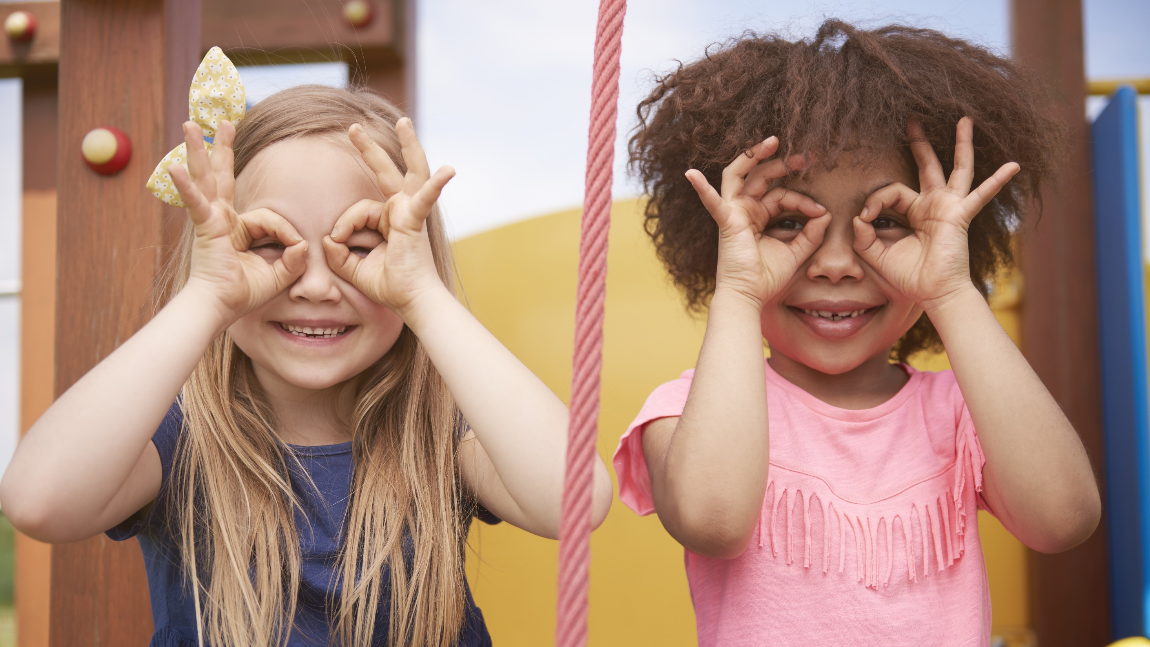
Enjoy your day!

