Slide 1

Unit 9: English in the World
Lesson 1.1: Vocabulary & Reading
Page 68

Slide 2



LESSON OUTLINE
Consolidation

Slide 3
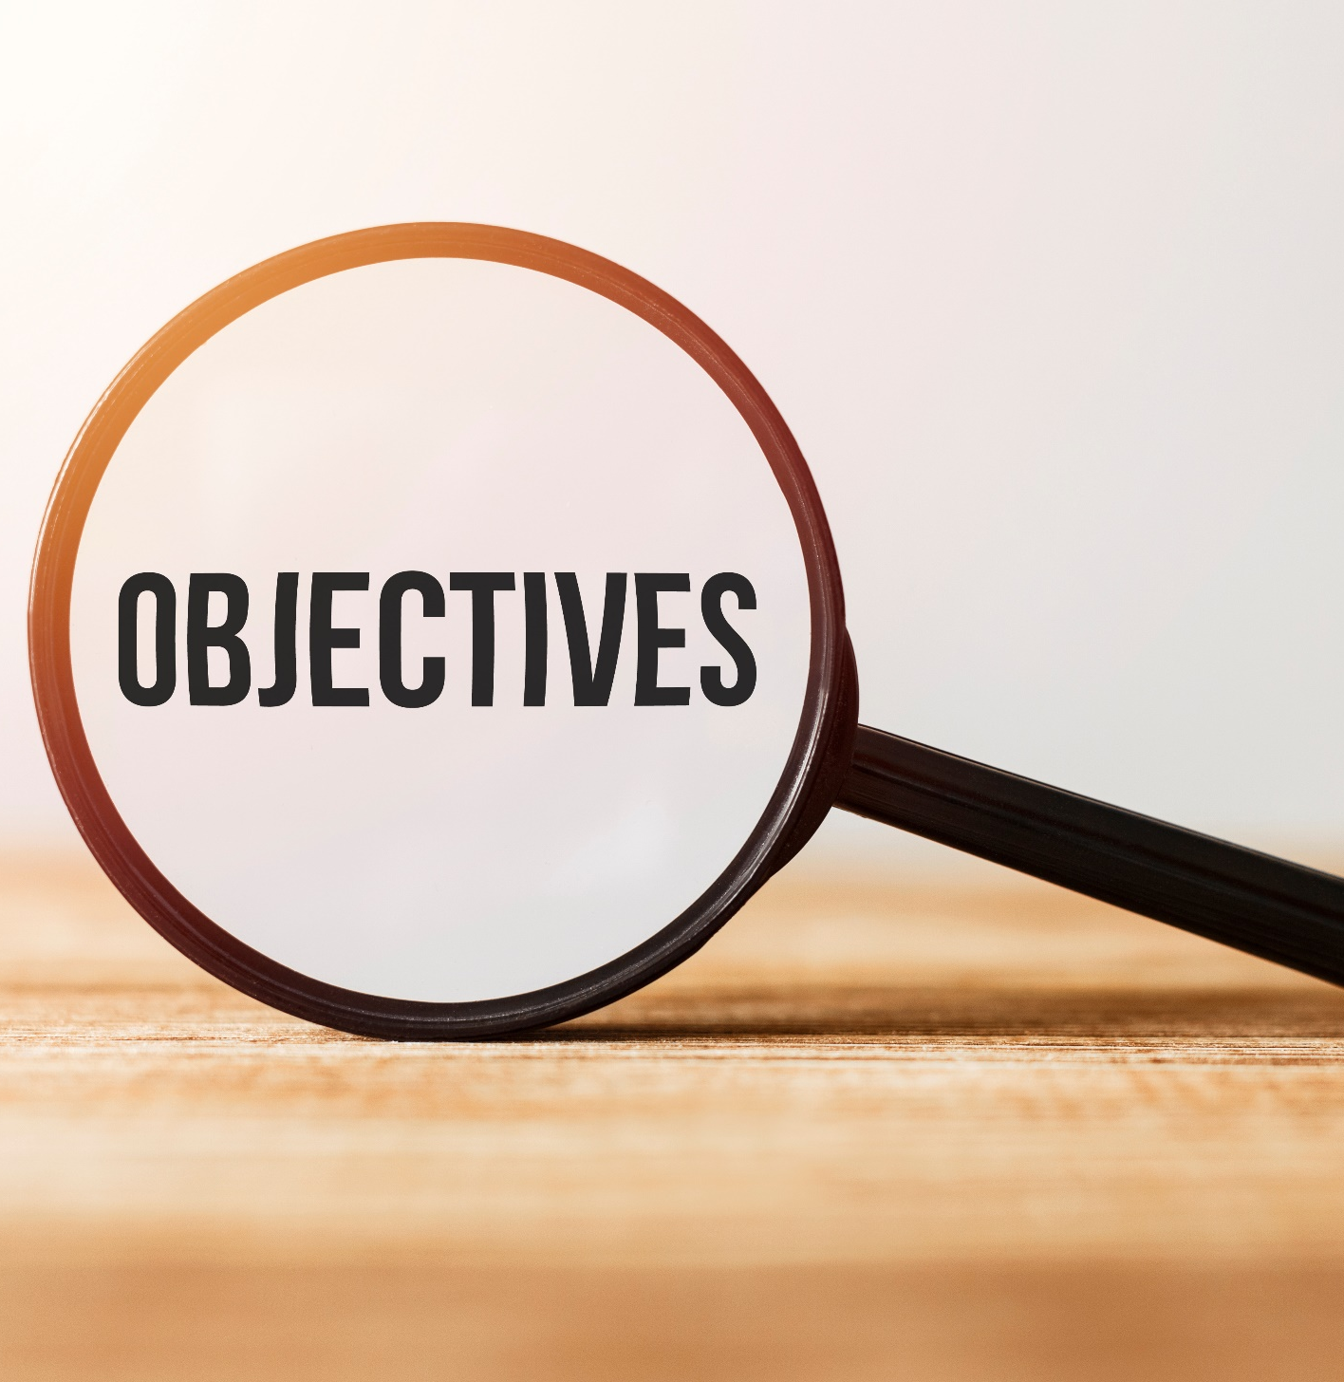
By the end of this lesson, students will be able to…
learn new vocabulary about the topic “English around the World”.
talk about tourist attractions and cultures of English-speaking countries.
- practice reading for main ideas and specific information.

Slide 4
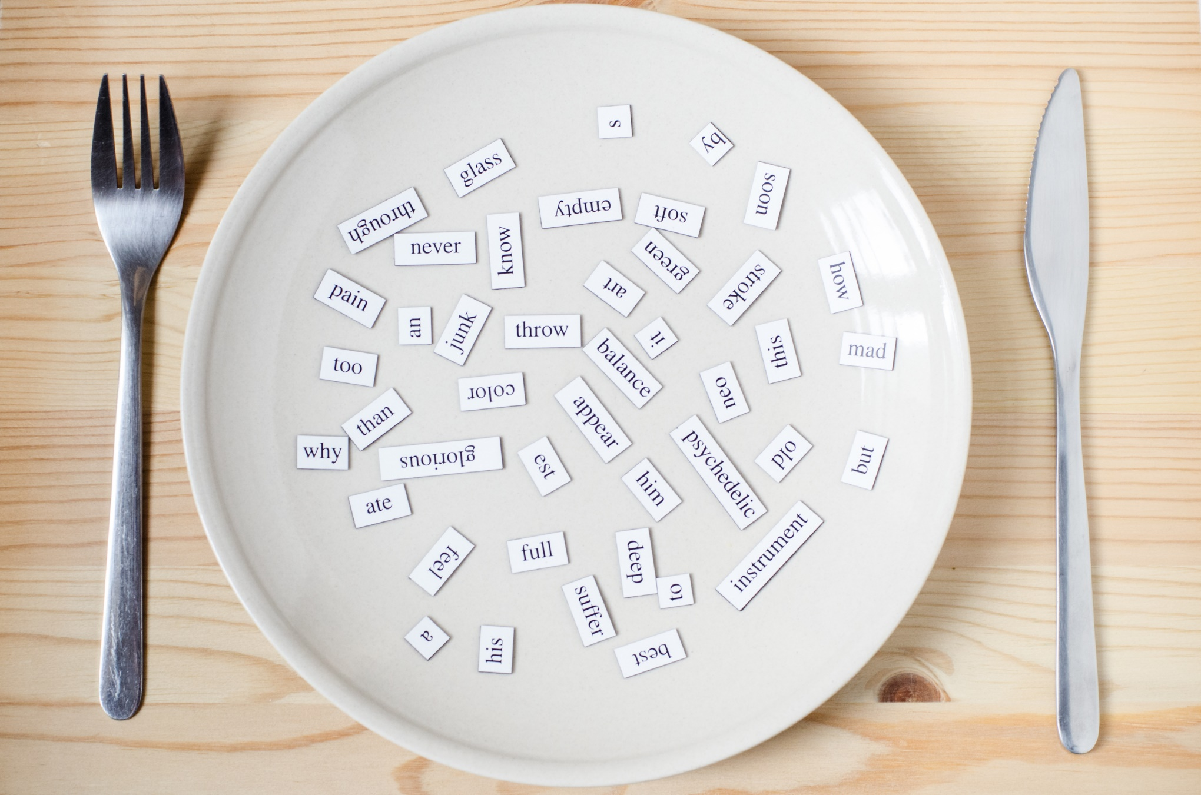
New words
tour guide
stadium
flight
historic
jog
ferry

Slide 5
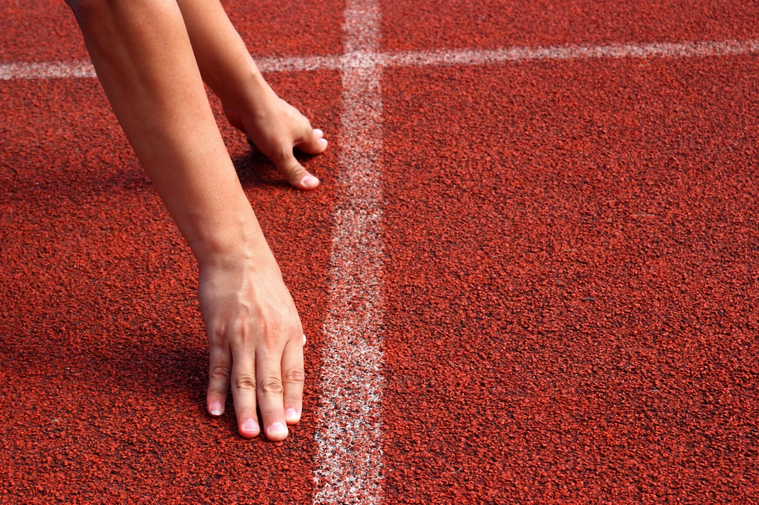
WARM-UP

Slide 6

Work in pairs.
1. Which countries are English-speaking countries?
2. Which countries do you like to visit?

Slide 7
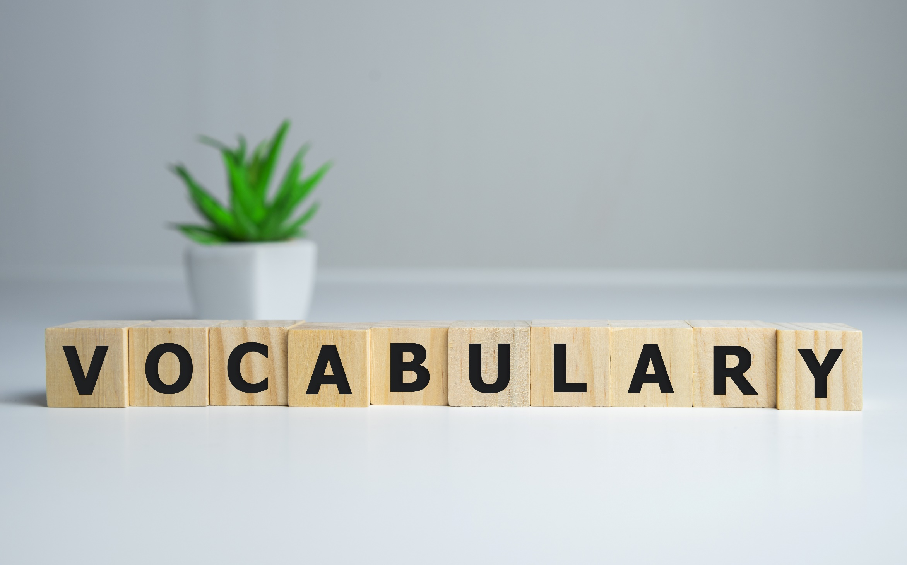


Slide 8

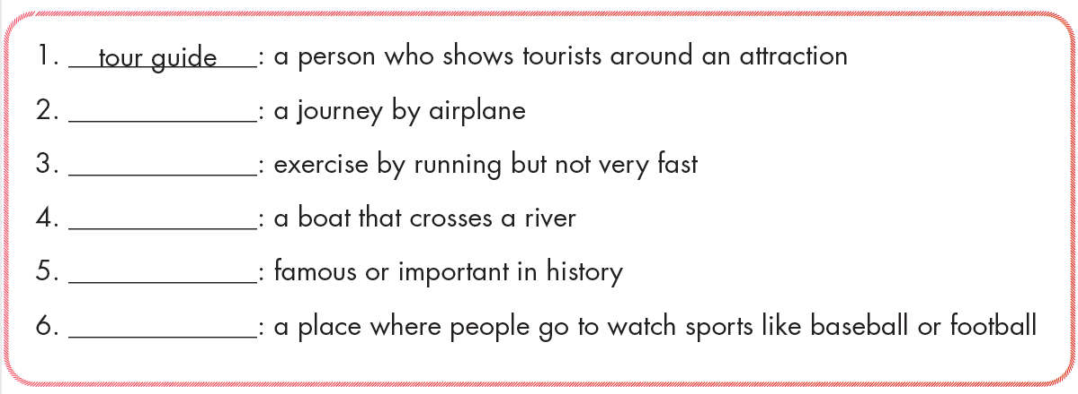
Work in pairs. Match the words with the definitions.
stadium
flight
historic
jog
ferry

Slide 9

Listen and repeat. Click each phrase to hear the sound
tour guide (n) /tʊr ɡaɪd/ hướng dẫn viên du lịch
stadium (n) /ˈsteɪdiəm/ sân vận động
flight (n) /flaɪt/ chuyến bay
historic (adj) /hɪˈstɔːrɪk/ mang tính lịch sử
jog (n) /dʒɑːɡ/ chạy bộ
ferry (n) /ˈferi/ phà
Notes:
GV click vào từng cụm nghe âm thanh

Slide 10

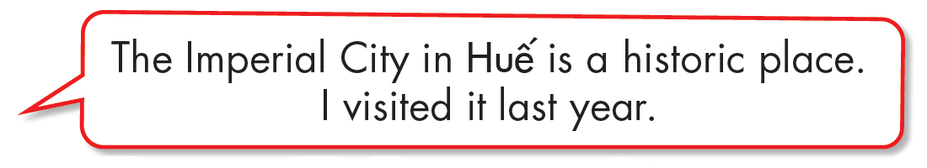
Work in pairs.
b. Do you know any historic places? Tell your partner.

Slide 11
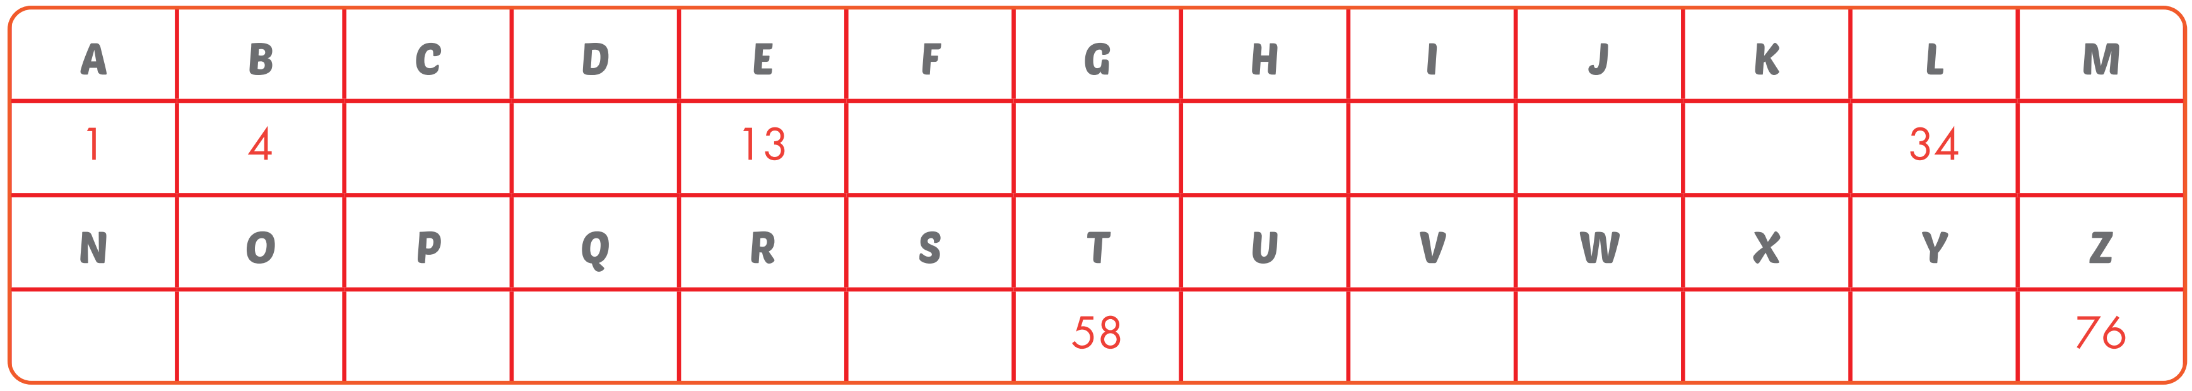

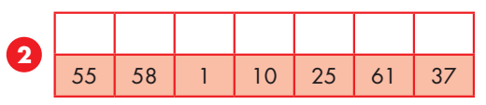
Extra Practice
WB, page 50
Complete the table and write the letters.
7
10
16
19
22
25
28
31
37
40
43
46
49
52
55
61
64
67
70
73
S T A D I U M

Slide 12
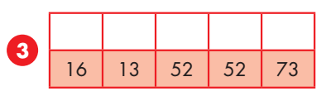
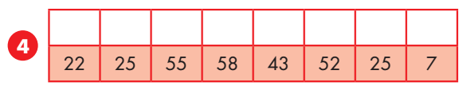
Extra Practice
WB, page 50
Complete the table and write the letters.
7
10
16
19
22
25
28
31
37
40
43
46
49
52
55
61
64
67
70
73
F E R R Y
H I S T O R I C

Slide 13
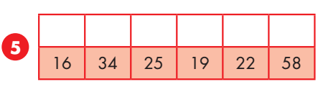
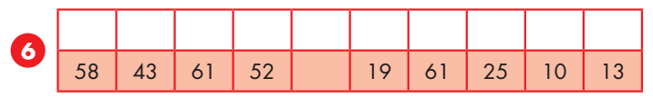
Extra Practice
WB, page 50
Complete the table and write the letters.
7
10
16
19
22
25
28
31
37
40
43
46
49
52
55
61
64
67
70
73
F L I G H T
T O U R G U I D E

Slide 14
Extra Practice
WB, page 50
Complete sentences, using words in the previous slides.
jog
stadium
ferry
historic
flight
tour guide
1. Jess likes to ____________ in the park by the river. It's a good way to exercise while enjoying the view.
2. There isn't an airport in my town. I had to go to Reno to catch a ____________ to New York.
3. The temple is on a small island. You have to take a ____________ across the river to go there.

Slide 15
Extra Practice
WB, page 50
Complete sentences, using words in the previous slides.
jog
stadium
ferry
historic
flight
tour guide
4. The ____________ gave us lots of information about the history of the building.
5. We went to the ____________ and watched a baseball game.
6. The town is famous for having many ____________ buildings. People built those in the twelfth century.

Slide 16
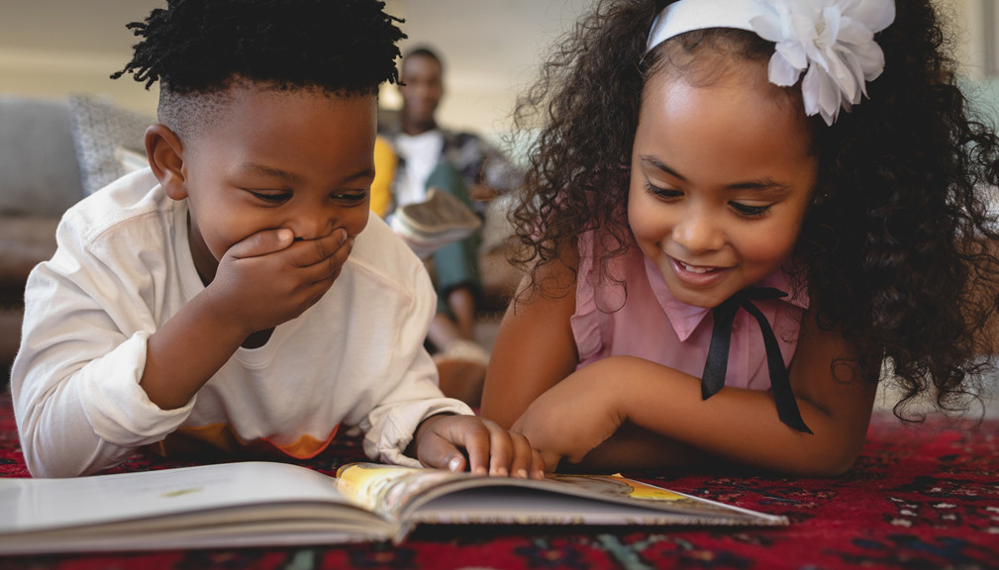

It’s reading time….

Slide 17

Pre - reading
Read the instruction quickly. Underline the key words. What are we going to do?
Read and choose the correct answer.
a. Read Jane's email to her friend. Where is Jane?

Slide 18
While - reading
Skim the text. Choose the correct answer.
Hi Sammy,
I'm here in the United States and having a great time! We arrived on Wednesday and visited the Lincoln Memorial and Georgetown. Georgetown is a historic area in Washington, D.C. The food here is great. I ate a hot dog. It's a traditional American street food. I really liked it. Tomorrow, we're going to the White House with a tour guide and taking a boat trip along the Potomac River. We're going to the National Air and Space Museum on our last day in Washington, D.C. On Friday, we will get a flight to New York City. I'm looking forward to going on the Staten Island Ferry to see the Statue of Liberty and going to Yankee Stadium. The weather here is warm and sunny and the people are very friendly. I hope you're enjoying your summer holiday back in London. I wish you were here.
Jane
1. Washington, D.C

Slide 19
Pre - reading
Read the instruction quickly. What are we going to do?
Read and circle the correct answer.
b. Now, read and circle the correct answer.

Slide 20
Pre - reading
Read the questions. Underline the key words.
b. Now, read and circle the correct answer.
So far, Jane has visited…
a. Georgetown. b. the museum. c. the Potomac River.
2. Tomorrow she's going to…
a. the Lincoln Memorial. b. the Potomac River. c. the museum.
3. They are going to New York…
a. by ferry. b. by bus. c. by plane.
4. Jane is looking forward to…
a. going to Yankee Stadium. b. her summer holiday. c. eating street food.
5. Sammy is in…
a. New York. b. London. c. Washington.

Slide 21
While - reading
Scan the text. Circle the correct answer.
1. So far, Jane has visited… a. Georgetown. b. the museum. c. the Potomac River.
Hi Sammy,
I'm here in the United States and having a great time! We arrived on Wednesday and visited the Lincoln Memorial and Georgetown. Georgetown is a historic area in Washington, D.C. The food here is great. I ate a hot dog. It's a traditional American street food. I really liked it. Tomorrow, we're going to the White House with a tour guide and taking a boat trip along the Potomac River. We're going to the National Air and Space Museum on our last day in Washington, D.C. On Friday, we will get a flight to New York City. I'm looking forward to going on the Staten Island Ferry to see the Statue of Liberty and going to Yankee Stadium. The weather here is warm and sunny and the people are very friendly. I hope you're enjoying your summer holiday back in London. I wish you were here.
Jane

Slide 22
While - reading
Scan the text. Circle the correct answer.
2. Tomorrow she's going to… a. the Lincoln Memorial. b. the Potomac River. c. the museum.
Hi Sammy,
I'm here in the United States and having a great time! We arrived on Wednesday and visited the Lincoln Memorial and Georgetown. Georgetown is a historic area in Washington, D.C. The food here is great. I ate a hot dog. It's a traditional American street food. I really liked it. Tomorrow, we're going to the White House with a tour guide and taking a boat trip along the Potomac River. We're going to the National Air and Space Museum on our last day in Washington, D.C. On Friday, we will get a flight to New York City. I'm looking forward to going on the Staten Island Ferry to see the Statue of Liberty and going to Yankee Stadium. The weather here is warm and sunny and the people are very friendly. I hope you're enjoying your summer holiday back in London. I wish you were here.
Jane

Slide 23
While - reading
Scan the text. Circle the correct answer.
3. They are going to New York… a. by ferry. b. by bus. c. by plane.
Hi Sammy,
I'm here in the United States and having a great time! We arrived on Wednesday and visited the Lincoln Memorial and Georgetown. Georgetown is a historic area in Washington, D.C. The food here is great. I ate a hot dog. It's a traditional American street food. I really liked it. Tomorrow, we're going to the White House with a tour guide and taking a boat trip along the Potomac River. We're going to the National Air and Space Museum on our last day in Washington, D.C. On Friday, we will get a flight to New York City. I'm looking forward to going on the Staten Island Ferry to see the Statue of Liberty and going to Yankee Stadium. The weather here is warm and sunny and the people are very friendly. I hope you're enjoying your summer holiday back in London. I wish you were here.
Jane

Slide 24
While - reading
Scan the text. Circle the correct answer.
4. Jane is looking forward to… a. going to Yankee Stadium. b. her summer holiday. c. eating street food.
Hi Sammy,
I'm here in the United States and having a great time! We arrived on Wednesday and visited the Lincoln Memorial and Georgetown. Georgetown is a historic area in Washington, D.C. The food here is great. I ate a hot dog. It's a traditional American street food. I really liked it. Tomorrow, we're going to the White House with a tour guide and taking a boat trip along the Potomac River. We're going to the National Air and Space Museum on our last day in Washington, D.C. On Friday, we will get a flight to New York City. I'm looking forward to going on the Staten Island Ferry to see the Statue of Liberty and going to Yankee Stadium. The weather here is warm and sunny and the people are very friendly. I hope you're enjoying your summer holiday back in London. I wish you were here.
Jane

Slide 25
While - reading
Scan the text. Circle the correct answer.
5. Sammy is in… a. New York. b. London. c. Washington.
Hi Sammy,
I'm here in the United States and having a great time! We arrived on Wednesday and visited the Lincoln Memorial and Georgetown. Georgetown is a historic area in Washington, D.C. The food here is great. I ate a hot dog. It's a traditional American street food. I really liked it. Tomorrow, we're going to the White House with a tour guide and taking a boat trip along the Potomac River. We're going to the National Air and Space Museum on our last day in Washington, D.C. On Friday, we will get a flight to New York City. I'm looking forward to going on the Staten Island Ferry to see the Statue of Liberty and going to Yankee Stadium. The weather here is warm and sunny and the people are very friendly. I hope you're enjoying your summer holiday back in London. I wish you were here.
Jane

Slide 26

Post - reading
Work in pairs.
Answer the questions:
What do you know about the United States?
Would you like to visit it?

Slide 27
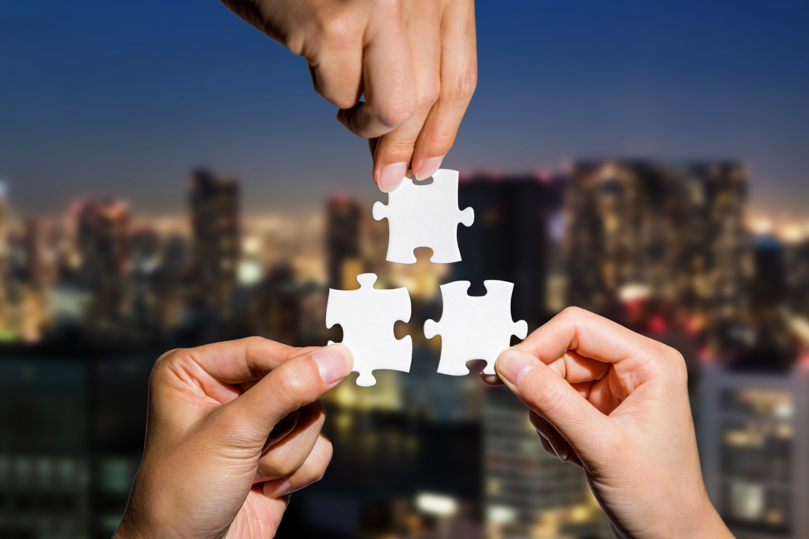
CONSOLIDATION

Slide 28
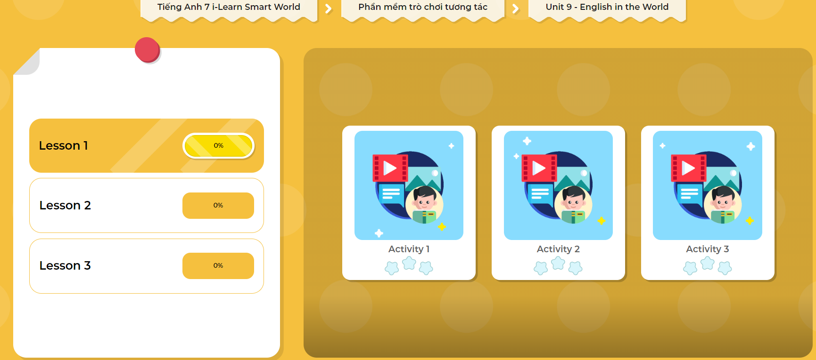
LET’S PLAY!
Click here to play the games!

Slide 29
Write about a place you want to visit on your vacation (about 70 words).

Slide 30

WRAP-UP

Slide 31
Today’s lesson
Vocabularies
tour guide
stadium
flight
historic
jog
ferry

Slide 32
Today’s lesson
Reading:
Reading for main ideas and specific information.
Speaking:
Tourist attractions and cultures of English-speaking countries.

Slide 33
Homework
Learn by heart the vocabularies and write a paragraph using them.
Do the Reading exercise in Tiếng Anh 7 i-Learn Smart World Workbook (page 50).
Do the exercises in Tiếng Anh 7 i-Learn Smart World Notebook (page 54).
Prepare the next lesson (page 69 SB).
Play the consolidation games in Tiếng Anh 7 i-Learn Smart World DHA App on www.eduhome.com.vn

Slide 34
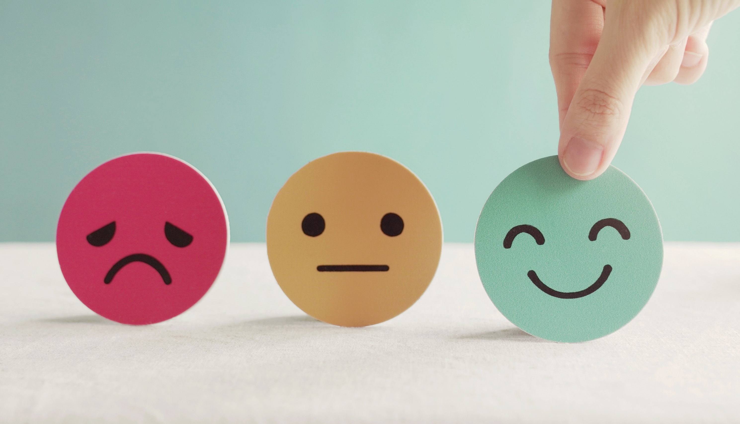
Lesson 3
Stay positive and have a nice day!

