Slide 1

Unit 1: Home & Places
Lesson 1a: Reading
Page 22

Slide 2
Lesson Outline
Warm-up
Vocabulary
Reading
Consolidation
Wrap-up

Slide 3
Objectives
By the end of this lesson, students will be able to…
Learn vocabulary to describe a house.
Practise reading for the main idea and specific information.

Slide 4

WARM-UP

Slide 5

What do you see in the picture?
=> It looks like a boat. It is on the river. There is a flag and a picture on it…
What type of house is it?

Slide 6

It’s time to learn …

Slide 7

Reading

Slide 8
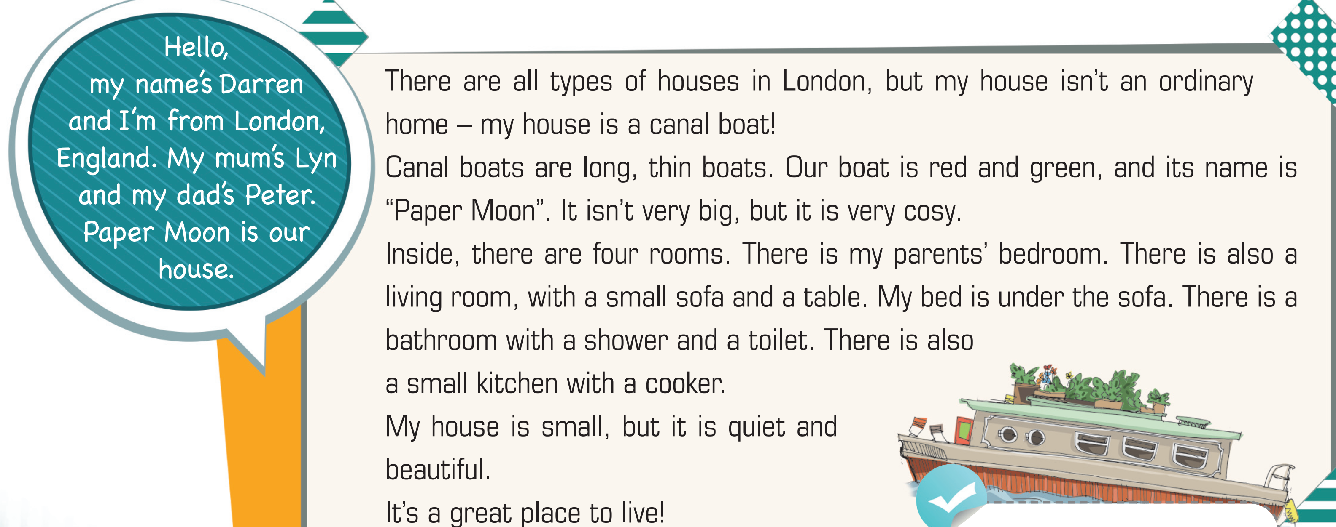
Find the words in the text. Guess their meanings.
Pre-reading
• ordinary • canal boat • long • cosy • shower • quiet

Slide 9

Vocabulary
• ordinary /ˈɔːdnri/ (adj): bình thường
• canal boat /kəˈnæl bəʊt/ (n): thuyền dài và hẹp, dùng để di chuyển trên các con kênh
• long /lɒŋ/ (adj): dài
• cosy /ˈkəʊzi/ (adj): ấm cúng
• shower /ˈʃaʊə(r)/ (n): vòi tắm hoa sen
• quiet /ˈkwaɪət/ (adj): yên tĩnh

Slide 10
Vocabulary
• ordinary /ˈɔːdnri/ (adj): bình thường
• canal boat /kəˈnæl bəʊt/ (n): thuyền dài và hẹp, dùng để di chuyển trên các con kênh
• long /lɒŋ/ (adj): dài
• cosy /ˈkəʊzi/ (adj): ấm cúng
• shower /ˈʃaʊə(r)/ (n): vòi tắm hoa sen
• quiet /ˈkwaɪət/ (adj): yên tĩnh

Slide 11
While-reading
1 Listen and read to find out.
=> The house is a canal boat.

Slide 12
2 Read the text and complete the sentences.
Read all the statements and underline the key words.
1 Darren is from_____________________________________.
2 His house is_______________________________________ .
3 Canal boats are ___________________________________ .
4 The name of Darren’s boat is _________________________ .
5 Darren’s bed is under _______________________________

Slide 13
London, England
1 Darren is from_____________________________________.
2 His house is_______________________________________ .
3 Canal boats are ____________________________________ .
4 The name of Darren’s boat is _________________________ .
5 Darren’s bed is under _______________________________ .
a canal boat
long and thin
“Paper Moon”
the sofa

Slide 14
Further practice
Read the text again. Choose the correct option for each question.
First, underline the key words.
What is Darren’s mother’s name?
Lyn B. Peter C. Paper Moon
2. What are the colours of Darren’s boat?
red and blue B. blue and green C. green and red
3. How many rooms are there in Darren’s house?
3 B. 4 C. 5
4. Where does Darren sleep in his house?
A. his parents’ bedroom B. living room C. kitchen

Slide 15
1. What is Darren’s mother’s name?
A. Lyn B. Peter C. Paper Moon
2. What are the colours of Darren’s boat?
A. red and blue B. blue and green C. green and red

Slide 16
3. How many rooms are there in Darren’s house?
A. 3 B. 4 C. 5
4. Where does Darren sleep in his house?
A. his parents’ bedroom B. living room C. kitchen

Slide 17
While-reading
Imagine you are living in a special house. Draw a picture of your house. Then, introduce that house to your partner.

Slide 18

CONSOLIDATION

Slide 19
Write a paragraph (60-80 words) to introduce your family and your house.

Slide 20

WRAP-UP

Slide 21
Today’s lesson
Vocabularies
Vocabulary to describe a house.

Slide 22
Homework
Practise the vocabularies and make sentences using them.
Do the exercises in TA 6 Right on WB (p. 12)
Prepare the next lesson (p. 23 SB)

Slide 23

Enjoy your day!

