Slide 2

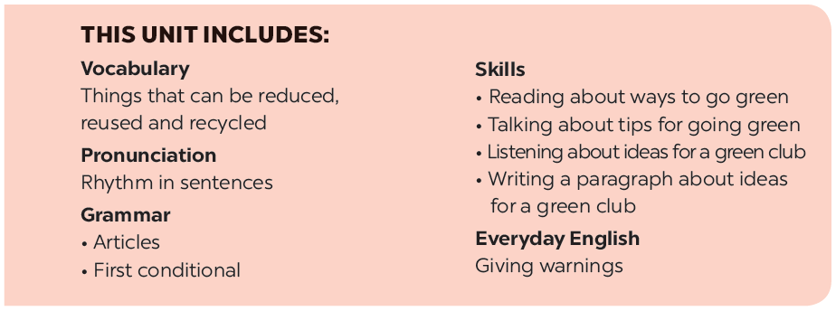

Slide 3







Vocabulary
Add more words to the word webs below.
Write the correct form of each verb in brackets.
Grammar
Combine each pair of sentences below to make a first conditional sentence.
Write a / an or the.

Slide 4
Vocabulary

Slide 5


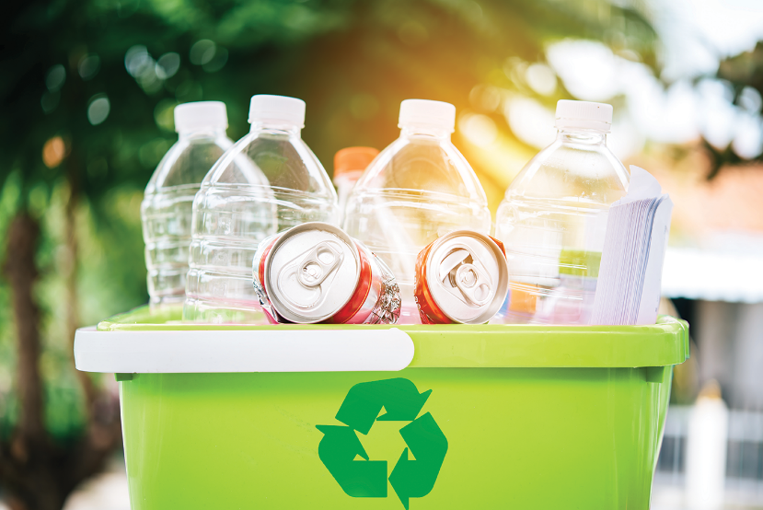
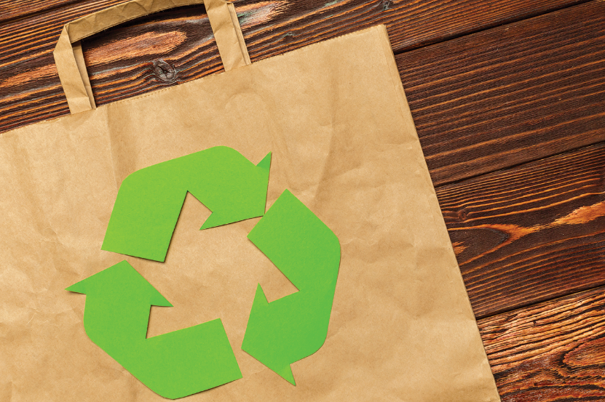
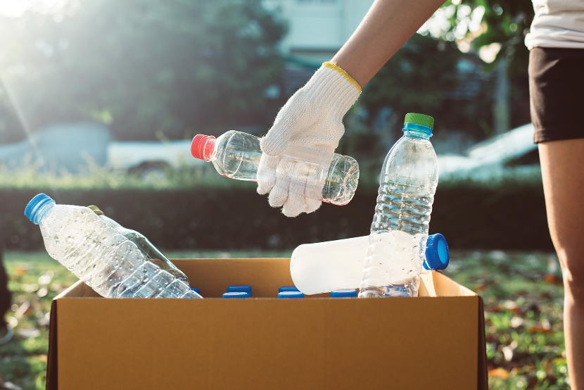
Add more words to the word webs below.

Slide 6
electricity
water
gas
Reduce
plastic bags
rubbish
paper

Slide 7
bottles
envelopes
cans
Reuse
plastic bottles
light bulbs
plastic bags

Slide 8
plastic
boxes
plastic
bags
books
Recycle
glass
newspapers
cans

Slide 9
Grammar

Slide 10

Write a / an or the.
1.
If I see
a dog, I will run away.
_______ dog, I will run away.
2.
Does your town have
an art gallery?
_______ art gallery?
The Moon is bright tonight.
3.
_______ Moon is bright tonight.
4.
There is a big temple in the town.
_______ temple is very old.
The temple is very old.
5.
- Is your mother
a teacher?
_______ teacher?
an artist.
- No, she isn’t. She’s
_______ artist.

Slide 11

Write the correct form of each verb in brackets.
If they (build) _______ an airport here, it (be) _______ very noisy.
1.
If they (build) build an airport here, it (be) will be very noisy.
People (save) will save the environment if they (reuse) reuse old items.
2.
People (save) _______ the environment if they (reuse) _______ old items.
If we (grow) grow trees, our school (be) will be greener.
3.
If we (grow) _______ trees, our school (be) _______ greener.
If we (not have) don’t have enough food, we (be) will be hungry.
4.
If we (not have) _______ enough food, we (be) _______ hungry.
5.
If we (be) are hungry, we (be) will be tired.
If we (be) _______ hungry, we (be) _______ tired.

Slide 12

Combine each pair of sentences below to make a first conditional sentence.
1.
We walk or cycle. We are healthy.
If we walk or cycle, we will be healthy.
2.
We use the car all the time. We make the air dirty.
If we use the car all the time, we will make the air dirty.
3.
You reuse paper. You save trees.
If you reuse paper, you will save trees.
4.
You make noise. Your sister doesn’t sleep.
If you make noise, your sister will not / won’t sleep.
5.
I see a used bottle on the road. I put it in the bin.
If I see a used bottle on the road, I will put it in the bin.

Slide 13
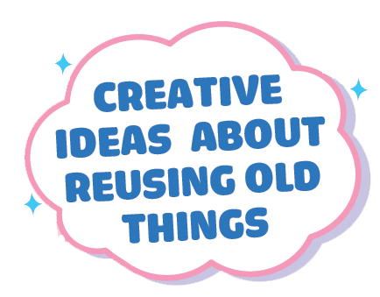

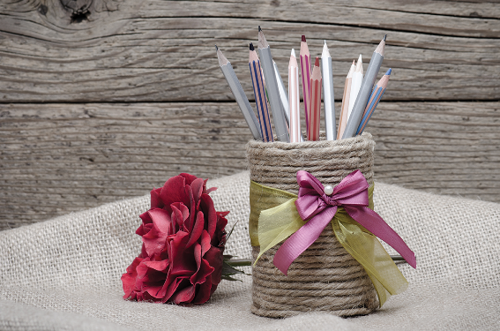
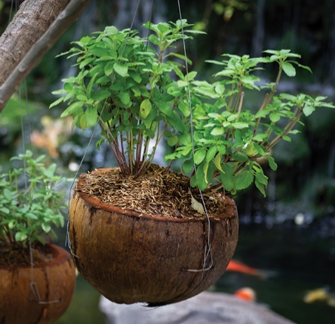


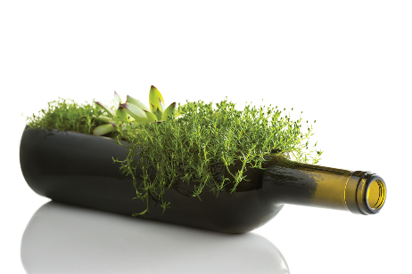
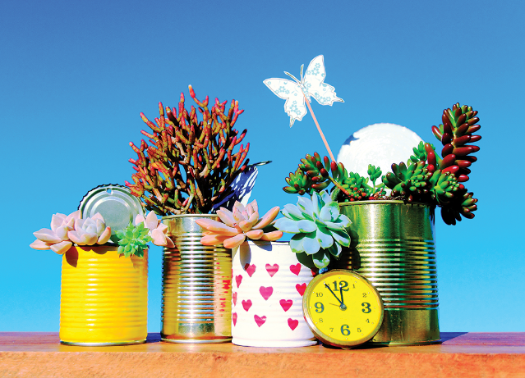

What can you see in each picture? What did people use to make the things in the pictures?
Now work in pairs or in groups to complete the project.
Choose a used object (a bottle, a sheet of paper, etc.).
Make something new from it and decorate it.
Bring it to class.
Do a “show and tell” about it.
Listen to other presentations and decide which is the best.

Slide 14


Answers:
Q1: A (0) B (2) C (2)
Q4: A (1) B (0) C (2)
9 - 12 points: You’re green!
Q2: A (1) B (0) C (2)
Q5: A (0) B (2) C (0)
5 – 8 points: Try to be greener!
Q3: A (0) B (2) C (0)
Q6: A (2) B (0) C (2)
1 – 4 points: You aren’t green at all!

Slide 15
Now I can … |  |  | 
use the words for things that can be reduced, reused and recycled.
say sentences with correct rhythm.
use the articles correctly.
use the first conditional to talk about possibilities.
give warnings.
read about ways to go green.
talk about tips for going green.
listen about ideas for a green club.
write a paragraph about ideas for a green club.
✓
✓
✓
✓
✓
✓
✓
✓
✓
✓
✓
✓
✓
✓
✓
✓
✓
✓
✓
✓
✓
✓
✓
✓
✓
✓
✓

Slide 16






Website: hoclieu.vn
Fanpage: facebook.com/www.tienganhglobalsuccess.vn/

