Slide 1
Notes / Instructions
Click the Batman logo to return to the question slide. Be careful when clicking the logo in the bottom left corner, don’t accidentally click the arrows.
Questions appear automatically, click once to reveal the answer. Click the check to award points or the “x” to return to the question slide.
No fonts required.
Pokemon, Doraemon, YuGiOh, SpongeBob, and other games at :
Sprite06 at Waygook.org

Slide 2

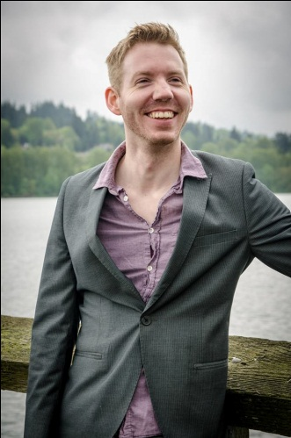
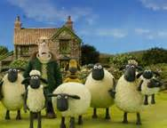

Look at teacher 看着老师 Kànzhe Lǎoshī
Listen to teacher 听老师说 Tīng Lǎoshī shuō
Answer teacher 回答老师 Huídá Lǎoshī
Be quiet 安靜 Ānjìng
Sit down 坐下 Zuò xià
Neil Teacher
外國老師
Wàiguó lǎoshī
You follow the rules and we
have fun & watch video
你遵循规则，我们玩得开心，观看视频..
Nǐ zūnxún guīzé, wǒmen wán dé kāixīn
& guānkàn shìpín
Shaun the sheep
小羊肖恩

Slide 3
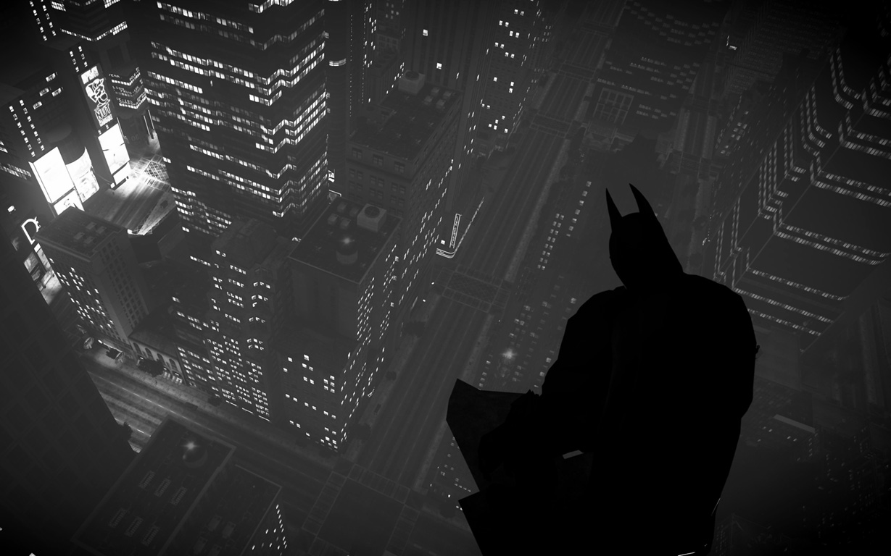
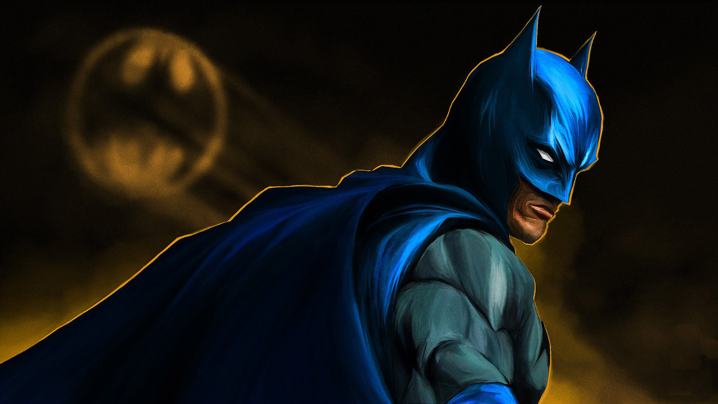
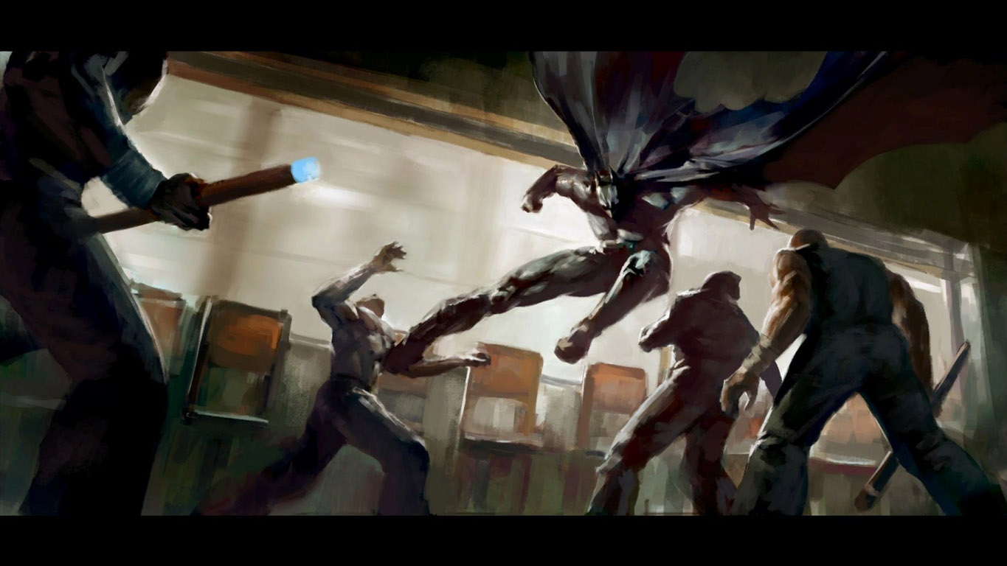
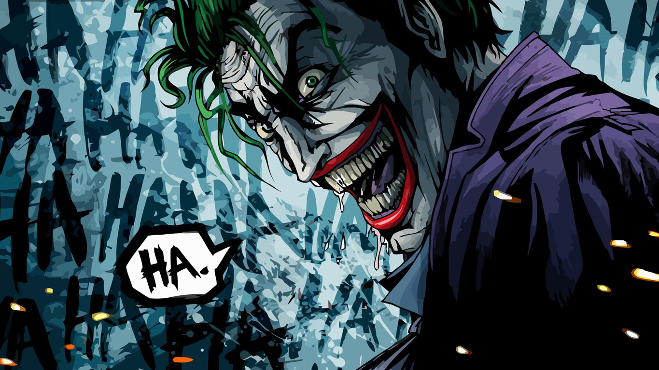

Slide 5
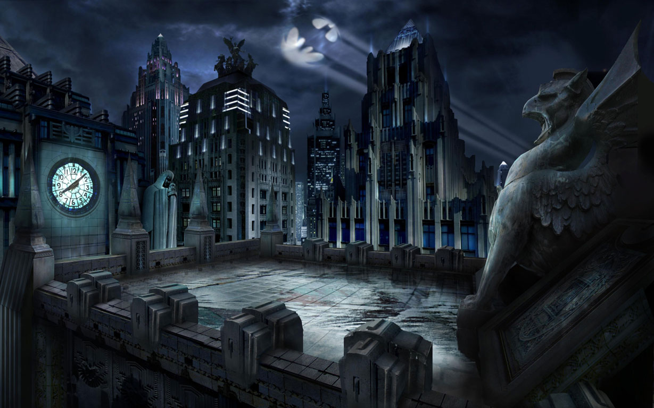
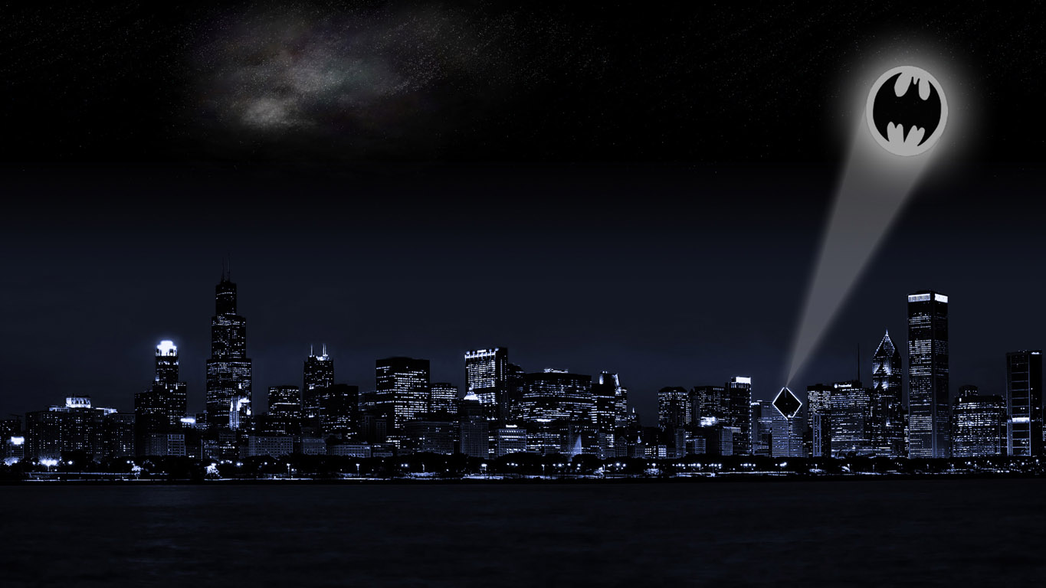
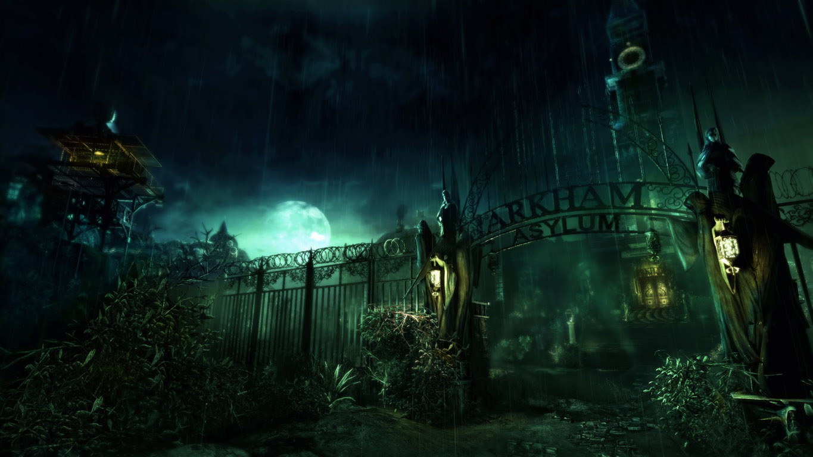
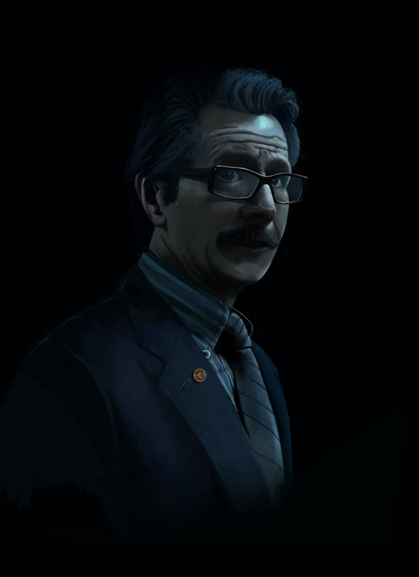
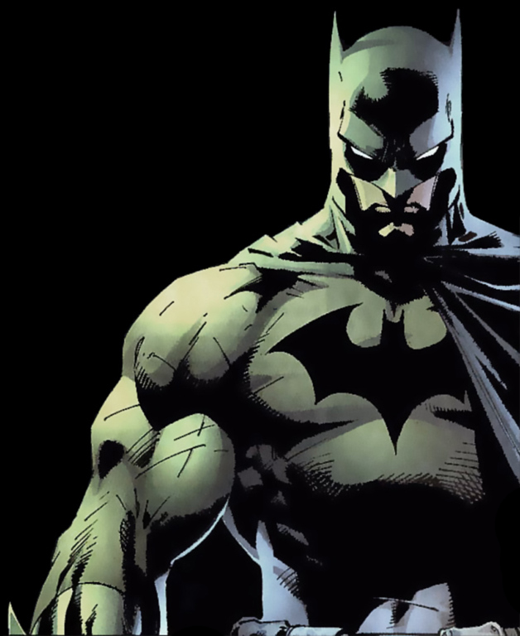


This morning the Joker attacked
Arkham Asylum…
Please .. re-capture Gotham’s villains.
Batman …. you came.
Thank you.
The city is in total chaos.
What’s the problem, Gordon?
I’ll take care of it.
The Joker left traps around the city.
Be careful.
= mystery
= points

Slide 6
A
B
C
D
E
F
G
H
I
J
K
L
M
N
O
P
Q
R
S
T
U
V
W
X
Y
Z

Slide 7
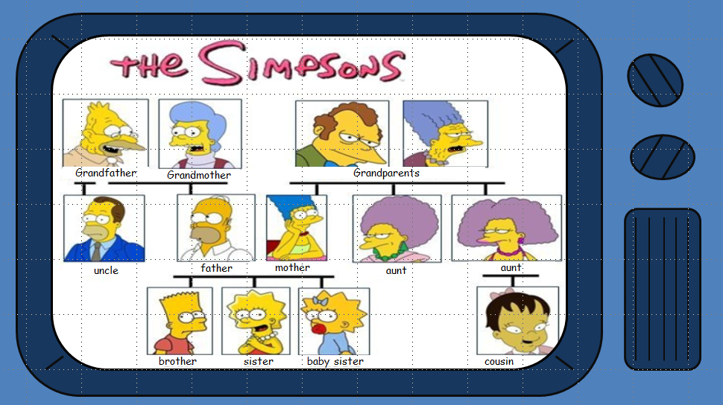


Who is it?
?
cousin.

Slide 8
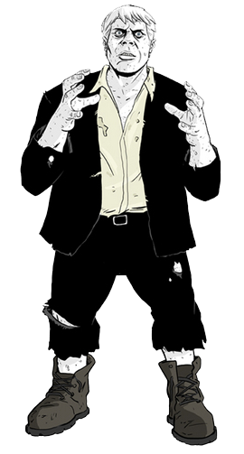
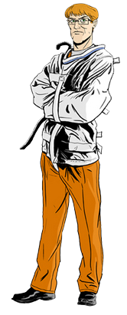
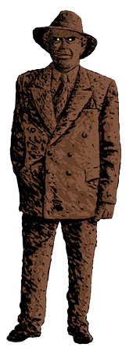
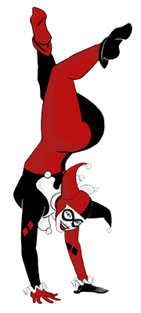
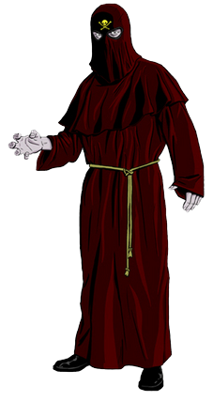
You caught 5 villains!

Slide 9
Who is it?
?
uncle

Slide 10
You caught 4 villains!

Slide 11
Who is it?
?
aunt

Slide 12
You caught 3 villains!

Slide 13
Who is it?
?
Enter answer here.

Slide 14
You caught 2 villains!

Slide 15
Who is it?
?
grandfather

Slide 16
You caught 1 villain!

Slide 17
Who is it?
?
grandparents

Slide 18
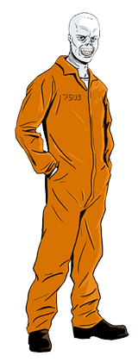
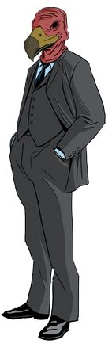
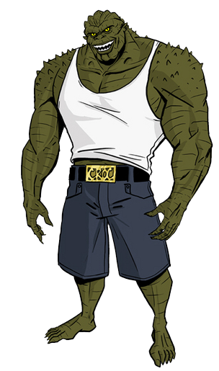
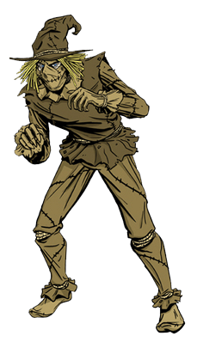
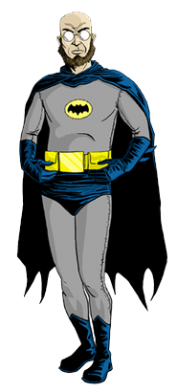
You caught 5 villains!

Slide 19
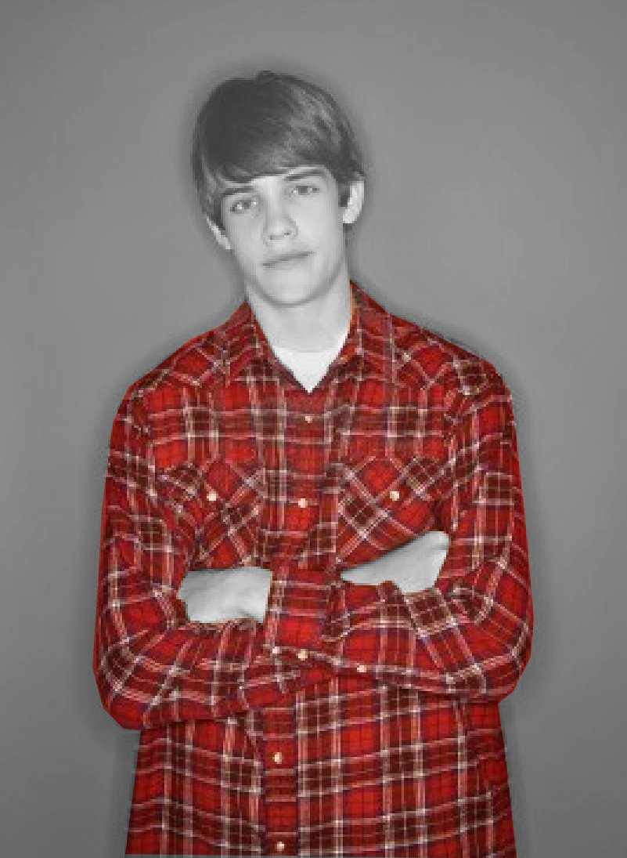
He has a … ….
Red shirt

Slide 20
You caught 4 villains!

Slide 21
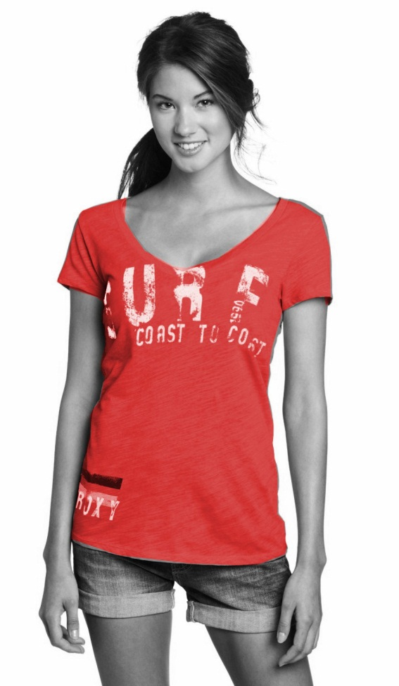
She has a … ….
Red t-shirt

Slide 22
You caught 3 villains!

Slide 23
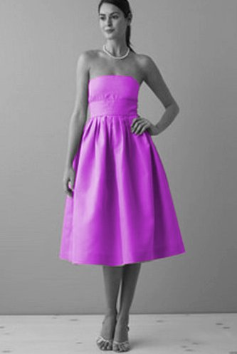
She has a … ….
Purple dress.

Slide 24
You caught 2 villains!

Slide 25
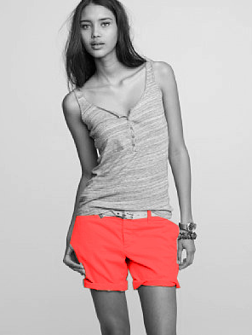
She has a … ….
Orange shorts

Slide 26
You caught 1 villain!

Slide 27
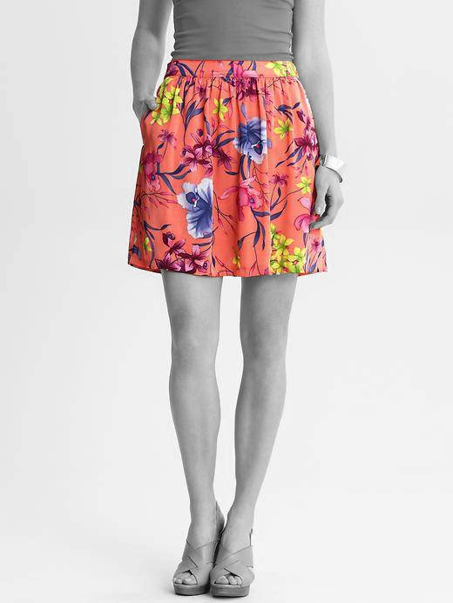
She has a … ….
Orange flower skirt.

Slide 28
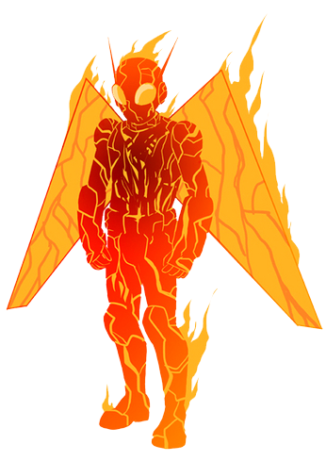
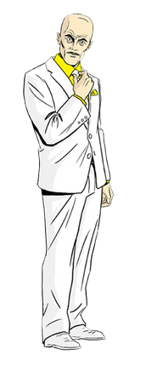
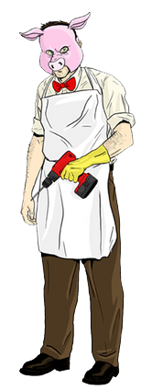
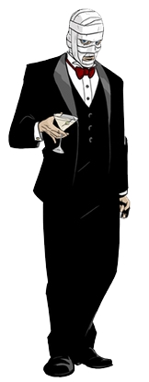
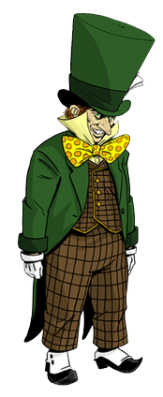
You caught 5 villains!

Slide 29

What does she do?
Enter answer here.

Slide 30
You caught 4 villains!

Slide 31

What does she do?
She’s a doctor

Slide 32
You caught 3 villains!

Slide 33
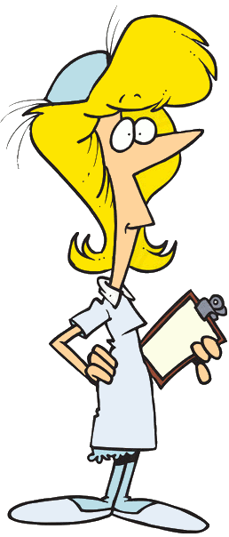
What does she do?
She’s a nurse.

Slide 34
You caught 2 villains!

Slide 35
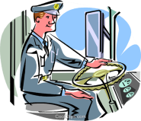
What does he do?
He’s a bus driver.

Slide 36
You caught 1 villain!

Slide 37

What does he do?
He’s a fireman.

Slide 38
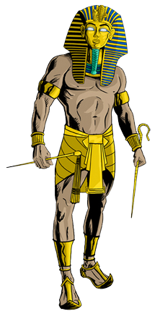
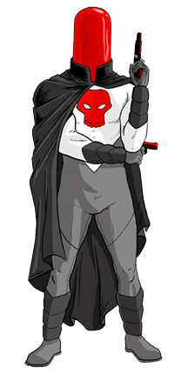
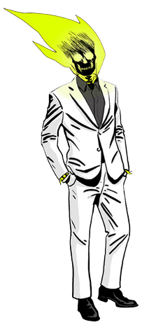
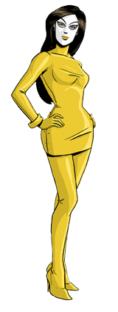
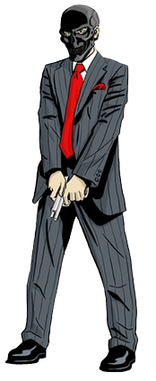
You caught 5 villains!

Slide 39
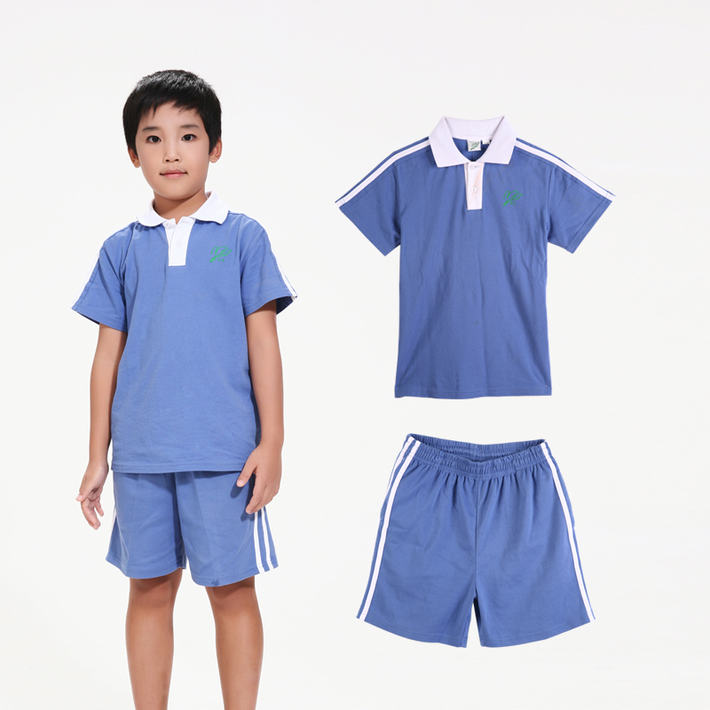
This is my friend.
He’s … . He has …
He’s … . He has blue …

Slide 40
You caught 4 villains!

Slide 41
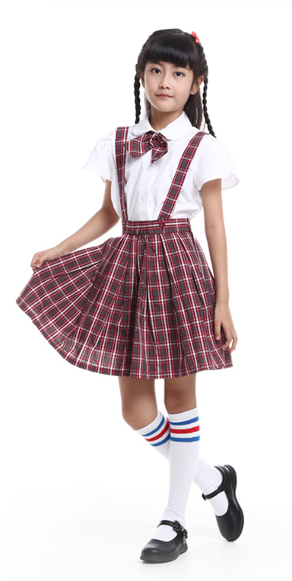
This is my friend.
She’s … . She has …
She’s … . She has …

Slide 42
You caught 3 villains!

Slide 43
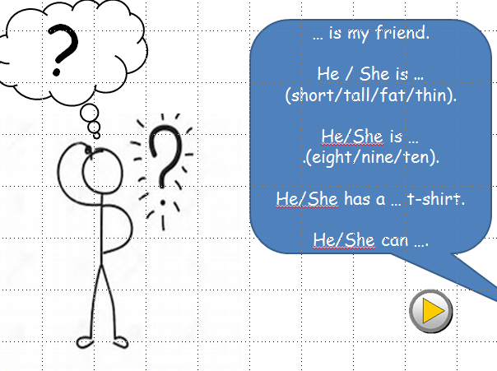
Think and say
…

Slide 44
You caught 2 villains!

Slide 45

What does he/she do?
teacher

Slide 46
You caught 1 villain!

Slide 47

What does he/she do?
doctor

Slide 48


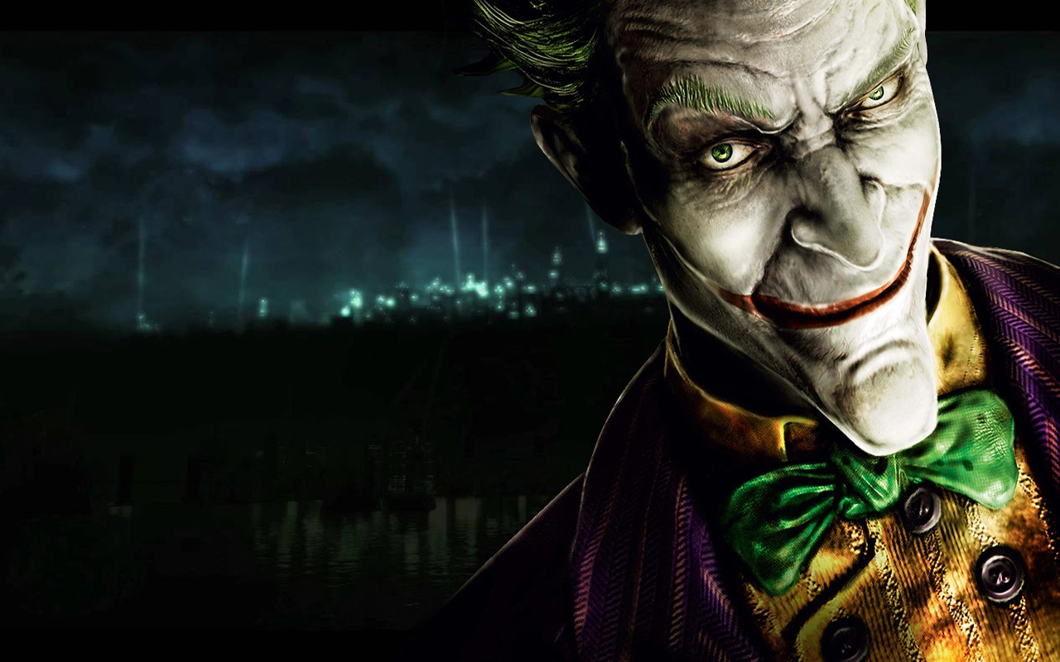
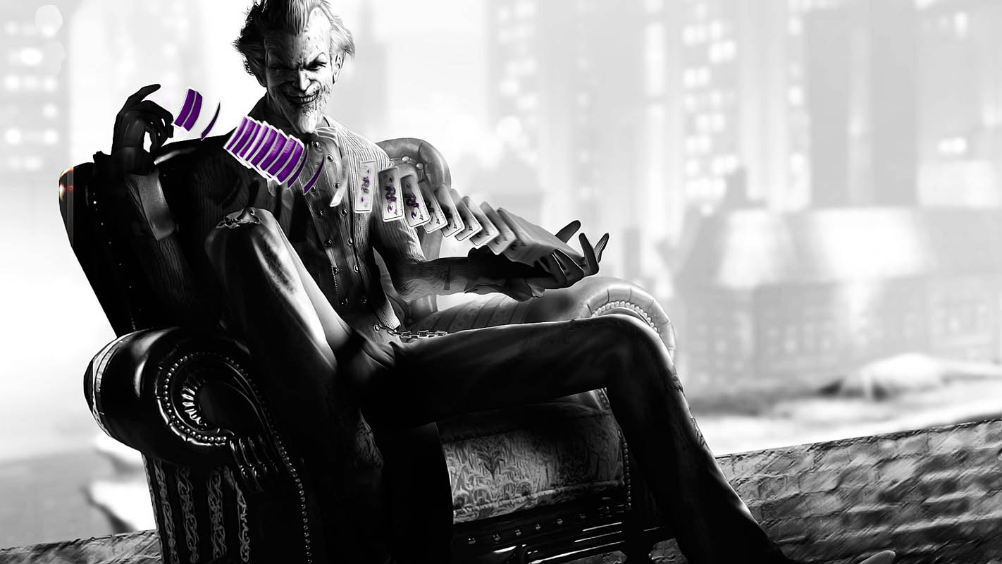



Slide 49

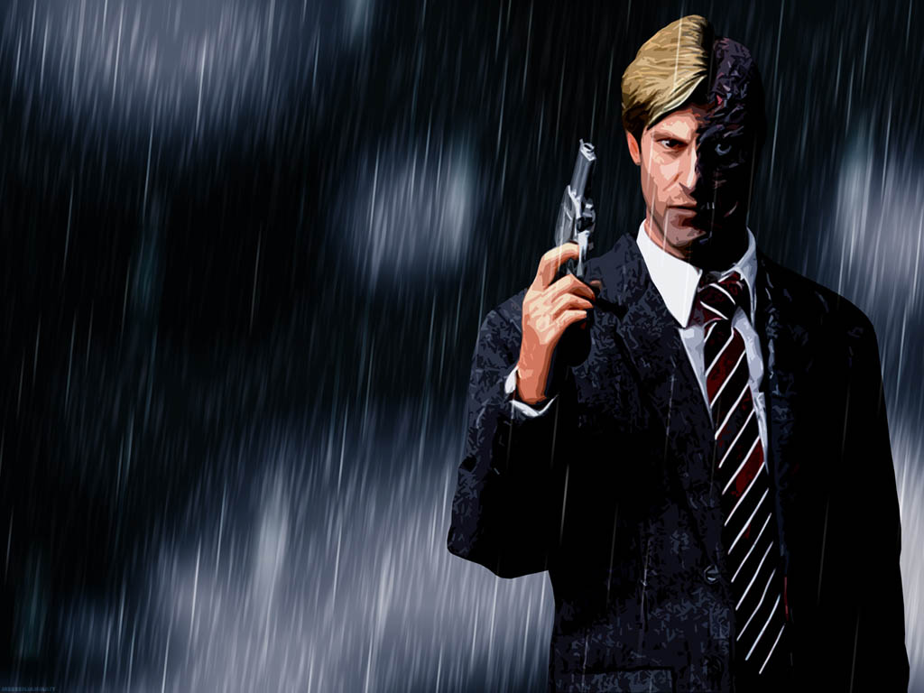
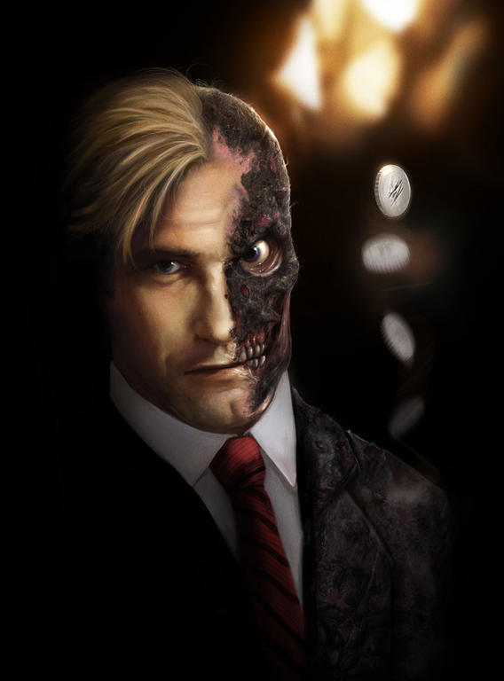
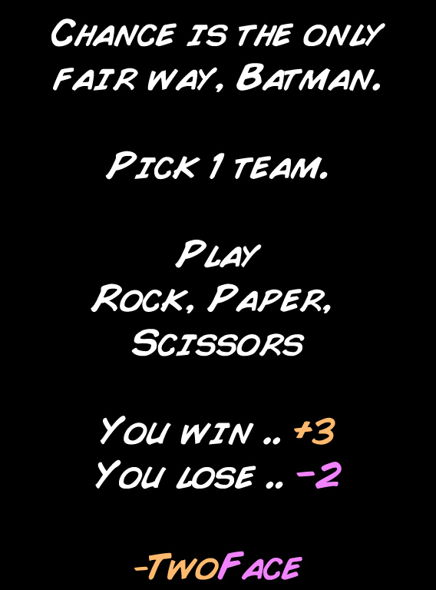

Slide 50

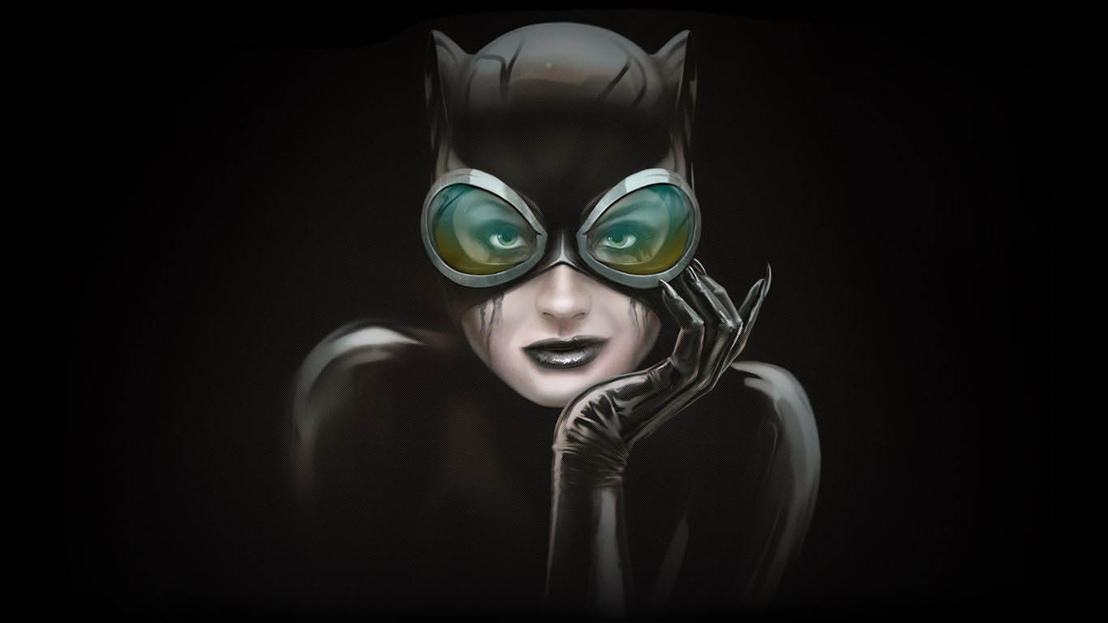
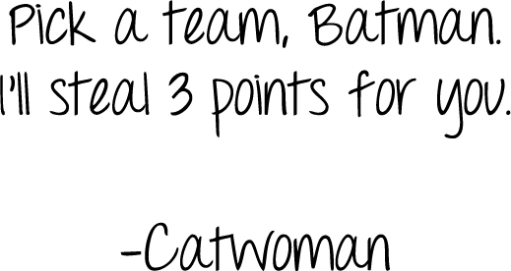

Slide 51
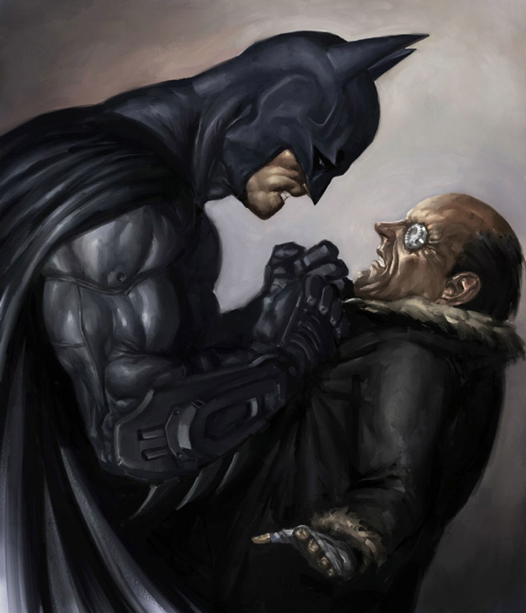




Slide 52

What does he/she do?
Enter answer here.

Slide 53




Slide 54






Slide 55




Slide 56






Slide 57

What does he/she do?
nurse

Slide 58


Slide 60






Slide 61





Slide 62

What does he/she do?
Enter answer here.

Slide 66




Slide 67

What does he/she do?
Enter answer here.

Slide 71





Slide 72
Who are they?
?
Parents.

Slide 77

SƯU TẦM: ĐOÀN VĂN DOANH, NAM TRỰC, NAM ĐỊNH
LINK NHÓM DÀNH CHO GV BỘ MÔN VẬT LÝ TRAO ĐỔI TÀI LIỆU VÀ CHUYÊN MÔN CT 2018
https://www.facebook.com/groups/299257004355186

