Slide 1

Unit 6: Entertainment
Lesson 6: CLIL
Page 114

Slide 2
Lesson Outline
Warm-up
Vocabulary
Reading
Speaking
Consolidation
Wrap-up

Slide 3
Objectives
By the end of this lesson, students will be able to…
- learn vocabulary: Nouns (planet, souvenir, ivory, tusk, custom); Verb phrases (take care).
- talk about travelling with care.
- know what travelling with care is.

Slide 4

WARM-UP

Slide 5
Add words to make phrases go with: do, go, have
do | go | have

Slide 6

It’s time to learn …

Slide 7

Reading

Slide 8

Pre-reading:
Vocabulary
• take care /ˈteɪk keə/ (v phr.) quan tâm, chăm sóc
• planet /ˈplænɪt/ (n) hành tinh
• souvenir /ˌsuːvəˈnɪə/ (n) quà lưu niệm
• ivory /ˈaɪvəri/ (n) chất liệu ngà (voi)
• tusk /tʌsk/ (n) ngà (voi)
• custom /ˈkʌstəm/ (n) phong tục, tập quán

Slide 9
Pre-reading:
Vocabulary
• take care /ˈteɪk keə/ (v phr.) quan tâm, chăm sóc
•
• planet /ˈplænɪt/ (n) hành tinh
•
• souvenir /ˌsuːvəˈnɪə/ (n) quà lưu niệm
•
• ivory /ˈaɪvəri/ (n) chất liệu ngà (voi)
• tusk /tʌsk/ (n) ngà (voi)
•
• custom /ˈkʌstəm/ (n) phong tục, tập quán

Slide 10

While-reading:
1. Read the title and the headings in the text. What is the text about?
Care for the planet
Spend your money wisely
Show respect

Slide 11
1. Read the title and the headings in the text. What is the text about? Listen and read the text to find out.
While-reading:
The text is about how to travel carefully.
Travelling the world is fun, but we need to take care when we visit new places. Here’s how!
Care for the planet
• It’s nice to get souvenirs during your travels, but be careful what you buy. Some are ivory from elephant tusks or wood from rainforest trees.
• Never drop litter on beaches and mountains, or in forests and oceans.
Spend your money wisely
• Spend your money in local shops and markets. Then, your money goes back to that place and the people that live there.
Show respect
• People all over the world have got different customs, so always respect local traditions.
• In some places, people wear special clothes or cover their hair. When you visit them, dress in the same way.

Slide 12
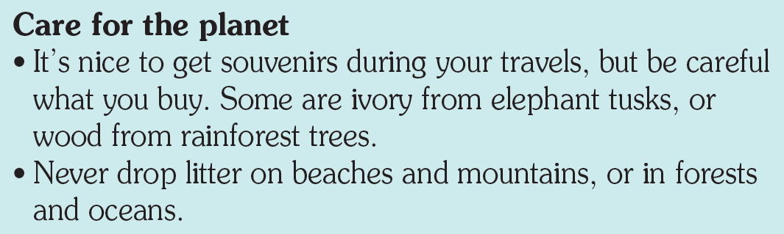
2 Read the text again and complete the sentences.
souvenirs
1 Be careful when you buy ___________________.
2 Don’t drop ___________________.
3 Spend money in ____________________.
4 Always respect ___________________.
5 Dress in ___________________ .
litter

Slide 13
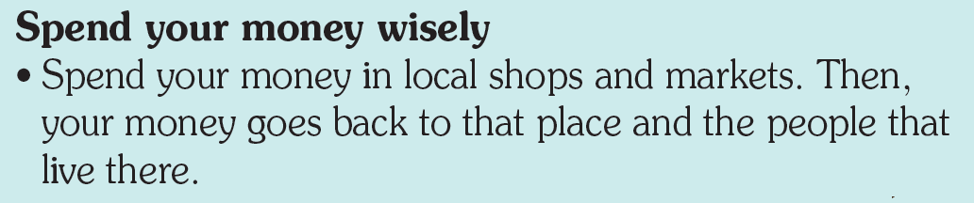
2 Read the text again and complete the sentences.
souvenirs
1 Be careful when you buy ___________________.
2 Don’t drop ___________________.
3 Spend money in ____________________.
4 Always respect ___________________.
5 Dress in ___________________ .
litter
local shops and markets

Slide 14
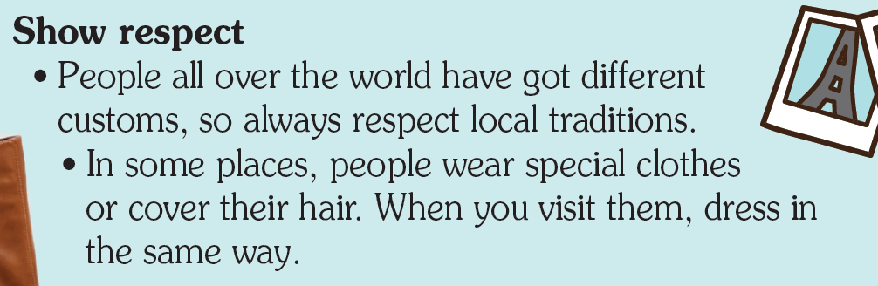
2 Read the text again and complete the sentences.
souvenirs
1 Be careful when you buy ___________________.
2 Don’t drop ___________________.
3 Spend money in ____________________.
4 Always respect ___________________.
5 Dress in ___________________ .
litter
local shops and markets
the local traditions
the same way

Slide 15
Post-reading:
3. Use your answers from Exercise 2 to tell your partner about what travelling with care means. Use should or shouldn’t.
Travelling with care means that you should/shouldn’t … .
Suggested answer:
Travelling with care means that you shouldn’t buy souvenirs from elephant tusks or wood from rainforest trees, and you shouldn’t drop litter. You should stay in small local hotels and spend your money in local shops and markets. You should also respect local traditions and sometimes dress in the same way as the local people to show respect.

Slide 16

CONSOLIDATION

Slide 17
Write a paragraph (about 40-60 words) to give advice to tourists who visit your hometown. (What should/shouldn’t they do?)

Slide 18

WRAP-UP

Slide 19
Today’s lesson
Vocabularies
take care, planet, souvenir, ivory, tusk, custom
CLIL
Citizenship: How to travel carefully.

Slide 20
Homework
Practise the vocabularies and make sentences using them.
Do the exercises in TA 6 Right on WB (p. 71).
Prepare the next lesson (p. 115 SB)

Slide 21
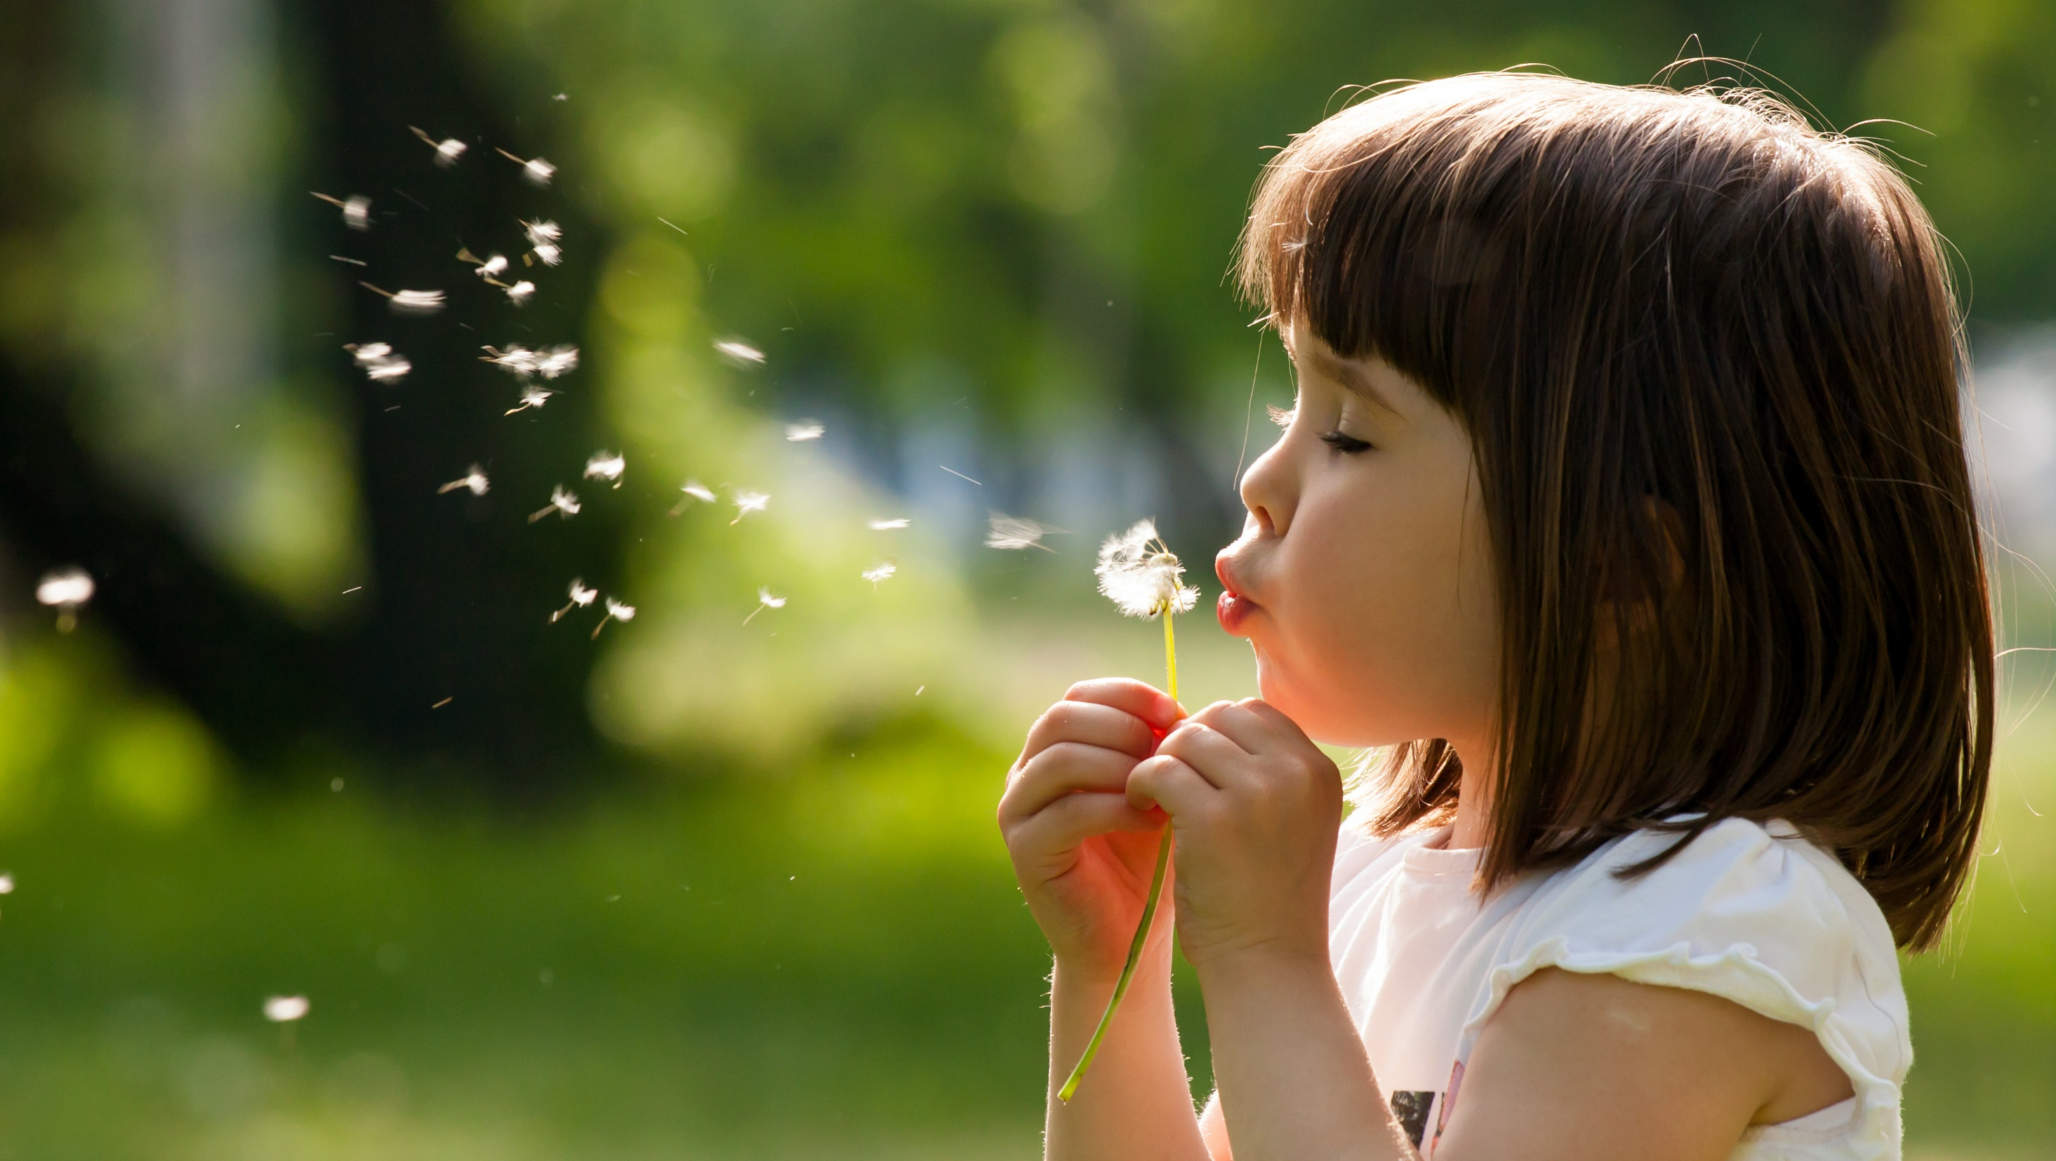
Enjoy your day!

