Slide 1


Slide 2


Unit
10
COMMUNICACTION IN THE FUTURE
LESSON 1: GETTING STARTED
At the technology club
1

Slide 3
LESSON 1: GETTING STARTED
WARM-UP
Game: Who knows more?
PRESENTATION
Vocabulary
Task 1: Listen and read.
Task 2: Read again and circle the correct answer.
Task 3: Match the words and phrases in the conversation with their pictures.
Task 4: Circle the words/ phrases which are CLOSEST in meaning to the underlined words/ phrases.
PRACTICE
FURTHER PRACTICE
Task 5: Complete the diagram of the history of communication technology.
CONSOLIDATION
Wrap-up
Homework

Slide 4

WARM-UP
Who knows more?
Work in groups in 3 minutes and list the names of social networks that you know.
The group with the most correct answers is the winner.
TECHNOLOGY

Slide 5
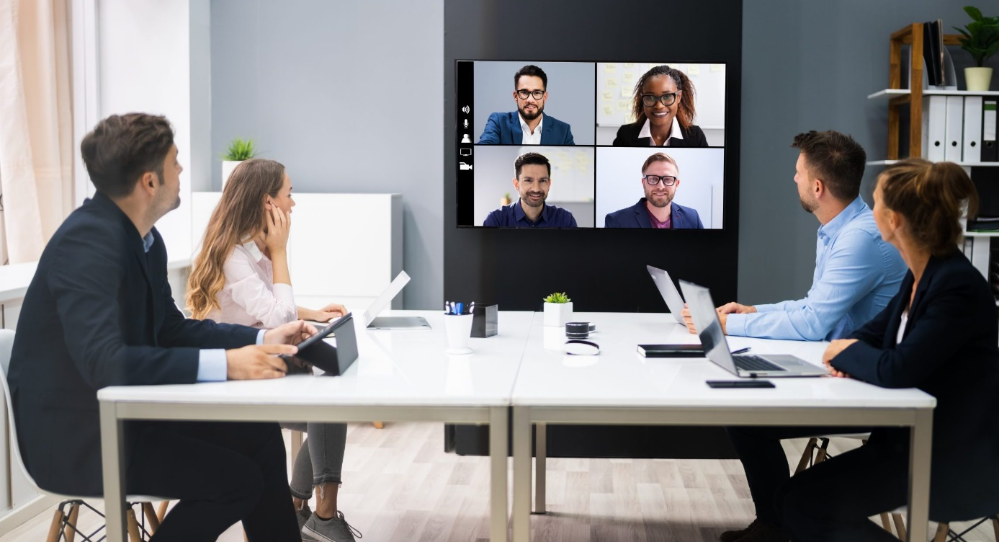

PRESENTATION
video conference (n)
/ˈvɪdiəʊ ˌkɒnfərəns/
họp trực tuyến

Slide 6

PRESENTATION
webcam (n)
/ˈwebkæm/
thiết bị ghi hình kĩ thuật số

Slide 7

PRESENTATION
zoom in (v)
/zuːm ɪn/
phóng to

Slide 8
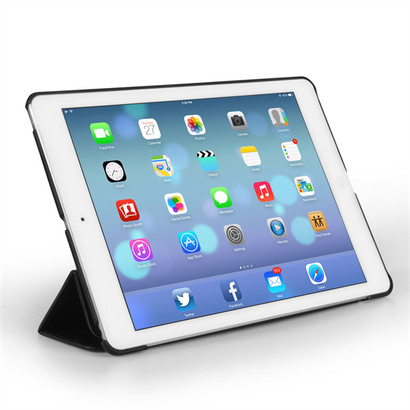
PRESENTATION
tablet (n)
/ˈtæblət/
máy tính bảng

Slide 9

PRESENTATION
internet connection (n)
/ˈɪntənet kəˈnekʃn/
kết nối mạng

Slide 10
PRESENTATION
New words | Pronunciation | Meaning
1. video conference (n) | /ˈvɪdiəʊ ˌkɒnfərəns/ | họp trực tuyến
2. webcam(n) | /ˈwebkæm/ | thiết bị ghi hình kĩ thuật số
3. zoom in (v) | /zu:m ɪn/ | phóng to
4. tablet (n) | /ˈtæblət/ | máy tính bảng
5. internet connection (n) | /ˈɪntənet kəˈnekʃn/ | kết nối mạng

Slide 11
PRACTICE
1
Listen and read.
Trang: Mark, we’re having a video conference with Tech Savvy next Thursday, but ...
Mark: Hold on. Is that the technology club at the Japanese school?
Trang: Exactly. But I’m a bit worried. I’ve never had a video conference call.
Mark: You’re kidding! Who doesn’t know how to make a video call? Alright, let’s do a practice call now.
Trang: Hmm, what do I need to do first?
Mark: It’s a piece of cake, Trang. Now, you sit in front of the computer. I’ll connect with you via one of my tablets and ...
Trang: Sorry, but how can I adjust this webcam? It’s focusing on my forehead.
Mark: Use this button to move it up or down, and this to zoom in or out.
Trang: Thanks. And can you see me clearly on your tablet?
Mark: Yes, of course. We have a high-speed Internet connection here.
Trang: I hope the conference goes smoothly.
Mark: I’m sure it will. We should hold more video conferences like this in the future.
Trang: That’s exactly how I feel.

Slide 12
PRACTICE
2
Read the conversation again and circle the correct answer A, B, or C.
1. What are Trang and Mark doing?
A. Practising a video call.
B. Making a call with Tech Savvy.
C. Learning how to use a tablet.
2. What device does Trang need help with?
A. The tablet. B. The computer. C. The webcam.
3. Mark says that they should ______ in the future.
A. have more video conferences
B. do more practice calls
C. have a high-speed Internet connection

Slide 13
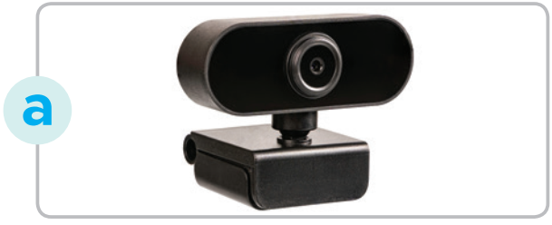

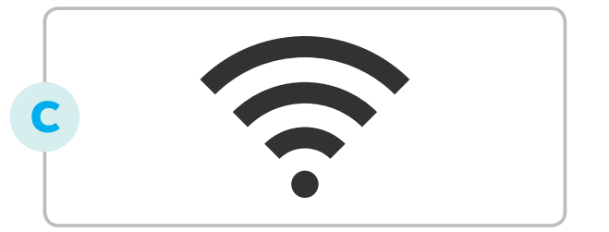
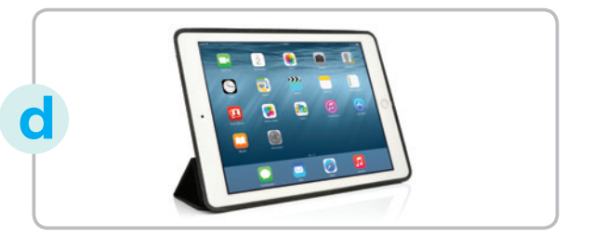

PRACTICE
3
Match the words and phrases in the conversation with their pictures.
1. tablet
2. webcam
3. zoom in
4. video conference
5. internet connection

Slide 14
PRACTICE
4
Circle the words/ phrases which are CLOSEST in meaning to the underlined words/ phrases.
1. Our English exam was a piece of cake. I got full marks on it.
A. easy B. difficult
2. You’re kidding! I can’t believe Ms Mai and you are sisters.
A. serious B. joking
3. I can’t read the text on the computer screen. Can you zoom in on it?
A. make it bigger B. make it smaller
4. We need a high-speed Internet connection to make video calls.
A. fast B. slow
5. That’s exactly how I feel. It’s true that video conferences are very convenient.
A. I don’t think so. B. You are absolutely right.

Slide 15
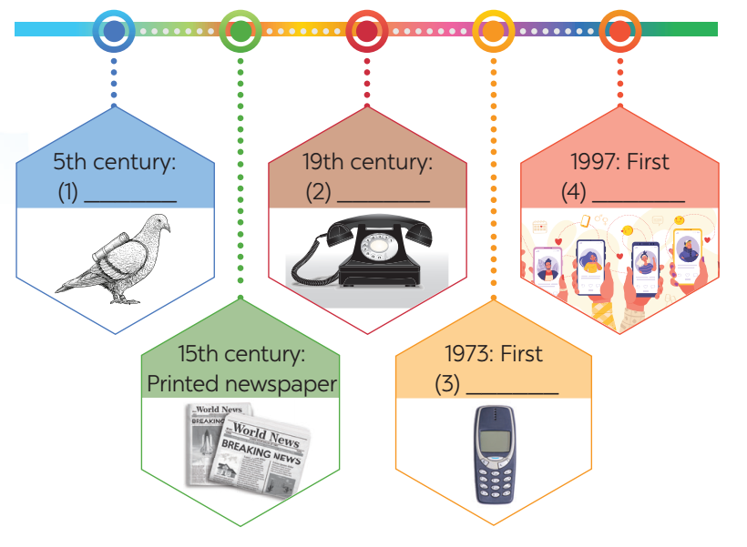
PRODUCTION
5
Work in groups. Complete the diagram of the history of communication technology with the words and phrases from the box.
carrier pigeon mobile phone
telephone social network
Answer:
1. carrier pigeon
2. telephone
3. mobile phone
4. social network

Slide 16

CONSOLIDATION
1
Wrap-up
What have we learnt in this lesson?
identify the topic of the unit
use lexical items related to communication
identify the language features that are covered in the unit

Slide 17

CONSOLIDATION
2
Homework
Do the exercise in the workbook

Slide 18

Website: hoclieu.vn
Fanpage: facebook.com/tienganhglobalsuccess.vn/

