Slide 1

Unit 6: Entertainment
Lesson 6f: Skills (cont.)
Page 113

Slide 2
Lesson Outline
Warm-up
Vocabulary
Speaking
Listening
Writing
Consolidation
Wrap-up

Slide 3
Objectives
By the end of this lesson, students will be able to…
- learn do/go/have phrases.
- invitations - acceptance/refusal.
- write a letter about their weekend plans.

Slide 4

WARM-UP

Slide 5
Choose the word whose underlined part is pronounced differently from that of the others.
1. A. light B. site C. hit D. find
/laɪt/ /saɪt/ /hɪt/ /faɪnd/
2. A. town B. brown C. cow D. bowl
/taʊn/ /braʊn/ /kaʊ/ /bəʊl/
3. A. chain B. fair C. chair D. hair
/tʃeɪn/ /feə/ /tʃeə/ /heə/

Slide 6

Work in pairs and talk about your free time activities.

Slide 7

It’s time to learn …

Slide 8

Vocabulary

Slide 9

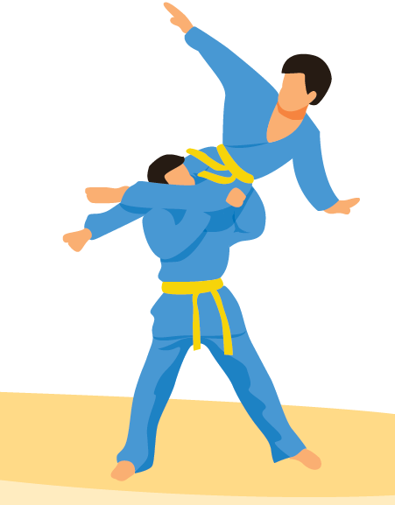
Choose the correct item. Listen and check.
1 have/go roller skating
2 have/do a sleepover
3 go/do windsurfing
4 do/go paintballing
5 have/do a games night
6 do/go Vovinam

Slide 10
Vocabulary: Listen and repeat
- go roller skating /ɡəʊ ˈrəʊləskeɪtɪŋ/ (v phr.): chơi trượt patin
- have a sleepover /hæv ə ˈsliːpəʊvə/ (v phr.): mời bạn ngủ qua đêm
- go windsurfing /ɡəʊ ˈwɪndˌsɜːfɪŋ/ (v phr.): lướt ván buồm
- go paintballing /ɡəʊ ˈpeɪntbɔːlɪŋ/ (v phr.): chơi bắn súng sơn
- have a games night /hæv ə ɡeɪmz naɪt/ (v phr.): thức đêm chơi trò chơi
- do Vovinam /du ˈvəʊvɪnam/ (v phr.): học Vovinam

Slide 11
Vocabulary: Listen and repeat

- go roller skating /ɡəʊ ˈrəʊləskeɪtɪŋ/ (v phr.): chơi trượt patin

- have a sleepover /hæv ə ˈsliːpəʊvə/ (v phr.): mời bạn ngủ qua đêm

- go windsurfing /ɡəʊ ˈwɪndˌsɜːfɪŋ/ (v phr.): lướt ván buồm

- go paintballing /ɡəʊ ˈpeɪntbɔːlɪŋ/ (v phr.): chơi bắn súng sơn
- have a games night /hæv ə ɡeɪmz naɪt/ (v phr.): thức đêm chơi trò chơi

- do Vovinam /du ˈvəʊvɪnam/ (v phr.): học Vovinam

Slide 12

Speaking

Slide 13

5. Discuss as in the example. Use the ideas in Exercise 4 as well as your own ideas.
A: Would you like to go paintballing this Saturday?
B: Sure, why not?/ That’s a great idea./ Thanks, but I can’t./ I’d love to, but I can’t.

Slide 14

Listening

Slide 15
6. Listen to John and Sue discussing a weekend activity. For the questions (1-5), choose the correct answer (A, B or C).
1 What will Sue do on Saturday afternoon?
A play tennis B attend a party C go to an escape room
2 The escape room they will go to looks like a room in ________ .
A a spaceship B a normal house C a castle
3 They are going to an escape room ________ .
A opposite a post office B beside a library C near an office building
4 Entry to the escape room will cost ________ .
A £5 B £10 C £15
5 Sue and John agree to meet at ________ .
A 7:00 B 6:30 C 6:45

Slide 16

The Old Quarter in Hanoi, Vietnam is a popular place for teens to hang out. With shops, trendy cafés, restaurants and lively nightlife, it's a perfect place to go shopping, have a meal, or go dancing with friends.
Where is a popular place for teens to hang out in London, UK? What can they do there?

Slide 17

Writing

Slide 18
Writing (a letter about your weekend plans)
7. Imagine you are going to Capital Karts this weekend. Write a letter to your English-speaking friend (about 50-60 words). Write about where you are going, who you are with and what you are going to do. Invite him/her to join you.

Slide 19
1 Read the task. Underline the key words and answer the questions.
Imagine you are going to Capital Karts this weekend. Write a letter to your English-speaking friend (about 50-60 words). Write about where you are going, who you are with and what you are going to do. Invite him/her to join you.

Slide 20

2 Read the model and complete the table.
Hi Emma,
Greetings from Cardiff. My family and I arrived yesterday. We’re staying at my uncle’s house. The weather’s great. How are you? Tomorrow I'm going to Roller World with my cousin, Amy. It's a fantastic indoor centre. You can go bowling and play games there, too, but we're going to go roller skating. Afterwards, we're going shopping. Why don't you come? You can stay with us. I hope you can make it! Dad can pick you up from the train station.
Let me know.
Karen
Roller World
Where
When
Who with
Activities
tomorrow
cousin, Amy
go roller skating, go shopping

Slide 21
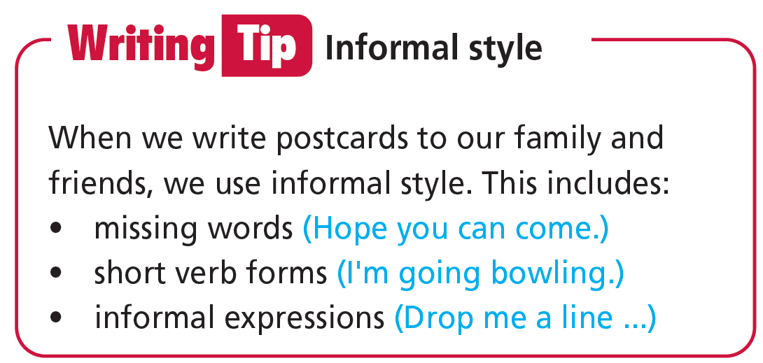

Slide 22
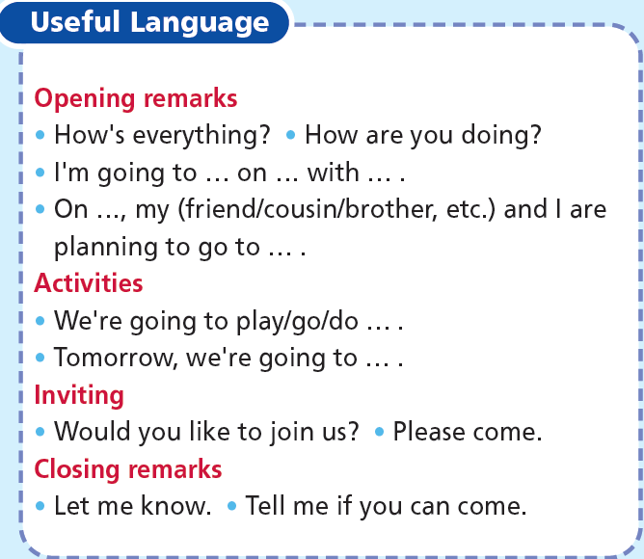

Slide 23
Your turn
7. Imagine you are going to Capital Karts this weekend. Write a letter to your English-speaking friend (about 50-60 words). Write about where you are going, who you are with and what you are going to do. Invite him/her to join you.

Slide 24

CONSOLIDATION

Slide 25
Write a paragraph (about 40-60 words) about your activities this weekend.

Slide 26

WRAP-UP

Slide 27
Today’s lesson
Vocabularies
do/go/have phrases
Skills
- Listening: discussion about a weekend activity.
- Speaking: Invitations - acceptance/ refusal.
- Writing: a letter about your weekend plans.

Slide 28
Homework
Practise the vocabularies and make sentences using them.
Do the exercises in TA 6 Right on WB (p. 59).
Do the exercises in TA 6 Right on Notebook (p. 59).
Prepare the next lesson (p. 114 SB).
Do Unit 6 Test 1 in Bài Tập Bổ Trợ TA 6 Right on (pp. 52 & 53).

Slide 29
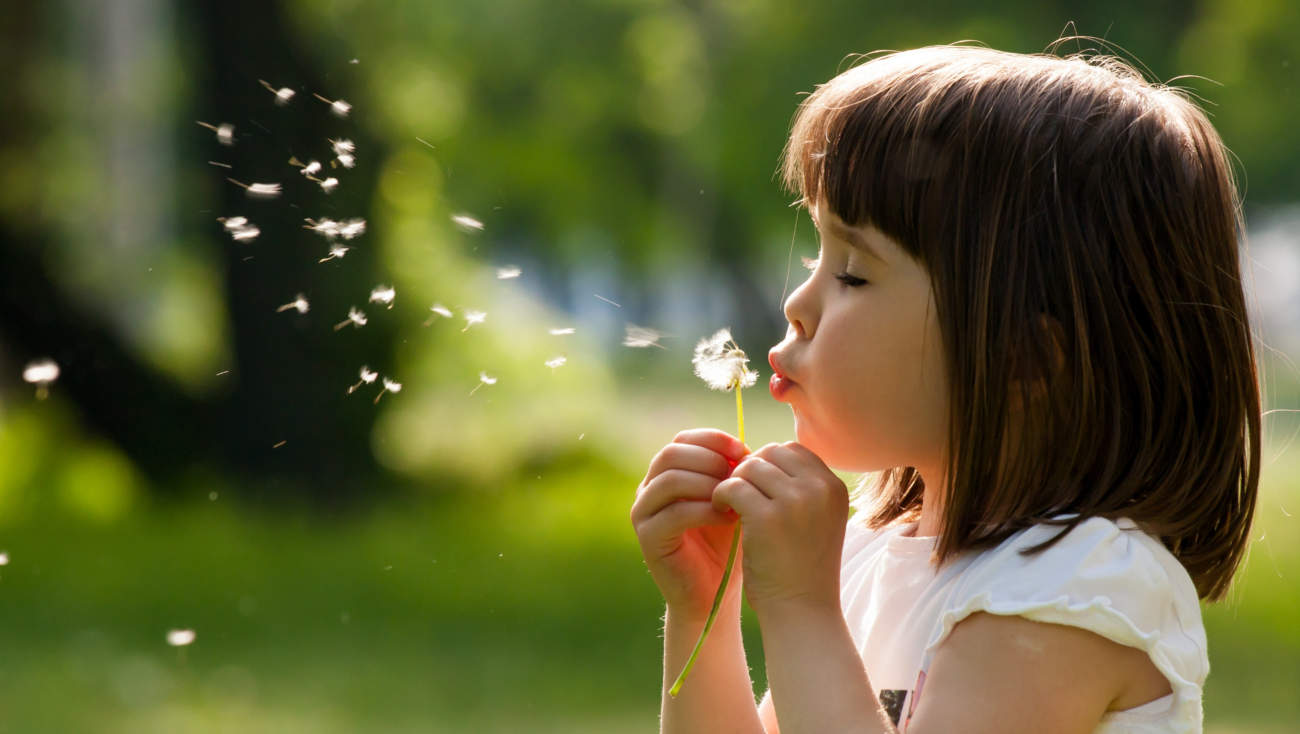
Enjoy your day!

