Slide 1

Unit 2: Life in the Country
Lesson 2.2: Grammar
Pages 19 & 20

Slide 2
Lesson Outline
Warm-up
Grammar
Consolidation
Wrap-up

Slide 3

By the end of this lesson, students will be able to…
- learn, practice and use Verbs expressing preference + to infinitive and adverbs of frequency

Slide 4
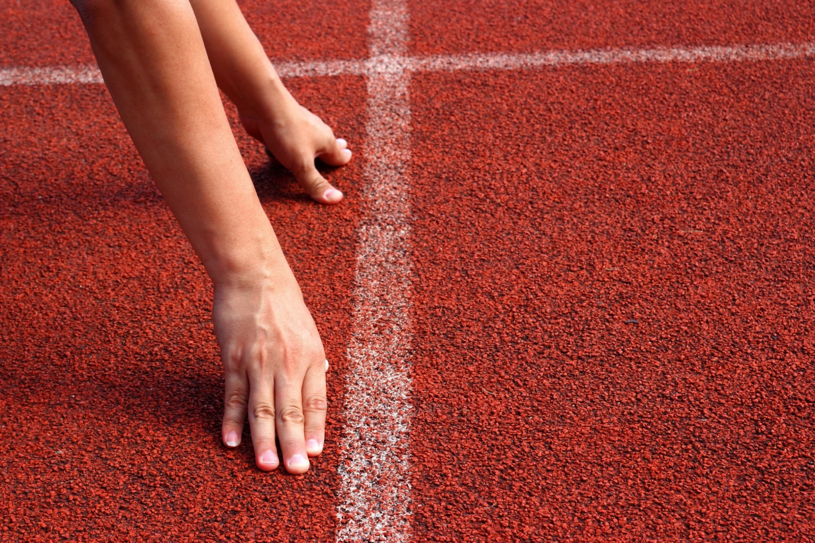
WARM UP

Slide 5
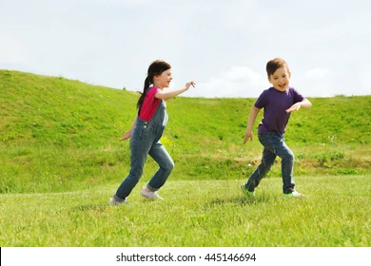
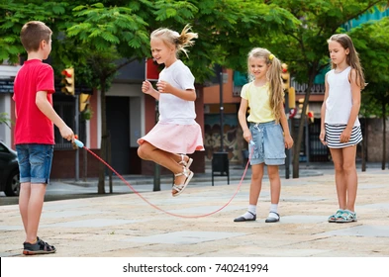
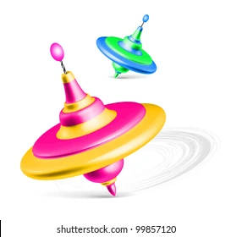
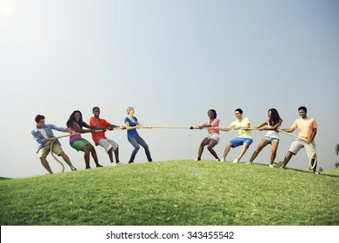
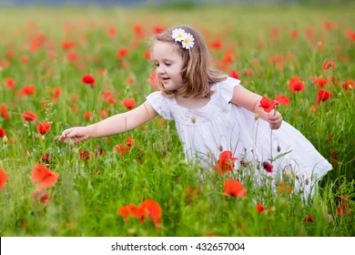
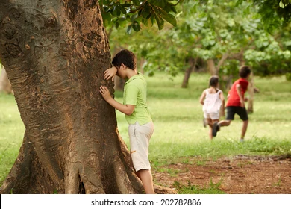
Pair work
Label the picture with these words: pick flowers, tug of war, jump rope, spinning tops, hide and seek, play tag
play tag
jump rope
spinning tops
tug of war
pick flowers
hide and seek

Slide 6

Presentation

Slide 7
Verbs (to express preference) + to -infinitives
Read the sentences and underline the verbs to express preferences & circle the verbs after that.
I love to play folk games.
She prefers to play spinning tops.
They don't like to go to the park.
Answer the questions:
What is the form of the verbs to express preference.
to-infinitive
verbs with to-infinitives → activities people like or prefer to do

Slide 8

Insert the adverbs of frequency on the time line
0%
100%
never
rarely
sometimes
often
usually
always
We can use adverbs of frequency to say how often things happen.
Example:
She usually plays tug of war with her cousins.
We always play sports at the park.

Slide 9
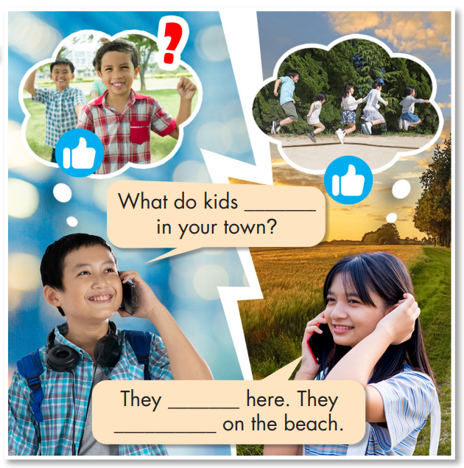

Fill in the blanks.
Listen and check your answers.
like to do
Listen again and repeat.
like to jump rope
usually jump rope

Slide 10
Practice

Slide 11
Task a
Read the examples and notes above, then unscramble the sentences.
1. visit/to/love/We/the/country.
________________________________________
2. to/games./He/folk/prefers/play
________________________________________
3. play?/she/like/Where/does/to
________________________________________
4. play/to/don't/shuttlecock./like/I
________________________________________
We love to visit the country.
He prefers to play folk games.
Where does she like to play?
I don't like to play shuttlecock.

Slide 12
5. they/hometown?/to/their/Do/like/visit
________________________________________
6. spinning/with/never/play/tops/my/sister./I
________________________________________
7. herd/buffalo/you/always/on/weekends?/Do
________________________________________
8. play/games/folk/in/cities./rarely/People
________________________________________
Do they like to visit their hometown?
I never play spinning tops with my sister.
Do you always herd buffalo on the weekends?
People rarely play folk games in cities.

Slide 13
Task b
Write sentences using the prompts.
1. I/like/visit/country.
_____________________________________________
2. she/prefer/jump rope?
_____________________________________________
3. what/kids/like/play/here?
_____________________________________________
4. he/like/play/tug of war.
_____________________________________________
I like to visit the country.
Does she prefer to jump rope?
What do kids like to play here?
Does she prefer to jump rope?

Slide 14
5. we/not/like/pick/flowers.
_____________________________________________
6. we/not/often/play spinning tops/after school.
_____________________________________________
7. who/she/usually/jump rope/with?
_____________________________________________
8. people/my hometown/sometimes/play/folk games.
_____________________________________________
We don't like to pick flowers.
We don't often play spinning tops after school.
Who does she usually jump rope with?
People in my hometown sometimes play folk games.

Slide 15
Extra exercise
WB page 11
Unscramble the sentences.
1. never/spinning/play/tops./I _______________________________________
2. jump rope?/Do/like/they/to _______________________________________
3. prefers/to/She/flowers./pick _______________________________________
4. What/country/in/people/like/do?/the/to/do _______________________________________
5. doesn't/tug/He/of/like/war./play/to
_______________________________________
I never play spinning tops.
Do they like to jump rope?
She prefers to pick flowers.
What do people in the country like to do?
He doesn't like to play tug of war.

Slide 16
Production

Slide 17

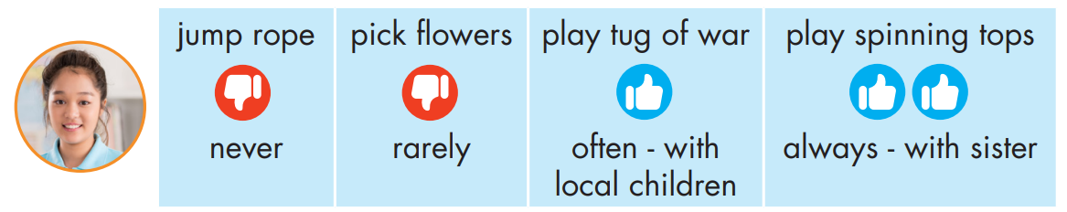
Task c
Work in pairs
Ask and answer about what An likes to do.
Does An like to
jump rope?
No, she doesn't.
She never jumps rope.

Slide 18

Does An like to pick flowers?
No, she doesn't.
She rarely picks flowers.

Slide 19
Does An like to play tug of war?
Yes, she does.
She often plays with local children.

Slide 20
Does An like to play spinning tops?
Yes, she does.
She always plays with her sister.

Slide 21

CONSOLIDATION

Slide 22
Write a short passage about what folk games and activities you like and don't like to do, and where and when you usually do them. Use verbs + to-infinitives
and adverbs of frequency.
For example:
I like jumping rope because it’s fun. I usually jump rope with my friends during break time. I hate playing tug of war because I may hurt myself. I never join that game.

Slide 23

WRAP-UP

Slide 24
Today’s lesson
Grammar
Verbs expressing preference + to infinitive
Adverbs of frequency
Speaking
Talking about folk games that you like/don’t like

Slide 25
Homework
Learn by hearts the grammar points and make sentences using them.
Do the grammar exercise on page 11 WB.
Do the exercises in Tiếng Anh 8 i-Learn Smart World Notebook on pages 16 & 17.
Prepare the next lesson (pages 20 & 21 SB)
Play the consolidation games on www.eduhome.com.vn

Slide 26

Lesson 3
Stay positive and have a nice day!

