Slide 1


Slide 2

1
REVIEW
2
FAMILY LIFE
Unit
LESSON 1
LANGUAGE

Slide 3

Unit
1
1
FAMILY LIFE
Family Life
Unit
OBJECTIVES
1. Knowledge
- Review the language learnt in Units 4, 5.
2. Core competence
- Develop critical thinking skills;
- Be collaborative and supportive in pair work and team work;
- Actively join in class activities.
3. Personal qualities
- Develop self-study skills

Slide 4
LESSON 1
LANGUAGE
Unit
GETTING STARTED
WARM-UP
Miming game
Task 1: Escape the maze.
Task 2: Pair the cards.
PRONUNCIATION
VOCABULARY
Task 1: Find the missing letters.
Task 2: Complete the sentences.
GRAMMAR
Task 1: Read and circle the correct answers.
Task 2: Recall the information.
CONSOLIDATION
Wrap-up
Home work

Slide 5
LESSON 1
LANGUAGE
Unit
GETTING STARTED
WARM-UP
Miming game

Slide 6
WARM-UP
Game rules
- 2 teams. Each team sends a member to the front.
- Listen to the word whispered by the teacher.
- The student in the front draws or mimes the word.
- The class make guesses of the answers.
- The 1st student to give the correct answer will get a point for their team.

Slide 7
LESSON 1
LANGUAGE
Unit
GETTING STARTED
WARM-UP
Miming game
Task 1: Escape the maze.
Task 2: Pair the cards.
PRONUNCIATION

Slide 8

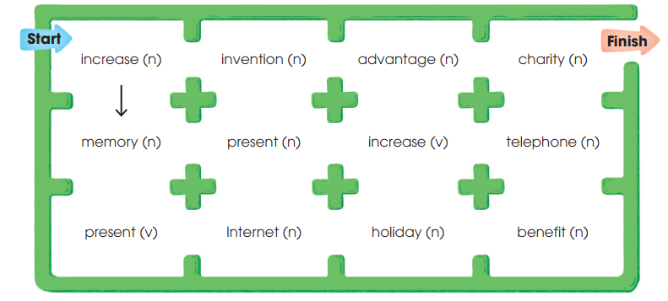
PRONUNCIATION
1
Escape the maze by connecting all the words with stress on the 1st syllable.

Slide 9
PRONUNCIATION
2
Pair the cards.
Rules
- Work in pairs.
- Choose 10 words and copy them on your cards.
- Shuffle the cards and spread them in front of you.
- Take turns to open any two cards. If the stress pattern of the words on the cards match, read the words and keep both cards.
- If the stress patterns don’t match or you can’t pronounce correctly, put them face down in the same position.
- The winner is the player with most cards.

Slide 10
PRONUNCIATION
2
Pair the cards
importance
computer
habitat
tropical
museum
attendance
diagram
photograph
forgetful
encourage
formulate
attitude
determine
examine
fortunate
fluency
dependent
acquaintance
enterprise
activate

Slide 11
LESSON 1
LANGUAGE
Unit
GETTING STARTED
WARM-UP
Miming game
Task 1: Escape the maze.
Task 2: Pair the cards.
PRONUNCIATION
Task 1: Find the missing letters.
Task 2: Complete the sentences.
VOCABULARY

Slide 12
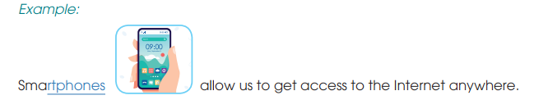
VOCABULARY
1
What are the missing letters?
Complete the sentences using the pictures to help you.

Slide 13
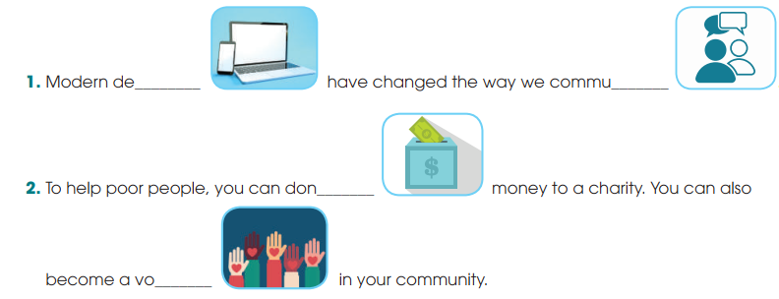
VOCABULARY
1
What are the missing letters?
Complete the sentences using the pictures to help you.
vices
nicate
ate
lunteer

Slide 14
VOCABULARY
2
Complete the sentences using these words.
useful
useless
interested
interesting
careful
careless
interesting / useful
Many ________________ inventions in the world are the results of hard work and ____________ experiments.
Things such as old clothes or toys seem ____________, but you can donate them to charity. Some poor people may be ___________ in them.
careful
useless
interested

Slide 15
LESSON 1
LANGUAGE
Unit
GETTING STARTED
WARM-UP
Miming game
Task 1: Escape the maze.
Task 2: Pair the cards.
PRONUNCIATION
VOCABULARY
Task 1: Find the missing letters.
Task 2: Complete the sentences.
GRAMMAR
Task 1: Read and circle the correct answers.
Task 2: Recall the information.

Slide 16
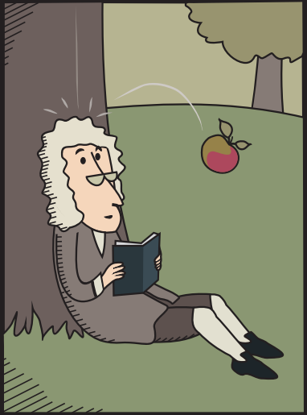

GRAMMAR
1
Read the text and circle the correct answers.
INVENTIONS AND DISCOVERIES BY ACCIDENT!
The invention or discovery of something is not always the result of careful experiments. Sometimes, luck can help scientists (1) finding / find new things. Below are some famous examples.
Gravity: (2) Discover / Discovering the law of gravity is probably the most famous example. Isaac Newton (3) sat / was sitting under an apple tree when an apple (4) fell / was falling on his head. He realised that something made apples fall straight to the ground. That was gravity!
Penicillin: Alexander Fleming came back from his holiday. He (5) was cleaning / cleaned his laboratory when he (6) discovered / was discovering something at the window. That was penicillin! Since then, doctors (7) used / have used penicillin around the world to save millions of lives.
Popsicles: In 1905, 11-year-old Frank Epperson decided (8) to make / making himself a soft drink. When he finished (9) make / making the drink, he left it outside with the wooden stick inside it. That night, the drink froze in cold weather and thanks to this ʽaccidentʼ, popsicles were later invented!

Slide 17
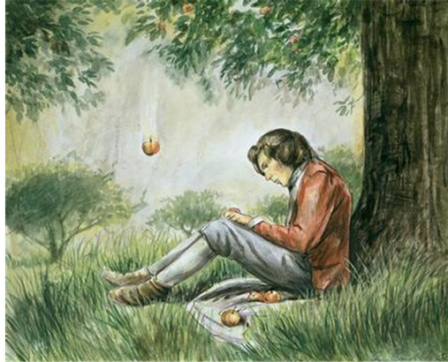
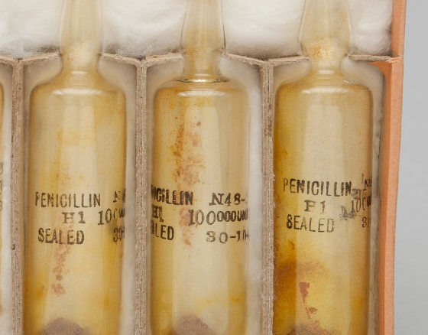
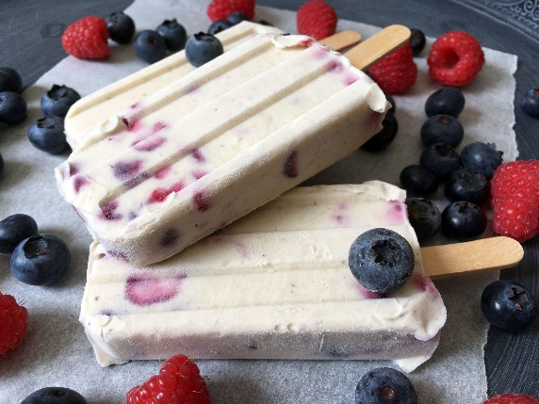
GRAMMAR
2
Recall the information.
- Work in groups of 3.
- Each student in the group chooses a different invention from the text and pretend you are the person who has invented or discovered the thing.
- Each student should try to explain how you did it using the information from the text.
E.g. I’m Isaac Newton and I discovered the law of gravity. I was sitting under the apple tree when an apple fell on my head. I realized that something made apples fall straight to the ground. That’s how I discovered gravity.

Slide 18
LESSON 1
LANGUAGE
Unit
GETTING STARTED
WARM-UP
Miming game
Task 1: Escape the maze.
Task 2: Pair the cards.
PRONUNCIATION
VOCABULARY
Task 1: Find the missing letters.
Task 2: Complete the sentences.
GRAMMAR
Task 1: Read and circle the correct answers.
Task 2: Recall the information.
CONSOLIDATION
Wrap-up
Home work

Slide 19
CONSOLIDATION
1
Wrap-up
1. Knowledge
Review the language learnt in Units 4, 5.
2. Core competence
- Develop critical thinking skills;
- Be collaborative and supportive in pair work and team work;
- Actively join in class activities.
3. Personal qualities
- Develop self-study skills

Slide 20
CONSOLIDATION
2
Homework
Do exercises in the workbook
Prepare for the next lesson:
REVIEW 2 – Lesson 2: Skills (1).

Slide 21

Website: hoclieu.vn
Fanpage: facebook.com/www.tienganhglobalsuccess.vn

