Slide 1

Unit 8: Traditions of
Ethnic Group in Vietnam
Lesson 3.2: Speaking & Writing
Page 83

Slide 2
Lesson Outline
Warm-up
Speaking
Writing
Consolidation
Wrap-up

Slide 3

By the end of this lesson, students will be able to…
- talk about fun thing to do at ethnic villages in Vietnam
- write a passage about a trip to an ethnic village in Vietnam

Slide 4

WARM UP

Slide 5
Write each category next to each sentence.
facts, examples, opinions
I had a fun trip to Quỳnh Sơn. I think you should visit this village
Opinions
I had a fun trip to Quỳnh Sơn. It’s a small village in Lạng Sơn, Vietnam. I went there last summer
Facts
I learned a lot about their culture. We learned how to fish on a lake. We also saw a traditional Tày folk music and dance
Examples

Slide 6

Speaking

Slide 7

Task a
Trips to ethnic villages in Vietnam
Work in pairs
You had a fun trip to an ethnic village. Ask and answer using the notes and your own ideas.

Slide 8

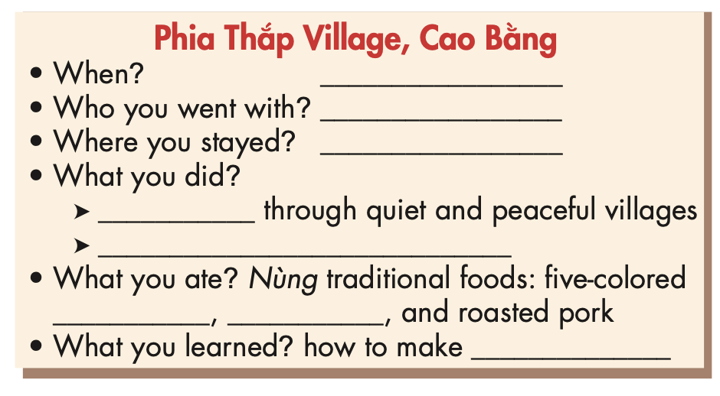
Task a
Trips to ethnic villages in Vietnam
Student A - take notes on what student B said.

Slide 9
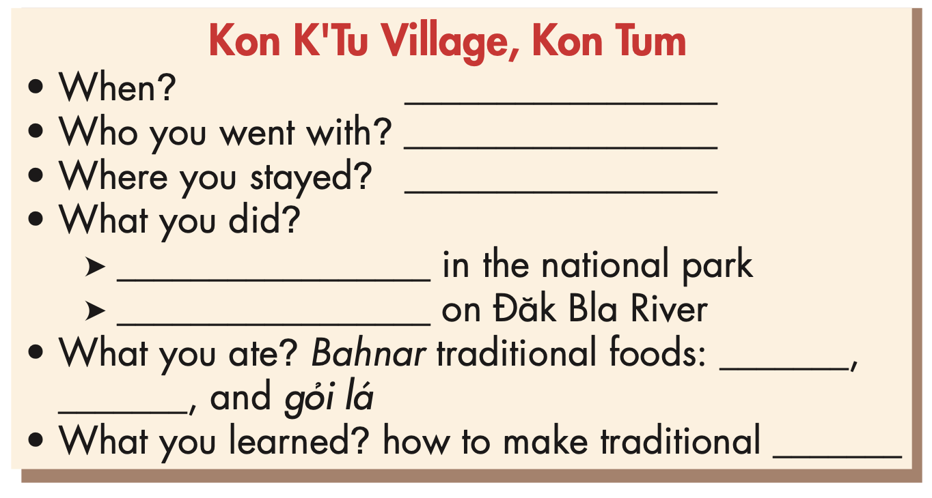
Task a
Trips to ethnic villages in Vietnam
Student B - take notes on what student A said

Slide 10
Where did you go on your holiday?
We went to Kon K’Tu Village in
Kon Tum.

Slide 11
When did you go?
I went there in last weekend.

Slide 12
Who did you go with?
I went with my parents and my older brother.

Slide 13
Where did you stay?
We stayed in a stilt house at the village.

Slide 14
What did you do?
I climbed a mountain

Slide 15
Task b
Trips to ethnic villages in Vietnam
Work in pairs
What do you think about the trips to Kon K’Tu and Phia Thắp?
Would you like to go there?

Slide 16
Writing

Slide 17
Pre-writing
How many common types of supporting information?
There are three common types:
+ Facts
+ Examples
+ Opinions
.

Slide 18
Pre-writing
Match the numbers with the letters of three common types of supporting information.
A. give your personal opinions to help support the main point
1. Facts
B. give true information to support the main point. The information answers questions like who, what, when,…?
2. Examples
3. Opinions
C. give specific examples to support the main point

Slide 19
Write your own passage about one of the trips to the ethnic villages, using the example notes in the table
While-writing
Kon K’Tu Village, Kon Tum
Where? (village)
When?
Who?
Where ? (stay)
What? (do, eat)
Your opinion?
last month
mom and dad
homestay
go hiking, go on a boat trip, eat grilled chicken, cơm lam, make traditional baskets.
exciting trip

Slide 20
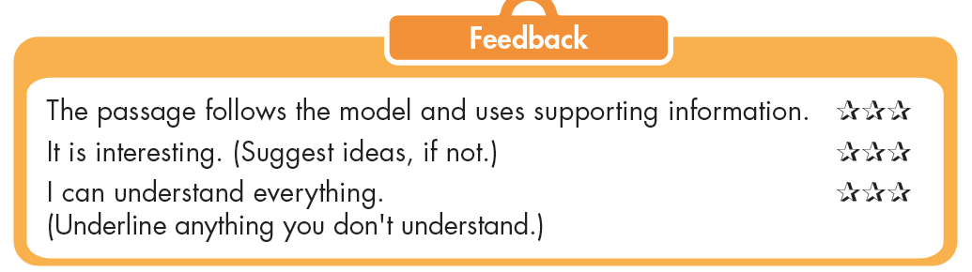
Post-writing
Exchange your piece of writing with a partner and check.

Slide 21
Read the sample passage and fill in the blanks.
Suggested answer
I ……… a very good trip to Kon K’Tu Village. It’s in Kon Tum. I ……… there last month. I went ……… my mom and dad. We ……… at a homestay. We went hiking ……… the national park and went ……… a boat trip on Đăk Bla River. We tried Bahnar traditional foods like grilled chicken and cơm lam. We also learned how to ……… traditional baskets. The trip was really ………! I think you should visit Kon K’Tu Village.
had
went
with
  stayed
  in
  on
  make
  exciting

Slide 22

CONSOLIDATION

Slide 23
Talk about your trip to an ethnic village Vietnam.
What did you go?
When did you go there?
Who do did you go with?
Where did you stay?
What activities did you do?
What do you think about the trip?

Slide 24

WRAP-UP

Slide 25
Today’s lesson
Speaking
Talking about your trip to an ethnic village in Vietnam.
Writing
Writing a passage about one of the trips to the ethnic villages.

Slide 26
Homework
Do the writing exercises on page 49 WB.
Complete the writing exercise in Tiếng Anh 8 i-Learn Smart World Notebook on page 69.
Prepare the next lesson (page 104 SB)
Play the consolidation games on www.eduhome.com.vn

Slide 27

Lesson 3
Stay positive and have a nice day!

