Slide 2



REVIEW
1
UNITS 1 – 2 – 3
LESSON 1: LANGUAGE
1

Slide 3
LESSON 1: LANGUAGE
LESSON 1: GETTING STARTED
WARM-UP
Memory game: Complete the chart
Task 1: Choose the word whose underlined part is pronounced diﬀerently.
Task 2: Write the names of school things and furniture in the house which begin with /b/ and /p/.
PRONUNCIATION
Task 3: Complete the words.
Task 4: Solve the crossword puzzle.
VOCABULARY
Task 5: Look at the picture of a classroom. Choose the best answer A, B, or C.
Task 6: Complete the sentences with the present simple or the present continuous form of the verbs in brackets.
GRAMMAR
CONSOLIDATION
Wrap-up
Homework

Slide 4




WARM-UP
MEMORY GAME
2 teams
Run to the board to complete the chart
Group with more correct answers

Slide 5
WARM-UP
Sounds:
/ɑ:/ and …..
/ʌ/
Pronunciation
Sounds:
/s/and …..
/z/
Sounds:
/b/ and …..
/p/
things
School ………… and adjectives
Unit 1-2-3
Vocabulary
house
furniture
Type of ….………, rooms and ..…….…...
activities
Things and ..……..….…. at Tet
Body
……… parts and appearance,
……………..… adjectives
personality
simple
frequency
Grammar
Present ..………… & Adverbs of ………………..
place
Possessive case & prepositions of …………
advice
Should / shouldn’t for ………....
continuous
Present ………………..

Slide 6
PRONUNCIATION
1
Choose the word whose underlined part is pronounced diﬀerently.
1. A. ears B. eyes C. lips
2. A. cat B. father C. calm
3. A. lights B. pencils C. lamps
4. A. notebooks B. rulers C. rooms
5. A. brother B. homework C. mother

Slide 7
PRONUNCIATION
2
Write the names of school things and furniture in the house which begin with /b/ and /p/.
- /b/: book, ___________________
- /p/: pen, ____________________
bag,
bed,
pencil,
picture,
posters,

Slide 8
VOCABULARY
3
Complete the words.
1. E _ _ l _ _ _ 4. s _ _ r _ _
2. h _ _ _ w _ _ _ 5. b _ _ m _ _ _ _ n
3. l _ _ _ h

Slide 9
PRACTICE - VOCABULARY
3
Complete the words.
1. English 4. sports
2. homework 5. badminton
3. lunch
Play | Do | Have | Study

Slide 10
PRACTICE - VOCABULARY
3
Complete the words.
1. English 4. sports
2. homework 5. badminton
3. lunch
Play | Do | Have | Study
sports badminton | homework | lunch | English

Slide 11
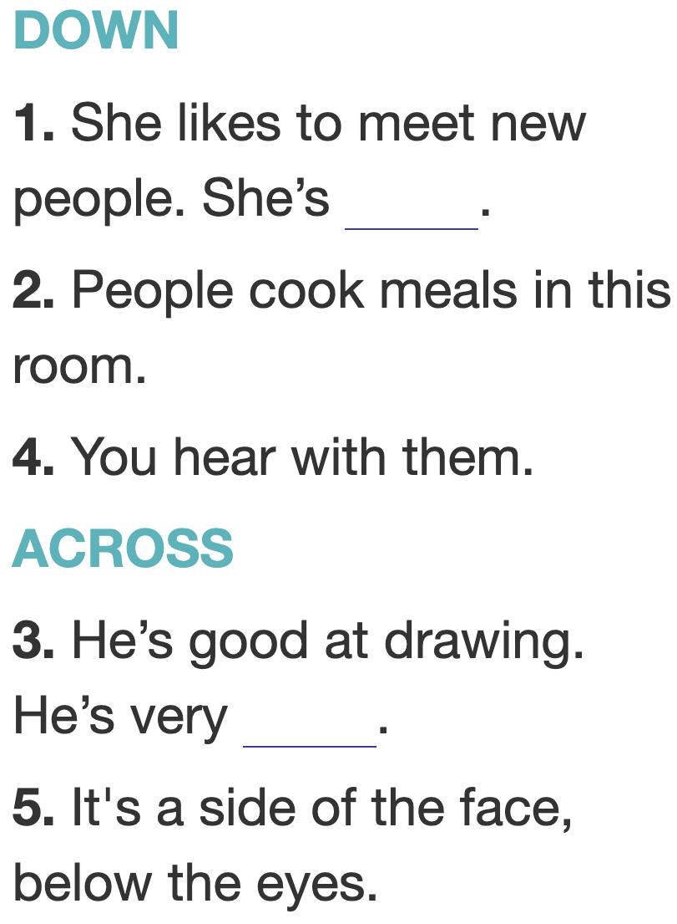
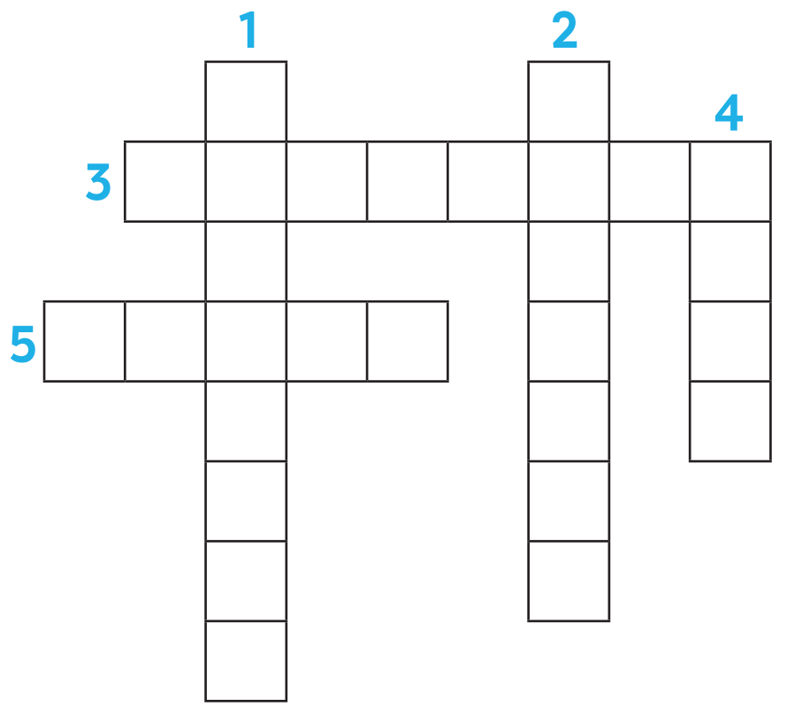
VOCABULARY
4
Solve the crossword puzzle.
F
R
I
E
N
D
L
Y
K
I
T
C
H
E
N
C E A T V
E
A
R
S
C H E K

Slide 12
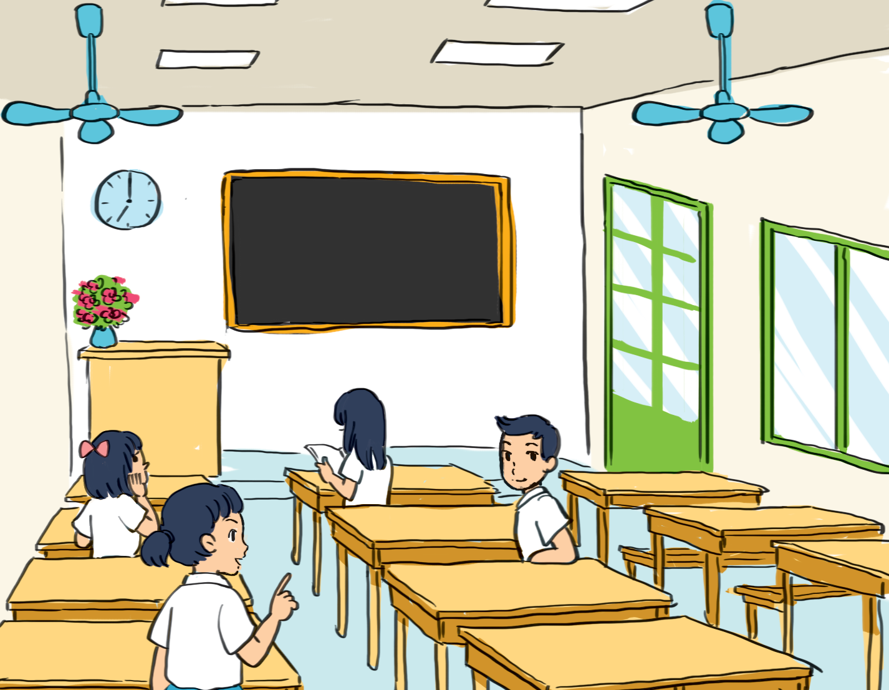
GRAMMAR
5
Look at the picture of a classroom. Choose the best answer A, B, or C.
1. There is a blackboard and a clock _____ the wall.
A. in B. on C. behind
2. A vase of flowers is on the ____ desk.
A. teacher’s B. teachers
C. teacher'

Slide 13
GRAMMAR
5
Look at the picture of a classroom. Choose the best answer A, B, or C.
3. A boy and three girls are _____ the classroom.
A. in B. on C. in front of
4. The window is ____ the big door.
A. behind B. next to
C. under

Slide 14
GRAMMAR
5
Look at the picture of a classroom. Choose the best answer A, B, or C.
5. A girl ______ her book now.
A. reads
B. reading
C. is reading

Slide 15
GRAMMAR
6
Complete the sentences with the present simple or the present continuous form of the verbs in brackets.
1. We can't go out now. It (rain) __________.
2. What time ____ you (have) _____ breakfast every day?
3. – ___ she (study) ________ English now? – No, she isn’t.
4. My dog (like) ____ my bed very much.
5. My mother (not cook) ___________ now. She (read) __________ a book.
is raining
do
have
Is
studying
likes
isn’t cooking
is reading

Slide 16

CONSOLIDATION
1
Wrap-up
What have we learnt in this lesson?
Pronunciation
Vocabulary
Grammar

Slide 17

CONSOLIDATION
2
Homework
Prepare for Review 1 - Lesson 2: Skills.

Slide 18






Website: hoclieu.vn
Fanpage: facebook.com/www.tienganhglobalsuccess.vn/

