Slide 1

Unit 9: Houses in the Future
Lesson 3.2: Reading, Speaking, & Writing
Page 77

Slide 2
Lesson Outline
Warm-up
Reading: Pre-Writing
Speaking: Pre-Writing
Writing
Consolidation
Wrap-up

Slide 3
Objectives
By the end of this lesson, students will be able to…
Talk about life on a space station as well as life on
the Moon.
Improve their 4 English skills (Reading, Listening, Speaking, and Writing)

Slide 4

WARM-UP

Slide 5
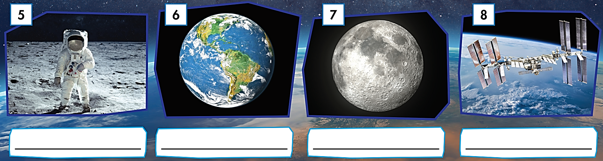

TEAM WORK
How many WORDS can you make with 10 LETTERS in the word “A-S-T-R-O-N-A-U-T”
For example,
- AS
- AT
- ….
- ….
AS
AT
STAR
START
RAT
AN
TAN
ART
ON
NO
NOT
TON
TAR
US
SON
SAT
ROAST
ROT
OUT
OUR
SOUR
TOUR
TOURS
………..

Slide 6

Reading: Pre-Writing

Slide 7
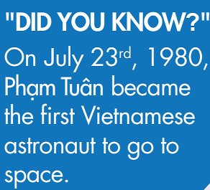
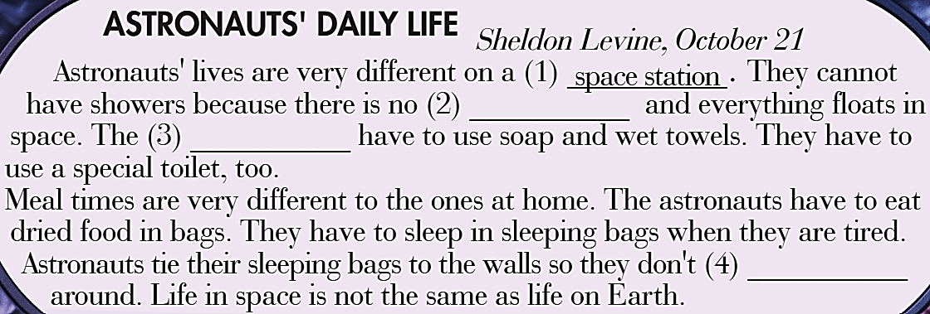
a. Read the article and fill in the blanks.
gravity
astronauts
float

Slide 8
b. Read the article again and answer the questions.
1. Why can't astronauts shower in space? ________________________________________________
2. How do astronauts clean themselves in space? ________________________________________________
3. What do they eat in space? ________________________________________________
4. Why do astronauts tie their sleeping bags to the wall? ________________________________________________
5. Who was the first Vietnamese person to go to space?
________________________________________________

Slide 9
Ask and answer the questions with a partner. Speak English!
1. Why can't astronauts shower in space? ________________________________________________
2. How do astronauts clean themselves in space? ________________________________________________
3. What do they eat in space? ________________________________________________
4. Why do astronauts tie their sleeping bags to the wall? ________________________________________________
5. Who was the first Vietnamese person to go to space?
________________________________________________

Slide 10
1. Why can't astronauts shower in space? _____________________________________________
2. How do astronauts clean themselves in space? _____________________________________________
Because there is no gravity there.
They have to use soap and wet towels.
Astronauts' lives are very different on a space station. They cannot have showers because there is no gravity and everything floats in space. The astronauts have to use soap and wet towels. They have
to use a special toilet, too.
Meal times are very different to the ones at home. The astronauts
have to eat dried food in bags. They have to sleep in sleeping bags when they are tired. Astronauts tie their sleeping bags to the walls so they don’t float around. Life in space is not the same as life on Earth.

Slide 11
3. What do they eat in space? ________________________________________________
4. Why do astronauts tie their sleeping bags to the wall? ________________________________________________
5. Who was the first Vietnamese person to go to space?
________________________________________________
They eat dried food in bags.
They tie their sleeping bags to the walls so they don’t float around.
Phạm Tuân.
Astronauts' lives are very different on a space station. They cannot have showers because there is no gravity and everything floats in space. The astronauts have to use soap and wet towels. They have
to use a special toilet, too.
Meal times are very different to the ones at home. The astronauts
have to eat dried food in bags. They have to sleep in sleeping bags when they are tired. Astronauts tie their sleeping bags to the walls so they don’t float around. Life in space is not the same as life on Earth.

Slide 12

Speaking: Pre-Writing

Slide 13


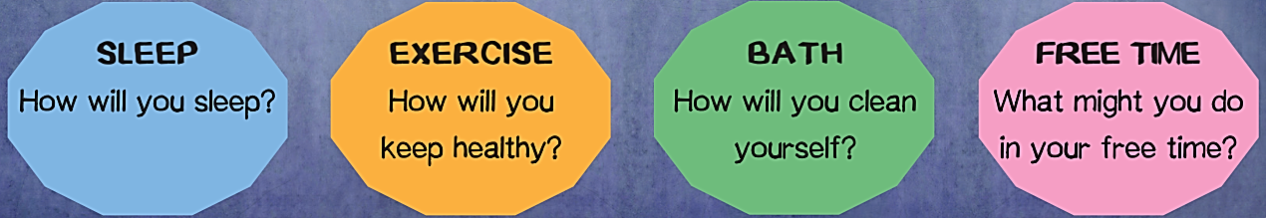

Slide 14

Writing

Slide 15
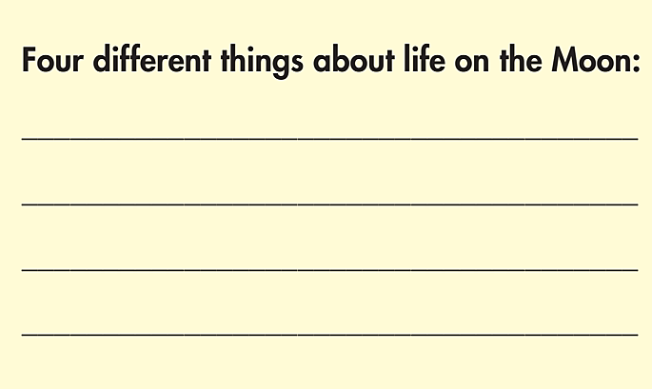
Pre-Writing
a. Choose four of the things you talked about in Speaking and note them down.

Slide 16
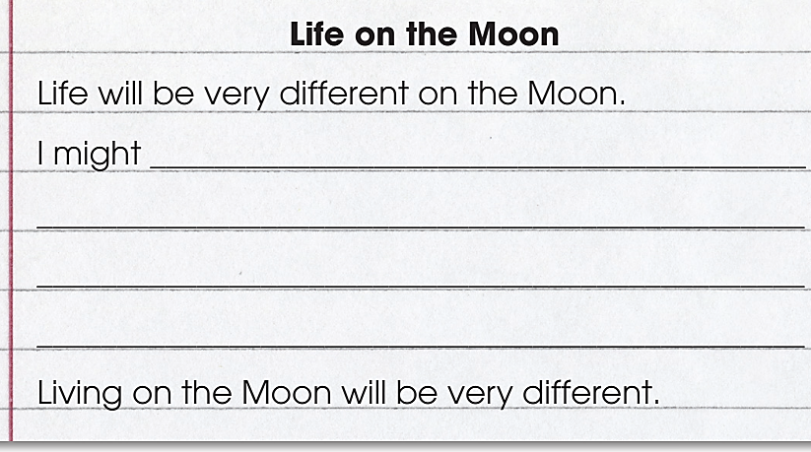
While-Writing
b. Now, write a paragraph about life on the Moon using your notes. Write 50 to 60 words.
Notes

Slide 17
Post-Writing
Swap your writing.
Read and correct your partner’s mistakes (if any).

Slide 18

CONSOLIDATION

Slide 19

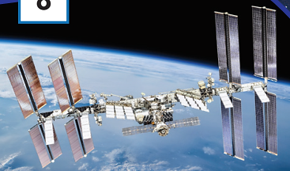
PAIR WORK
Why is life very different on a space station?

Slide 20

WRAP-UP

Slide 21
Today’s lesson
Reading
Read about life on a space station
Speaking
Talk about life on the Moon.
Writing
- Write about life on the Moon.

Slide 22
Homework
Review Unit 9 vocabulary and grammar.
Do the exercises on page 55, WB
Complete the writing notes in Tiếng Anh 6 i-Learn Smart World Notebook on page 57
Prepare the next lesson (pages 102-103, SB)
Play the consolidation games in Tiếng Anh 6 i-Learn Smart World DHA App on www.eduhome.com.vn

Slide 23
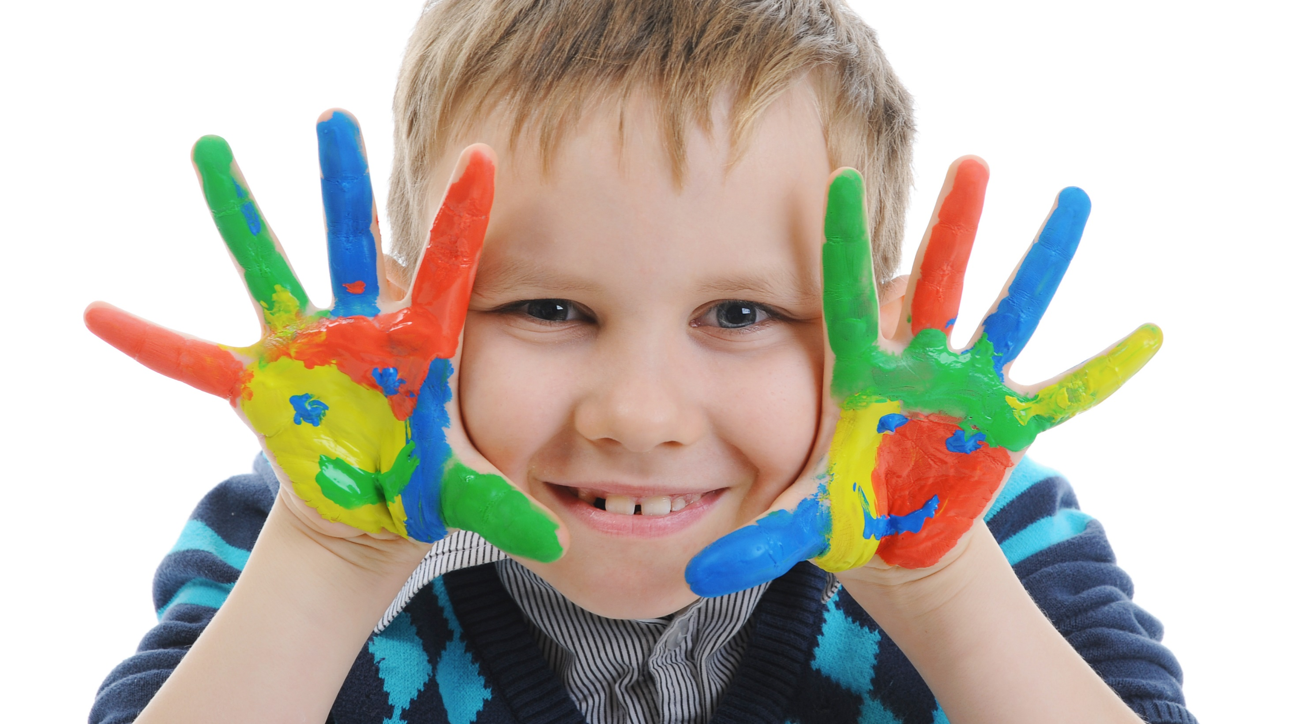
Enjoy your day!

