Slide 1


Slide 2



Unit
11
TRAVELLING IN THE FUTURE
LESSON 5: SKILLS 1
READING
SPEAKING
Unit

Slide 3

OBJECTIVES
By the end of the lesson, students will be able to:
- read for general and specific information about a future car.
- talk about why a means of transport will / won’t be popular.

Slide 4
LESSON 5: SKILLS 1
WARM-UP
Game: Networking
* Vocabulary
* Brainstorming
Task 1: Read the passage and answer the question.
Task 2: Read the passage again and complete the fact.
Task 3: Retelling
READING
SPEAKING
Task 4: Look at the fact file in 3 then ask and answer questions about it.
Task 5: Discussion. Report to the class.
CONSOLIDATION
Wrap-up
Homework

Slide 5
WARM-UP
MEANS OF TRANSPORT

Slide 6
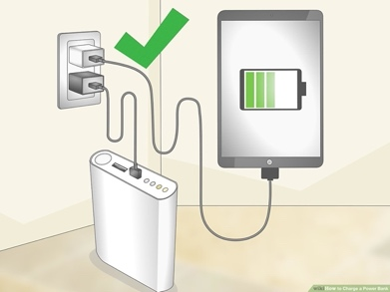
READING: VOCABULARY
charge (v)
/tʃɑːdʒ/
sạc pin

Slide 7
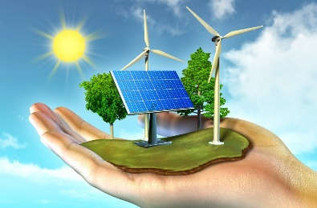
READING: VOCABULARY
economical (adj)
/ˌiːkəˈnɒmɪkəl/
tiết kiệm nhiên liệu

Slide 8
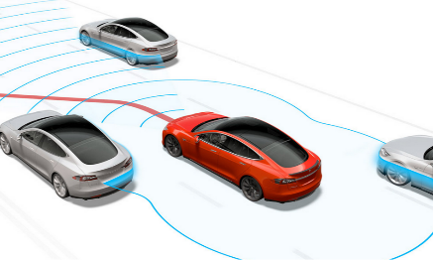
READING: VOCABULARY
autopilot (adj, n)
/ˈɔːtəʊˌpaɪlət/
lái tự động

Slide 9
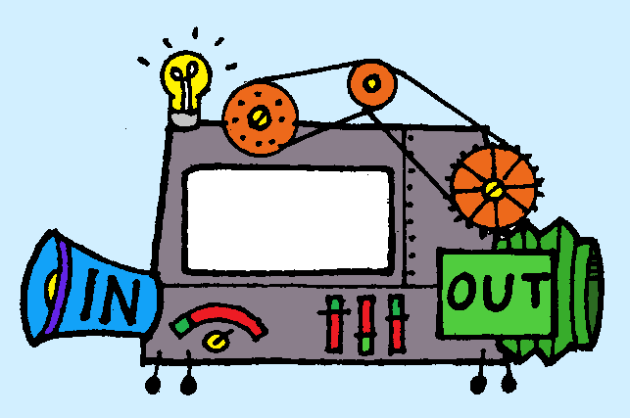
READING: VOCABULARY
function (n)
/ˈfʌŋkʃən/
chức năng

Slide 10
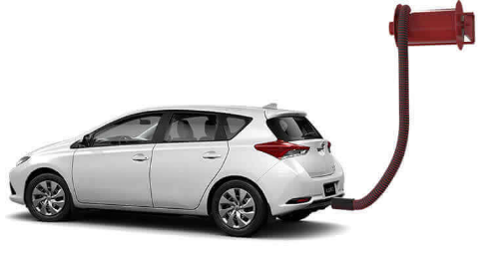
READING: VOCABULARY
run on (phr. v)
/rʌn ɒn/
chạy bằng
(nhiên liệu nào)

Slide 11
READING: VOCABULARY
New words | Pronunciation | Meaning
1. charge (v) | /tʃɑːdʒ/ | sạc pin
2. economical (a) | /ˌiːkəˈnɒmɪkəl/ | tiết kiệm nhiên liệu
3. autopilot (adj, n) | /ˈɔːtəʊˌpaɪlət/ | lái tự động
4. function (n) | /ˈfʌŋkʃən/ | chức năng
5. run on (phr.v.) | /rʌn ɒn/ | chạy bằng (nhiên liệu nào)

Slide 12

READING
1
Brainstorming: Look at the picture and find the words or phrases to describe it.
Suggested answer:
The car: convenient, safe, comfortable, modern, automatic, automated, autopilot, etc.
The driver: relaxing / isn’t driving, etc.

Slide 13
WHILE-READING
2
Read the passage and answer the question.
﻿What is its main idea?
A. Roadrunner is a success.
B. Roadrunner is a car company.
C. Roadrunner’s cars have an autopilot function.

Slide 14
READING
3
Read the passage again and complete the fact file with no more than two words or a number.
Fact file
﻿Name of the company | Roadrunner
Speed was introduced in | (1) ________________
Safety will be the | (2) ________________ and (3) ________________ electric car
Both models have | a gaming screen and a (4) _________________
Both models run on | (5) ________________
Passengers can | read, sleep, play games
2015
safest / largest
largest / safest
autopilot function
electricity

Slide 15
READING
3
Retelling.
Tell the class again about the Roadrunner company.

Slide 16

SPEAKING
4
Look at the fact file in 3 then ask and answer questions about it.
Suggested questions:
- When was Speed introduced? / When did they introduce Speed?
- What do you know about Safety? / What is special about Safety?
- What functions do these models have?
- What do these models run on?
- What can passengers do when they are travelling in the car?

Slide 17

SPEAKING
5
Discuss why Roadrunner’s cars will or won’t become popular in the near future. Report your reasons to the class.
Why Roadrunner’s cars will or won’t become popular in the near future?

Slide 18
CONSOLIDATION
1
WRAP-UP
READING
SPEAKING

Slide 19

CONSOLIDATION
2
HOMEWORK
Do exercises in the workbook.
Prepare for the next lesson: Skills 2

Slide 20

Website: hoclieu.vn
Fanpage: facebook.com/www.tienganhglobalsuccess.vn/

