Slide 1

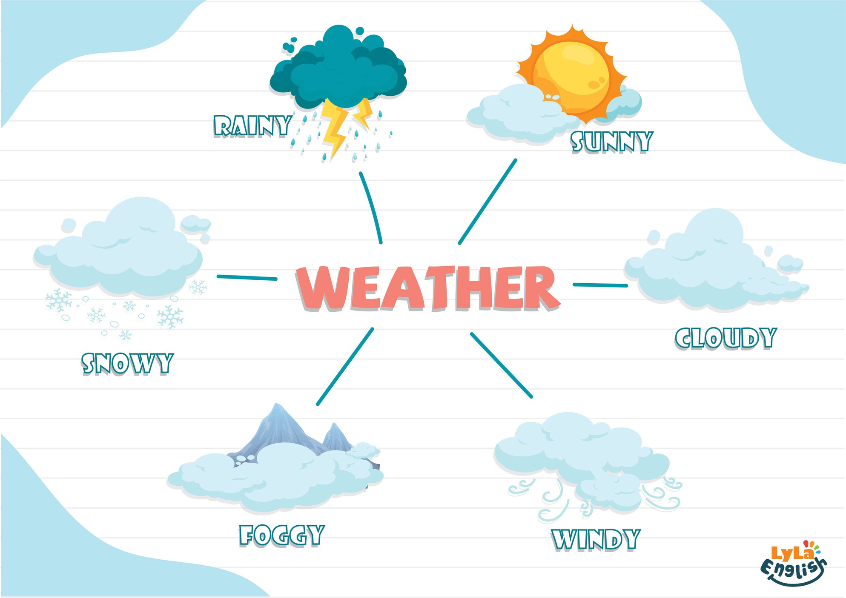




Slide 2



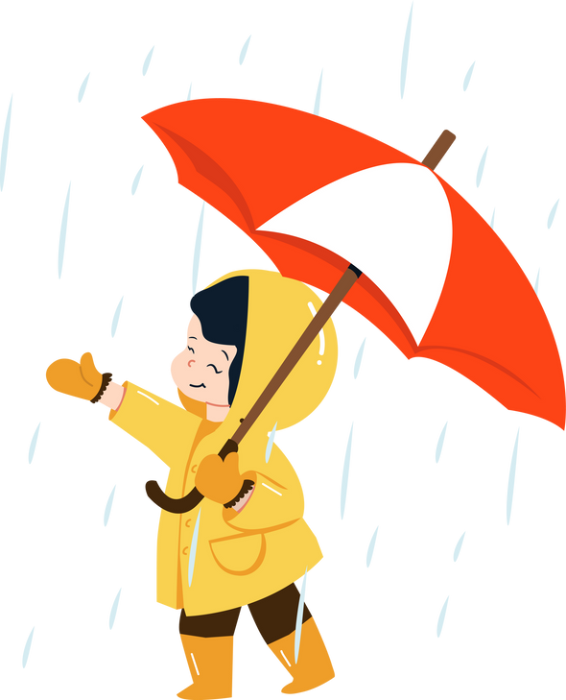


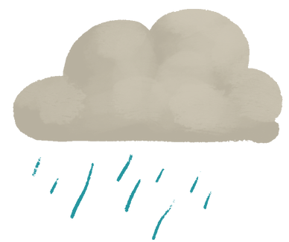

I. QUESTION
1.How’s the weather today?
It’s....
2. Is it sunny today? -Yes, it is.
-No, it is’nt.

Slide 3





II. VOCABULARY
Rainy:.....................................................
Sunny:....................................................
Cloudy:.....................................................

Slide 4



II. VOCABULARY
Foggy:.....................................................
Snowy:....................................................
Windy:......................................................

Slide 5
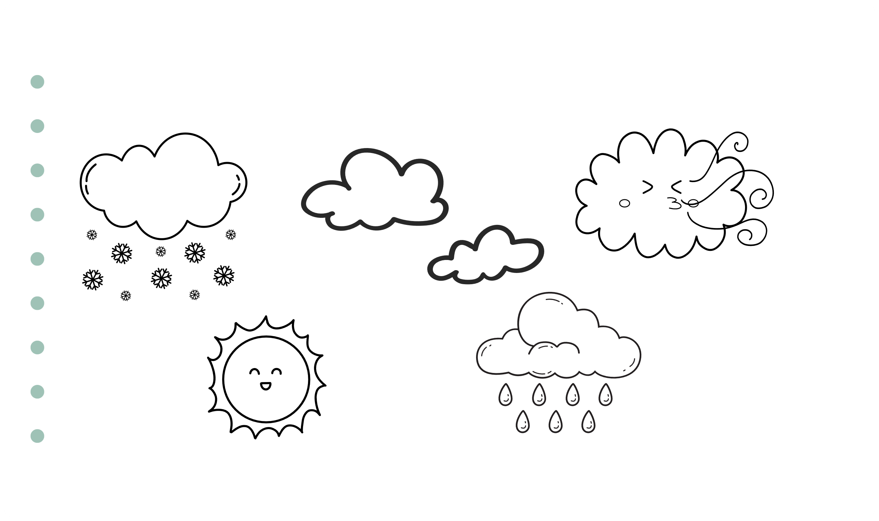


III. EXERCISES
1. Read and color:
Windy
Snowy
Cloudy
Rainy
Sunny

Slide 6
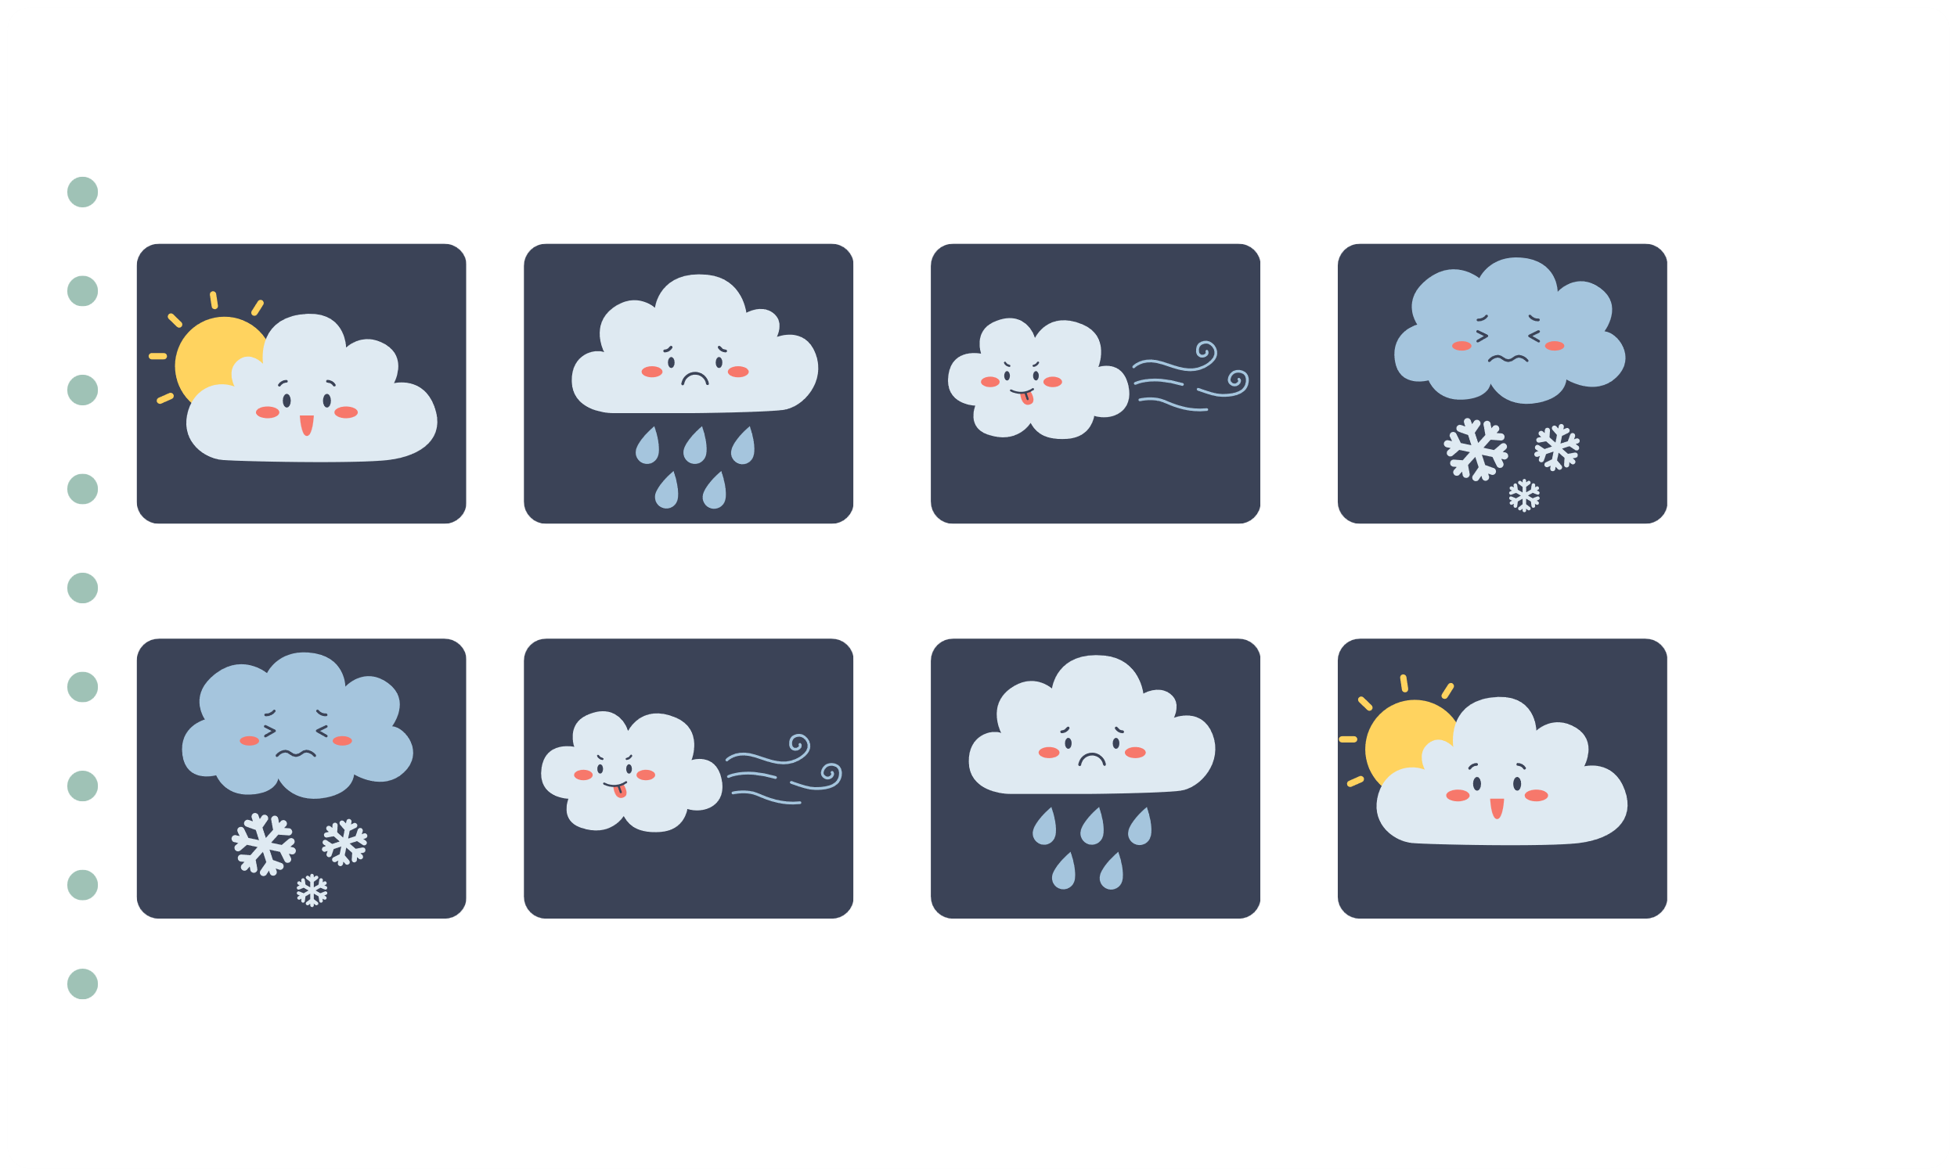


III. EXERCISES
2. Find and line the similar picture:

Slide 7






III. EXERCISES
3. Fill the words below:
s
S
r
s
f
w

Slide 8

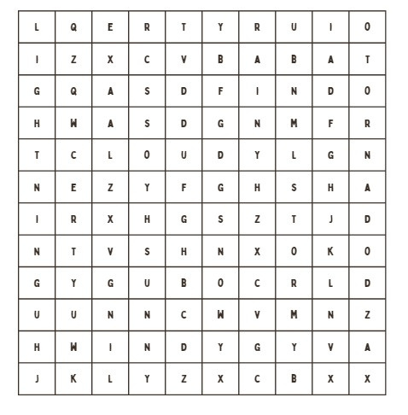


III. EXERCISES
4. Find the word:

Slide 9


III. EXERCISES
5. Trace and match:
sunny
rainy
windy
snowy
cloudy

Slide 10
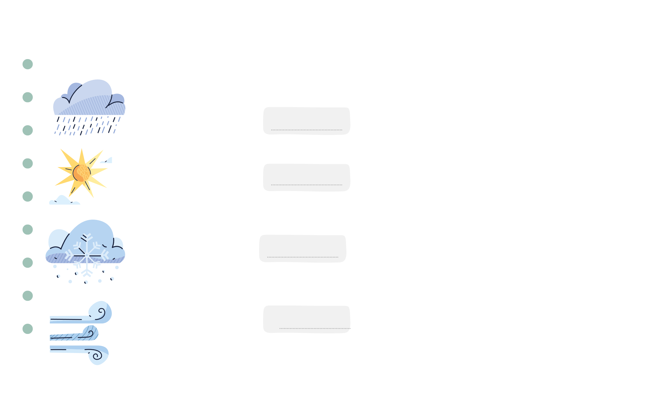
III. EXERCISES
6. Look at the pictures and complete the sentences:
It’s a
day.
It’s a
day.
It’s a
day.
It’s a
day.

Slide 11






III. EXERCISES
7. Reorder the words:
w/n/i/y/d ...
s/w/n/o/y .....
c/o/u/l/y/d ...
s/n/u/n/y ...

Slide 12

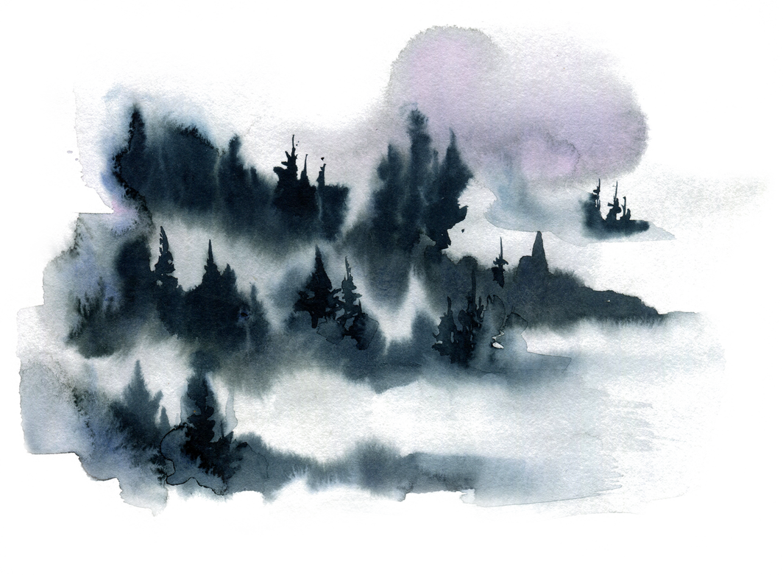





III. EXERCISES
8. Look at the picture and guess the word:

