Slide 1

UNIT 1: FAMILY LIFE
Lesson 2.3 – Pronunciation & Speaking
Page 9

Slide 2




Lesson .
LESSSON OUTLINE
Consolidation

Slide 3

By the end of this lesson,
students will be able to:
pronounce the sound /l/.
talk about personality using so and because.

Slide 4



Slide 5

Work in pairs.
Choose the word whose main stress is placed
differently from the others.
A. aerobics B. detector C. decision D. barbecue
2. A. lazy B. happy C. tidy D. asleep
3. A. karaoke B. information C. intelligence D. punctuation
/erˈoʊbɪks/
/dɪˈtektə/
/dɪˈsɪʒən/
/ˈbɑ:rbəkju:/
/ˈleɪzi/
/ˈhæpi/
/ˈtaɪdi/
/əˈsli:p/
/ˌkæriˈoʊki/
/ˌɪnfəˈmeɪʃən/
/ɪnˈtelədʒəns/
/ˌpʌŋktʃuˈeɪʃən/

Slide 6
Work in pairs.
Choose the word whose underlined part is
pronounced differently from that of the other words.
A. unbalanced B. united C. unable D. untidy
2. A. student B. member C. teacher D. father
3. A. pretty B. helpful C. upset D. selfish
/ʌnˈbælənst/
/ju:ˈnaɪtɪd/
/ʌnˈeɪbəl/
/ʌnˈtaɪdi/
/ˈstu:dənt/
/ˈmembə/
/ˈti:tʃə/
/ˈfɑ:ðər/
/ˈprɪti/
/ˈhelpfəl/
/ʌpˈset/
/ˈselfɪʃ/

Slide 7

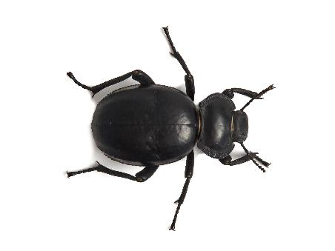
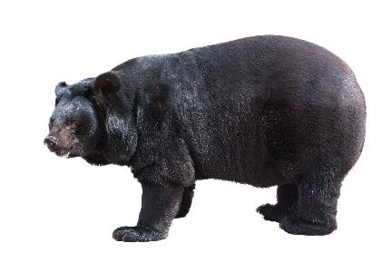
TONGUE TWISTERS:
A big black bug bit a big black bear.
Where’s the big black bear the big black bug bit?

Slide 8



Slide 9


lemon
public
Italian
fail
luggage
wallet







lazy reliable helpful




Slide 10



1. light
night

2. pills
pins

3. bill
bin

Slide 11
1. light
night
2. pills
pins
3. bill
bin

Slide 12

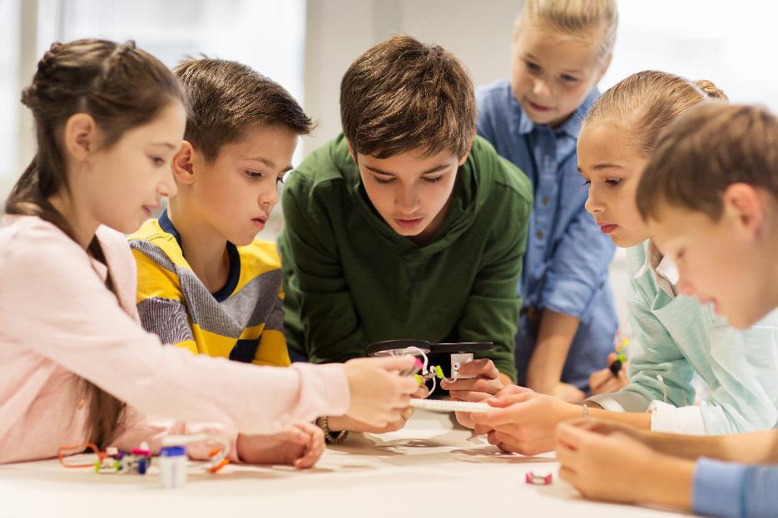

Slide 13
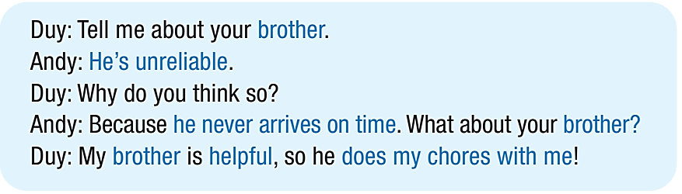
a. Practice the conversation between Duy and Andy.

Slide 14
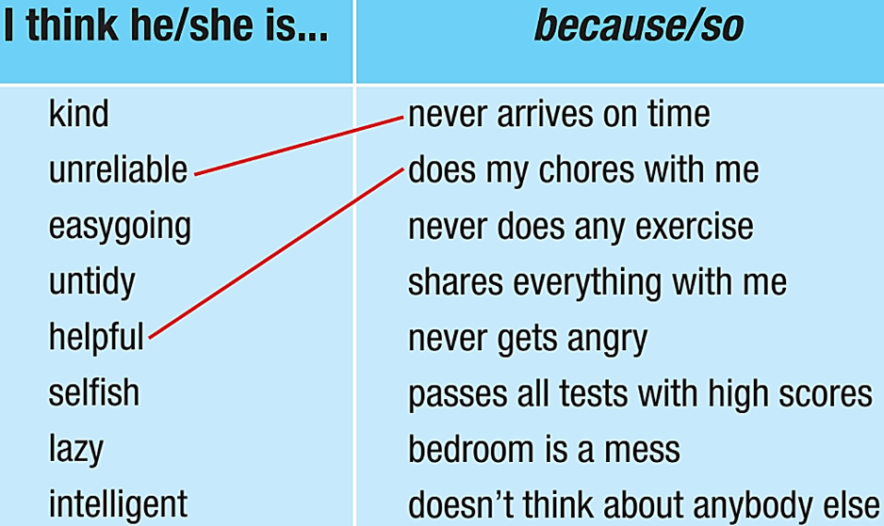
b. Match the adjectives to the examples.

Slide 15
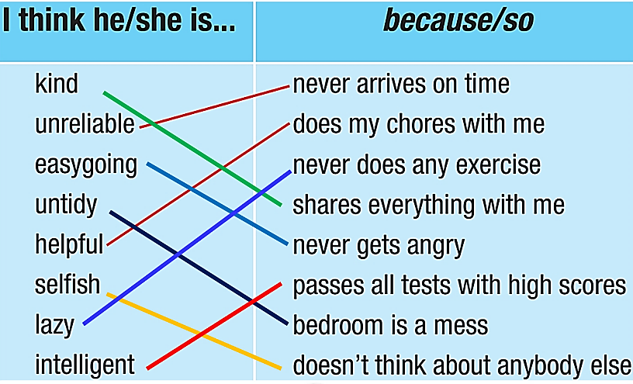
Make more conversations using the ideas in the box.
Duy: Tell me about your brother.
Andy: He’s unreliable.
Duy: Why do you think so?
Andy: Because he never arrives on
time. What about your brother?
Duy: My brother is helpful, so he
does my chores with me!

Slide 16



Slide 17
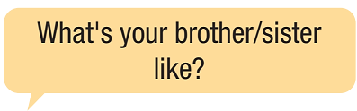
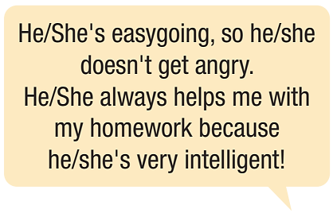
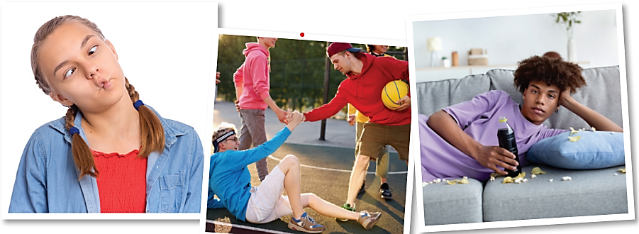
a. In pairs: Take turns asking about 3 family members.
Use 2 personality adjectives and so/because.

Slide 18
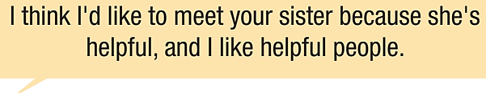
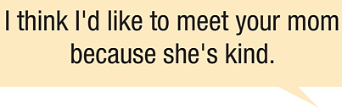
b. Now, discuss which person from your partner's family you would like to meet and why.

Slide 19

Consolidation

Slide 20

Report to the class.
Which member from your partner's family would you like to meet? Why?
I think I'd like to meet Andy’s sister because she’s helpful, and I like helpful people.
I think I'd like to meet Sue’s mom because she's kind.
I think I'd like to meet Peter’s dad because he’s friendly.

Slide 21
Today’s lesson
Wrap-up
Pronunciation: the sound /l/.
Speaking: talking about personality using so and because

Slide 22

Review the vocabulary and grammar points in Tiếng Anh 10 i-Learn Smart World Notebook on pages 4 & 5.
Prepare the next lesson on page 10, SB.
Play the consolidation games in Tiếng Anh 10 i-Learn Smart World DHA App on www.eduhome.com.vn

Slide 23
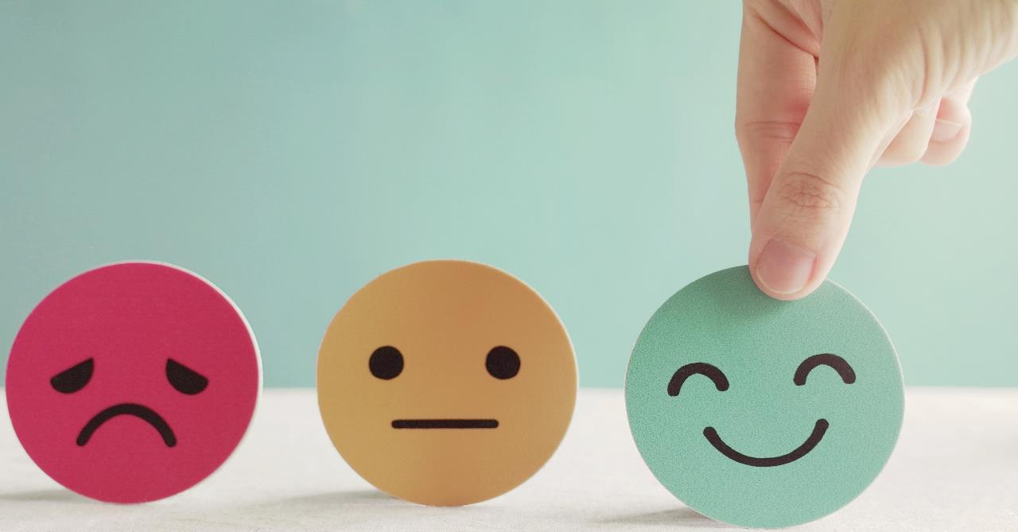
Have a nice day!

