Slide 1


Slide 2



Unit
12
ENGLISH-SPEAKING COUNTRIES
LESSON 7: LOOKING BACK & PROJECT
Grammar
  Words related to the topic English-speaking countries
  Articles
Design a poster introducing a place in an English-speaking country
Unit
Vocabular
Project

Slide 3

OBJECTIVES
By the end of the lesson, students will be able to:
review the vocabulary and grammar of Unit 12
apply what they have learnt (vocabulary and grammar) into practice through a project

Slide 4
LESSON 7: LOOKING BACK & PROJECT
WARM-UP
Video watching
Task 1: Look at the pictures and write the correct words or phrases to complete the sentences.
Task 2: Choose the best answer to complete each sentence.
VOCABULARY REVIEW
Task 3: Complete the sentences with a / an or the.
Task 4: Underline and correct the article mistakes in the sentences below.
GRAMMAR REVIEW
PROJECT
Project: Explore English-speaking countries!
CONSOLIDATION
Wrap-up
Homework

Slide 5
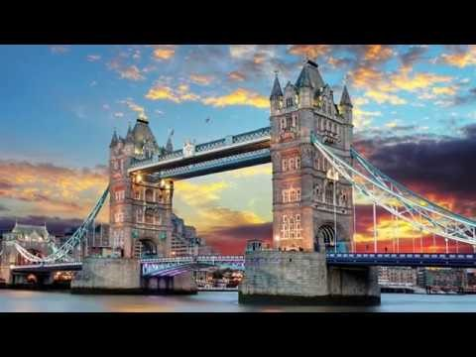
WARM-UP
How many English-speaking countries are mentioned in the video?
What are they?
Notes:
https://ejoy-english.com/go/intl/vi/video/6-english-speaking-countries/60729

Slide 6
WARM-UP
How many English-speaking countries are mentioned in the video>
What are they?
They are:
  The Philippines
  Australia
  Republic of Ireland
  Canada
  The USA
  The UK
6 English-speaking countries

Slide 7
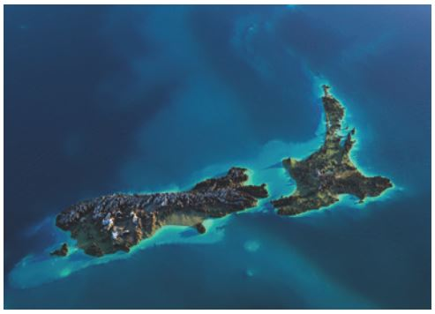
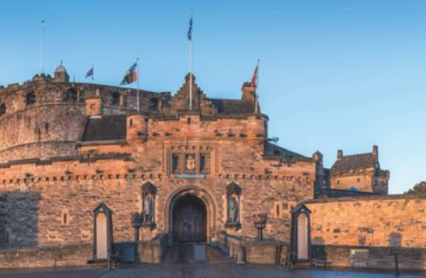
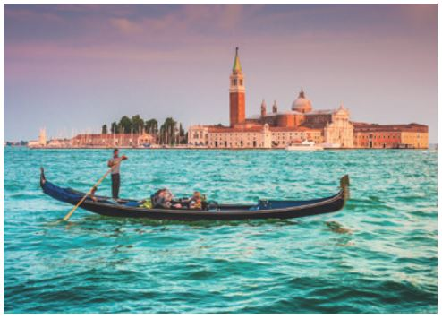
VOCABULARY REVIEW
1
Look at the pictures and write the correct words or phrases to complete the sentences.
1. Both England and New Zealand are _____________ countries.
2. A great attraction of Scotland is the ____________.
3. People can go sightseeing by taking a ________________.
island
castle
boat ride

Slide 8

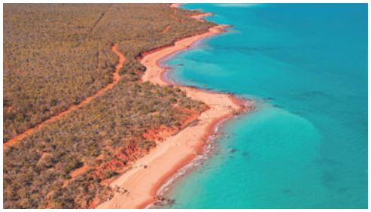
VOCABULARY REVIEW
1
Look at the pictures and write the correct words or phrases to complete the sentences.
4. Most Maori men have _____________ on their arms.
5. California is famous for its long sunny _________________.
tattoos
coastline

Slide 9
VOCABULARY REVIEW
2
Choose the best answer A, B, or C to complete each sentence.
1. – What do you call the people from Canada?
– ______.
A. Canadians B. Canadian C. Canada people
2. Scotland, with its ______ landscapes, attracts millions of visitors every year.
A. warm B. amazing C. local
3. – What is a ______ of London?
– The red telephone box.
A. capital B. symbol C. landscape

Slide 10
VOCABULARY REVIEW
2
Choose the best answer A, B, or C to complete each sentence.
4. Niagara Falls is a great ______ on the border of the USA and Canada.
A. forest B. river C. attraction
5. Aborigines are the ______ people of Australia.
A. native B. historical C. foreign

Slide 11
GRAMMAR REVIEW
3
Complete the sentences with a / an or the.
1. Auckland is ______ biggest city on ______ North Island of New Zealand.
2. ______ castle is ______ strong building with thick and high walls.
3. Surrounding ______ UK is ______ Atlantic Ocean.
4. Hawaii is ______ state of ______ USA.
5. ______ attraction is ______ interesting place for visitors.
the
the
A
a
the
the
a
the
An
an

Slide 12
GRAMMAR REVIEW
4
Underline and correct the article mistakes in the sentences below.
1. Ottawa is a capital of Canada.
2. He’s the Englishman. He lives in Oxford.
3. When people travel, they use an map to find their way round.
4. Can you see a Big Ben from where you are standing?
5. Canadians love ice hockey, the winter sport
→ the
→ an
→ a
→ Ø
→ a

Slide 13
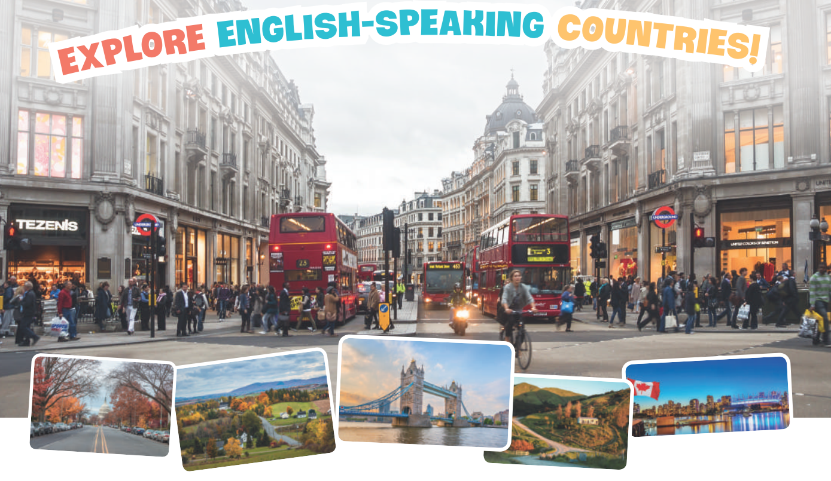
PROJECT
5
1
Discuss and choose a place in an English-speaking country.
Work in groups.
2
Find information about it, including:
  its name
  its location
  its attractions
3
Design a poster to introduce the place and present it to the class.
4
Your class votes for the most appealing poster.

Slide 14
CONSOLIDATION
1
Wrap-up
Grammar
  Words related to the topic English-speaking countries
  Articles
Design a poster introducing a place in an English-speaking country
Vocabular
Project

Slide 15

CONSOLIDATION
2
Homework
Prepare for the final test.

Slide 16

Website: hoclieu.vn
Fanpage: facebook.com/www.tienganhglobalsuccess.vn/

