Slide 1

Unit 2: Fit for life
Lesson 2a: Reading
Page 30

Slide 2
Lesson Outline
Warm-up
Reading
Consolidation
Wrap-up

Slide 3
Objectives
By the end of this lesson, students will be able to…
- learn and use vocabularies: martial art, level, pad, protection, punch, respect.
- practise talking about a type of martial arts.
- practise reading for specific information and read for detail.
- collect information about a martial art they know and make notes.
- improve listening skills and pronunciation.

Slide 4

WARM-UP

Slide 5
Answer the questions
- What sports do you do in your free time?
Do you want to attend a martial art class? Why or why not?

Slide 6

It’s time to learn …

Slide 7
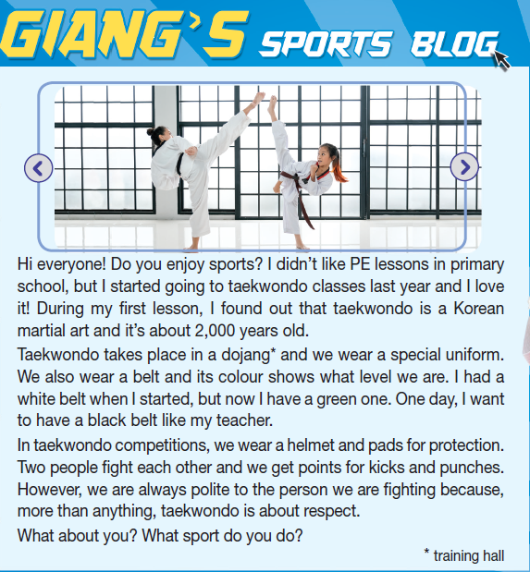
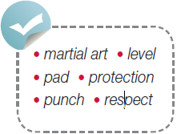
Pre-reading
Find these words in the text, try to guess what are their meanings.

Slide 8

Vocabulary
Listen and repeat.
- level /ˈlevəl/ (n): mức độ, đai (võ thuật)
- martial art /ˌmɑːʃəl ˈɑːt/ (n): môn võ thuật
- pad /pæd/ (n): miếng đệm
- protection /prəˈtekʃən/ (n): sự bảo vệ
- punch /pʌntʃ/ (n): cú đấm
- respect /rɪˈspekt/ (n): sự tôn trọng

Slide 9
1 Look at the pictures. Then answer the questions.
Which sport do they show?
The sport is taekwondo.
What do you know about this sport?
It’s from Korea. People kick and punch. They wear a special uniform, a helmet, and pads to do it.

Slide 10
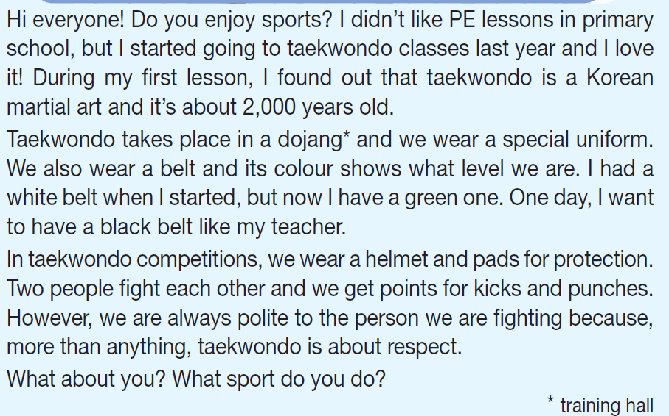
While-reading
Listen and read the text.

Slide 11
2. Read the text. Fill in the table with the information from the text.
Name | Origin | Equipment
Taekwondo
Korea

Slide 12
2. Read the text. Fill in the table with the information from the text.
Name | Origin | Equipment
a special uniform, a belt, a helmet and pads
Taekwondo
Korea

Slide 13
3. Read the text again. Decide if the statements are R (right) or W (wrong).
Tips:
Underline the important information.
Compare the information with that in the text.
1. Giang started taekwondo lessons last year.
2. Taekwondo is a new martial art.
3. Giang’s teacher has got a black belt.
4. Taekwondo teaches us respect.

Slide 14
3. Read the text again. Decide if the statements are R (right) or W (wrong).
1. Giang started taekwondo lessons last year.
2. Taekwondo is a new martial art.
3. Giang’s teacher has got a black belt.
4. Taekwondo teaches us respect.
R

Slide 15
3. Read the text again. Decide if the statements are R (right) or W (wrong).
1. Giang started taekwondo lessons last year.
2. Taekwondo is a new martial art.
3. Giang’s teacher has got a black belt.
4. Taekwondo teaches us respect.
R
W

Slide 16
3. Read the text again. Decide if the statements are R (right) or W (wrong).
1. Giang started taekwondo lessons last year.
2. Taekwondo is a new martial art.
3. Giang’s teacher has got a black belt.
4. Taekwondo teaches us respect.
R
W
R

Slide 17
3. Read the text again. Decide if the statements are R (right) or W (wrong).
1. Giang started taekwondo lessons last year.
2. Taekwondo is a new martial art.
3. Giang’s teacher has got a black belt.
4. Taekwondo teaches us respect.
R
W
R
R

Slide 18
Extra Practice
Read the text again and circle the correct answers.
1. What subject didn’t she like when she was a primary school student?
A. Maths B. Physical Education C. Arts D. Music
2. What was the colour of her belt when she started?
A. green B. black C. yellow D. white
3. Which of the following is NOT true according to the passage?
A. She wants to become a martial art teacher.
B. She wants to have a black belt.
C. In taekwondo competitions, they wear a helmet and pads for protection.
D. People are taught respect when they learn taekwondo.
4. The word polite in paragraph 3 is closest in meaning to ______.
A. rude B. happy C. well-behaved D. curious

Slide 19
Extra Practice
Read the text again and circle the correct answers.
1. What subject didn’t she like when she was a primary school student?
A. Maths B. Physical Education C. Arts D. Music
2. What was the colour of her belt when she started?
A. green B. black C. yellow D. white
3. Which of the following is NOT true according to the passage?
A. She wants to become a martial art teacher.
B. She wants to have a black belt.
C. In taekwondo competitions, they wear a helmet and pads for protection.
D. People are taught respect when they learn taekwondo.
4. The word polite in paragraph 3 is closest in meaning to ______.
A. rude B. happy C. well-behaved D. curious

Slide 20

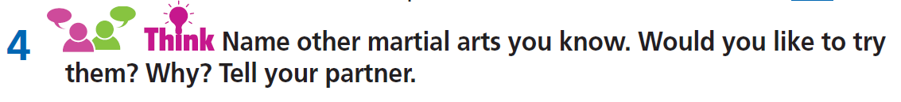
Post-reading
Example
I would like to try hapkido because this type of martial arts makes you learn techniques on self-defence.

Slide 21
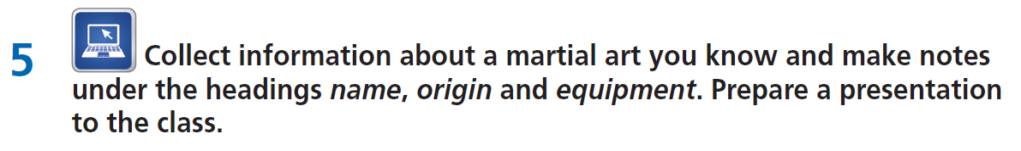

Slide 22

CONSOLIDATION

Slide 23
Write a paragraph (60-80 words) about a martial art you like.

Slide 24

WRAP-UP

Slide 25
Lesson 3
Today’s lesson
Vocabularies
martial art
level
pad
protection
punch
respect
Reading
- Reading for specific information.
- Read for details.

Slide 26
Homework
- Do exercises in workbook on page 16.
- Prepare the next lesson (page 31 SB).

Slide 27
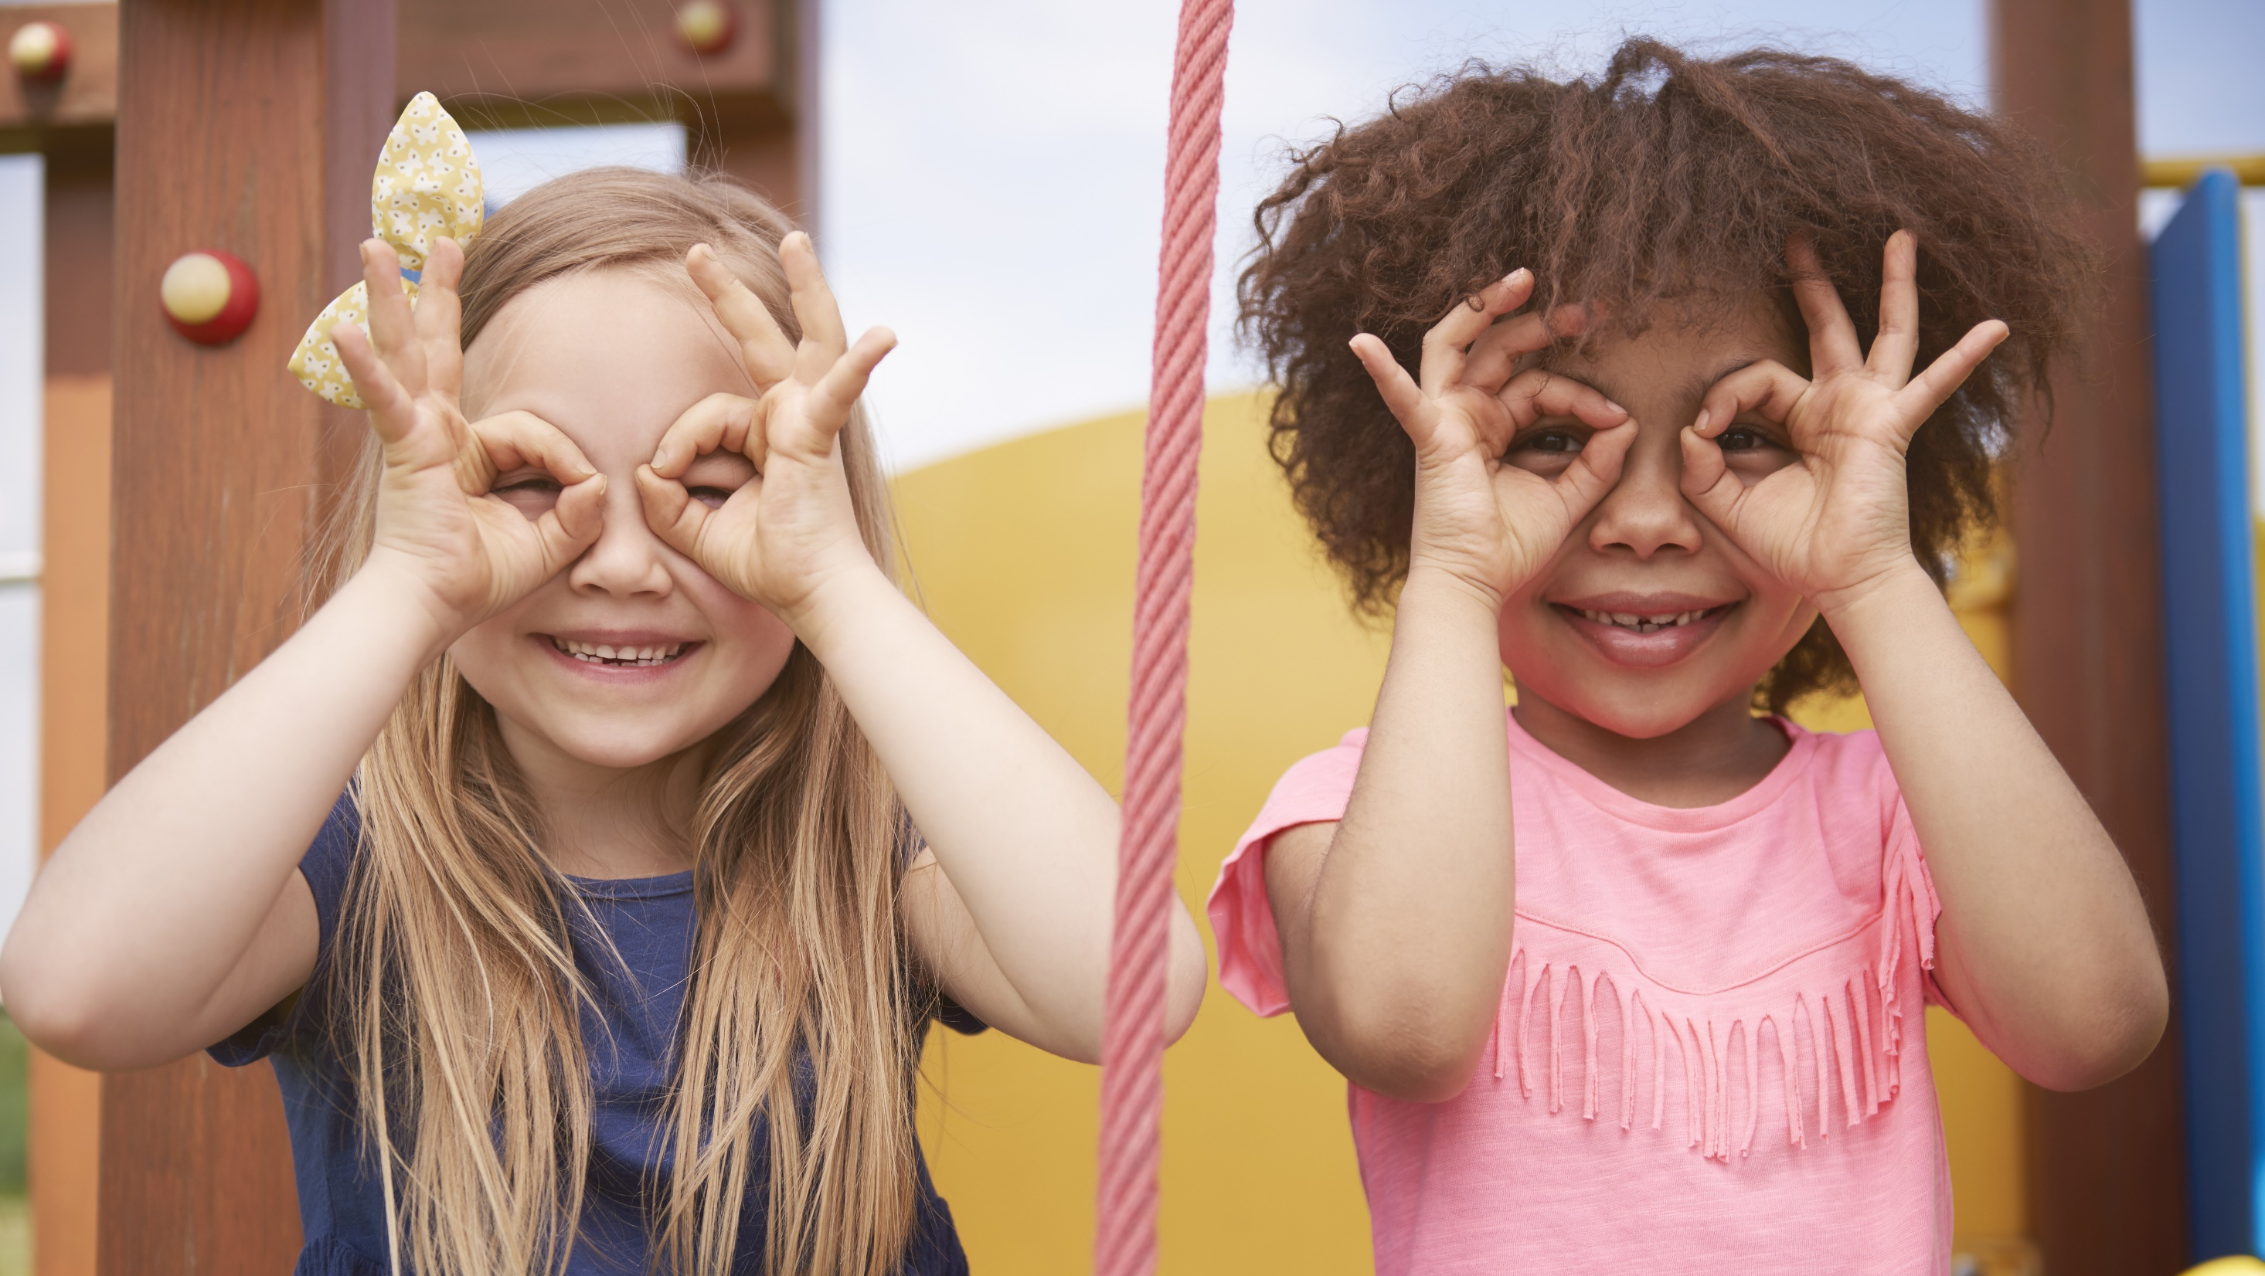
Enjoy your day!

