Slide 1

REVIEW 3 (Units 6-8)
Lesson 1 – Vocabulary, Listening & Reading
Page 72

Slide 2




LESSON OUTLINE
Consolidation

Slide 3

By the end of this lesson,
students will be able to …
practice listening and reading for specific information.
practice test-taking skills.
consolidate and practice vocab. presented in units 6-8

Slide 4
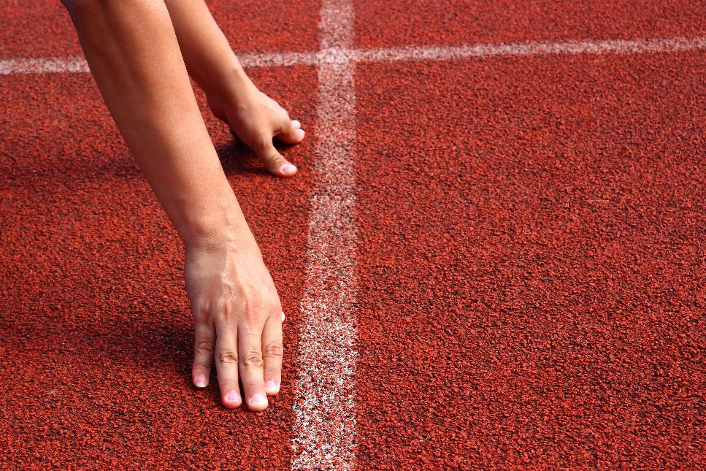


Slide 5

Work in pairs.
Where do you live?
Is your living area fresh or polluted?
What will you do to help your place be fresher?

Slide 6
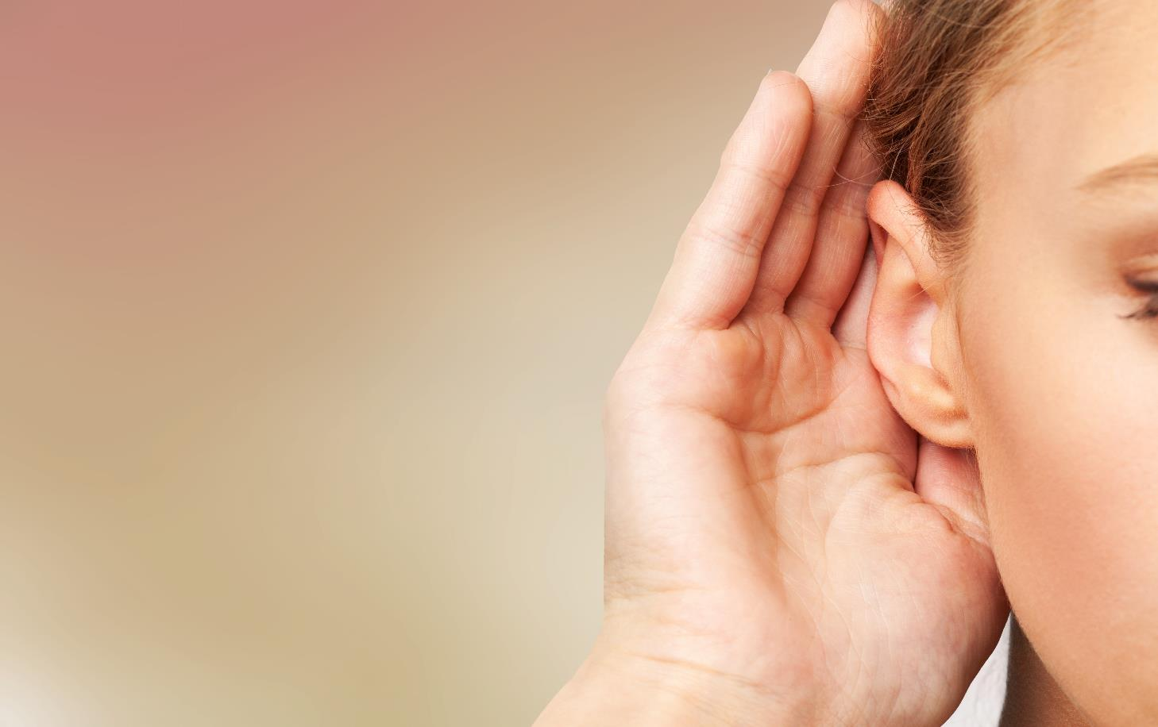


Slide 7

Pre-Listening
Underline the key words/phrases.
You will hear a student talking about an environmental campaign at his school. For each question, write the correct answer in the gap. Write one or two words or a number

Slide 8

While-Listening
Listen twice and write words or a number
The 3rd time to check
The campaign wants to (1) _____________ selling plastic bottles in the school.
He says that putting (2) _____________ in the school cafeteria will help.
The lowest temperature of the air conditioning will be (3) _____________ degrees.
Students won't need the air conditioning so much if they (4) _____________ in the summer.
Students can (5) _____________ the campaign if they have ideas to share.
ban
recycling bins
28
wear T-shirts
email

Slide 9

Scripts
Hi, everyone. Thanks for coming to hear about our school's new Go Green campaign. Everybody knows that it's important for us to protect the environment. I'm here to talk about some ways we are going to do that. The campaign wants to reduce the amount of plastic that we use. We'd like to ban the sale of plastic bottles in the school. Plastic is difficult to recycle, so this is important. We also want to recycle all cans that are sold here. If we put recycling bins in the school cafeteria, it will help us do that. Right now, the school uses a lot of electricity.

Slide 10
Some classrooms have air conditioners turned on all the time. This is a terrible waste. We will put signs on classroom doors reminding students to turn off the air conditioning when they leave the classroom. Also from now, no classrooms will have the air conditioning lower than twenty-eight degrees. The good news is, the school will let students wear T-shirts in the summer. If we all wear T-shirts, we won't need air conditioning so much. Finally, we want to hear your ideas for ways to help the environment. You can email us at this address if you have ideas you want to share. Thanks for listening.

Slide 11
Extra Practice
WB, page 67
Pre-Listening
Underline the key words/phrases.
You will hear five short conversations. You will hear each conversation twice. There is one question for each conversation. For each question, choose the correct answer (A, B, or C).
1. You will hear two friends talking about going to the gym. What rule does the girl mention?
A. You have to be a member.
B. Sports clothes must be worn during exercise.
C. Sports equipment must be cleaned after use.

Slide 12
2. You will hear two friends talking about a swimming pool. What do they think would improve the pool?
A. making it bigger
B. making it cleaner
C. making a separate area for young children
3. You will hear a phone call between a woman and a hotel receptionist. What does the woman decide to do?
A. to book a hotel room
B. to cancel a room she booked
C. to change the date for a room she booked

Slide 13
4. You will hear two people talking in a sports center. What should the man do after using the gym?
A. return equipment to the front desk
B. pay for the gym
C. empty his locker
5. You will hear a mother and a daughter talking about a college dorm. What does the girl tell her mother?
A. Her roommate is unfriendly.
B. She will enjoy college.
C. There are too many other students.

Slide 14
While-Listening
Listen twice and choose the correct answer.
The 3rd time to check
1. You will hear two friends talking about going to the gym. What rule does the girl mention?
A. You have to be a member.
B. Sports clothes must be worn during exercise.
C. Sports equipment must be cleaned after use.

Slide 15
2. You will hear two friends talking about a swimming pool. What do they think would improve the pool?
A. making it bigger
B. making it cleaner
C. making a separate area for young children
3. You will hear a phone call between a woman and a hotel receptionist. What does the woman decide to do?
A. to book a hotel room
B. to cancel a room she booked
C. to change the date for a room she booked

Slide 16
4. You will hear two people talking in a sports center. What should the man do after using the gym?
A. return equipment to the front desk
B. pay for the gym
C. empty his locker
5. You will hear a mother and a daughter talking about a college dorm. What does the girl tell her mother?
A. Her roommate is unfriendly.
B. She will enjoy college.
C. There are too many other students.

Slide 17
1. G: Hi, Jim, would you like to go to the gym with me this afternoon?
B: Yes, I’d love to. What time?
G: About 4:30. Is that OK for you?
B: Yeah, it’s great. I’ll walk there. It’s not very far from my house.
G: OK. I’ll meet you there. Bye!
B: Oh, wait! Do you have to be a member to use the gym?
G: No, but it’s cheaper for members. I have a card.
B: Hmm, maybe I’ll join next time.
G: Don’t forget your sports clothes. You have to wear them when you’re exercising.
B: Sure. I’ll bring them with me.
G: And your sports shoes. They won’t let you use the equipment if you’re not wearing sports shoes.
B: No problem. See you then!
Scripts

Slide 18
2. G1: Hey, Kelly, have you heard? There’s a new swimming pool in the park.
G2: Really? We should go and try it.
G1: I went there yesterday.
G2: Really? How was it?
G1: It was great. The water was cleaner than the pool in the Sports Center.
G2: Nice! Is it a big pool?
G1: It’s OK. It’s big enough to swim in.
G2: Do you want to go tomorrow?
G1: Yeah, sure. There was one thing I didn’t like though.
G2: What?
G1: There isn’t a separate area for kids and adults. I think that could be dangerous.
G2: Wow! That is dangerous. We should talk to the pool manager.

Slide 19
3. W: Hello, is that Riverside Hotel?
M: Yes. How can I help you?
W: I booked a double room on the fourteenth but I need to change the date.
M: What date would you like?
W: Do you have one available for the sixteenth?
M: No, I’m sorry. All our double rooms are booked. Would you like a single?
M: No, thanks. I think I’ll cancel my booking.
M: OK. May I have your name, please?
W: Ella Kendall. The room I booked was 2823.
M: Alright, Ms. Kendall. Room 2823. That’s done.
W: Thank you for your help.
M: You’re welcome

Slide 20
4. M: Hi, I want to register for membership at your center.
W: Of course. Would you like to look at our guidelines?
M: Yes, please...It says, “Sports equipment can be rented at the front desk.”
W: That’s right. You can rent badminton and tennis rackets for two dollars an hour. We supply the balls and shuttlecocks for free. Please return everything to the front desk after use.
M: Great. Do I need to wear sports clothes?
W: Yes. Sports clothes and sports shoes must be worn by all members when they use the gym. You can leave your things in your locker.
M: OK. Is there anything else?
W: Yes, please wipe down the gym equipment after use.
M: All right. Thanks for your help. Do you have a pen?

Slide 21
5. W: How was your first day staying in the dormitory?
G: It was pretty good. I met some nice people.
W: How many other students live there?
G: Seven others. Four boys and four girls. There are two students to one room.
W: That’s not too many. Did you go out to the mall or something?
G: No, but we hung out together. We talked a lot and ate pizza. It was fun.
W: Cool. What about your roommate? What’s she like?
G: Her name’s Jessica. She’s very friendly. She likes video games, too. I guess we’ll spend a lot of time playing together.
W: Are you glad you chose this college?
G2: Yes. I think it’s going to be great

Slide 22
Extra Practice
WB, page 68
Pre-Listening
Underline the key words/phrases.
You will hear five short conversations. You will hear each conversation twice. There is one question for each conversation. For each question, choose the correct answer (A, B, or C).
Listen twice and check

Slide 23
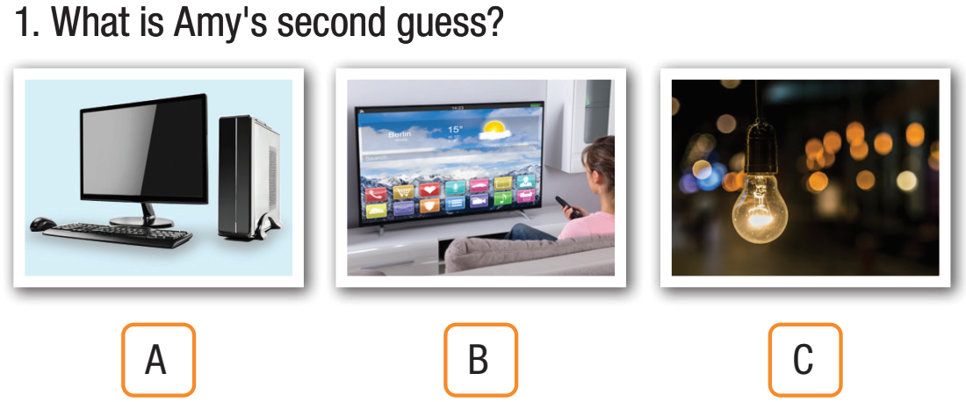

Slide 24
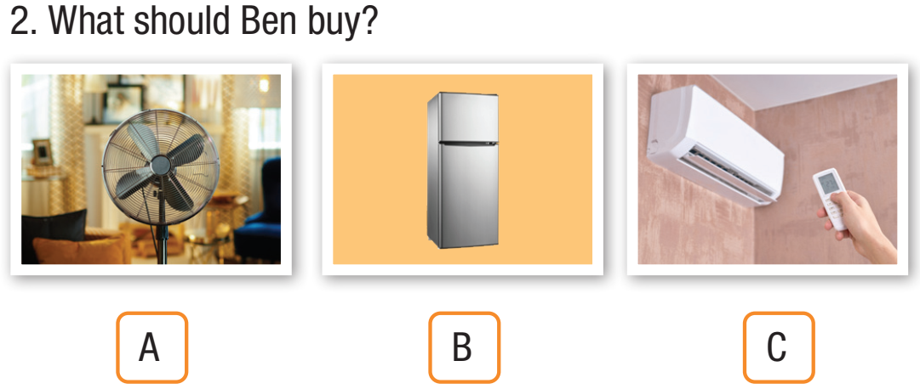

Slide 25
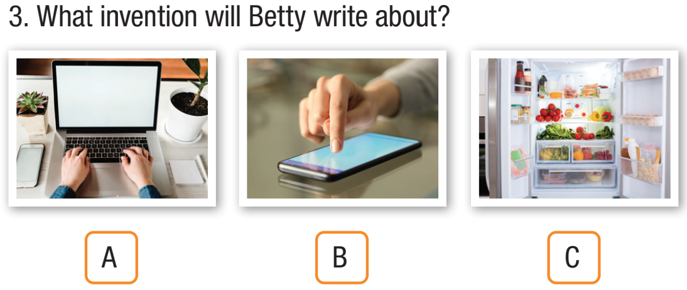

Slide 26
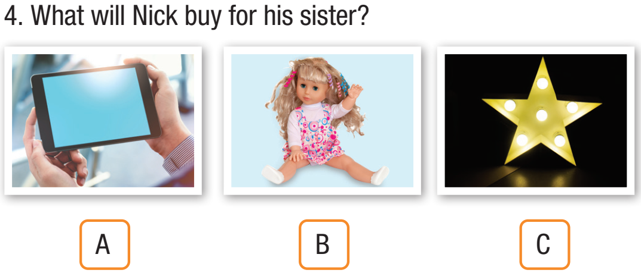

Slide 27
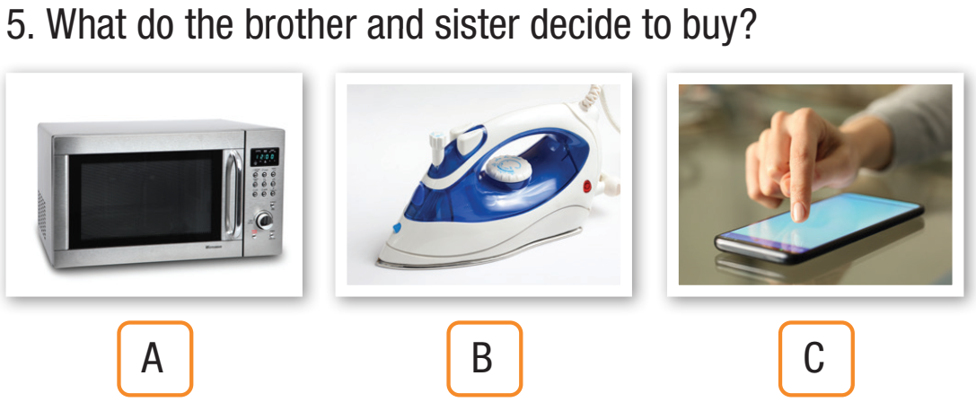

Slide 28
1. Kim: Hey, Amy. Do you want to play a game?
Amy: Sure.
Kim: OK. See if you can guess what invention I’m thinking of.
Amy: Go ahead.
Kim: This is something almost every house and room has.
Amy: Is it a TV?
Kim: No, sorry. That’s a good guess but it’s not that.
Amy: Give me another clue.
Kim: You should turn it off when you leave the room.
Amy: Is it a computer?
Kim: No, it’s not a computer. Last chance. You need to turn it on when it’s dark.
Amy: I know. It’s a lightbulb.
Kim: Yes, That’s right!
Amy: OK. My turn.
Scripts

Slide 29
2. Ben: Hi, I’m Ben. I’m moving in today.
Mark: Hi, Ben. I’m Mark. Nice to meet you. Do you need any help?
Ben: Oh, yes please. Thanks very much.
Mark: Wow! This is a big fan.
Ben: Yeah. Be careful.
Mark: Did you know your room has an aircon?
Ben: No, I didn’t know. Oh, maybe I won’t need the fan after all.
Mark: You could always sell it.
Ben: Yeah, good idea.
Mark: What else do you need help with?
Ben: My fridge. It’s very heavy.
Mark: Let me help...Oh no! I’m so sorry.
Ben: That’s OK. It’s not your fault.
Mark: Can you get it repaired?
Ben: Well, it was really old anyway. I guess I should buy a new one.

Slide 30
3. Dad: What are you doing, Betty?
Betty: My technology homework. It’s so difficult!
Dad: Why? What do you have to do?
Betty: I have to choose the most useful invention of the 21st century and write an essay about it.
Dad: What’s so hard about that? There are lots of really useful inventions. For example, the refrigerator that has your favorite ice cream in it.
Betty: Yes, but what’s the most useful one?
Dad: That’s up to you. Which one couldn’t you live without? Your cellphone?
Betty: That’s easy. My laptop. I use it to do my homework, watch movies, listen to music, and chat to my friends.
Dad: Well, there you go. Write about that.
Betty: OK. Thanks, Dad

Slide 31
4. Jenny: Did you find anything for your sister’s birthday, Nick?
Nick: No, Jenny. Not yet. I’m not sure what she’d like. Maybe a tablet?
Jenny: Yeah, that’s not a bad idea but a bit expensive. What about a doll?
Nick: A doll? She’s fourteen! She’s too old to play with dolls.
Jenny: I guess so. What about this? It’s really cute.
Nick: What is it?
Jenny: It’s a night light in the shape of a star.
Nick: I don’t think she’ll like it. I really think the tablet is the best gift.
Jenny: Do you have enough money?
Nick: Here’s one with a promotion. Look, it’s fifty percent off.
Jenny: Wow! That’s a great price. You should get it.
Nick: Yeah, I know she’ll really like it.

Slide 32
Jim: What should we buy Mom for her birthday?
Ellen: I’m not sure. She likes cooking. What about the microwave?
Jim: No, it’s too expensive. Anyway, she has an oven.
Ellen: How about the electric iron?
Jim: Yeah, that’s not a bad idea. It’s on sale as well.
Ellen: Hmm. I feel a bit bad getting her things for the house.
Jim: Yeah, I know what you mean. She likes reading. Should we get her a cookbook?
Ellen: Oh, Jim! I mean we should get her something fun.
Jim: Hey! What about a new cellphone? Her one is really old.
Ellen: I’m not sure.
Jim: So, iron, cookbook, or cellphone? Which one?
Ellen: I think the cellphone is probably the best.
Jim: Yeah, I agree.

Slide 33
Post-Listening
Work in groups.
1 Is there a green campaign at your school?
2 If yes, what do you do to support this campaign?

Slide 34



Slide 35
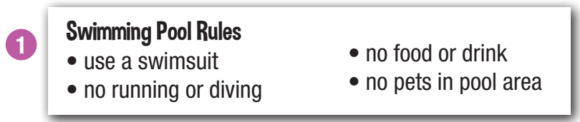
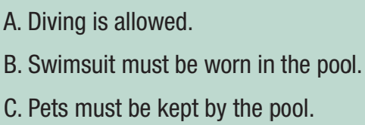
Pre-Reading
Look and read. Choose the correct answer (A, B, or C)
Underline the key words/phrases.

Slide 36
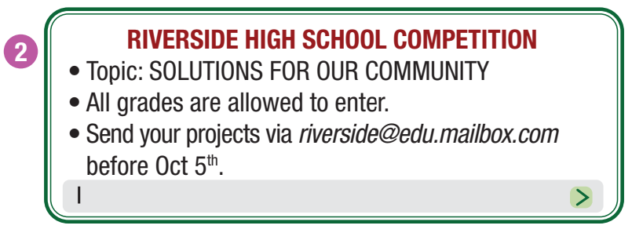
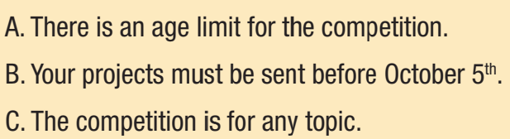

Slide 37
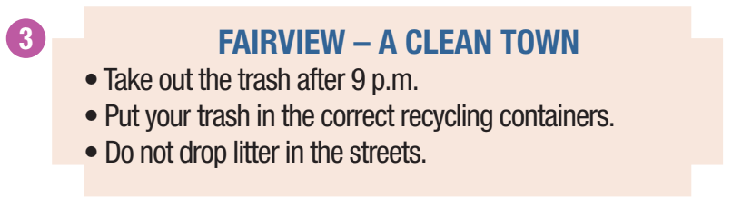
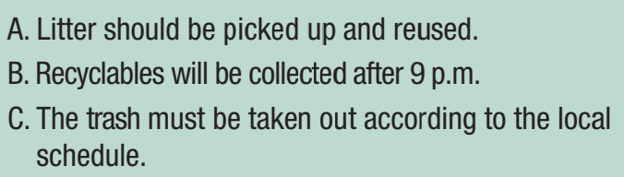

Slide 38
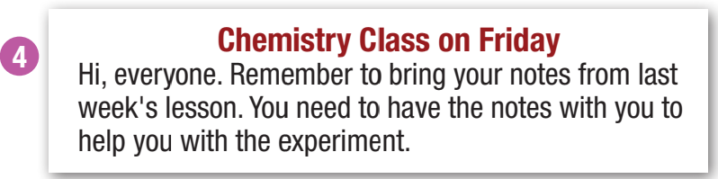
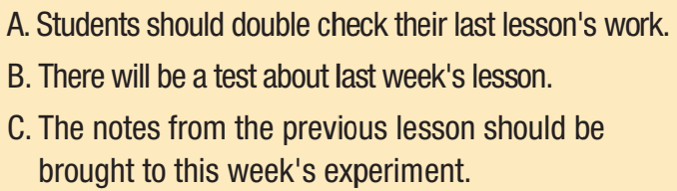

Slide 39
While-Reading
Skim and scan the text to get the specific information and choose the best option.

Slide 43
Extra Practice
WB, page 68
Pre-Reading
For each question, write the correct answer. Write one word for each gap.
Underline the key words/phrases.
The Many Uses of Your Cell Phone
People used to only use their cell phone for making phone calls, (1) ___________ now you can use them for almost everything. You are able to communicate with your friends and family through text messages, emails, chat programs, and phone calls. You (2) ___________ even video chat with people around the world. Cell phones are a great way to keep in touch.

Slide 44
Cell phones can keep you entertained for hours. If you like playing games, (3) ___________ are thousands of apps you can download and install on your cell phone. You can also watch movies and TV programs. You do not need to go (4) ___________ the movies or watch TV. You can use your cell phone to listen to your favorite music and share songs with your friends.

Slide 45
Cell phones have almost as many functions as a computer. Some people use their cell phone to do their work. There are many writing programs, and you can make presentations on your cell phone.
Cell phones (5) ___________ made our lives better in so many ways. Now, things are much easier to do.

Slide 46
While-Reading
Skim and scan to choose the suitable words to fill in the gap.
The Many Uses of Your Cell Phone
People used to only use their cell phone for making phone calls, (1) ___________ now you can use them for almost everything. You are able to communicate with your friends and family through text messages, emails, chat programs, and phone calls. You (2) ___________ even video chat with people around the world. Cell phones are a great way to keep in touch.
but
can

Slide 47
Cell phones can keep you entertained for hours. If you like playing games, (3) ___________ are thousands of apps you can download and install on your cell phone. You can also watch movies and TV programs. You do not need to go (4) ___________ the movies or watch TV. You can use your cell phone to listen to your favorite music and share songs with your friends.
there
to

Slide 48
Cell phones have almost as many functions as a computer. Some people use their cell phone to do their work. There are many writing programs, and you can make presentations on your cell phone.
Cell phones (5) ___________ made our lives better in so many ways. Now, things are much easier to do.
have

Slide 49
Extra Practice
WB, page 69
For each question, choose the correct answer (A, B, or C).
Pre-Reading
Underline the key words/phrases.
How to help improve local environment
There are many things people can do to improve their local environment. Families should make sure that glass, paper, and other recyclables are put into the right bins for recycling. If your neighborhood doesn't have a recycling program, ask your mayor to start one. It'd be easier for everyone to recycle their trash if there were drop-off locations near their house or if they could leave their trash outside for pickup.

Slide 50
Stores can also help solve environmental problems. They should stop giving single-use plastic bags to their customers and sell reusable bags. If people had to buy reusable bags, they would start to bring their own bags. Stores should also use less packaging for food items. Lots of fruit and vegetables don't need to be wrapped in plastic.
Schools and businesses should try to use less electricity because electrical power plants can cause a lot of pollution. Use fans and open windows when you can to save electricity.

Slide 51
Or try to set the air conditioner temperature to around 24 – 27 degrees Celsius and not too low like 18 degrees.
Everyone will still feel comfortable, and the air conditioners won't use as much electricity.
Schools should stop selling plastic bottles in their cafeterias and ask students to bring reusable bottles. Teachers can organize clean-ups around the school or in parks.
Students should bring reusable water bottles to school and try to use less paper.

Slide 52
While-Reading
Skim and scan to get the specific information
Families should...
A. start recycling programs in their neighborhoods.
B. recycle their household trash.
C. leave their glass and paper outside for recycling.
2. How can stores help make the environment better?
A. ask their customers to bring their own bags
B. make their customers pay for plastic bags
C. reduce food packaging

Slide 53
3. What can schools and businesses do to save electricity?
A. use air conditioners at a higher temperature
B. open windows and only use fans
C. use air conditioners at between 18 and 27 degrees
4. What should schools do to help the environment?
A. give lessons about the local environment
B. encourage students to use their own bottles
C. ask teachers and students to clean up parks

Slide 54
5. What would be the best conclusion for this article?
A. Environmental issues are one of the biggest problems we face today.
B. Recycling is the best way to improve things.
C. If we all do our best to improve things, the local environment will be cleaner and less polluted.

Slide 55

Post-Reading
Work in pairs.
Discuss: How to improve our environment.

Slide 56

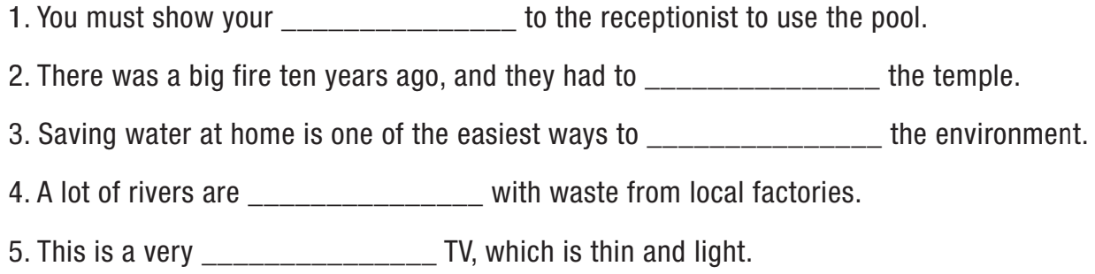
Fill in the blanks with words from the box. There is one extra word which you do not need to use.
member card
rebuild
protect
polluted
portable

Slide 57

Consolidation

Slide 58
Write a short paragraph about how to improve the environment where you live.

Slide 59

WRAP-UP

Slide 60
Today’s lesson
Listening and Reading: practice listening and reading for specific information
Vocabulary: consolidate and practice presented in units 6-8

Slide 61
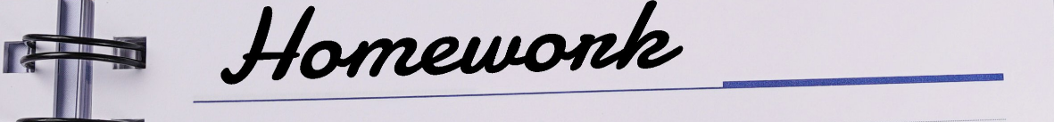
Do exercises in WB on page 67 (Reading) & page 69 (Listening).
Prepare the next lesson on page 73 in SB.
Play the consolidation games in Tiếng Anh 10 i-Learn Smart World DHA App on www.eduhome.com.vn

