Slide 2

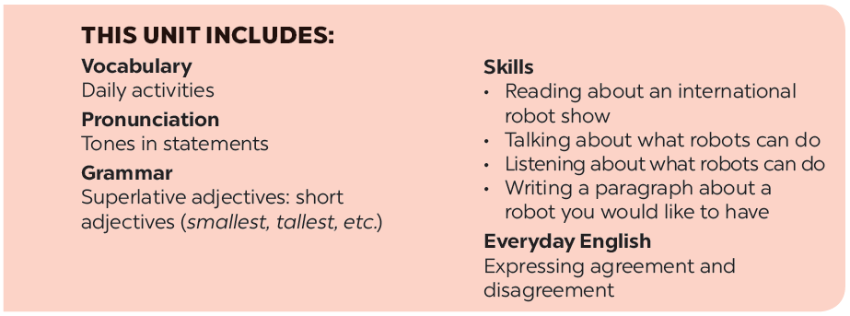

Slide 3







Vocabulary
Pronunciation
Match the verbs in column A to the words or phrases in column B. Then listen, check and repeat them.
Falling tone in statements
Listen and repeat the following sentences.
Work in pairs. Tell your partner the activities in 1 you can or can’t do now.
Practise saying the statements in the following paragraph. Then listen and repeat.
Work in pairs. Read the information about what V10, a robot, can or can’t do. Ask and answer questions.

Slide 4
Vocabulary

Slide 5



Match the verbs in column A to the words or phrases in column B. Then listen, check and repeat them.
A
B
c. our feelings
1.
understand
a. fruit
a. fruit
2.
pick
b. the washing
b. the washing
3.
do
c. our feelings
e. plants
4.
water
d. as a guard
d. as a guard
5.
work
e. plants

Slide 6

Work in pairs. Tell your partner the activities in 1 you can or can’t do now.
Example:
I can pick fruit but I can’t understand your feelings.

Slide 7

Work in pairs. Read the information about what V10, a robot, can or can’t do. Ask and answer questions.
Skills of V10 | Can | Can’t
Repair a broken machine |  | 
Do the washing | 
Work as a guard | 
Read our moods |  | 
Water plants | 
Understand what we say |  | 
Example:
A: Can V10 do the washing?
B: Yes, it can.

Slide 8
Pronunciation
Falling tone in statements

Slide 9


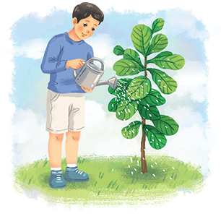
Listen and repeat the following sentences.
1.
I often water plants after school.
2.
Shifa can do many things like humans.
3.
My dad makes delicious meals at weekends.
4.
WB2 is the strongest of all the robots.
5.
H8 is a home robot.

Slide 10

Pronunciation
Falling tone in statements
Our voice often goes down at the end of a statement.
Example:
We go to school every morning.

Slide 11


Practise saying the statements in the following paragraph. Then listen and repeat.
My robot is Jimba. It’s a home robot. It’s very helpful. It can do the housework. It can also water plants and pick fruit. It can work as a guard. I love my robot very much.

Slide 12






Website: hoclieu.vn
Fanpage: facebook.com/www.tienganhglobalsuccess.vn/

