Slide 1


Slide 2



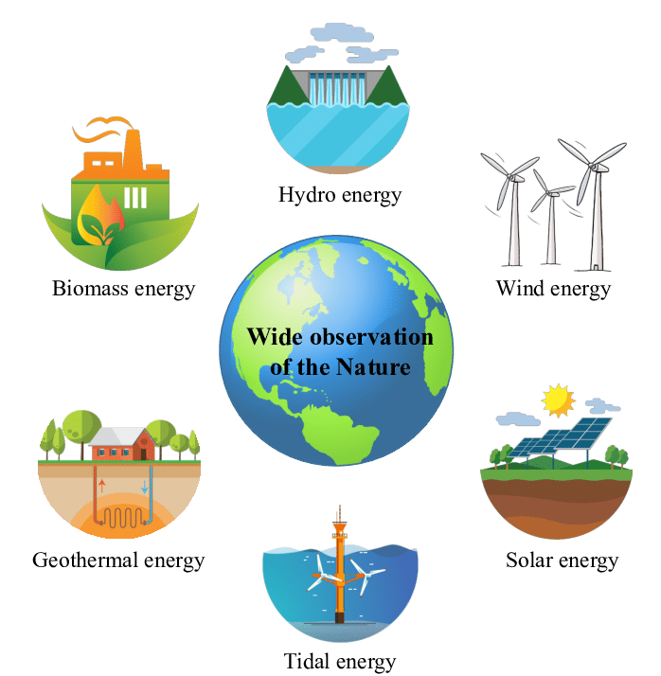
Unit
10
ENERGY SOURCES
LESSON 5: SKILLS 1
Unit

Slide 3

OBJECTIVES
By the end of the lesson, students will be able to:
+ Reading:
read for specific information about renewable and non-renewable sources of energy.
+ Speaking:
talk about advantages and disadvantages of different sources of energy

Slide 4
LESSON 5: SKILLS 1
WARM-UP
Game: Hangman
* Vocabulary
* Discussion
* Practice
Task 1: Read the text and choose the best option to complete the sentences.
Task 2: Read the text again and answer the questions
READING
Task 3: Work in groups. Discuss and put the following words or phrases in the appropriate columns.
Task 4: Work in pairs. Ask and answer questions about the advantages and disadvantages of different energy sources.
SPEAKING
PRODUCTION
Task 5: Presentation
CONSOLIDATION
Wrap-up
Home work

Slide 5


LESSON 1: GETTING STARTED
WARM-UP
Game:Hangman
Aims of the stage:
To introduce the topic of reading.

Slide 6

WARM-UP
R E N E W A B L E

Slide 7

LESSON 5: SKILLS 1
WARM-UP
Game: Hangman
* Vocabulary
* Discussion
* Practice
Task 1: Read the text and choose the best option to complete the sentences.
Task 2: Read the text again and answer the questions
READING
Aims of the stage:
To provide students with some lexical items before reading the text.

Slide 8
PRE-READING - VOCABULARY
produce (v)
= to make things, mostly in large quantity
Examples:
Companies produce many toys for children before Christmas.
/prəˈdjuːs/
SẢN XUẤT

Slide 9
PRE-READING - VOCABULARY
limited (a)
= not very great in amount or extent
Examples:
Coal is limited.
/əˈveɪləbl/
BỊ HẠN CHẾ

Slide 10
PRE-READING - VOCABULARY
available (a)
= that you can get, buy or find
Examples:
The coal takes a long time to be available again.
/əˈveɪləbl/
CÓ SẴN

Slide 11
PRE-READING - VOCABULARY
New words | Pronunciation | Meaning
produce (v) | /prəˈdjuːs/ | SẢN XUẤT
limited (a) | /əˈveɪləbl/ | BỊ HẠN CHẾ
available (a) | /əˈveɪləbl/ | CÓ SẴN

Slide 12
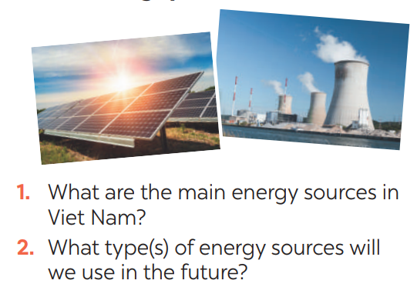

PRE-READING
1
Dicussion. Look at the pictures:

Slide 13
LESSON 5: SKILLS 1
WARM-UP
Game: Hangman
* Vocabulary
* Discussion
* Practice
Task 1: Read the text and choose the best option to complete the sentences.
Task 2: Read the text again and answer the questions
READING

Slide 14
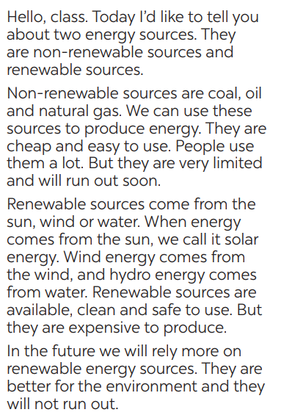
WHILE-READING
2
Read the text and choose the best option to complete the sentences.
Aim of the task:
To help Ss develop their reading skill for details and specific information (skimming and scanning)

Slide 15
WHILE-READING
2
Read the text and choose the best option to complete the sentences.
1. Non-renewable sources are cheap and ______.
A. available B. easy to use C. expensive
2. ______ come from the sun, wind or water.
A. Renewable sources B. All energy sources C. Non-renewable sources
3. When energy comes from water, we call it ______.
A. wind energy B. solar energy C. hydro energy
4. Renewable energy sources are better for ______.
A. the environment B. our cars C. hydro energy

Slide 16
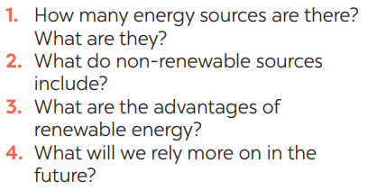
WHILE-READING
3
Read the text again and answer the questions
Aim of the task:
To help Ss further develop their reading skill for specific information (scanning).
ANSWER KEY:
1. There are two energy sources. They
are non-renewable sources and renewable sources.
2. Non-renewable sources are coal, oil
and natural gas.
3. Renewable sources are available, clean and safe to use.
4. In the future, we will rely more on
renewable energy sources.

Slide 17
LESSON 5: SKILLS 1
WARM-UP
Game: Hangman
* Vocabulary
* Discussion
* Practice
Task 1: Read the text and choose the best option to complete the sentences.
Task 2: Read the text again and answer the questions
READING
Task 3: Work in groups. Discuss and put the following words or phrases in the appropriate columns.
Task 4: Work in pairs. Ask and answer questions about the advantages and disadvantages of different energy sources.
SPEAKING

Slide 18
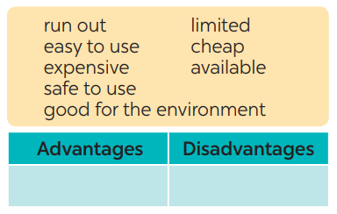
SPEAKING
4
Work in groups. Discuss and put the following words or phrases in the appropriate columns.
Aim of the task:
To prepare lexical items for Ss to talk about advantages and disadvantages of sources of energy
easy to use, safe to use, good for environment, cheap, available
run out, expensive, limited

Slide 19

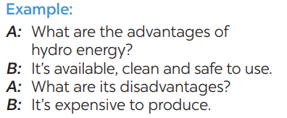
SPEAKING
5
Work in pairs. Ask and answer questions about the advantages and disadvantages of different energy sources
Aim of the task:
To provide Ss an opportunity to ask and answer questions about the advantages and disadvantages of different types of energy sources.

Slide 20
LESSON 5: SKILLS 1
WARM-UP
Game: Hangman
* Vocabulary
* Discussion
* Practice
Task 1: Read the text and choose the best option to complete the sentences.
Task 2: Read the text again and answer the questions
READING
Task 3: Work in groups. Discuss and put the following words or phrases in the appropriate columns.
Task 4: Work in pairs. Ask and answer questions about the advantages and disadvantages of different energy sources.
SPEAKING
PRODUCTION
Task 5: Presentation

Slide 21


PRODUCTION
5
Presentation: Advantages and disadvantages of a source of energy.

Slide 22
LESSON 5: SKILLS 1
WARM-UP
Game: Hangman
* Vocabulary
* Discussion
* Practice
Task 1: Read the text and choose the best option to complete the sentences.
Task 2: Read the text again and answer the questions
READING
Task 3: Work in groups. Discuss and put the following words or phrases in the appropriate columns.
Task 4: Work in pairs. Ask and answer questions about the advantages and disadvantages of different energy sources.
SPEAKING
PRODUCTION
Task 5: Presentation
CONSOLIDATION
Wrap-up
Home work

Slide 23
CONSOLIDATION
1
WRAP-UP
READING
SPEAKING

Slide 24
CONSOLIDATION
2
HOMEWORK
Prepare for the next lesson: Skills 2

Slide 25


