Slide 1

UNIT 6: COMMUNITY LIFE
Lesson 2.3 – Pronunciation & Speaking
Page 53

Slide 2




LESSON OUTLINE
Consolidation

Slide 3

By the end of this lesson,
students will be able to …
practice the final /ts/ sound.
talk about rules.

Slide 4



Slide 5

Choose the word whose main stress is placed
differently from the others.
Work in pairs.
A. member B. locker C. racket D. balloon
2. A. return B. delay C. predict D. practice
3. A. center B. swimming C. raincoat D. report
/ˈmembə/
/ˈlɑ:kə/
/ˈrækɪt/
/bəˈlu:n/
/rɪˈtɜ:n/
/dɪˈleɪ/
/prɪˈdɪkt/
/ˈpræktɪs/
/ˈsentə/
/ˈswɪmɪŋ/
/ˈreɪŋkoʊt/
/rɪˈpɔ:rt/

Slide 6
Work in pairs.
Choose the word whose underlined part is
pronounced differently from that of the other words.
A. library B. equipment C. hospital D. following
2. A. cap B. place C. day D. play
3. A. desk B. bench C. friend D. use
/ˈlaɪbreri/
/ɪˈkwɪpmənt/
/ˈhɑ:spɪtəl /
/ˈfɑ:loʊɪŋ/
/kæp/
/pleɪs/
/deɪ/
/pleɪ/
/desk/
/bentʃ/
/frend/
/ju:z/

Slide 7
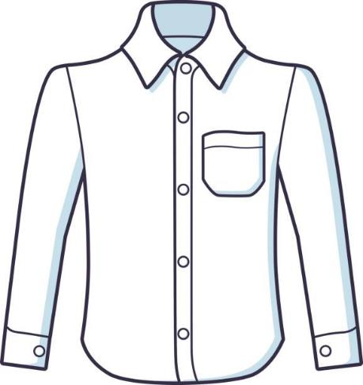
Game: Who is faster?
SHIRT

Slide 8
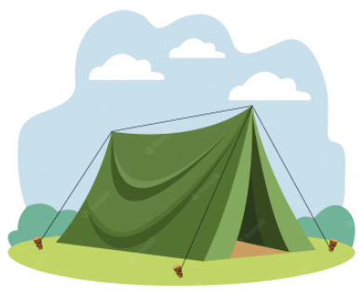
TENT

Slide 9

RACKET

Slide 10
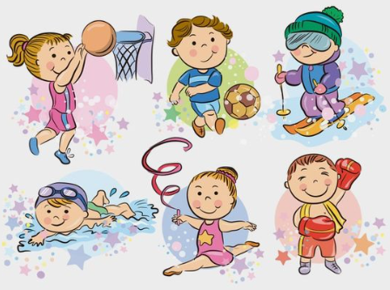
SPORTS

Slide 11
Change into plural nouns
SHIRT
TENT
RACKET
SHIRTS
TENTS
RACKETS

Slide 12



Slide 13

Lead-in
Final /ts/ sounds
b. Listen to the words and focus on the underlined letters.
rackets sports tickets T-shirts
c. Listen and cross out the word with the wrong sound.
tents students courts
d. Take turns saying the words in c. while your partner points to them.

Slide 14

Practice

Slide 15

a. Match the rules to the pictures and take turns saying the rules for each place.
1. Clothes should be kept in the lockers.
2. Books should be returned to the front desk.
3. Tickets must be shown to the driver when getting on.
4. Swimming caps must be worn at all times.
5. Bags must not be left by passengers.
6. Passports must be shown on arrival.
7. Registration forms should be filled in by guests.
8. Books must not be returned late.

Slide 16
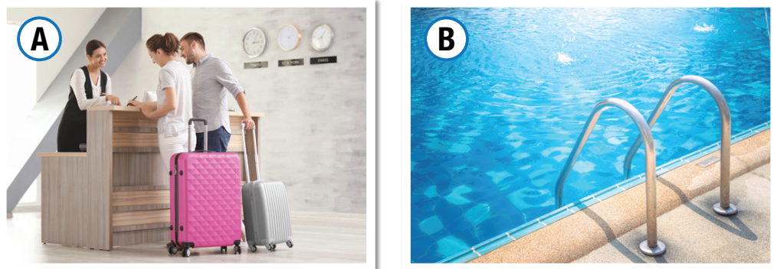
Rules No. 6, 7
Rules No. 1, 4

Slide 17
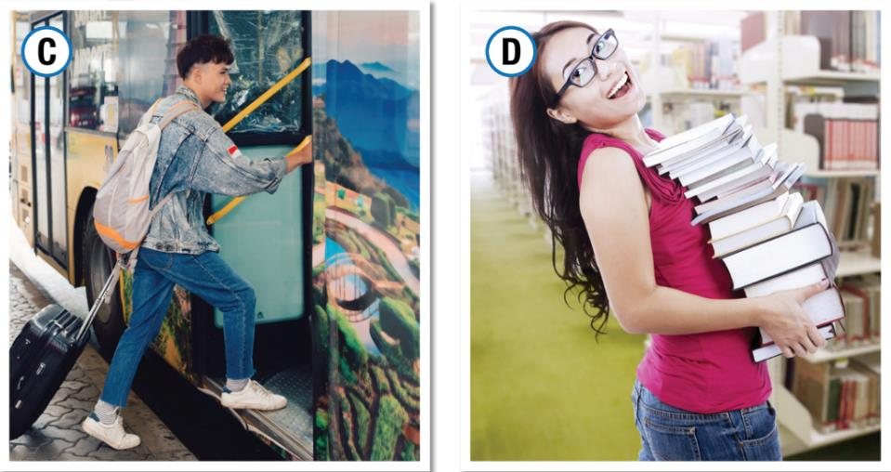
Rules No. 3, 5
Rules No. 2, 8

Slide 18

Production

Slide 19
Work in pairs.
b. Think of one more rule for each place.

Slide 20
You are going to make some new rules for your school. In pairs: Choose one of the following places: gym, library, and schoolyard. Discuss and write six rules for that place.

Slide 21
Sample: At the library
1. Food must not be eaten in the library.
2. Our books must be looked after.
3. Quiet voices must be used.

Slide 22
Sample: At the gym
1. Food, gum, glass, and soft drinks must not be taken to the gym.
2. Litter must be put into the garbage can.
3. Weights must be replaced after use.

Slide 23
Sample: At the schoolyard
1. Wet equipment can not be used.
2. Litter must be put into the garbage can.
3. Flowers must not be picked up.

Slide 24

Consolidation

Slide 25

Work in pairs.
Listen to another pair's rules. Do you agree that they are good rules? How would you change them?

Slide 26

WRAP-UP

Slide 27
Today’s lesson
Pronunciation: practice final /ts/ sounds
Speaking: talk about rules using Modals with Passive Voice

Slide 28

Review all the vocabularies and grammar point in the lesson.
Practice talking about rules with Modals .
Find out more nouns with /ts/ sounds and practice saying them.
Prepare the next lesson – Lesson 3 on page 54 in SB.
Play the consolidation games in Tiếng Anh i-Learn Smart World DHA App on www.eduhome.com.vn

