Slide 2



Unit
4
MY NEIGHBOURHOOD
LESSON 3: A CLOSER LOOK 2
1

Slide 3
LESSON 3: A CLOSER LOOK 2
LESSON 1: GETTING STARTED
WARM-UP
Game: Crossword
PRESENTATION
Grammar focus
Task 1: Complete the sentences.
Task 2: Complete the letter.
Task 3: Compare two neighbourhoods.
PRACTICE
PRODUCTION
Task 4: Ask and answer about two neighbourhoods.
CONSOLIDATION
Wrap-up
Homework

Slide 4

WARM-UP
CROSSWORD

Slide 5
WARM-UP
1
C | L | E | V | E | R
2
B | U | S | T | O | P
3
T | E | M | P | L | E
4
P | E | A | C | E | F | U | L
5
C | A | T | H | E | D | R | A | L
6
S | Q | U | A | R | E
7
N | O | I | S | Y
8
E | X | P | E | N | S | I | V | E
9
B | O | R | I | N | G
10
M | O | D | E | R | N

Slide 6
1. He always get good marks. He does exercises at school very quickly. He is ____.
WARM-UP
CLEVER

Slide 7
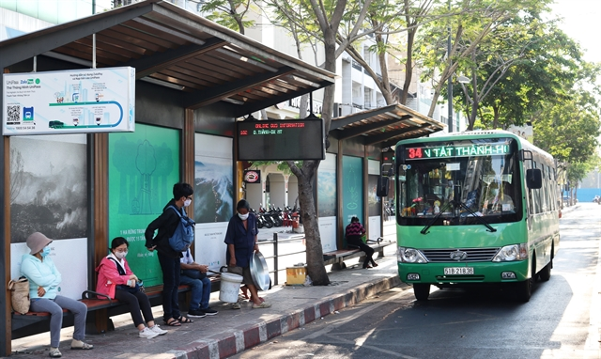
2. What is this?
WARM-UP
BUS STOP

Slide 8
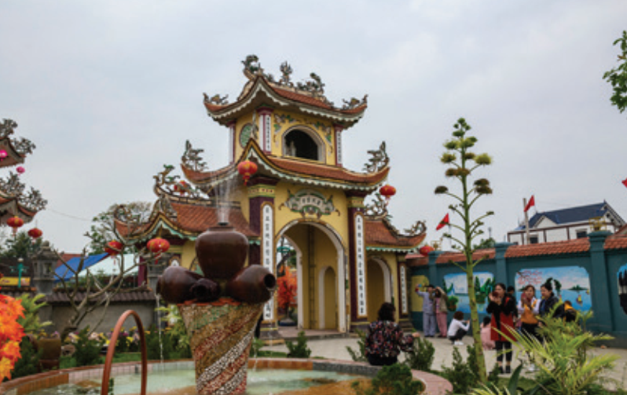
WARM-UP
3. What is this?
TEMPLE

Slide 9
4. _____ is opposite to NOISY.
WARM-UP
PEACEFUL

Slide 10
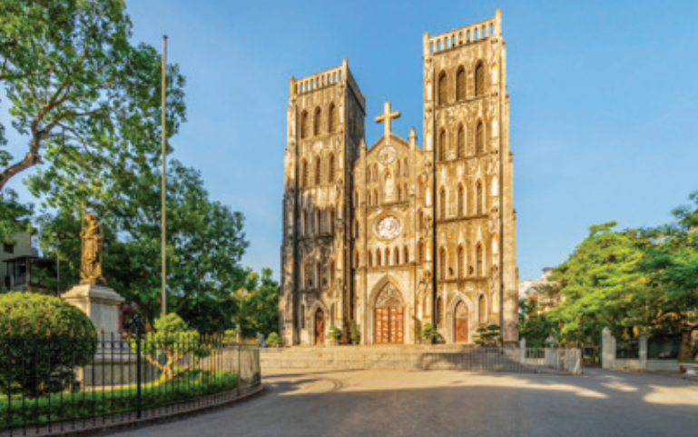
WARM-UP
5. What is this?
CATHEDRAL

Slide 11
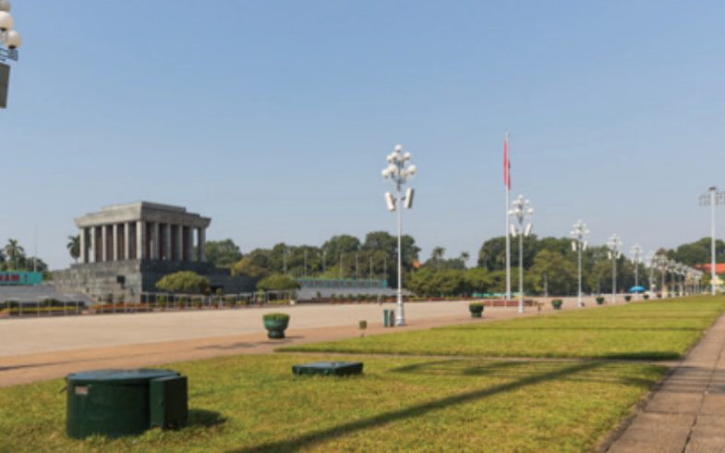
WARM-UP
6. What is this?
SQUARE

Slide 12
WARM-UP
7. The city is crowed. It is ______.
NOISY

Slide 13
WARM-UP
8. ______ is opposite to cheap.
EXPENSIVE

Slide 14
9. I don’t like living in the countryside because it is ______.
WARM-UP
BORING

Slide 15
10. ______ is opposite to traditional.
WARM-UP
MODERN

Slide 16

PRESENTATION
We can use comparative adjectives to compare two people or things.

Slide 17
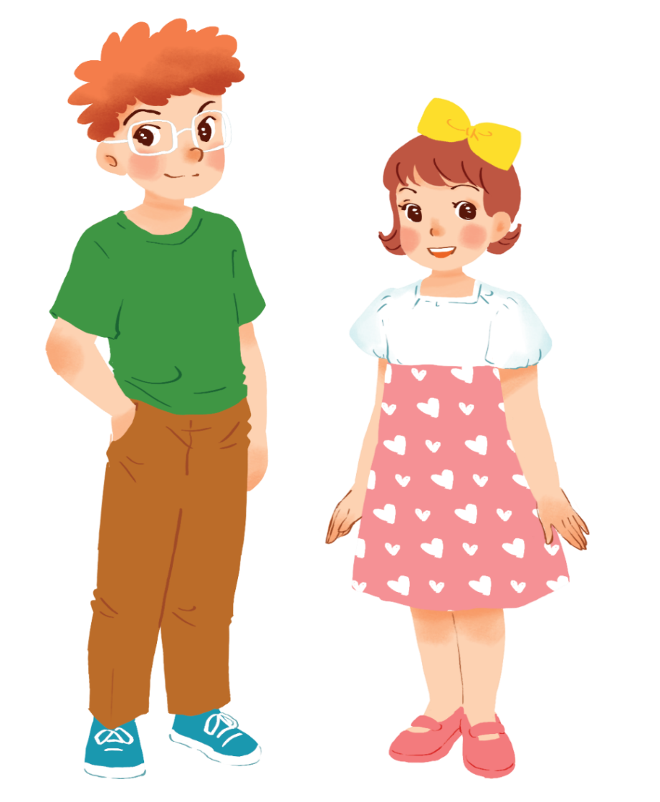
PRESENTATION
Example:
Tom is taller than Mary.

Slide 18
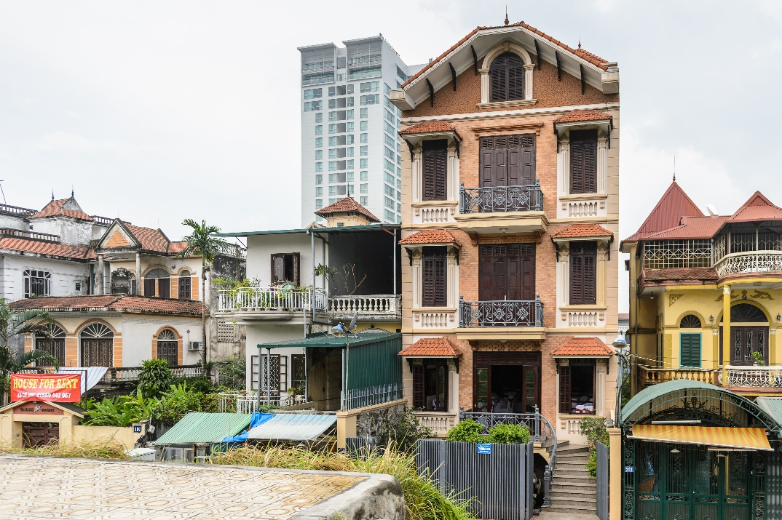
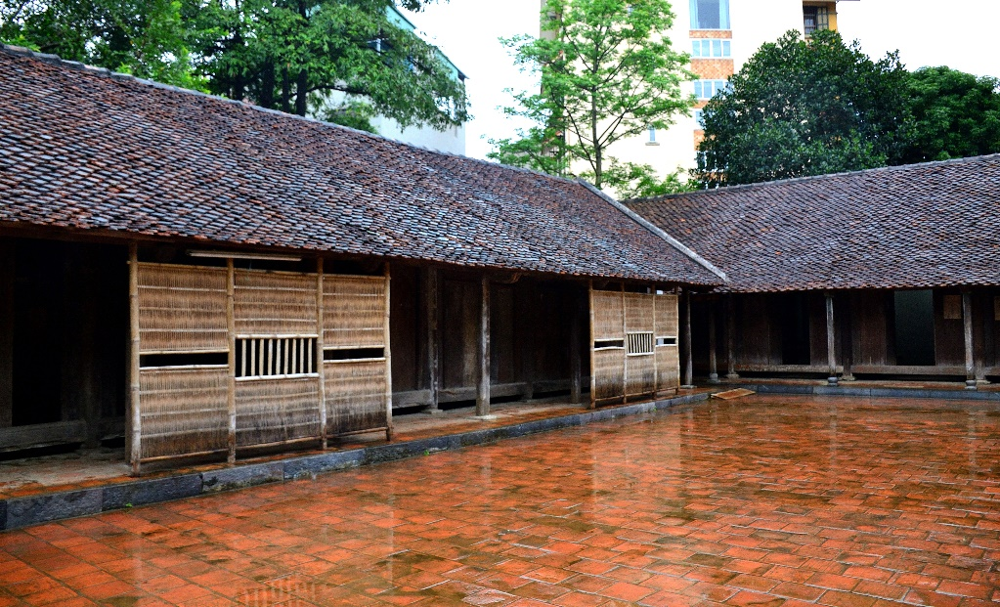
PRESENTATION
Example:
A house in a city is normally more expensive than a house in the countryside.

Slide 19
PRESENTATION
Comparative adjectives
Short adj:
S + be + adj-ER + than + S’.
Long adj:
S + be + MORE + adj + than + S’.

Slide 20
PRESENTATION
* Note:
 | Positive | Comparative | Rule
one syllable | fast | faster | + er
 | large | larger | + r
two syllables | noisy | noisier | y → ier
 | modern | more modern | more + adj
three or more syllables | expensive | more expensive | more + adj

Slide 21
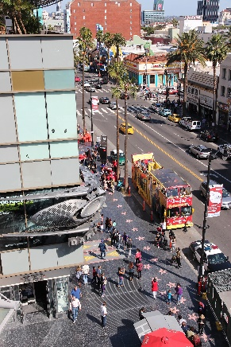
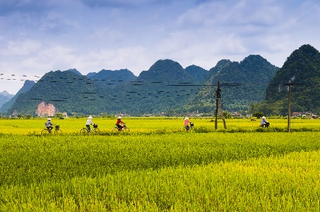
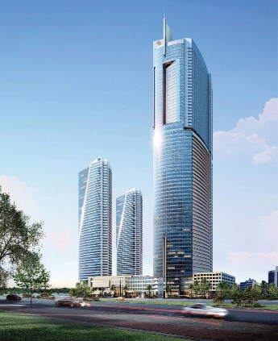
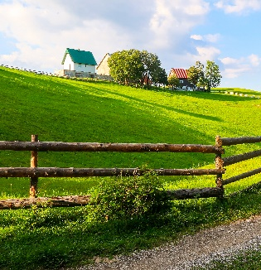
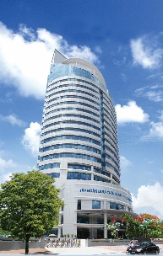
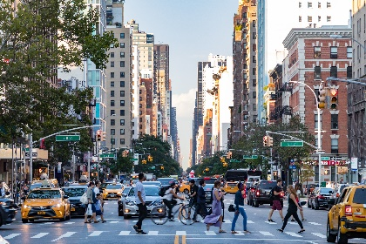
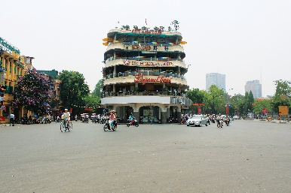
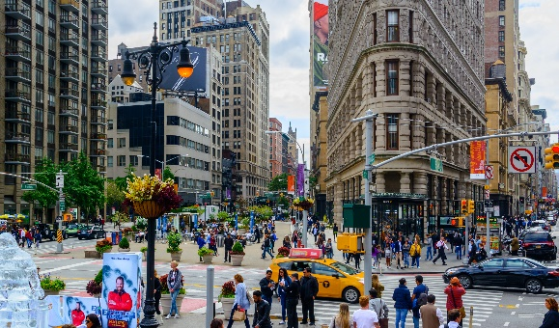
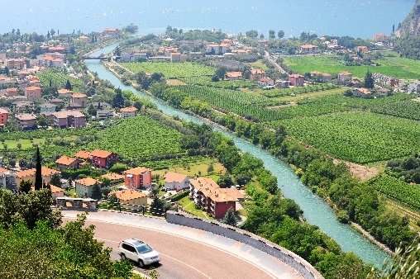
PRACTICE
1
Complete the following sentences with the comparative form of the adjectives in brackets. Number 1 is an example.

Slide 22





Tom
Jerry
40
Lucky Numbers
10
20
30
60
70
80
50
70
10
40
20
30
60
50
1
2
3
4
5
6
7
8

Slide 23
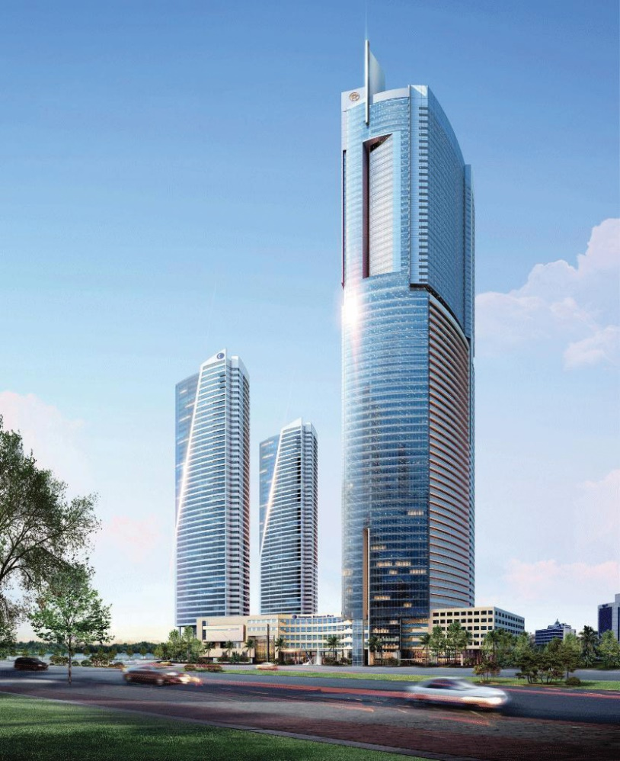

PRACTICE
1.
This building is __________ than that building. (tall)
taller

Slide 24
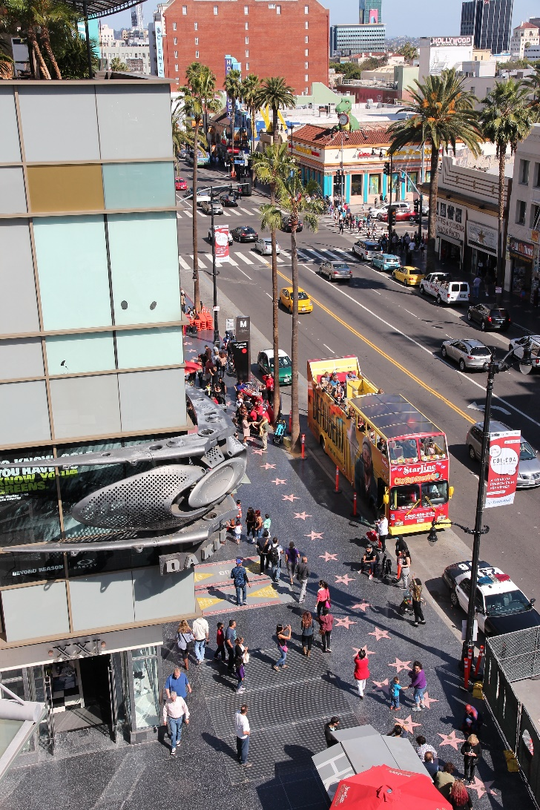

PRACTICE
2.
My neighbourhood is _______ than your neighbourhood. (noisy)
noisier

Slide 25
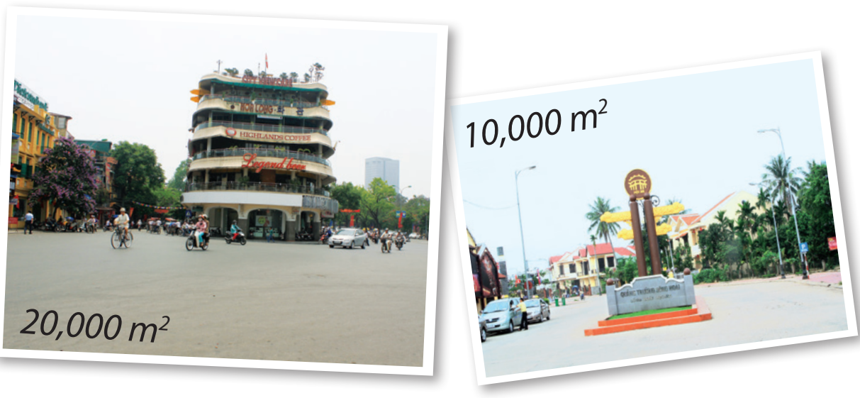
PRACTICE
3.
The square in Ha Noi is _________ than the square in Hoi An. (big)
bigger

Slide 26


PRACTICE
4.
Living in the countryside is _______________ than living in a city. (peaceful)
more peaceful

Slide 27
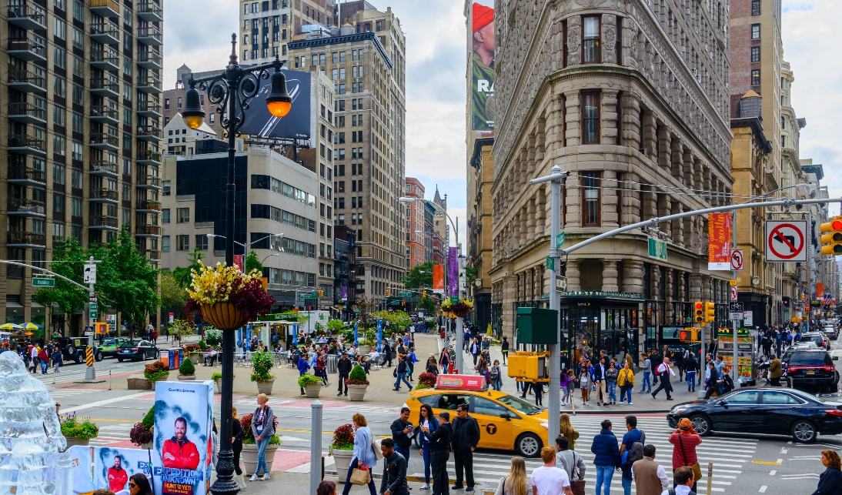

PRACTICE
5.
Is living in a city _______________ than living
in the countryside? (exciting)
more exciting

Slide 28

PRACTICE
LUCKY NUMBER!

Slide 29
PRACTICE
LUCKY NUMBER!

Slide 30
PRACTICE
LUCKY NUMBER!

Slide 31

PRACTICE
2
Use the correct form of the words in brackets to complete the letter.
Dear Nick,
How are you?
Ha Noi is beautiful but it’s too busy for me. I’m having a great time at Cua lo Beach now. The weather is (1. hot) hotter than that in Ha Noi. The houses and buildings are (2. small) _______ and (3. old) _______ than those in Ha Noi.
The streets are (4. wide) _______ with less traffic. the seafood here is (5. delicious) ______________ and (6. cheap) _______ than the seafood in Ha Noi.
See you soon,
Vy
smaller
older
wider
more delicious
cheaper

Slide 32
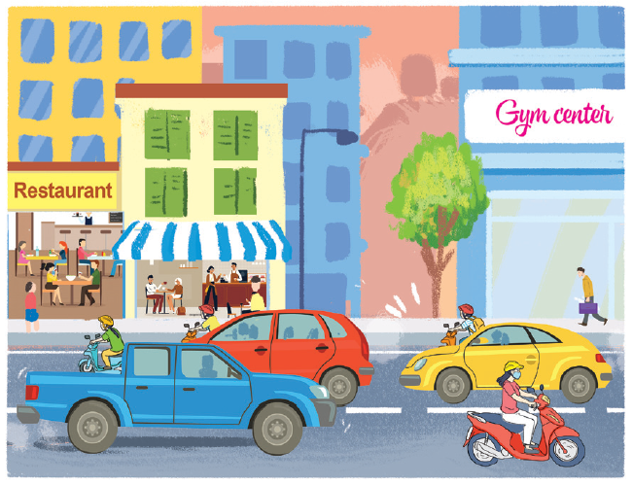
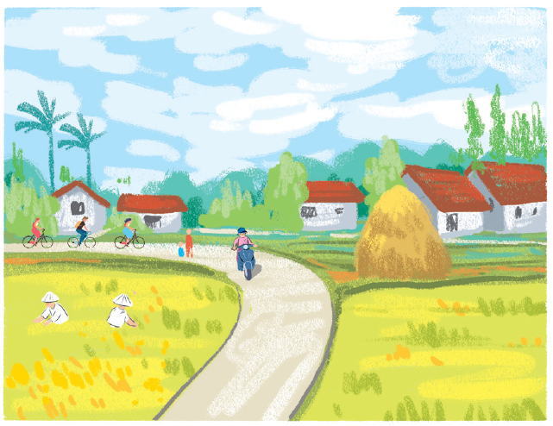
PRACTICE
3
Compare two neighbourhoods.
noisy crowded quiet peaceful modern busy boring
Example:
Binh Minh is noisier than Long Son.
Binh Minh
Long Son

Slide 33
PRODUCTION
4
Work in pairs. Ask and answer questions about Binh Minh and Long Son neighbourhoods using the pictures in 3.
Example:
1. Binh Minh / crowded / Long Son?
2. Long Son / quiet / Binh Minh ?
3. Binh Minh / boring / Long Son?
4. Long Son / busy / Binh Minh?
5. Long Son / peaceful / Binh Minh?
A: Is Binh Minh noisier than Long Son?
B: Yes, it is.
A: Is Long Son more modern than Binh Minh?
B: No, it isn’t.

Slide 34

CONSOLIDATION
1
Wrap-up
What have we learnt in this lesson?
Comparative adjectives

Slide 35

CONSOLIDATION
2
Homework
- Do exercises in the workbook.
- Make sentences to compare people and things in their classroom, using comparative adjectives.

Slide 36






Website: hoclieu.vn
Fanpage: facebook.com/www.tienganhglobalsuccess.vn/

