Slide 1

UNIT 4: INTERNATIONAL ORGANIZATIONS & CHARITIES
Lesson 1.3 – Pronunciation & Speaking
Page 58

Slide 2




Lesson 1.3
LESSON OUTLINE
Consolidation

Slide 3

By the end of this lesson,
students will be able to …
to practice word stress for two-syllable verbs.
to talk about charity.

Slide 4



Slide 5

Work in pairs.
Choose the word whose main stress is placed
differently from the others.
A. sneakers B. bookstore C. money D. delight
2. A. service B. exchange C. shopping D. pudding
3. A. charity B. donation C. provision D. achievement
/ˈsni:kəz/
/ˈbʊkstɔ:r/
/ˈmʌni/
/dɪˈlaɪt/
/ˈsɜ:vɪs/
/ɪksˈtʃeɪndʒ/
/ˈʃɑ:pɪŋ/
/ˈpʊdɪŋ/
/ˈtʃerəti/
/doʊˈneɪʃən/
/prəˈvɪʒən/
/əˈtʃi:vmənt/

Slide 6
Work in pairs.
Choose the word whose underlined part is
pronounced differently from that of the other words.
A. money B. laptop C. promise D. product
2. A. game B. mall C. day D. clay
3. A. phone B. note C. show D. cost
/ˈmʌni/
/ˈlæptɑ:p/
/ˈprɑ:mɪs/
/ˈprɑ:dʌkt/
/ɡeɪm/
/mɑ:l/
/deɪ/
/kleɪ/
/foʊn/
/noʊt/
/ʃoʊ/
/kɑ:st/

Slide 7
Game: two-syllable words
Work in groups. Take turns to call out a two-syllable verb. The winner is the group who can say most words and don’t repeat any words that have been said before.
support
listen
…

Slide 8



Slide 9

Lead-in
Word stress for two-syllable verbs
Most two-syllable verbs have stress on the second syllable.
Listen to the words and focus on the underlined letters.
receive support
Listen and cross out the word that has the wrong word stress.
receive provide supply
Read the words with the correct stress to a partner.

Slide 10
Practice
Ask and answer, using the pictures and prompts.

Slide 11
Practice

Slide 12
Practice
What does the charity do?
It provides free meals.
How are you helping right now?
I am volunteering in the kitchen.

Slide 13
Practice
What does the charity do?
It supports poor students.
How are you helping right now?
I am building a new school.

Slide 14
Practice
What does the charity do?
It supports old people.
How are you helping right now?
I am donating clothes.

Slide 15



Slide 16
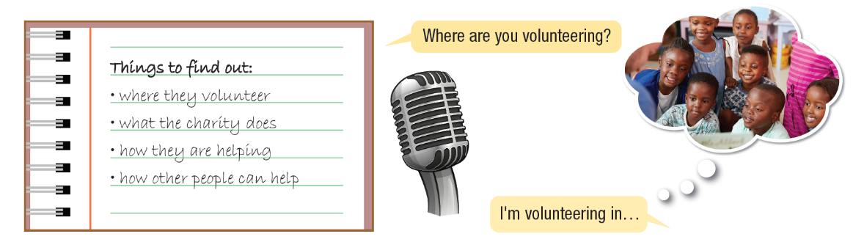
Tell me about your charity
You’re a journalist interviewing a charity volunteer.
Student A, use your notes and interview the volunteer.
Student B, use your own ideas to answer the questions. Swap roles and repeat.

Slide 17
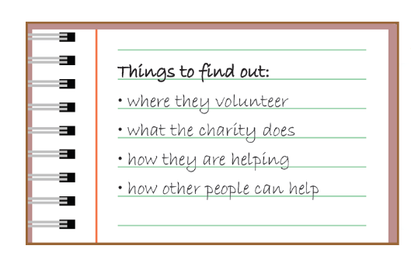
Tell me about your charity.
Where are you volunteering?
I am volunteering in .
What does the charity do?
It …
How are they helping?
They are …
How can other people help?
They can …
b. Now, join another pair and role-play your interview to them.

Slide 18

Consolidation

Slide 19
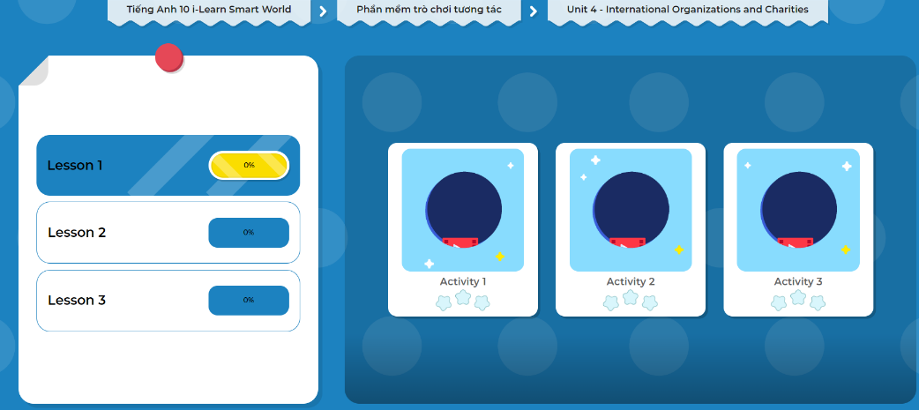
LET’S PLAY!
Click here to play the games.

Slide 20

WRAP-UP

Slide 21
Today’s lesson
Pronunciation: practice stress for two-syllable verbs
Speaking: ask and answer about your charity

Slide 22

Practice word stress for two-syllable verbs.
Find out more examples of two-syllable verbs and practice saying them.
Prepare the next lesson – Lesson 2.1 on page 33 in SB.
Play the consolidation games in Tiếng Anh 10 i-Learn Smart World DHA App on www.eduhome.com.vn

