Slide 1


Slide 2

1
Unit
FAMILY LIFE
REVIEW 1
LESSON 3
SKILL 2_READING AND WRITING

Slide 3

Unit
1
1
FAMILY LIFE
Family Life
Unit
OBJECTIVES
Practice reading for general and specific information about how to live a green life;
practice writing a short paragraph about ways of living green.

Slide 4
LESSON 3
SKILL 1_ READING AND WRITING
Unit
GETTING STARTED
Name the pictures: Traditional music
WARM-UP
Task 1: Read the text below. Then work in pairs to complete the crossword with five words
from the text. (p. 40)
Task 2: Read the text again and give short answers to the following questions. (p. 41)
READING
WRITING
Task 1: Think about ways of living a green lifestyle. Complete the paragraph. Use what you have learnt and the ideas below to help you. (p. 41)
Wrap up
Homework
CONSOLIDATION

Slide 5

LESSON 3
SKILL 1_ READING AND WRITING
Unit
GETTING STARTED
WARM-UP
Name the pictures: Traditional music

Slide 6

LESSON 3
SKILL 1_ READING AND WRITING
Unit
GETTING STARTED
Name the pictures: Traditional music
WARM-UP
Task 1: Read the text below. Then work in pairs to complete the crossword with five words
from the text. (p. 40)
Task 2: Read the text again and give short answers to the following questions. (p. 41)
READING

Slide 7
READING
1
Read the text below. Then work in pairs to complete the crossword with five words from the text. (p. 40)
Collect water to live a green life
Water is essential for life. Therefore, the methods of collecting water are important for meeting its growing need.
The traditional method involves collecting rainwater and storing it for later use. Rainwater is collected from a roof and sent to a container. Collected rainwater is an excellent source of water for people, animals, and plants.
There is also a new method of collecting water. It can turn the tiny drops of water in the air into drinking water. Air-to-water technology creates water from air and releases it all the time. It uses the sun’s energy and works well even in dry conditions.
In general, collecting rainwater or creating water from air will allow people to save natural resources, improve the environment, and live a green life.

Slide 8
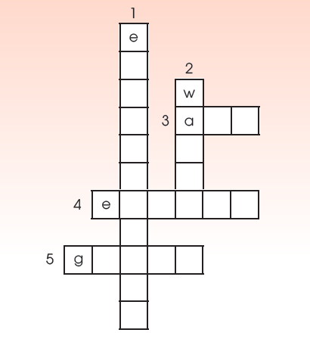
READING
1
Read the text below. Then work in pairs to complete the crossword with five words from the text. (p. 40)
ACROSS
3. the mixture of gases surrounding the earth that we breathe
4. a source of power that can be used to provide light and heat, or drive machines
5. a way of living that is good for the environment
DOWN
1. the natural world in which people, animals, and plants live
2. a liquid without colour or smell that falls as rain and is used for drinking, washing, etc.
Answer key:
1. environment
4. energy
2. water
5. green
3. air

Slide 9
READING
2
Read the text again and give short answers to the following questions. (p. 41)
1. What's important for meeting the growing need for water?
2. What's the traditional method of collecting rainwater?
3. What's the new method of creating water?
The methods of collecting water (are).
Rainwater is collected from a roof and sent to a container.
Tiny drops of water are turned into drinking water.

Slide 10
LESSON 3
SKILL 1_ READING AND WRITING
Unit
GETTING STARTED
Name the pictures: Traditional music
WARM-UP
Task 1: Read the text below. Then work in pairs to complete the crossword with five words
from the text. (p. 40)
Task 2: Read the text again and give short answers to the following questions. (p. 41)
READING
WRITING
Task 1: Think about ways of living a green lifestyle. Complete the paragraph. Use what you have learnt and the ideas below to help you. (p. 41)

Slide 11
WRITING
1
Think about ways of living a green lifestyle. Complete the paragraph. Use what you have learnt and the ideas below to help you. (p. 41)
There are many ways you can make your life greener.
________________________________________________________________________________________________
________________________________________________________________________________________________
Living a green lifestyle is not difficult, but these small
changes will make a big difference.
Living green
- Planting more trees and plants
- Organising regular clean-up
activities
- Collecting litter, setting up
more recycling bins
- Turning off electrical devices
when not in use
- Using energy from the sun,
wind, and water

Slide 12
WRITING
1
Think about ways of living a green lifestyle. Complete the paragraph. Use what you have learnt and the ideas below to help you. (p. 41)
Sample answer:
There are many ways you can make your life greener. First, make your area green by planting more trees and plants. Second, make your area clean by organising regular clean-up activities, collecting litter and setting up more recycling bins. Finally, turn off electrical devices when not in use and use energy from the sun, wind and water. Living a green lifestyle is not difficult, but these small changes will make a big difference.

Slide 13
LESSON 3
SKILL 1_ READING AND WRITING
Unit
GETTING STARTED
Name the pictures: Traditional music
WARM-UP
Task 1: Read the text below. Then work in pairs to complete the crossword with five words
from the text. (p. 40)
Task 2: Read the text again and give short answers to the following questions. (p. 41)
READING
WRITING
Task 1: Think about ways of living a green lifestyle. Complete the paragraph. Use what you have learnt and the ideas below to help you. (p. 41)
Wrap up
Homework
CONSOLIDATION

Slide 14
CONSOLIDATION
1
Wrap-up
Practice reading for general and specific information about how to live a green life;
practice writing a short paragraph about ways of living green.

Slide 15
CONSOLIDATION
2
Homework
Prepare for Unit 4_ Getting started

Slide 16


