Slide 2
Unit 4
urbanization
GETTING STARTED
Urban Development

Slide 3
LESSON I
GETTING STARTED
WARM-UP
Game: Lucky Wheel
PRESENTATION
Vocabulary
Task 1: Listen and read.
Task 2: True or False.
Task 3: Match each word with its definition.
Task 4: Complete the sentences.
PRACTICE
PRODUCTION
Role play
CONSOLIDATION
Wrap-up
Homework

Slide 4
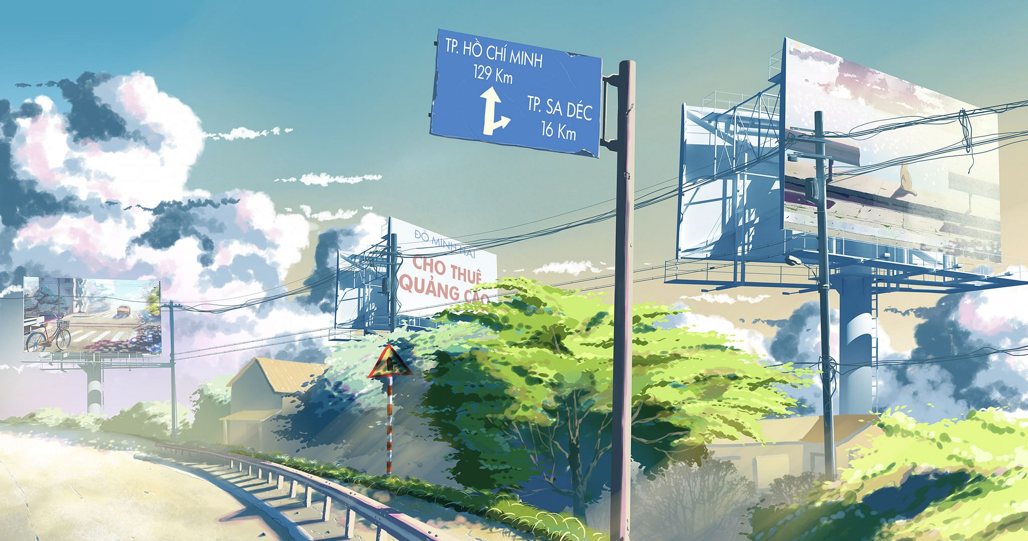
WARM-UP
WARM-UP
Lucky Wheel
Work in 4 groups.
Answer the question to get a bonus.
The team has the most correct answers is the winner.

Slide 5





WARM-UP
1
2
3
8
9
10
10
4
5
6
10
10
7
8
9
9
8
TURN

Slide 6







WARM-UP
An area of land where waste materials are buried under the surface
BACK
A. landfill (n)
B. packaging (n)
C. container (n)
D. reuse (v)

Slide 7


WARM-UP
Something such as a box or bowl that you can use to keep things in
BACK
A. packaging (n)
B. container (n)
C. reuse (v)
D. landfill (n)

Slide 8

WARM-UP
To use something again
BACK
A. reuse (v)
B. landfill (n)
C. container (n)
D. waste (n)

Slide 9
WARM-UP
The act of using something in a careless way, causing it to be lost or destroyed
BACK
A. pollution
B. packaging (n)
C. waste (n)
D. container (n)

Slide 10
WARM-UP
Materials used to wrap or protect things
we buy from shops
BACK
A. container (n)
B. packaging (n)
C. reuse (v)
D. landfill (n)

Slide 11
WARM-UP
Many people have now started to care _________ the environment
BACK
A. in
B. about
C. at
D. of

Slide 12
WARM-UP
We should work _________ some solutions
to reduce plastic pollution.
BACK
A. for
B. on
C. out
D. with

Slide 13


WARM-UP
The future of our planet depends _________ how we deal with climate change.
BACK
A. on
B. from
C. in
D. with

Slide 14
WARM-UP
My sister is responsible for looking _________ the plants at home.
BACK
A. up
B. after
C. for
D. with

Slide 15
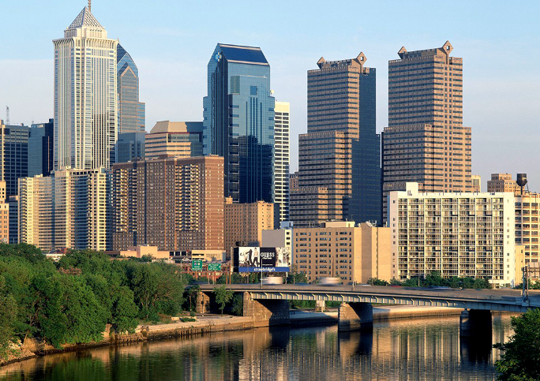
VOCABULARY
urban (adj)
/ˈɜː.bən/
of or in a city or town

Slide 16
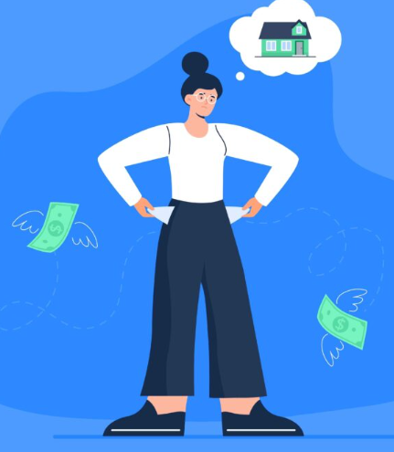
VOCABULARY
afford (v)
/əˈfɔːd/
to be able to buy or do something because you have enough money or time

Slide 17
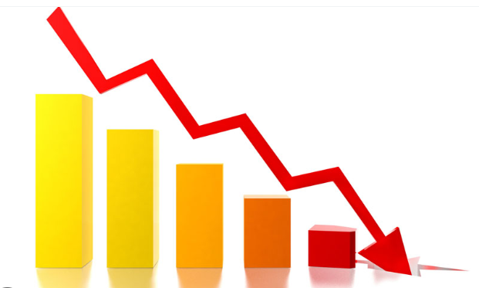
VOCABULARY
decrease (v)
/ˈdiː.kriːs/
to become less, or to make something become less

Slide 18

VOCABULARY
expand (v)
/ɪkˈspænd/
to increase in size, number, or importance, or to make something increase in this way

Slide 19

VOCABULARY
housing (n)
/ˈhaʊ.zɪŋ/
buildings for people to live in

Slide 20

VOCABULARY
leisure (n)
/ˈleʒ.ər/
the time when you are not working or doing other duties

Slide 21
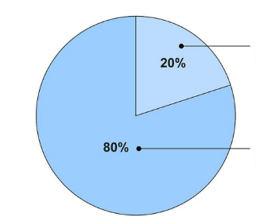
VOCABULARY
proportion (n)
/prəˈpɔː.ʃən/
the number or amount of a group or part of something when compared to the whole

Slide 22

VOCABULARY
rapidly (v)
/ˈræpɪdli/
very quickly; at a great rate

Slide 23

VOCABULARY
reliable (adj)
/rɪˈlaɪ.ə.bəl/
Someone or something that is reliable can be trusted or believed because he, she, or it works or behaves well in the way you expect

Slide 24
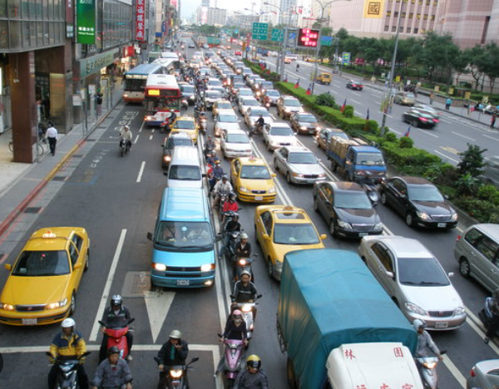
VOCABULARY
rush hour
ˈrəSH ˌou(ə)r
the busy part of the day when towns and cities are crowded, either in the morning when people are travelling to work, or in the evening when people are travelling home

Slide 25

VOCABULARY
seek (v)
/siːk/
to try to find or get something,
especially something that is not a physical object

Slide 26
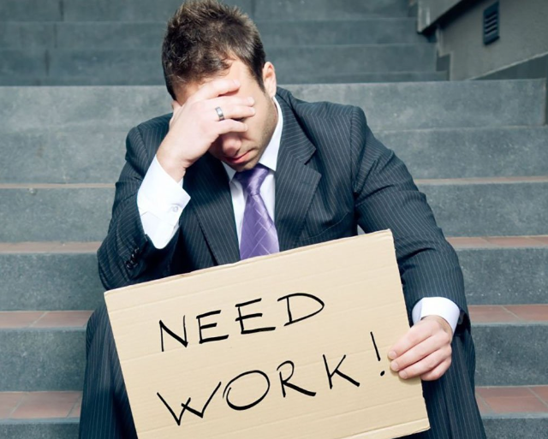
VOCABULARY
unemployment (n)
/ˌʌn.ɪmˈplɔɪ.mənt/
the number of people who do not have a job that provides money

Slide 27
VOCABULARY
New words | Pronunciation | Meaning
afford (v) | /əˈfɔːd/ | to be able to buy or do something because you have enough money or time
colonial (adj) | /kəˈləʊniəl/ | relating to a colony or colonialism
concern (n) | /kənˈsɜːn/ | a worried or nervous feeling about something, or something that makes you feel worried
decrease (v) | /ˈdiː.kriːs/ | to become less, or to make something become less

Slide 28
VOCABULARY
New words | Pronunciation | Meaning
expand (v) | /ɪkˈspænd/ | to increase in size, number, or importance, or to make something increase in this way
gradually (adv) | /ˈɡrædʒ.u.ə.li/ | slowly over a period of time or a distance
housing (n) | /ˈhaʊ.zɪŋ/ | buildings for people to live in
leisure (n) | /ˈleʒ.ər/ | the time when you are not working or doing other duties

Slide 29
VOCABULARY
New words | Pronunciation | Meaning
proportion (n) | /prəˈpɔː.ʃən/ | the number or amount of a group or part of something when compared to the whole
rapidly (v) | /ˈræpɪdli/ | very quickly; at a great rate
reliable (adj) | /rɪˈlaɪ.ə.bəl/ | Someone or something that is reliable can be trusted or believed because he, she, or it works or behaves well in the way you expect
resident (n) | /ˈrez.ɪ.dənt/ | a person who lives or has their home in a place

Slide 30
VOCABULARY
New words | Pronunciation | Meaning
rush hour | /ˈrʌʃˌou(ə)r/ | the busy part of the day when towns and cities are crowded, either in the morning when people are travelling to work, or in the evening when people are travelling home
seek (v) | /siːk/ | to try to find or get something, especially something that is not a physical object
unemployment (n) | /ˌʌn.ɪmˈplɔɪ.mənt/ | the number of people who do not have a job that provides money

Slide 31

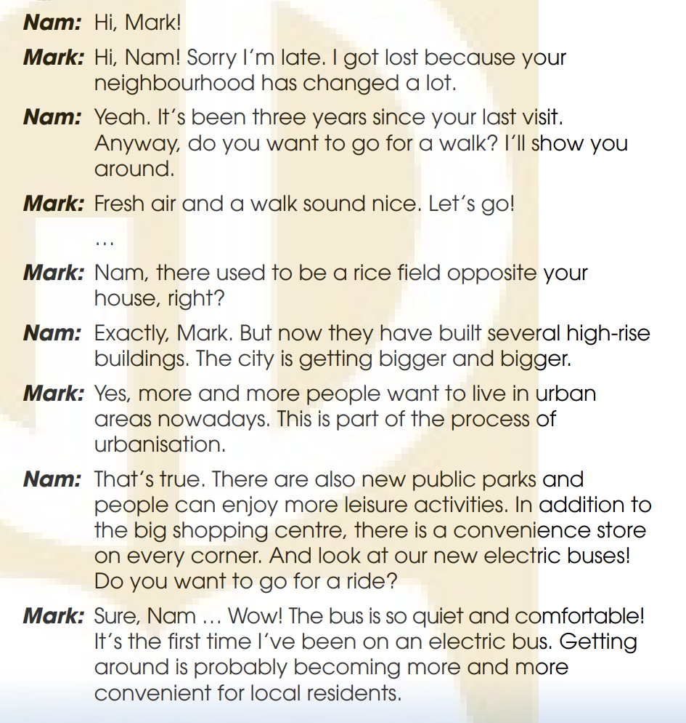
PRACTICE
1
Listen and read.

Slide 32
PRACTICE
2
Nam: Hi, Mark!
Mark: Hi, Nam! Sorry, I’m late. I got lost because your neighborhood has changed a lot.
Nam: Yeah. It’s been three years since your last visit.
Anyway, do you want to go for a walk? I’ll show you
around.
Mark: Fresh air and a walk sound nice. Let’s go!
…
Mark: Nam, there used to be a rice field opposite your
house, right?
Nam: Exactly, Mark. But now they have built several high-rise
buildings. The city is getting bigger and bigger
True or False.
 | T | F
1. The last time Mark visited Nam’s place was three years ago.
2. There used to be a park opposite Nam’s house.
✓
✓
There used to be a rice field

Slide 33
PRACTICE
Nam: That’s true. There are also new public parks and
people can enjoy more leisure activities. In addition to
the big shopping centre, there is a convenience store
on every corner. And look at our new electric buses!
Do you want to go for a ride?
Mark: Sure, Nam … Wow! The bus is so quiet and comfortable!
It’s the first time I’ve been on an electric bus. Getting
around is probably becoming more and more
convenient for local residents.
Nam: Not really. The more crowded the area becomes, the worse traffic jams get, especially during rush hour. The cost of living is also going up. These are the changes that I don’t like.
Mark: That’s true, Nam. I guess urbanization
can also cause problems.
2
True or False.
 | T | F
3. There aren’t any new leisure or shopping facilities in Nam’s neighbourhood
4. Traffic jams and rising cost of living are the two problems that Nam mentioned
✓
There are also new public parks and a convenience store
✓

Slide 34
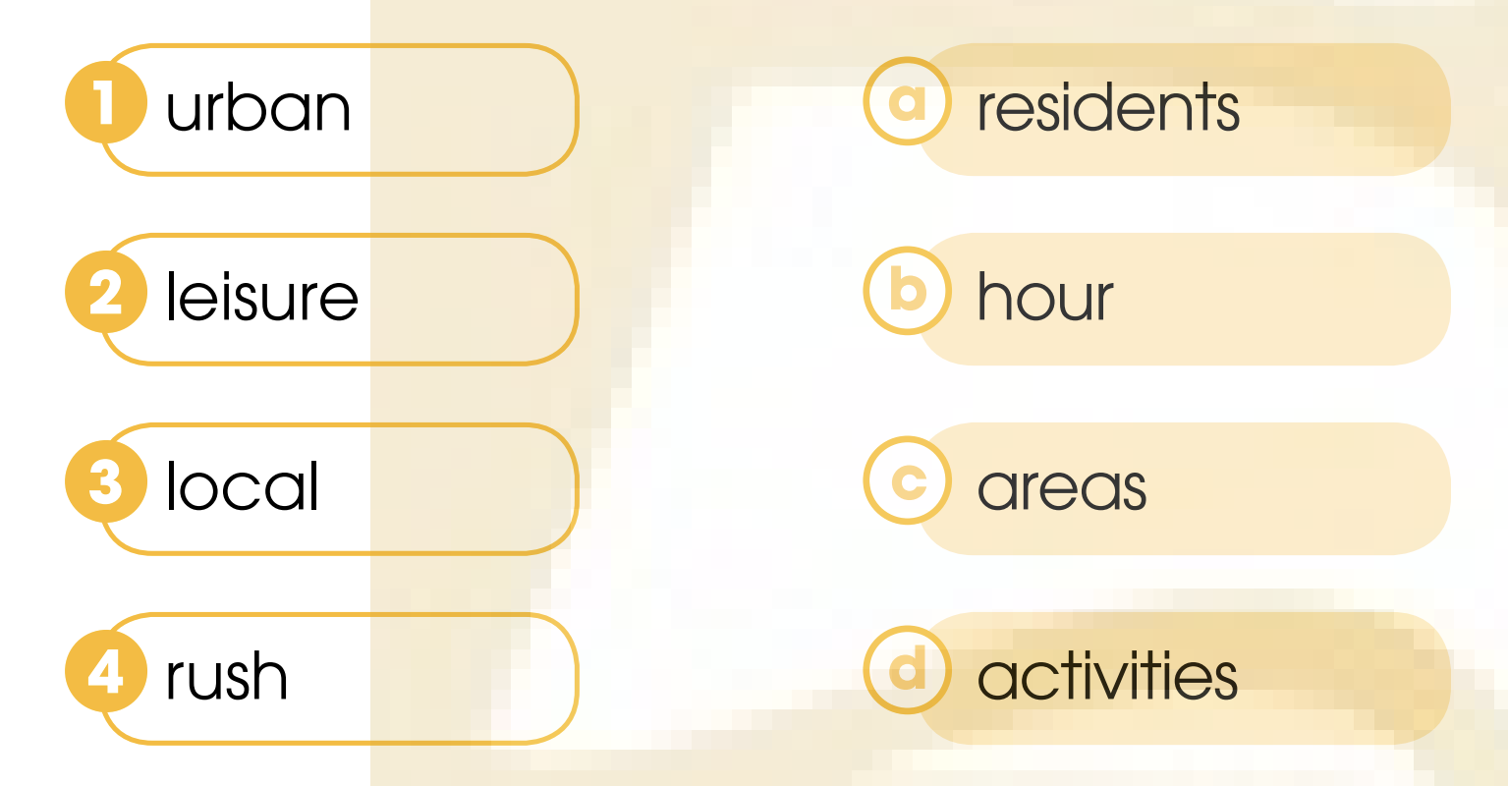
PRACTICE
3
Match the words to make phrases mentioned in 1.

Slide 35


PRACTICE
4
Complete the sentences using words and a phrase from 1.
Nam: Exactly, Mark. But now they have built several high-rise buildings.
The city is getting bigger and bigger.
They ________ several
high-rise buildings opposite Nam’s house.
have built
2. The city where Nam lives is getting ________________ .
bigger and bigger

Slide 36

PRACTICE
4
Complete the sentences using words and a phrase from 1.
Mark: Sure, Nam … Wow! The bus is so quiet and comfortable! It’s the first time I’ve been on an electric bus. Getting around is probably becoming more and more convenient for local residents.
Nam: Not really. The more crowded the
area becomes, the worse traffic jams
get, especially during rush hour. The
cost of living is also going up. These
are the changes that I don’t like.
It’s the first time
3. _______________Mark has been on an electric bus
The more
4. ________ crowded the area becomes, ________ traffic jams get.
the worse

Slide 37
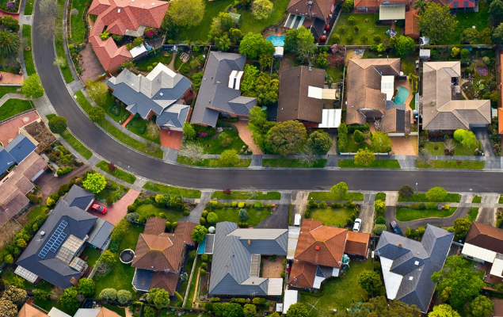


PRODUCTION
Role-play
Work in pairs.
Student A has just returned to the neighborhood. You don’t know much about the area because everything has changed. You ask for more information about the town.
Student B poses as a local to introduce the neighborhood.
5 minutes to prepare for the role play.
3 minutes for each performance.

Slide 38
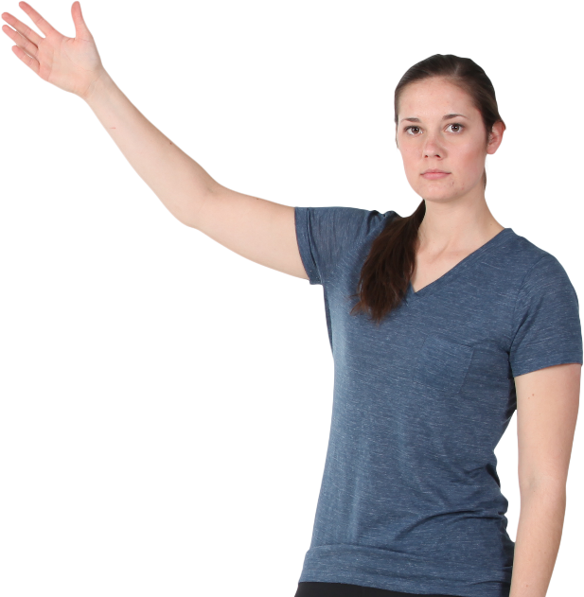


Role-play
PRODUCTION
Excuse me! Could you help me? I got lost because the neighbourhood has changed a lot.
What can I do for you?
Can you show me the way to the nearest bus stop? It used to be here three years ago, but I can’t find it now.
It was relocated to the corner of Cach Mang Thang Tam street and Bac Hai street last year. That place is now a busy street. Things has changed rapidly.
I guess this is part of the process of urbanisation. Thank you. You are so reliable.
You’re welcome!

Slide 39

CONSOLIDATION
1
Wrap-up
What have you learnt today?
More knowledge about Urban Development
Reading for specific information

Slide 40
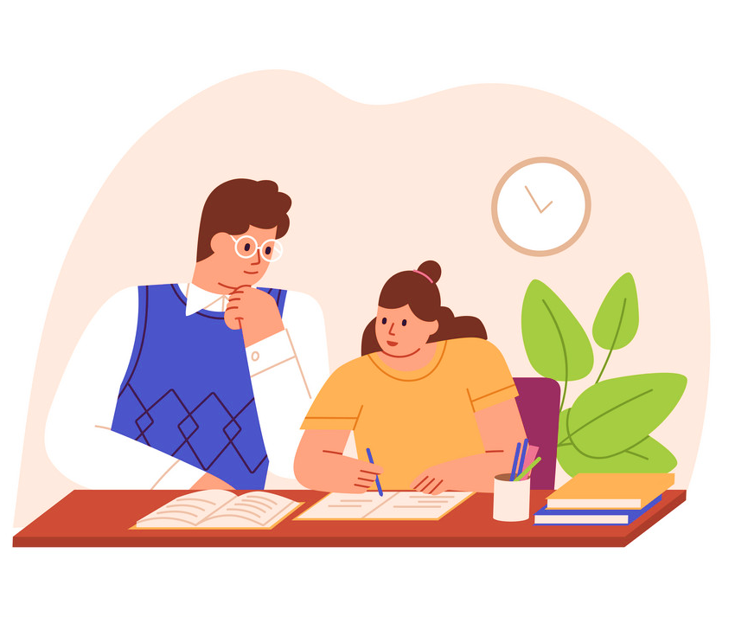
CONSOLIDATION
2
Homework
Learn by heart new vocabulary.
Do exercises in the workbook.
Prepare for Lesson 2 - Unit 4.
Prepare for the Project (Lesson 8).

Slide 41
Website: hoclieu.vn
Fanpage: facebook.com/www.tienganhglobalsuccess.vn

