Slide 1

Unit 5: Travel & Transportation
Lesson 5c: Vocabulary
Page 84

Slide 2
Lesson Outline
Warm-up
Vocabulary
Listening
Wrap-up

Slide 3
Objectives
By the end of this lesson, students will be able to…
- learn and talk about travel and transport: ambulance, cruise ship, express train, fire engine, tram, truck, underground train.
- listen for details.

Slide 4

WARM-UP

Slide 5

Work in pairs.
Choose the word whose main stress is placed
differently from the others. Practise saying them.
1. A. canoe B. landmark C. building D. river
2. A. photographer B. helicopter C. environment D. ingredient
3. A. village B. uncle C. airport D. police
/kəˈnuː/
/ˈlændmɑːk/
/ˈbɪldɪŋ/
/ˈrɪvər/
/fəˈtɒɡrəfər/
/ˈhelɪkɒptər/
/ɪnˈvaɪrənmənt/
/ɪnˈɡriːdiənt/
/ˈvɪlɪdʒ/
/ˈʌŋkl/
/ˈeəpɔːt/
/pəˈliːs/

Slide 6
Work in pairs.
Please find at least 5 kinds of transport:
e.g. car, motorbike, bicycle, airplane, ship

Slide 7

It’s time to learn …

Slide 8
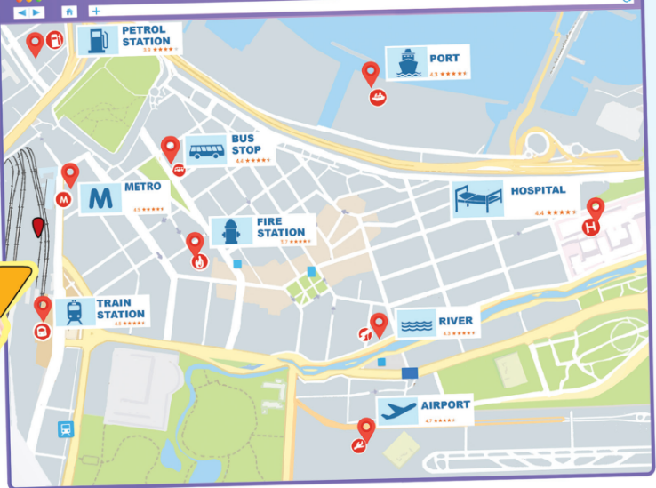
You can see the map on the Internet. I can see a petrol station, a hospital, a port, a bus stop, a metro, a fire station, a river, an airport and a train station.

Slide 9
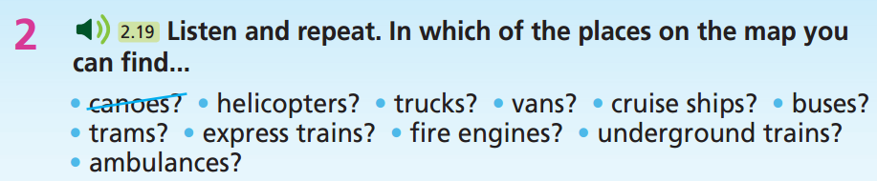

e.g.
We can find canoes on a river.
We can find helicopters at an airport.
We can find trucks and vans at a petrol station.
We can find cruise ships at a port.
We can find buses and trams at a bus stop.
We can find express trains at a train station.
We can find fire engines at a fire station.
We can find underground trains at a metro.
We can find ambulances at a hospital.

Slide 10
Vocabulary
Listen and repeat.
ambulance /ˈæmbjələns/ (n) xe cứu thương
cruise ship /’kruːz ʃɪp/ (n) du thuyền
express train /ɪkˈspres treɪn/ (n) tàu siêu tốc
fire engine /ˈfaɪər endʒɪn/ (n) xe cứu hỏa
tram /træm/ (n) xe điện
truck /trʌk/ (n) xe tải lớn
underground train /ˌʌndəˈɡraʊnd ‘treɪn/ (n. phr) tàu điện ngầm

Slide 11
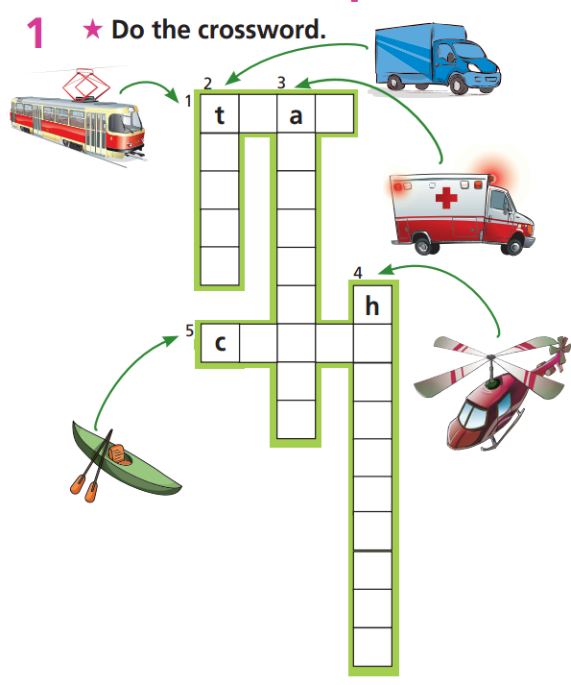
Extra Practice
WB page 44
r
m
r
m
u
b
c
u
k
l
a
a
n
o
e
c
l
e
i
c
o
p
t
e
r

Slide 12
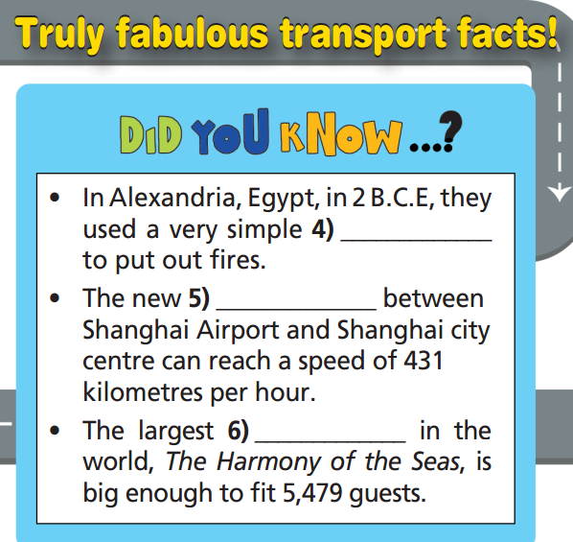
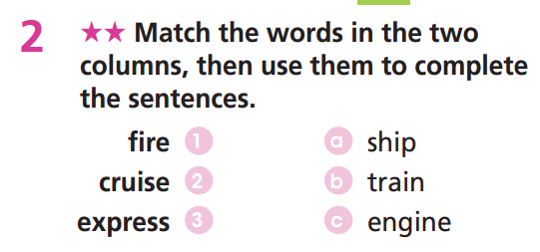
Extra Practice
WB page 44
fire engine
express train
cruise ship

Slide 13
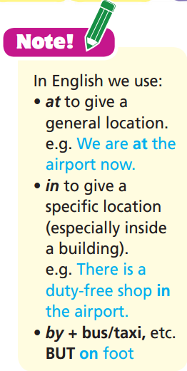

Slide 14
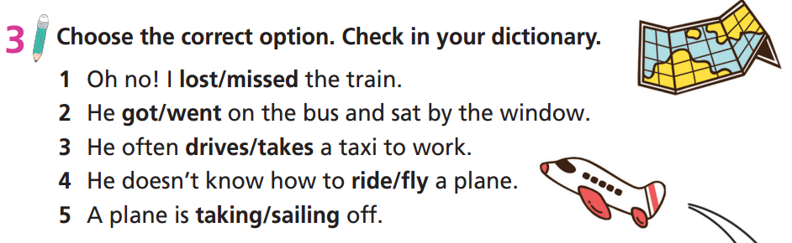

Slide 15

Listening

Slide 16
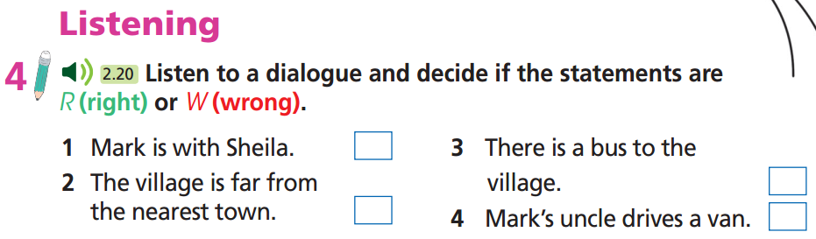

Slide 17
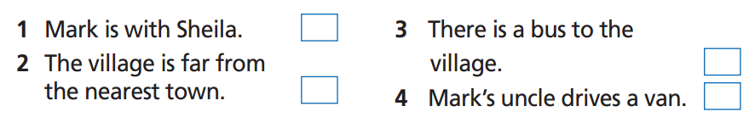
Pre-Listening
Read the instruction quickly. Underline the key words. What are we going to do?
Listen and decide if the statements are R (right) or W (wrong).
Listen to a dialogue and decide if the statements are R (right) or W (wrong).

Slide 18


While-Listening
Now listen and choose the correct answer.  FIRST TIME
☞ YOUR ANSWER?
☞ WHY?

Slide 19

Now listen again and check.  SECOND TIME
Sheila: Hi, Mark! Where are you now?
Mark: Hi, Sheila! I’m in a little village in the mountains. It’s miles from the nearest town. I’m surprised I can receive phone calls at all!

Slide 20

Now listen again and check.  SECOND TIME
Mark: Hi, Sheila! I’m in a little village in the mountains. It’s miles from the nearest town. I’m surprised I can receive phone calls at all!

Slide 21

Now listen again and check.  SECOND TIME
Sheila: Well, how did you get there? Is there a train station?
Mark: No, I didn’t come by train.
Sheila: Did you take the bus, then?
Mark: No – buses don’t come up here. The road is too narrow and steep.

Slide 22

Now listen again and check.  SECOND TIME
Mark: My uncle and aunt live here. That’s how I got here – my uncle gave me a lift in his van. It’s a really beautiful village, but you’re right – it’s not easy to get to!

Slide 23
Extra Practice
Listen again and answer the following questions:
Where is Mark?
Why couldn’t the bus get there?
How could Mark get there?
How did he feel about the village?

Slide 24
Read the instruction and questions quickly. Underline the key words. What are we going to do?
Listen again and answer the following questions:
Where is Mark?
Why couldn’t the bus get there?
How could Mark get there?
How did he feel about the village?

Slide 25
☞ YOUR ANSWER?
Listen again and answer the following questions:
Where is Mark?
=> In a village.
2. Why couldn’t the bus get there?
=> Because the road is too narrow and steep.
3. How could Mark get there?
=> In a van.
4. How did he feel about the village?
=> It’s really beautiful.

Slide 26
Now listen again and check.
Mark: Hi, Sheila! I’m in a little village in the mountains. It’s miles from the nearest town. I’m surprised I can receive phone calls at all!
Where is Mark?
=> In a village.

Slide 27
Now listen again and check.
Sheila: Did you take the bus, then?
Mark: No – buses don’t come up here. The road is too narrow and steep.
2. Why couldn’t the bus get there?
=> Because the road is too narrow and steep.

Slide 28
Now listen again and check.
Mark: My uncle and aunt live here. That’s how I got here – my uncle gave me a lift in his van. It’s a really beautiful village, but you’re right – it’s not easy to get to!
3. How could Mark get there?
=> In a van.
4. How did he feel about the village?
=> It’s really beautiful.

Slide 29
Audio Scripts
Practise the dialogue in pairs.
Sheila: Hi, Mark! Where are you now?
Mark: Hi, Sheila! I’m in a little village in the mountains. It’s miles from the nearest town. I’m surprised I can receive phone calls at all!
Sheila: Well, how did you get there? Is there a train station?
Mark: No, I didn’t come by train.
Sheila: Did you take the bus, then?
Mark: No – buses don’t come up here. The road is too narrow and steep.
Sheila: Really? What are you doing there, Mark? It sounds like the middle of nowhere!
Mark: My uncle and aunt live here. That’s how I got here – my uncle gave me a lift in his van. It’s a really beautiful village, but you’re right – it’s not easy to get to!

Slide 30

Post-Listening
Work in pairs
Ask and answer about the kind of transportation your friend used on the last holiday.
No, I didn’t go by bus. I travelled by plane because it was much faster.
Did you travel by bus on your holiday?

Slide 31

CONSOLIDATION

Slide 32
Write at least 4 sentences about the kinds of transportation you often use for:
- Going to school - Going out with friends
- Going out with family - Travelling with family
….
Remember to explain why you choose that kind of transportation.
e.g.
I often walk to school because it is very near my house. Because I am still young, I cannot ride a motorbike. So, I often go out with friends by bus, or my father will give me a lift on his motorbike. I usually travel with my family by plane or by train because they are more convenient.

Slide 33

WRAP-UP

Slide 34
Today’s lesson
Vocabulary
ambulance
cruise ship
express train
fire engine
tram
truck
underground train
Listening
Listen for details

Slide 35
Homework
Practise the vocabularies and make sentences using them.
Do the exercises in TA 7 Right on WB (page 44)
Prepare the next lesson (page 85 SB)
Do the exercise in TA 7 Right on Notebook (page 39)

Slide 36

Enjoy your day!

