Slide 1
Time allowed - 8-10 minutes
Normally you will do the speaking test with another candidate. The two of you will meet two examiners. One of the examiners will talk to you, the other does not particpate in the conversations.
There are two parts to the speaking test:
Speaking part 1: short questions and answers between you and the examiner
Speaking part 2: the examiner gives you some information or a card with some ideas for questions. You have to talk with the other candidate and ask or answer questions.
How to prepare for KET Speaking
Speak as much as you can, with your friends
Practise asking and asnwering questions about daily life
Practise giving information about yourself

Slide 2
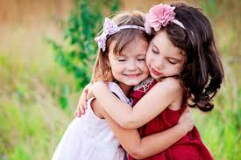
Part 1: Tell about best friend

Slide 3

Brain storm
What is his/her name?
How long have you known each other?
What is he/she look like?
what are his/her characters?
what do you usually do together?

Slide 4
Grammar
How long have you known …?
We’ ve known … + since + (mốc tg)
+ for + (khoảng tg)
Eg: since 2010, since last summer,…
for about 5 years, for 4 months …

Slide 5
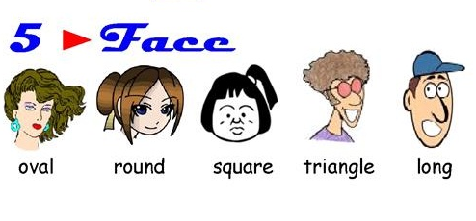
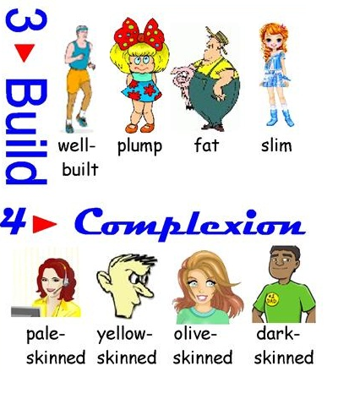
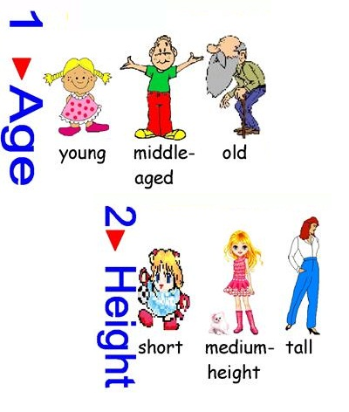
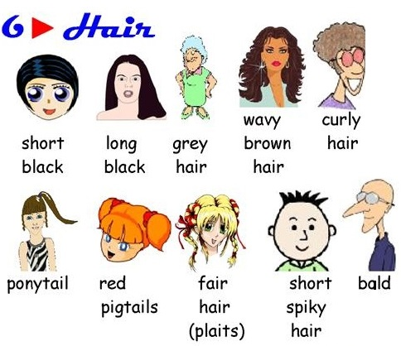
Useful vocabulary: appearance

Slide 6
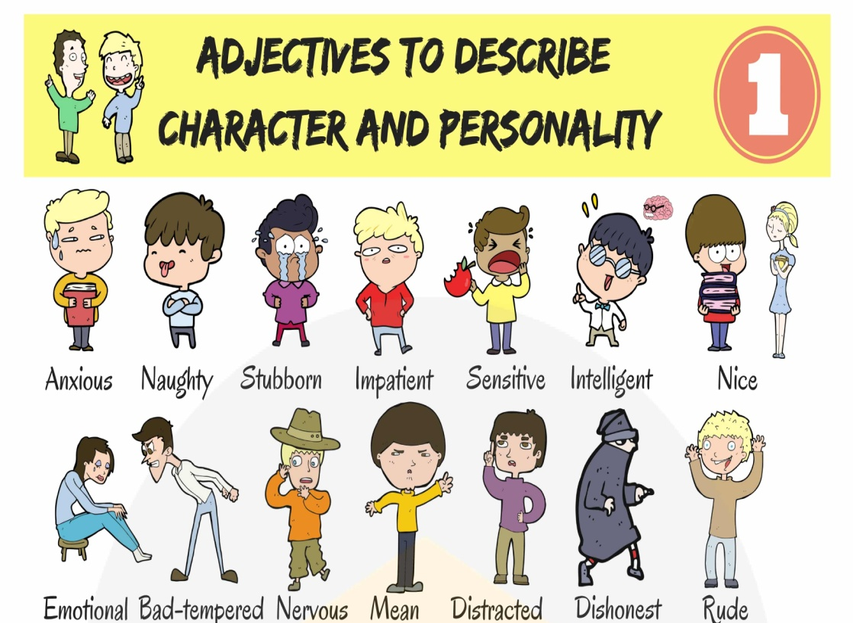

Useful vocabulary: characters

Slide 7
My best friend is …..
He/she is …..

Slide 8

What do you do with your bff?
bff = best friend forever

Slide 9


Slide 10
And now, tell about best friend
(3-4mins)

Slide 11
Speaking part 2:
Asking and answering questions using these prompt cards

Slide 12
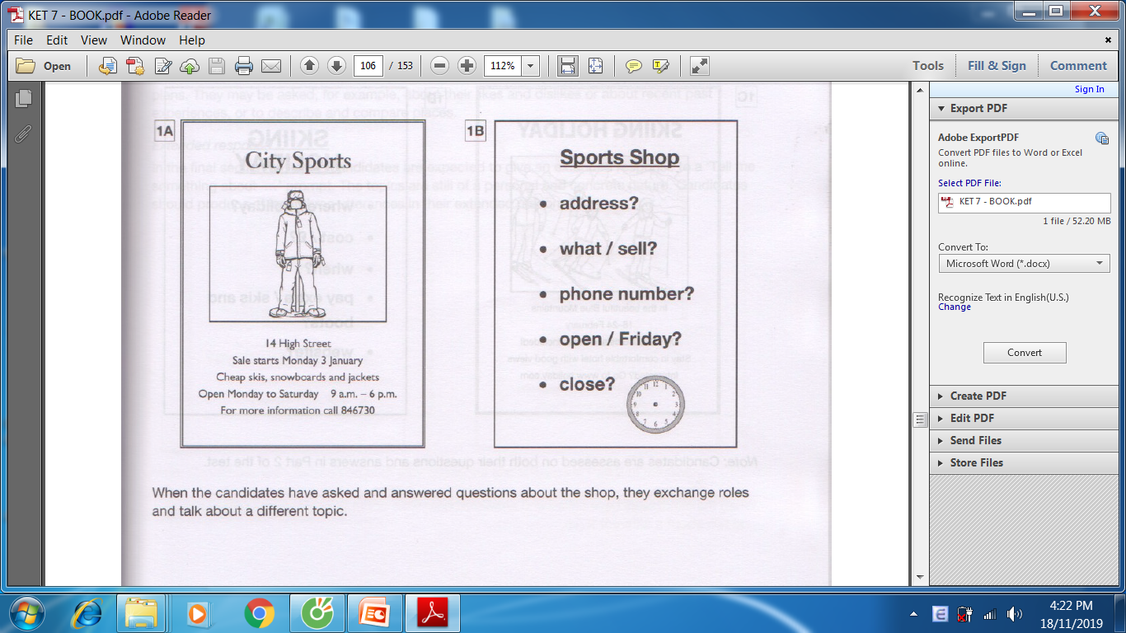
Ask and answer questions using the words given.
What are other questions and answers you can think of?

Slide 13
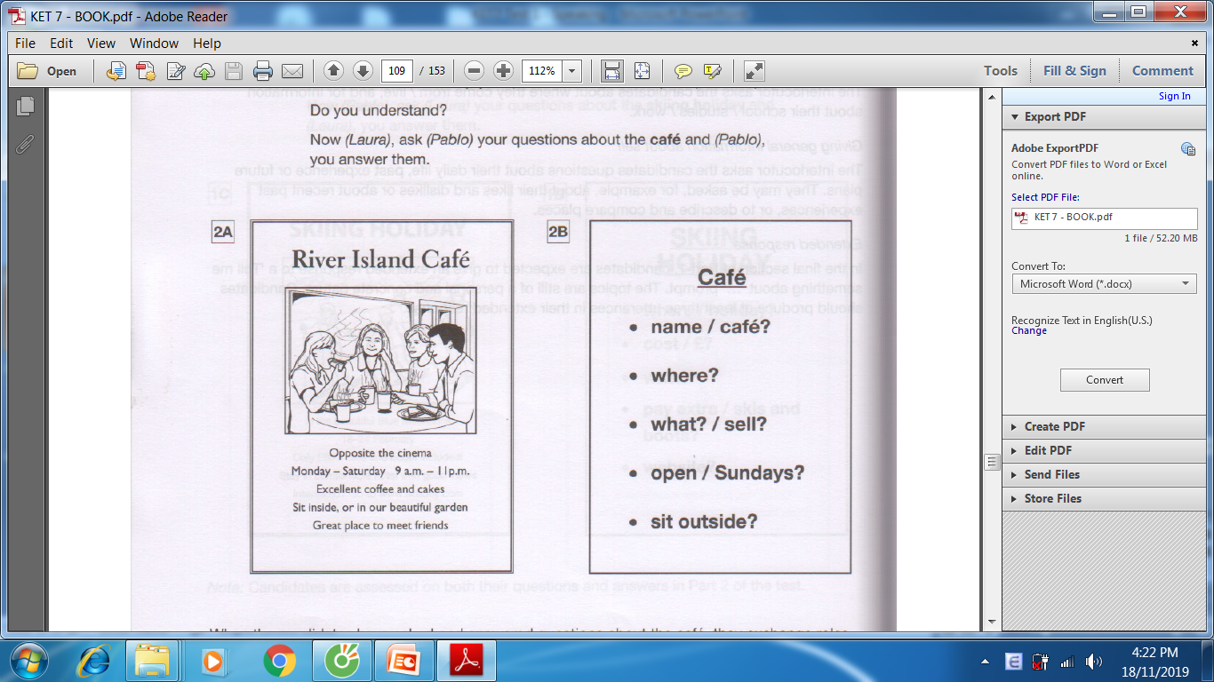
Ask and answer questions using the words given.
What are other questions and answers you can think of?

Slide 14
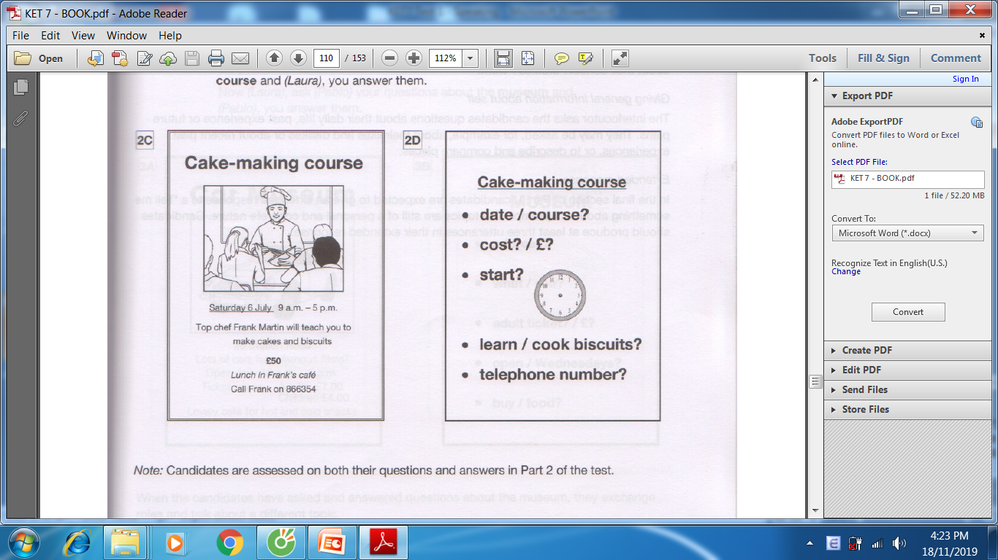
Ask and answer questions using the words given.
What are other questions and answers you can think of?

