Slide 1



Unit 3: On Screen
Lesson 3F: Reading

Slide 2
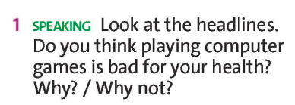
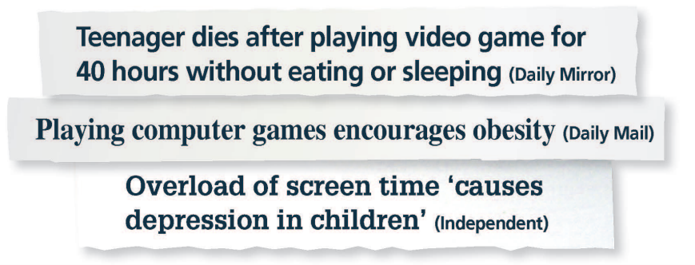
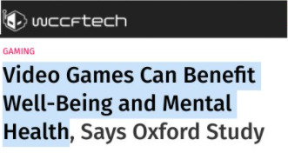
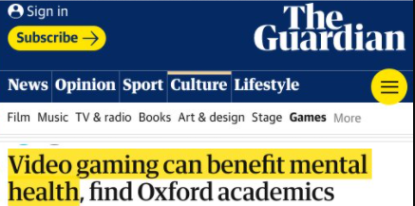




2
1
5
4
3
7
6
8
9

Slide 3

Which headline is about positive effects and which is about negative effects?
6
7
5
1
4
2
3
9
8
positive effects
negative effects
1
4
5
2
3
6
7
8
9
www.phuongnam.edu.vn

Slide 4



www.phuongnam.edu.vn

Slide 5

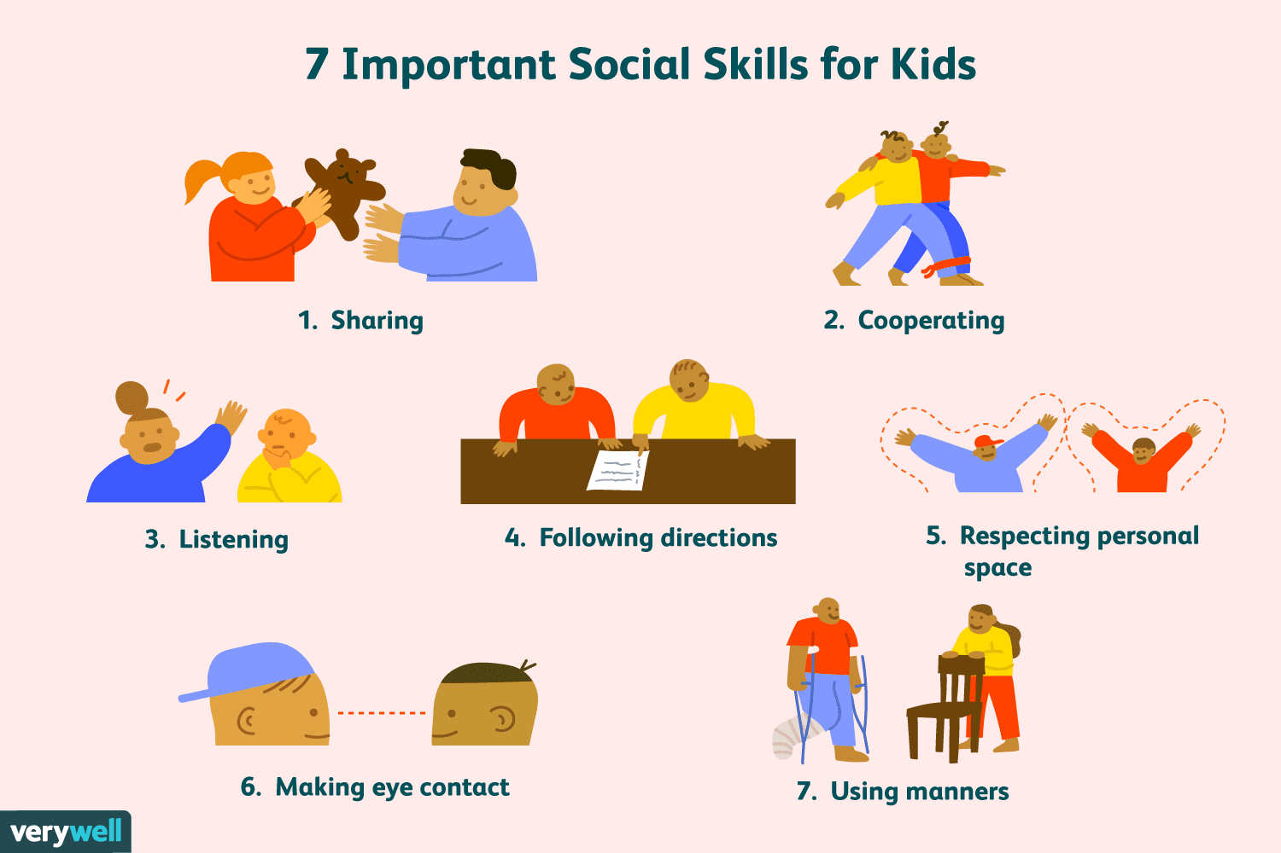
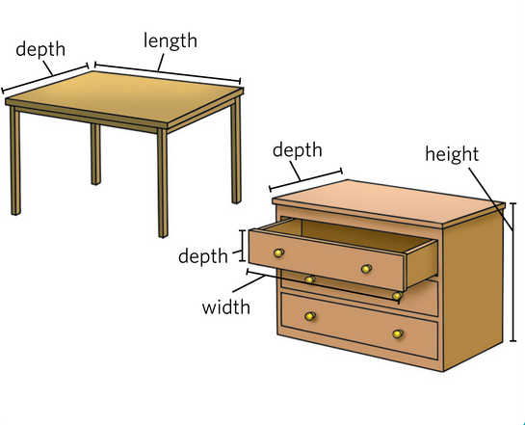
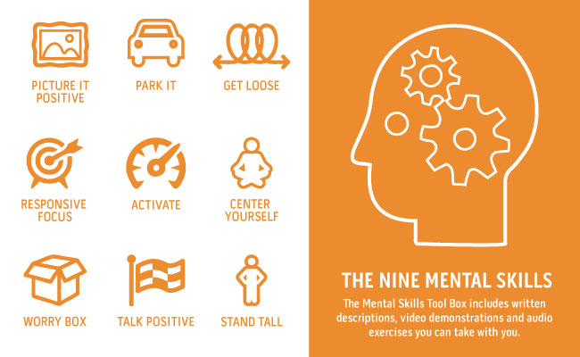


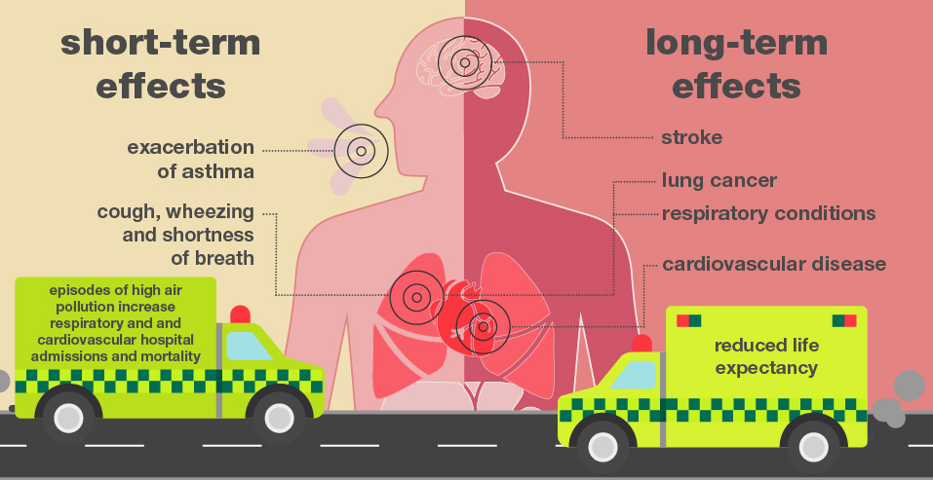
VOCABULARY
health effects (n) /helθ əˈfekts/
changes in health resulting from exposure to a source
combat (n) /ˈkɑːmbæt/
fighting or a fight, especially during a time of war
a measurement in space, for example how high,
wide or long something is
dimension (n) /dɪˈmenʃn/
concern (v) /kənˈsɝːn/
to cause worry to someone
to think or accept that something is true but without having proof of it
assume (v) /əˈsuːm/
any competence facilitating interaction and
communication with others
social skills (n)
tools for the mind include skills like positive self-talk, enhancing confidence, goal setting, etc.
mental skills (n)
www.phuongnam.edu.vn

Slide 6
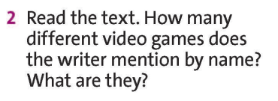



www.phuongnam.edu.vn

Slide 7
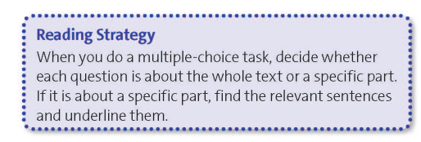
www.phuongnam.edu.vn

Slide 8
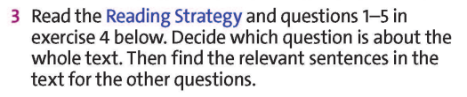


lines 1-6
lines 11-16
lines 21-23
lines 1-6
about the whole text
www.phuongnam.edu.vn

Slide 9

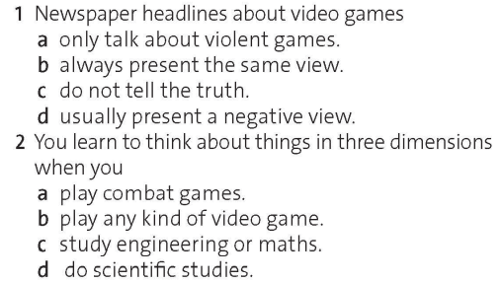
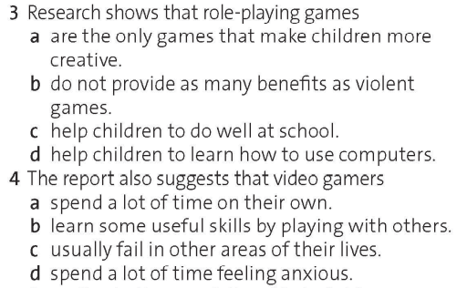
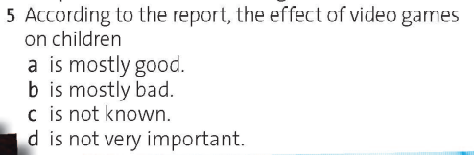
www.phuongnam.edu.vn

Slide 10
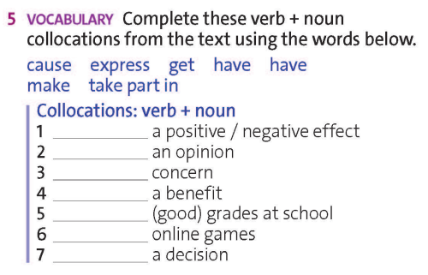
have
express
cause
provide
get
take part in
make
www.phuongnam.edu.vn

Slide 11
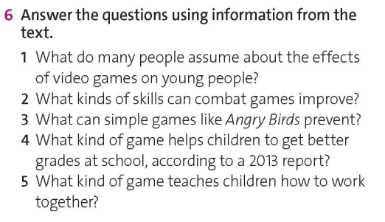
They think video games have a negative effect on young people.
Combat games improve mental skills, such as thinking about objects in 3D.
They can prevent people from feeling anxious.
www.phuongnam.edu.vn

Slide 12
Role-playing game/ RPGs can help children to get better grades at school.
Huge online games like Minecraft and Farmville teach children teamwork.
www.phuongnam.edu.vn

Slide 13
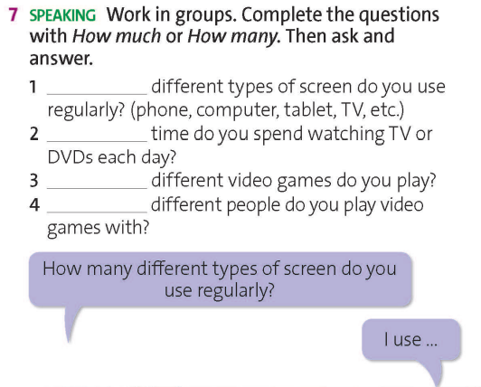
How many
How much
How many
How many
www.phuongnam.edu.vn

Slide 14
*Remember to take notes your friends’ answer.
How many
How much
How many
How many
Example
www.phuongnam.edu.vn

Slide 15
*Remember to take notes your friends’ answer.
How many
Suggestive answer:
I regularly use_______ types of screen. They are______, ______ and_____.
www.phuongnam.edu.vn

Slide 16
*Remember to take notes your friends’ answer.
How much
Suggestive answer:
I commonly spend_______ hours watching ______ everyday.
www.phuongnam.edu.vn

Slide 17
*Remember to take notes your friends’ answer.
How many
Suggestive answer:
I play_______ games. They are____________ and ____________.
www.phuongnam.edu.vn

Slide 18
*Remember to take notes your friends’ answer.
How many
Suggestive answer:
I have a group of__________ friends who play ________ with me.
www.phuongnam.edu.vn

Slide 19
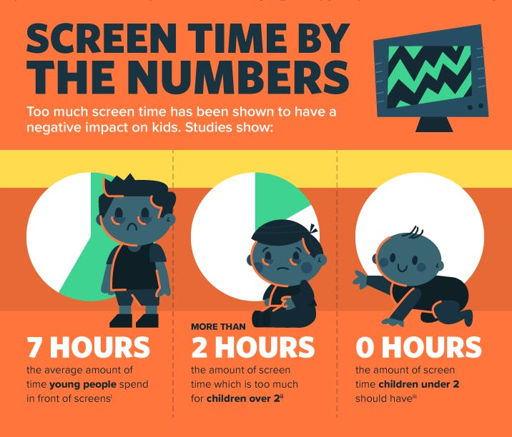
Extra activity: Look at the picture below.
Based on the answer in ex7,
do you think you and your friends spent too much time on phone, computer or TV?
How to reduce your screen time?
www.phuongnam.edu.vn

Slide 20







7 TIPS TO HELP REDUCE YOUR SCREEN TIME
www.phuongnam.edu.vn

Slide 21
01
Homework
02
03
1. Finish all the tasks
2. Prepare U3-G (P.42)
04
?
05
06

Slide 22

www.phuongnam.edu.vn

Slide 23



Thank you!
CTCP ĐẦU TƯ VÀ PHÁT TRIỂN GIÁO DỤC PHƯƠNG NAM

