Slide 1

UNIT 7: TEENS
Review
Page 103

Slide 2
Lesson Outline
Warm-up
Vocabulary
Grammar
Pronunciation
Writing
Consolidation
Wrap-up

Slide 3

By the end of this lesson, students will be able to…
Review the target language learnt in the unit
Practice test taking skills

Slide 4

WARM UP

Slide 5
Discuss in class. Share ideas about your dreams.
What is your dream?
My dream is to . . .
What do you want to be when you grow up?
I want to . . .
Why do you want to . . .?
Because . . .

Slide 6

Vocabulary

Slide 7
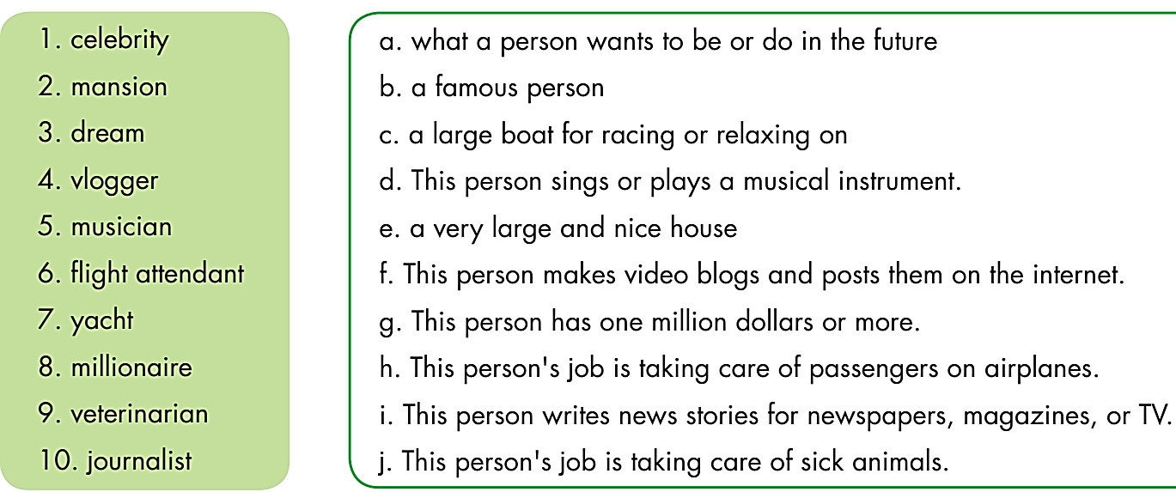

Slide 8
In pairs. Compare your answers.
What does ‘mansion’ mean?
‘Mansion’ is a very large and nice house.

Slide 9
What does ‘mansion’ mean?
‘Mansion’ is a very large and nice house.
b
e
a
f
d
h
c
g
j
i

Slide 10
Grammar

Slide 11

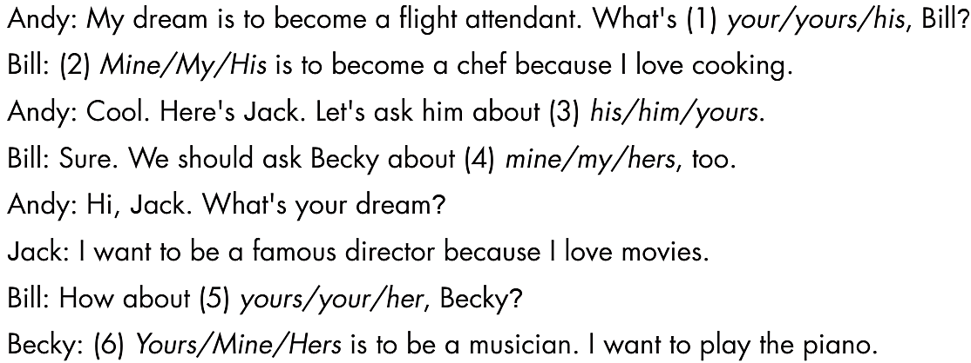

Slide 12
In groups of 4. Practice the conversation, then make a conversation about your dreams and dream jobs.
Andy: My dream is to become a flight attendant. What's yours, Bill?
Bill: Mine is to become a chef because I love cooking.
Andy: Cool. Here's Jack. Let's ask him about his.
Bill: Sure. We should ask Becky about hers, too.
Andy: Hi, Jack. What's your dream?
Jack: I want to be a famous director because I love movies.
Bill: How about yours, Becky?
Becky: Mine is to be a musician. I want to play the piano.

Slide 13
1. Nancy: I have a new sports car.
Me: She told ___________________________________________
2. George: My father is an engineer.
Me: He said ___________________________________________
3. Lily: My sister doesn't like her new yacht.
Me: She told ___________________________________________
4. Amanda: I can't live without my guitar.
Me: She said ___________________________________________
5. Joseph: I'm not a good musician.
Me: He told ____________________________________________
me (that) she had a new sports car.
(that) his father was an engineer.
me (that) her sister didn’t like her new yacht.
(that) she couldn’t live without her guitar.
me (that) he wasn’t a good musician.

Slide 14
Pronunciation

Slide 15
1. A. musician B. flight C. rich D. millionaire
2. A. finished B. told C. said D. reported
3. A. easy B. teacher C. dream D. great

Slide 16
Check your answers. Then listen and practice.

1. A. musician B. flight C. rich D. millionaire
/mjuːˈzɪʃən/ /flaɪt/ /rɪtʃ/ /ˌmɪljəˈner/
2. A. finished B. told C. said D. reported
/ˈfɪnɪʃt/ /toʊld/ /sɛd/ /rɪˈpɔrtəd/
3. A. easy B. teacher C. dream D. great
/ˈi:zi/ /ˈtiːtʃər/ /driːm/ /ɡreɪt/



Slide 17
Writing

Slide 18

Pre-writing
Work with a partner. Talk about your dream job. Use the questions below to help you.

Slide 19
While-writing

Slide 20
Post-writing
CLASS DISCUSSION
Tell the class about your dream job.

Slide 21

CONSOLIDATION

Slide 22
VOCABULARY REVIEW
Test your memory
In pairs. Challenge your partner by taking turns saying ONE of the NEW WORDS you have learned in Unit 7.

Slide 23
Listen and repeat.
______________
celebrity (n) người nổi tiếng
helicopter (n) trực thăng
home theater (n) rạp phim ở nhà
jet (n) máy bay phản lực
mansion (n) biệt thự
millionaire (n) triệu phú
sports car (n) ô-tô thể thao
yacht (n) du thuyền
game designer (n) người thiết kế game
director (n) đạo diễn
flight attendant (n) tiếp viên hàng không
journalist (n) nhà báo
musician (n) nhạc sĩ, nhạc công
veterinarian (n) bác sĩ thú y
vlogger (n) người làm vlog
engineer(n) kĩ sư
dentist (n) nha sĩ

Slide 24

WRAP-UP

Slide 25
Today’s lesson
Review the target language learnt in the unit
Practice test taking skills

Slide 26
Homework
Review Unit 7 about dreams and dream jobs.
Do the exercises on page 56, WB.
Prepare the next lesson (page 74, SB).
Play the consolidation games on www.eduhome.com.vn

Slide 27

Lesson 3
Stay positive and have a nice day!

