Slide 1


Slide 2

Unit
10
1
Unit
FAMILY LIFE
ECOTOURISM
LESSON 2
LANGUAGE

Slide 3

Unit
1
1
FAMILY LIFE
Family Life
Unit
OBJECTIVES
Use the lexical items related to the topic ecotourism;
Identify intonation patterns and use appropriate intonation (i.e. rising or falling tone);
Use conditional sentences Type 1 and Type 2 correctly.

Slide 4
LESSON 2
LANGUAGE
Unit
Matching: Caves in Phong Nha – Ke Bang National Park
WARM-UP
Pronunciation
Task 1: Listen to these sentences. Pay attention to the intonation and repeat. (p. 111)
Task 2: Work in pairs and role-play this conversation. Pay attention to the intonation. Then listen and check. (p. 111)
PRESENTATION
Vocabulary: Ecotourism
Task 1. Below is what ecotourists do. Match each sentence on the left with its explanation on the right. (p. 112)
Task 2: Complete these sentences with the highlighted words in Task 1. (p. 112)
PRACTICE
Grammar: The past simple vs the past continuous
Task 1: Decide whether these statements can be real (R) or not (N). (p. 112)
Task 2: Put the verbs in brackets in the correct forms. (p. 112)
CONSOLIDATION
Wrap-up
Homework

Slide 5

LESSON 2
LANGUAGE
Unit
WARM-UP
Matching: Caves in Phong Nha – Ke Bang National Park
Match the pictures with names of the caves in Phong Nha – Ke Bang National Park.

Slide 6
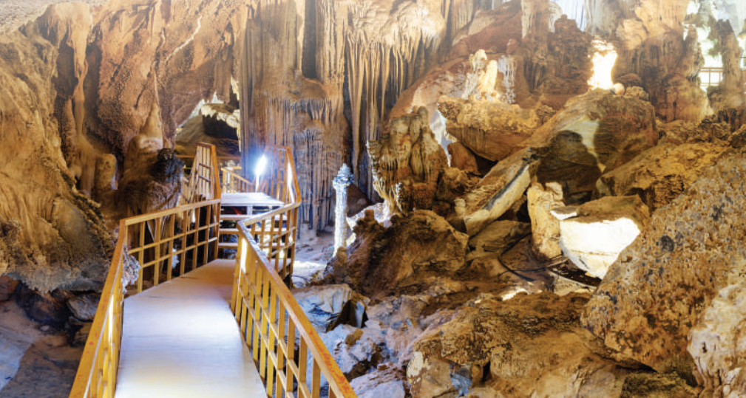
WARM-UP
Phong Nha Cave
Son Doong Cave
Hang En Cave
Hang Toi Cave (Dark Cave)
Hang Voi Cave (Elephant Cave)
Thien Duong Cave (Paradise Cave)
Tra Ang Cave
Tu Lan Cave
Hang Va Cave
Hang Vom & Hang Gieng Vooc Cave
Phong Nha Cave

Slide 7
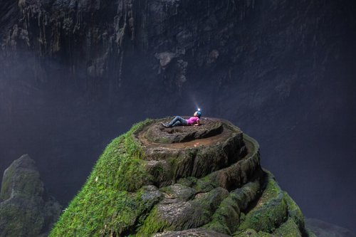
WARM-UP
Phong Nha Cave
Son Doong Cave
Hang En Cave
Hang Toi Cave (Dark Cave)
Hang Voi Cave (Elephant Cave)
Thien Duong Cave (Paradise Cave)
Tra Ang Cave
Tu Lan Cave
Hang Va Cave
Hang Vom & Hang Gieng Vooc Cave
Son Doong Cave

Slide 8
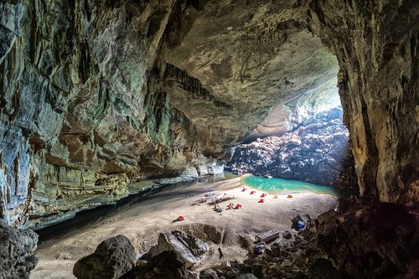
WARM-UP
Phong Nha Cave
Son Doong Cave
Hang En Cave
Hang Toi Cave (Dark Cave)
Hang Voi Cave (Elephant Cave)
Thien Duong Cave (Paradise Cave)
Tra Ang Cave
Tu Lan Cave
Hang Va Cave
Hang Vom & Hang Gieng Vooc Cave
Hang En Cave

Slide 9
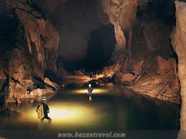
WARM-UP
Phong Nha Cave
Son Doong Cave
Hang En Cave
Hang Toi Cave (Dark Cave)
Hang Voi Cave (Elephant Cave)
Thien Duong Cave (Paradise Cave)
Tra Ang Cave
Tu Lan Cave
Hang Va Cave
Hang Vom & Hang Gieng Vooc Cave
Hang Toi Cave

Slide 10
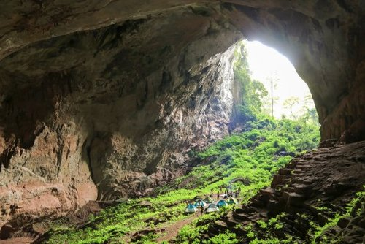
WARM-UP
Phong Nha Cave
Son Doong Cave
Hang En Cave
Hang Toi Cave (Dark Cave)
Hang Voi Cave (Elephant Cave)
Thien Duong Cave (Paradise Cave)
Tra Ang Cave
Tu Lan Cave
Hang Va Cave
Hang Vom & Hang Gieng Vooc Cave
Hang Voi Cave

Slide 11
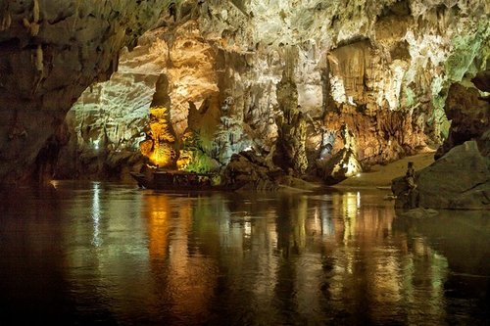
WARM-UP
Phong Nha Cave
Son Doong Cave
Hang En Cave
Hang Toi Cave (Dark Cave)
Hang Voi Cave (Elephant Cave)
Thien Duong Cave (Paradise Cave)
Tra Ang Cave
Tu Lan Cave
Hang Va Cave
Hang Vom & Hang Gieng Vooc Cave
Thien Duong Cave

Slide 12
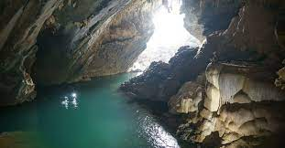
WARM-UP
Phong Nha Cave
Son Doong Cave
Hang En Cave
Hang Toi Cave (Dark Cave)
Hang Voi Cave (Elephant Cave)
Thien Duong Cave (Paradise Cave)
Tra Ang Cave
Tu Lan Cave
Hang Va Cave
Hang Vom & Hang Gieng Vooc Cave
Tra Ang Cave

Slide 13
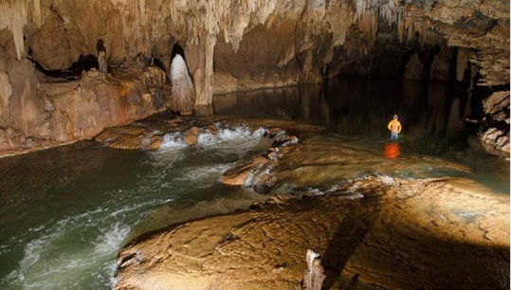
WARM-UP
Phong Nha Cave
Son Doong Cave
Hang En Cave
Hang Toi Cave (Dark Cave)
Hang Voi Cave (Elephant Cave)
Thien Duong Cave (Paradise Cave)
Tra Ang Cave
Tu Lan Cave
Hang Va Cave
Hang Vom & Hang Gieng Vooc Cave
Tu Lan Cave

Slide 14
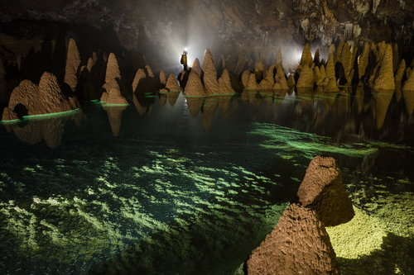
WARM-UP
Phong Nha Cave
Son Doong Cave
Hang En Cave
Hang Toi Cave (Dark Cave)
Hang Voi Cave (Elephant Cave)
Thien Duong Cave (Paradise Cave)
Tra Ang Cave
Tu Lan Cave
Hang Va Cave
Hang Vom & Hang Gieng Vooc Cave
Hang Va Cave

Slide 15
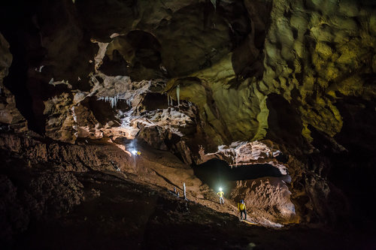
WARM-UP
Phong Nha Cave
Son Doong Cave
Hang En Cave
Hang Toi Cave (Dark Cave)
Hang Voi Cave (Elephant Cave)
Thien Duong Cave (Paradise Cave)
Tra Ang Cave
Tu Lan Cave
Hang Va Cave
Hang Vom & Hang Gieng Vooc Cave
Hang Vom & Hang Gieng Vooc Cave

Slide 16
LESSON 2
LANGUAGE
Unit
Matching: Caves in Phong Nha – Ke Bang National Park
WARM-UP
Pronunciation
Task 1: Listen to these sentences. Pay attention to the intonation and repeat. (p. 111)
Task 2: Work in pairs and role-play this conversation. Pay attention to the intonation. Then listen and check. (p. 111)
PRESENTATION

Slide 17
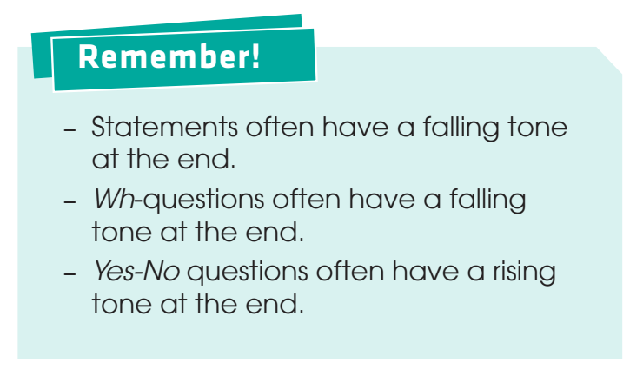
PRESENTATION
Intonation

Slide 18
LESSON 2
LANGUAGE
Unit
Matching: Caves in Phong Nha – Ke Bang National Park
WARM-UP
Pronunciation
Task 1: Listen to these sentences. Pay attention to the intonation and repeat. (p. 111)
Task 2: Work in pairs and role-play this conversation. Pay attention to the intonation. Then listen and check. (p. 111)
PRESENTATION
PRACTICE

Slide 19
LESSON 2
LANGUAGE
Unit
GETTING STARTED
WARM-UP
Name volunteering activities
PRESENTATION
Pronunciation
Task 1: Listen to the sentences and circle the word with the stress you hear.
Task 2: Listen again and practise saying the sentences in 1.
PRACTICE

Slide 20



PRACTICE
1
Listen to these sentences. Pay attention to the intonation and repeat.
1. I’ll also try to bring snacks with less packaging.
2. What’s an eco-friendly fieldtrip?
3. Can we bring snacks?

Slide 21
PRACTICE
2
Work in pairs and role-play this conversation. Pay attention to the intonation. Then listen and check.
Mum: Have you packed for the trip tomorrow?
Mai: Yes, I have.
Mum: Why are you taking so little food?
Mai: Because I don’t want to leave litter behind. It’s not good for the environment.
Mum: That’s a good idea.

Slide 22
LESSON 2
LANGUAGE
Unit
Matching: Caves in Phong Nha – Ke Bang National Park
WARM-UP
Pronunciation
Task 1: Listen to these sentences. Pay attention to the intonation and repeat. (p. 111)
Task 2: Work in pairs and role-play this conversation. Pay attention to the intonation. Then listen and check. (p. 111)
PRESENTATION
Vocabulary: Ecotourism
Task 1. Below is what ecotourists do. Match each sentence on the left with its explanation on the right. (p. 112)
Task 2: Complete these sentences with the highlighted words in Task 1. (p. 112)

Slide 23
PRESENTATION
1
Below is what ecotourists do. Match each sentence on the left with its explanation on the right.
1. I am responsible for protecting the environment.
2. I am aware of the damage I may cause to the environment.
3. I help people learn about the environmental impact of tourism.
4. I help local businesses make a profit.
5. I buy traditional arts and crafts to help local culture and businesses.
a. I know that when I travel, I may damage the environment.
b. I understand it is my duty to protect the environment.
c. I buy handmade things to help local artists and craftsmen or craftswomen earn some money and introduce their culture to more people.
d. I help local people earn some money by using local services and buying local products.
e. I tell people about the positive and negative effects of tourism on the environment.

Slide 24
LESSON 2
LANGUAGE
Unit
Matching: Caves in Phong Nha – Ke Bang National Park
WARM-UP
Pronunciation
Task 1: Listen to these sentences. Pay attention to the intonation and repeat. (p. 111)
Task 2: Work in pairs and role-play this conversation. Pay attention to the intonation. Then listen and check. (p. 111)
PRESENTATION
Vocabulary: Ecotourism
Task 1. Below is what ecotourists do. Match each sentence on the left with its explanation on the right. (p. 112)
Task 2: Complete these sentences with the highlighted words in Task 1. (p. 112)
PRACTICE

Slide 25
PRACTICE
2
Complete these sentences with the highlighted words in Task 1.
1. We can help local artists make a _____________ by buying handmade arts and _____________.
2.Many tourists are not _____________ of the _____________ of their actions on the local community.
3.Both local people and tourists should be _____________ for protecting the environment.
profit
crafts
aware
impact
responsible

Slide 26
LESSON 2
LANGUAGE
Unit
Matching: Caves in Phong Nha – Ke Bang National Park
WARM-UP
Pronunciation
Task 1: Listen to these sentences. Pay attention to the intonation and repeat. (p. 111)
Task 2: Work in pairs and role-play this conversation. Pay attention to the intonation. Then listen and check. (p. 111)
PRESENTATION
Vocabulary: Ecotourism
Task 1. Below is what ecotourists do. Match each sentence on the left with its explanation on the right. (p. 112)
Task 2: Complete these sentences with the highlighted words in Task 1. (p. 112)
PRACTICE
Grammar: The past simple vs the past continuous
Task 1: Decide whether these statements can be real (R) or not (N). (p. 112)
Task 2: Put the verbs in brackets in the correct forms. (p. 112)

Slide 27
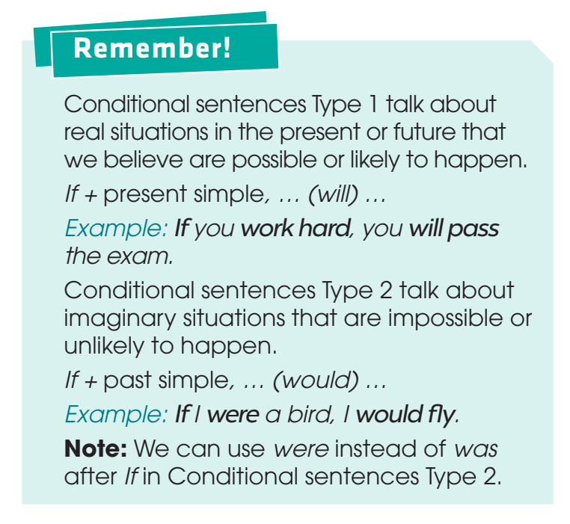
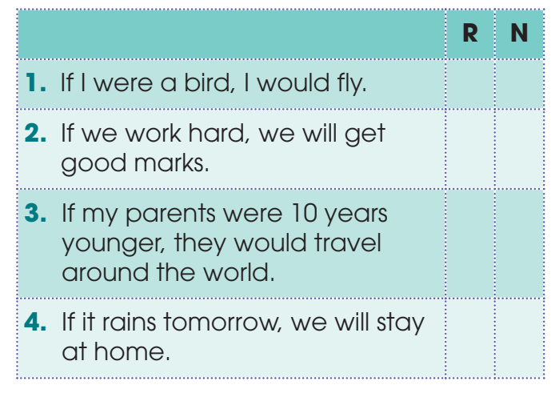

PRESENTATION
1
Decide whether these statements can be real (R) or not (N).

Slide 28
LESSON 2
LANGUAGE
Unit
Matching: Caves in Phong Nha – Ke Bang National Park
WARM-UP
Pronunciation
Task 1: Listen to these sentences. Pay attention to the intonation and repeat. (p. 111)
Task 2: Work in pairs and role-play this conversation. Pay attention to the intonation. Then listen and check. (p. 111)
PRESENTATION
Vocabulary: Ecotourism
Task 1. Below is what ecotourists do. Match each sentence on the left with its explanation on the right. (p. 112)
Task 2: Complete these sentences with the highlighted words in Task 1. (p. 112)
PRACTICE
Grammar: The past simple vs the past continuous
Task 1: Decide whether these statements can be real (R) or not (N). (p. 112)
Task 2: Put the verbs in brackets in the correct forms. (p. 112)
CONSOLIDATION

Slide 29
LESSON 2
LANGUAGE
Unit
Name volunteering activities
WARM-UP
Pronunciation
Task 1: Listen to the sentences and circle the word with the stress you hear.
Task 2: Listen again and practise saying the sentences in 1.
PRESENTATION
Vocabulary: Community development
Task 1: Match the words with their meanings.
Task 2: Complete the following sentences using the correct forms of the words in 1.
Task 3: Choose the correct word to complete each of the following sentences.
PRACTICE
Grammar: The past simple vs the past continuous
Task 1: Choose the correct verb form in each of the following sentences.
Task 2: Combine the two sentences using when or while where appropriate.

Slide 30
PRACTICE
PRACTICE
2
Put the verbs in brackets in the correct forms.
1. If tourists buy local products, more of their money (stay) ___________ in the community.
2.If we lived in the countryside, we (grow) ___________ our own vegetables.
3.If my grandmother (be) ___________ still alive, she (be) ___________ a hundred today.
4.If people (give) ___________ up flying, they (reduce) ___________ their carbon footprint.
will stay
would grow
were / was
would be
give
will reduce

Slide 31
LESSON 2
LANGUAGE
Unit
Matching: Caves in Phong Nha – Ke Bang National Park
WARM-UP
Pronunciation
Task 1: Listen to these sentences. Pay attention to the intonation and repeat. (p. 111)
Task 2: Work in pairs and role-play this conversation. Pay attention to the intonation. Then listen and check. (p. 111)
PRESENTATION
Vocabulary: Ecotourism
Task 1. Below is what ecotourists do. Match each sentence on the left with its explanation on the right. (p. 112)
Task 2: Complete these sentences with the highlighted words in Task 1. (p. 112)
PRACTICE
Grammar: The past simple vs the past continuous
Task 1: Decide whether these statements can be real (R) or not (N). (p. 112)
Task 2: Put the verbs in brackets in the correct forms. (p. 112)
CONSOLIDATION
Game: Surprising matching!
Wrap up & Homework

Slide 32

Game:
Surprising matching!
The class will be divided into 4 groups.
Group A will write If clause type 1. Group B will write Main clause type 1.
Group C will write If clause type 2 Group D will write Main clause type 2.

Slide 33
Game:
Surprising matching!
Now match:
Group A + Group B
Group C + Group D

Slide 34
CONSOLIDATION
1
Wrap-up
Use the lexical items related to the topic ecotourism;
Identify intonation patterns and use appropriate intonation (i.e. rising or falling tone);
Use conditional sentences Type 1 and Type 2 correctly.

Slide 35
CONSOLIDATION
2
Homework
1. Prepare for the next lesson: Unit 10_Reading
2. Do exercises in the workbook

Slide 36


