Slide 1

UNIT 3: SHOPPING
Lesson 2.3 – Pronunciation and Speaking
Page 25

Slide 2




Lesson 2.3
Unit 3 Lesson 2.3
LESSSON OUTLINE
Consolidation

Slide 3

Unit 3 Lesson 2.3
By the end of this lesson,
students will be able to:
- practice sound change Can I take…?
- practice making a complaints.

Slide 4



Slide 5

Work in pairs.
Choose the word whose main stress is placed
differently from the others.
A. receipt B. battle C. worker D. treasure
2. A. transportation B. exclamation C. punctuation D. calculator
3. A. disconnect B. deliver C. encounter D. recycle
/rɪˈsi:t/
/ˈbætəl/
/ˈwɜ:kə/
/ˈtreʒə/
/ˌtrænspəˈteɪʃən/
/ˌekskləˈmeɪʃən/
/ˌpʌŋktʃuˈeɪʃən/
/ ˈkælkjəleɪtər/
/ˌdɪskəˈnekt/
/dɪˈlɪvə/
/ɪnˈkaʊntə/
/ˌri:ˈsaɪkəl/

Slide 6
Work in pairs.
Choose the word whose underlined part is
pronounced differently from that of the other words.
A. offer B. restart C. repair D. prepare
2. A. sister B. diving C. morning D. visit
3. A. Monday B. brother C. soccer D. lover
/ˈɑ:fə/
/ˌri:ˈstɑ:rt/
/rɪˈper/
/prɪˈper/
/ˈsɪstə/
/ˈdaɪvɪŋ/
/ˈmɔ:rnɪŋ/
/ˈvɪzɪt/
/ˈmʌndeɪ/
/ˈbrʌðə/
/ˈsɑ:kə/
/ˈlʌvə/

Slide 7

Unit 3 Lesson 2.3
Work in pairs
Can I take your phone number?
Can I take your address?
Sure. Here it is.

Slide 8



Slide 9


Unit 3 Lesson 2.3
a. "Can I take…?" often sounds like /kənaɪteɪk/.
Notes:
Please, click on each phrase to hear the sound

Slide 10


Unit 3 Lesson 2.3
b. Notice the sound changes of the
underlined words.
Can I take your name, please?
Notes:
Please, click on each phrase to hear the sound

Slide 11

Unit 3 Lesson 2.3
c. Listen and cross out the one with the wrong sound changes.
Can I take your phone number?
Can I take your address?
– Wrong. No connected speech.
Notes:
Please, click on each phrase to hear the sound

Slide 12
Unit 3 Lesson 2.3
d. Read the sentences with the correct
sound changes to a partner.
Can I take your phone number?
Can I take your address?
Notes:
Please, click on each phrase to hear the sound

Slide 13



Slide 14

Unit 3 Lesson 2.3
Practice the conversation. Swap roles and repeat.
Customer: I have a problem with my laptop.
Manager: What's the problem?
Customer: It overheats when I do my homework.
Manager: Do you have your receipt?
Customer: Here it is.
Manager: It's still under warranty. We can repair it for free.
Customer: OK.
Manager: Can I take your name, please?
Customer: Yes, it's Ali Benn. That's A-L-I B-E-N-N.
Manager: Can I take your phone number?
Customer: Sure, it's 0985214173.
Manager: We'll call you when it's ready.
Customer: OK.

Slide 15
Unit 3 Lesson 2.3
b. Make two more conversations using the ideas provided.
Customer: I have a problem with my laptop.
Manager: What's the problem?
Customer: It overheats when I do my homework.
Manager: Do you have your receipt?
Customer: Here it is.
Manager: It's still under warranty. We can repair it for free.
Customer: OK.
Manager: Can I take your name, please?
Customer: Yes, it's Ali Benn. That's A-L-I B-E-N-N.
Manager: Can I take your phone number?
Customer: Sure, it's 0985214173.
Manager: We'll call you when it's ready.
Customer: OK.
(restarts/disconnects)
(play games/use the internet)
(no longer/still)
(twenty dollars/free)
(Sam Davis/Karen Samuels)
(0128485012/ 093219555)

Slide 16



Slide 17

Unit 3 Lesson 2.3
RETURNING A LAPTOP
You have a problem with your laptop and want to get it fixed
at the store where you bought it. In pairs:
Student B: You're the manager of PC Planet.
  Find out what's wrong with the customer's laptop.
  Repair it for free if they bought it less than 12 months ago.
  For older laptops, use the repair price list.
  Fill in the form with the customer's information.
  Swap roles and repeat. Student B, turn back to page 25.
Student A: Complete the note with your own ideas, then talk to the manager.
Swap roles and repeat.

Slide 18
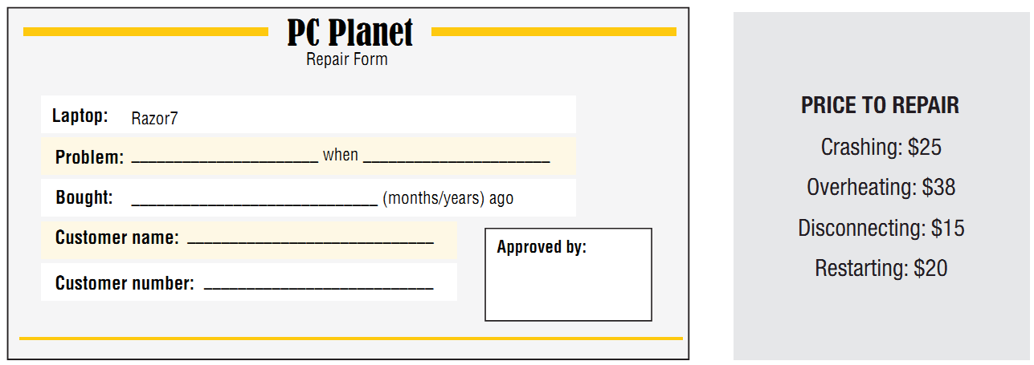
Unit 3 Lesson 2.3
RETURNING A LAPTOP
You have a problem with your laptop and want to get it fixed
at the store where you bought it. Student B

Slide 19
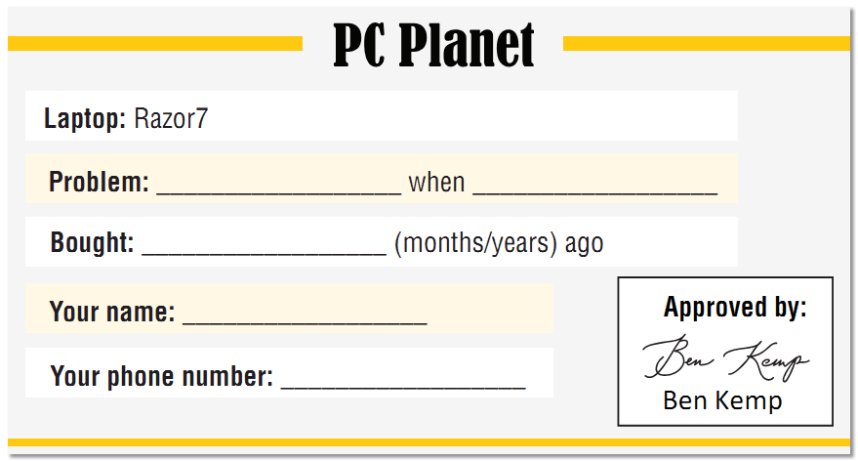
Unit 3 Lesson 2.3
RETURNING A LAPTOP
You have a problem with your laptop and want to get it fixed
at the store where you bought it. Student A

Slide 20

Unit 3 Lesson 2.3
RETURNING A LAPTOP
b. Have you ever complained in a store or restaurant?
Why? What happened?

Slide 21

Consolidation

Slide 22

Unit 3 Lesson 2.3
Write a short paragraph about how to protect your laptop from crashing?
Write 100 to 120 words.

Slide 23

WRAP-UP

Slide 24
Unit 3 Lesson 2.3
Today’s lesson
Wrap-up
Pronunciation: sound changes
Speaking: starting a formal conversation
making complaints.

Slide 25
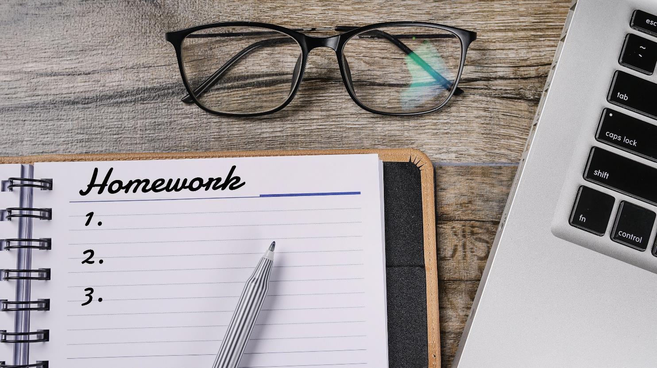

Slide 26
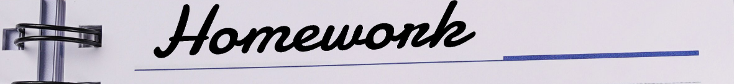
Unit 3 Lesson 2.3
Make 10 sentences about your complaints/ Write a short passage about your complaints.
Practise the conversation in SB on page 25.
Prepare the next lesson – Listening and Reading on page 26 in SB.
Play consolidation games in Tiếng Anh 10 i-Learn Smart World DHA App on www.eduhome.com.vn

Slide 27

Have a nice day!

