Slide 1

UNIT 1: FAMILY LIFE
Lesson 3.2 – Writing & Speaking
Page 11

Slide 2



Lesson .
LESSSON OUTLINE
Consolidation

Slide 3

By the end of this lesson,
students will be able to:
understand and use the text language to write text messages.
make and respond to requests in writing text messages.

Slide 4



Slide 5

What does each text language phrase mean?
OMG
ATM
YW
NW
HTH
KIT
BFF
TGIF
Oh my God.
At the moment.
You’re welcome.
No way!
Hope this helps.
Keep in touch.
Best friends forever.
Thanks God it’s Friday.

Slide 6



Slide 7

Pre-writing
a. Read the Writing Skill about text language.
Using text language to shorten messages
Sometimes you can use symbols >:( (angry), emojis (happy), and letters b4n (bye for now) to shorten your text
messages. Text messages don't usually use punctuation except for question marks ? and exclamation points !
Sometimes the meaning of a message can have different examples of text language. For example, lol (laugh out loud)
and :v can both mean laughing.

Slide 8
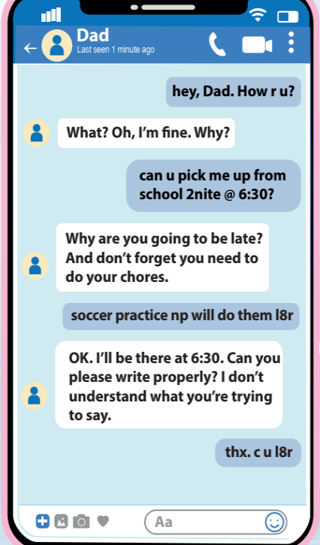
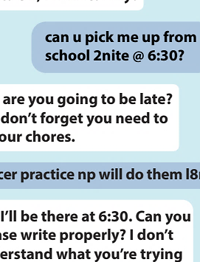
Pre-writing
a. Read Adam’s text message again
and underline all the text language.

Slide 9
b. Rewrite the text messages in full sentences with proper punctuation and spelling. Use the skill box to help you.
what time 2nite? _____________________________________
2. c u l8r @ the park _____________________________________
3. u look ☹ r u ok? ______________________________________
4. gotta go b4n _________________________________________
5. I feel ☹ bcoz my mom is >:(_____________________________
6. that was a gr8 party :v _________________________________
What time tonight?
See you later at the park.
You look sad. Are you OK?
(I’ve) got to go. Bye for now.
I feel sad because my mom is angry.
That was a great party. Haha.

Slide 10
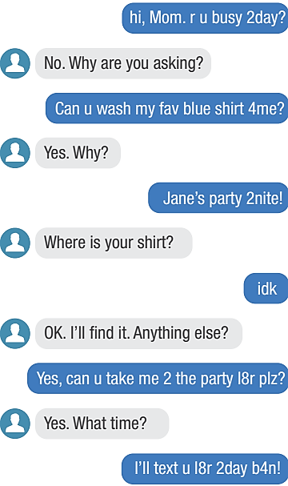
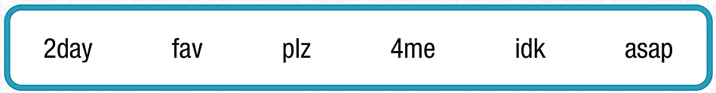
Practice, WB p.6
a. Write the text language in the box
next to its meaning.
2day fav plz
4me idk asap
1. I don't know
2. for me
3. as soon as possible
4. please
5. today
6. favorite
idk
4me
asap
plz
2day
fav

Slide 11

Practice, WB p.6
b. Read the text from Brian to his mom and circle True or False.
1. Brian's mom is busy today.
True/False
2. Brian wants her to buy him a new shirt.
True/False
3. He is going to a party tonight.
True/False
4. Brian's mom isn't going to take him to the party. True/False
5. Brian is going to text his mom later.
True/False

Slide 12



Slide 13

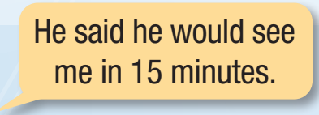
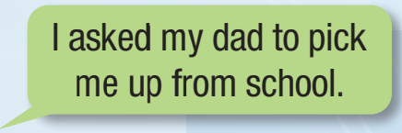
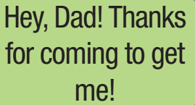
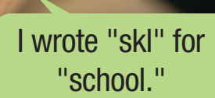
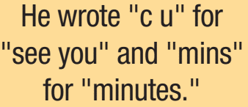
a. In pairs: Talk about the last time you texted somebody to request something. What did you ask for? How did you make the messages shorter with text language?

Slide 14
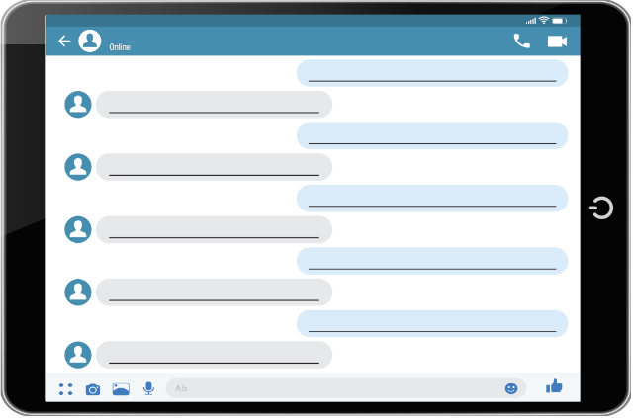
b. You need to ask your friend for help. Choose your role and plan your messages to make and respond to a request. Think about the following questions:
Who?
What?
When?
Where?
Why?

Slide 15


Slide 16
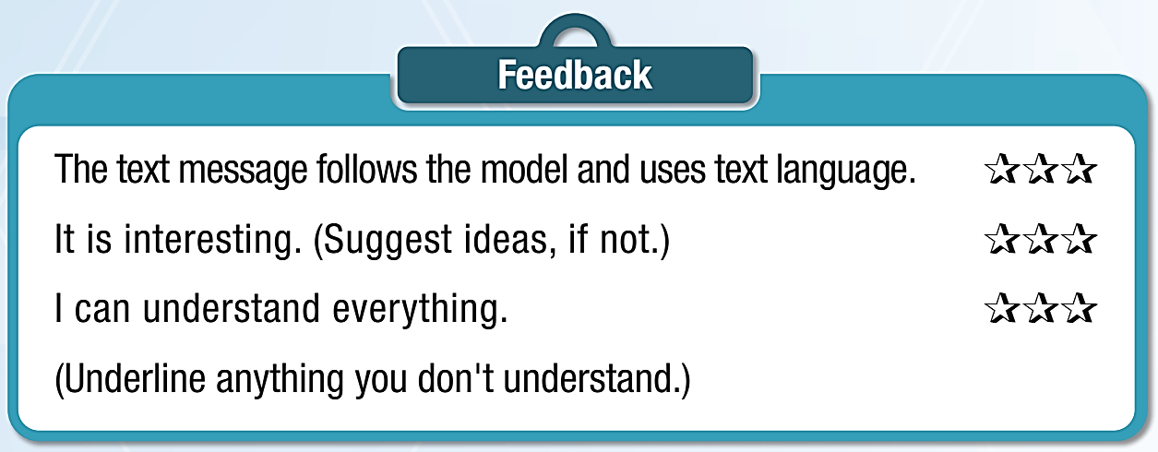
While-writing
Now, with your partner, take turns to write messages making
and responding to a request. Use the Feedback form to help you.

Slide 17
Post-writing
Do the same with A NEW PARTNER. Remember to use the text language as much as possible!

Slide 18

Consolidation

Slide 19

CHALLENGE YOUR PARTNER!
Take turns writing as many text language phrases as possible. Who has more phrases, you or your partner?
You
b4n: bye for now
_________________
_________________
_________________
Your partner
brb: be right back
_________________
_________________
_________________

Slide 20
Today’s lesson
Wrap-up
Speaking: making and responding to requests in text messages.
Writing: using the text language in text messages.

Slide 21

Finish page 7, WB.
Complete the writing notes in Tiếng Anh 10 i-Learn Smart World Notebook on page 7.
Prepare the next lesson on page 12, SB.
Play the consolidation games in Tiếng Anh 10 i-Learn Smart World DHA App on www.eduhome.com.vn

Slide 22

Have a nice day!

