Slide 1

Unit 1: Free Time
Lesson 3.1: Listening & Reading
Page 10

Slide 2




Lesson 3.1
LESSSON OUTLINE
Consolidation

Slide 3

By the end of this lesson, students will be able to…
- talk about extreme sports.
- practice listening and understanding general and specific information about extreme sports.
- read an invitation email for gist and detail.

Slide 4

WARM UP

Slide 5

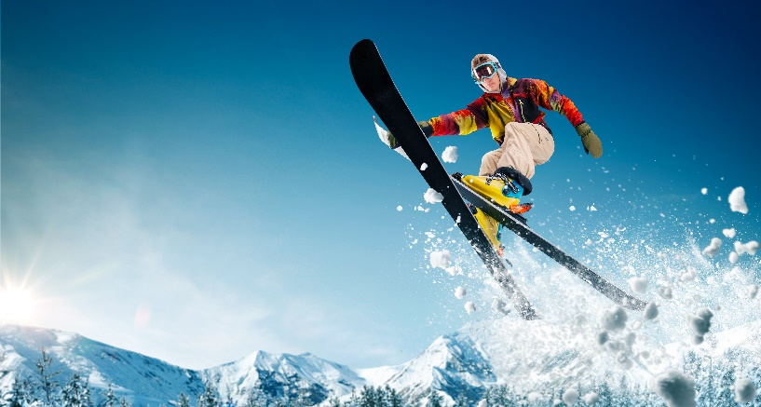

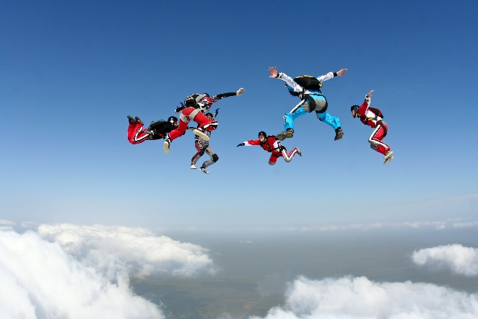
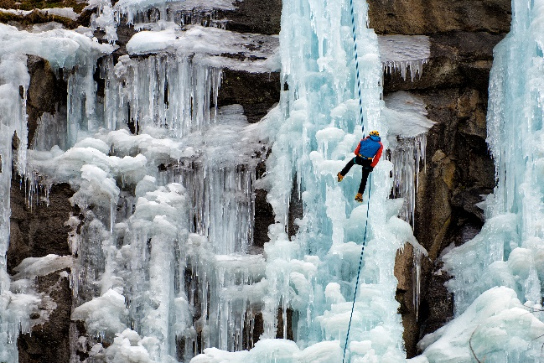

What do we call these sports?
Rock Climbing
Skiing Jumping
Kiteboarding
They are extreme sports.
Skydiving
Ice Climbing
Surfing

Slide 6

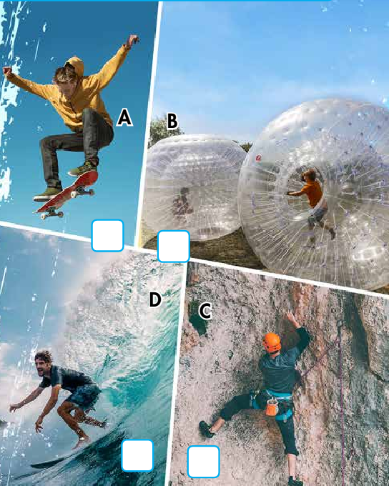

In pairs: Match the extreme sports to the pictures. Would you like to try any of them? Can you name three other extreme sports?
Other extreme sports: waterskiing, scuba diving, bungee jumping, parasailing, ice climbing, slacklining,…
1
4
2
3

Slide 7


It’s listening time….

Slide 8
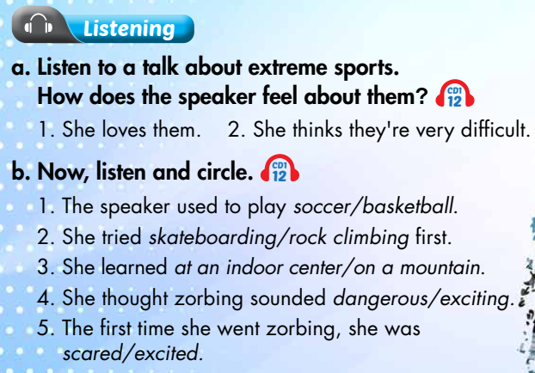

Slide 9
Pre – listening
Before listening.
a. Underline the key words and guess the speaker’s feeling.
1. She loves them. 2. She thinks they're very difficult.
active feeling and ready to take up.
scary and not ready to take up.

Slide 10
b. Underline the key words in each sentence and predict the answer.
The speaker used to play soccer/basketball.
2. She tried skateboarding/rock climbing first.
3. She learned at an indoor center/on a mountain.
4. She thought zorbing sounded dangerous/exciting.
5. The first time she went zorbing, she was scared/excited.

Slide 11



While - listening
a. Listen to a talk about extreme sports.
How does the speaker feel about them?
Listen the first time to recognize the speaker’s feeling.
“Of course, everything was OK and I loved it.”
→ She loves them .

Slide 12
While - listening
Listen the first time to recognize what Harry’s job is.
“I spoke to the city mayor last week and told
him that things need to change. I think the city
needs to use more solar power”
→ Harry is an energy expert.

Slide 13

Listen two times and circle the correct answer.
1. The speaker used to play soccer/basketball.
2. She tried skateboarding/rock climbing first.
3. She learned at an indoor center/on a mountain.
4. She thought zorbing sounded dangerous/exciting.
5. The first time she went zorbing, she was scared/excited.

Slide 14
Audio script:
I used to spend a lot of time playing soccer. Then, one day, a friend introduced me to extreme sports.These are sports that are very dangerous and exciting, for example, skateboarding and surfng.
The frst extreme sport I tried was rock climbing. I learned how to do it at an indoor rock climbing center, but I was soon climbing mountains. After that, I was ready for a new challenge. I heard about zorbing and thought it sounded really exciting. Zorbing is when you get inside a big, soft ball, and roll down a hill. The frst time I went zorbing, I waspretty scared. I thought the ball would break! Of course, everything was OK and I loved it.

Slide 15

Post - listening
Work in pairs.
Do you think the speaker will take up zorbing for a long time ? Why (not)?

Slide 16


It’s reading time….

Slide 17
Pre - reading
Underline the key words and guess what is the email about.
trying a new activity
2. doing an activity again

Slide 18
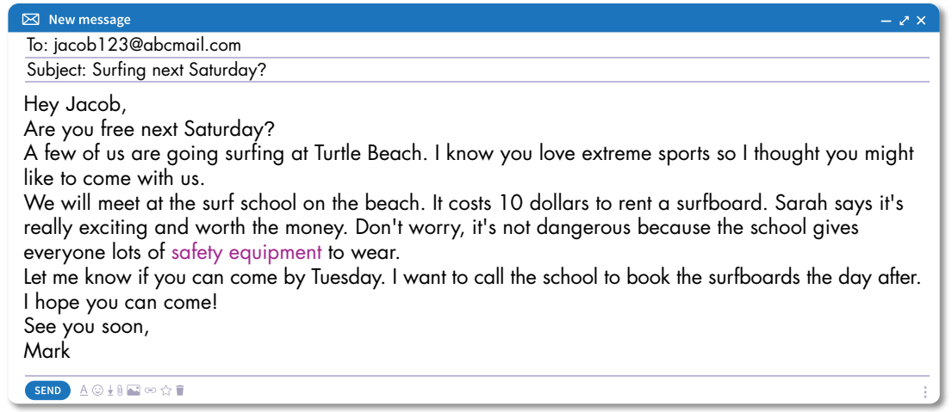
While - reading
Skim the email and underline the key words.
The email is about
1. trying a new activity

Slide 19
While - reading
Scan the email again and answer the questions
1. What extreme sport does Mark invite Jacob to do?
2. Where is the school?
3. What does Sarah say?
4. What does the school give everyone to wear?
5. When will Mark book the surfboards?
Surfing.
On the beach.
It’s really exciting and worth the money.
Safety equipment.
Wednesday.

Slide 20
Post - reading
Work in pairs.
1.Which extreme sport would you like to try?
2.Why?

Slide 21

CONSOLIDATION

Slide 22
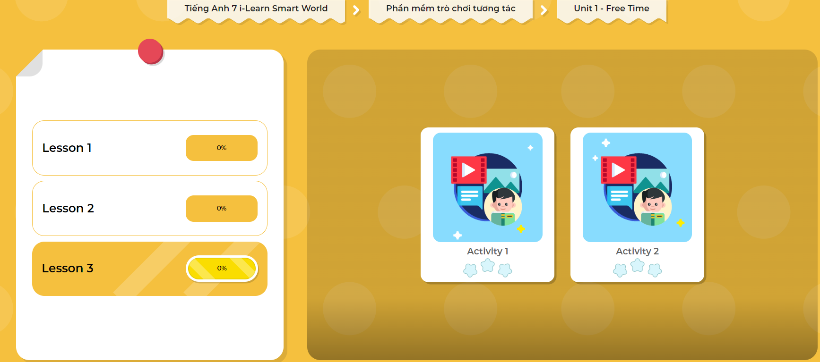
Extra Practice
DHA App
Let’s play!
Click here to play the game

Slide 23
Name some extreme sports:
skateboarding, surfing, rock climbing, zorbing, waterskiing, scuba diving, bungee jumping, parasailing, ice climbing, slacklining, etc.

Slide 24

WRAP-UP

Slide 25
Today’s lesson
Extreme sports
Listening:
- Listen for gist and recognize the correct/ incorrect information
Reading:
- Skim and scan for general and specific information

Slide 26
Homework
Learn by heart the new vocabularies.
Practice talking about the extreme sport you like.
Do exercises in Workbook: Lesson 3 – Listening and Reading (page 6).
Practice the vocabulary in Tiếng Anh 7 i-Learn Smart World Notebook (page 8).
Prepare: Lesson 3 – Writing and Speaking (page 11 – SB).
Play the consolidation games in Tiếng Anh 7 i-Learn Smart World DHA App on www.eduhome.com.vn

Slide 27

Lesson 3
Stay positive and have a nice day!

