Slide 2


Unit
11
OUR GREENER WORLD
LESSON 4: COMMUNICATION
1

Slide 3
LESSON 4: COMMUNICATION
LESSON 1: GETTING STARTED
WARM-UP
Warm-up: Q and A
Everyday English: Giving warnings
PRESENTATION
Task 1: Listen and read the short conversation below, paying attention to the highlighted sentences
Task 2: Work in pairs. Student A is watering flowers in the garden. Student B is giving some warnings. Act out the dialogue. Remember to use the highlighted language in 1
PRACTICE
A survey on ways to go green:
Task 3: The 3Rs Club in your school is doing a survey. Answer the following questions by choosing A, B, or C.
Task 4: Interview a classmate, using the questions in 3. Compare your answers. How many different answers do you have?
PRODUCTION
CONSOLIDATION
Wrap-up
Homework

Slide 4
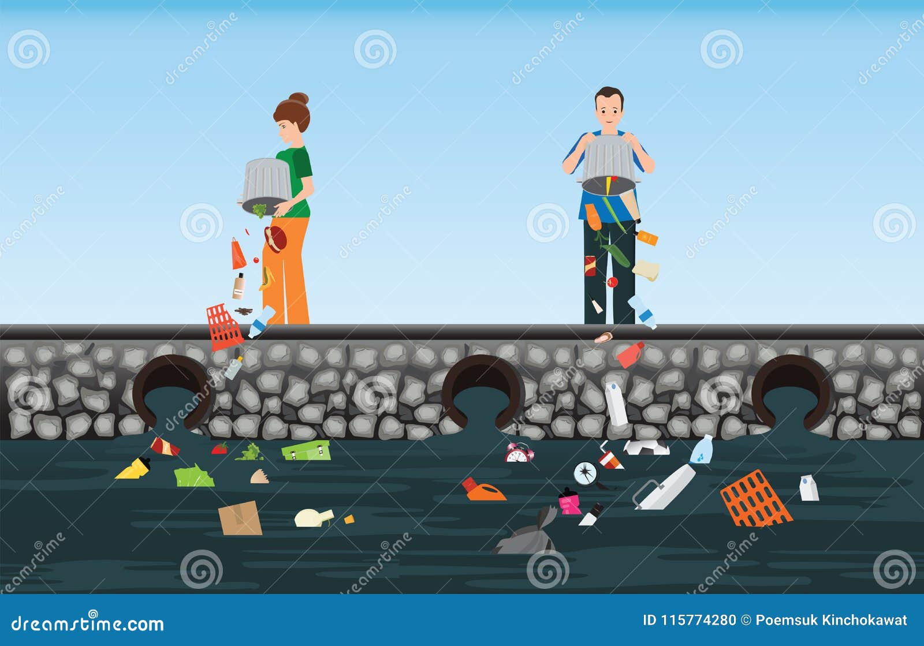

WARM-UP
Q and A
Look at the picture.
What are the people in the picture doing?
What will happen if they continue dumping rubbish into the river?

Slide 5

Everyday English
Giving warnings

Slide 6


PRESENTATION
Listen and read the dialogue between Mi and Mike. Pay attention to the highlighted sentences.
Mi: You are giving the goldfish too much food.
Don’t do that.
Mike: Why?
Mi: If you give them too much food, they will die.
Mike: I see. Thank you.

Slide 7

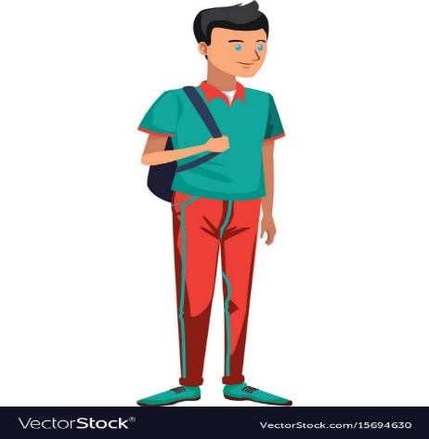
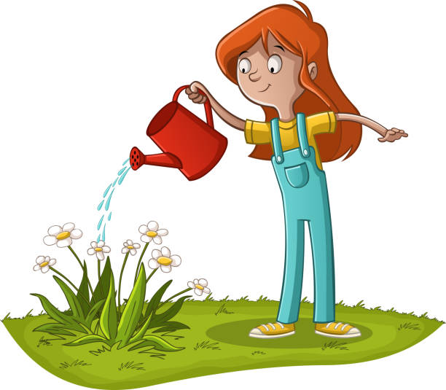


PRACTICE
Work in pairs. Act out the dialogue basing on the following situations. Remember to use the highlighted language in 1.
Situation 1: Student A is watering ﬂowers in the garden. Student B is giving some warnings.
Situation 2: Student A is staying up too late. Student B is giving some warnings.

Slide 8
A survey on ways to go green

Slide 9


PRACTICE
The 3Rs Club in your school is doing a survey. Answer the following questions by choosing A, B, or C.

Slide 10

PRACTICE
The 3Rs Club in your school is doing a survey. Answer the following questions by choosing A, B, or C.
1.
If you find a beautiful old glass, you will______.
A.
B.
decorate it
throw it away
C.
use it to keep pencils in
2.
If you have a sheet of paper, how often will you write on both sides?
A.
B.
Never.
Sometimes.
C.
Always.
3.
If you bring your lunch to school, you will ______.
A.
wrap the food in paper
put the food in a reusable box
B.
C.
wrap the food in a plastic bag

Slide 11
PRACTICE
The 3Rs Club in your school is doing a survey. Answer the following questions by choosing A, B, or C.
4.
If you have old clothes, how often will you give them to those in need?
A.
Sometime.
B.
Never.
C.
Always.
5.
If it’s hot in your room, you will _______.
A.
open the fridge and stand in front of it
B.
go outside and enjoy the breeze
C.
turn on both the fan and the air-conditioner.
6.
If your school is one kilometre from your home, you will _____.
A.
walk
B.
ask your parent to drive you
C.
cycle

Slide 12
PRACTICE
The 3Rs Club in your school is doing a survey. Answer the following questions by choosing A, B, or C.
Check your answers with the key on page 57, count the points and see how green you are.

Slide 13



Answers:
Q1: A (0) B (2) C (2)
Q4: A (1) B (0) C (2)
9 - 12 points: You’re green!
Q2: A (1) B (0) C (2)
Q5: A (0) B (2) C (0)
5 – 8 points: Try to be greener!
Q3: A (0) B (2) C (0)
Q6: A (2) B (0) C (2)
1 – 4 points: You aren’t green at all!

Slide 14

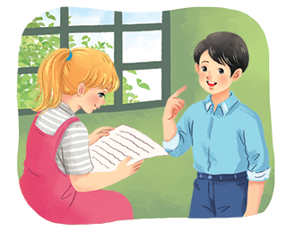
PRODUCTION
Interview a classmate, using the questions in 3. Compare your answers. How many different answers do you have?
Example:
A: What’s your answer to Question 1?
B: It’s A. What’s your answer?
...
Notes:
City landmarks phải ở trên mục 3

Slide 15

CONSOLIDATION
1
Wrap-up
What have we learnt in this lesson?
Everyday English: Giving warnings
A survey on ways to go green

Slide 16

CONSOLIDATION
2
Homework
- List 5 ways you often do to become greener.

Slide 17







