Slide 1


Slide 2

REVIEW
1
UNITS 1-2-3
LESSON 1: LANGUAGE
Pronunciation
Vocabulary
Grammar
UNITS
1-2-3
HOBBIES

Slide 3
LESSON 1: LANGUAGE
WARM-UP
Keyword game
PRONUNCIATION
Task 1: Circle the word whose underlined part is pronounced differently from the others.
VOCABULARY
Task 2: Circle the correct answer A, B, or C to complete each sentence.
Task 3. Complete the sentences with the words from the box.
GRAMMAR
Task 4. Choose the correct answer A, B, or C.
Task 5: Underline the correct bold word in each sentence.
CONSOLIDATION
Wrap-up
Homework

Slide 4



WARM-UP
SET 1
Teenagers

Slide 5
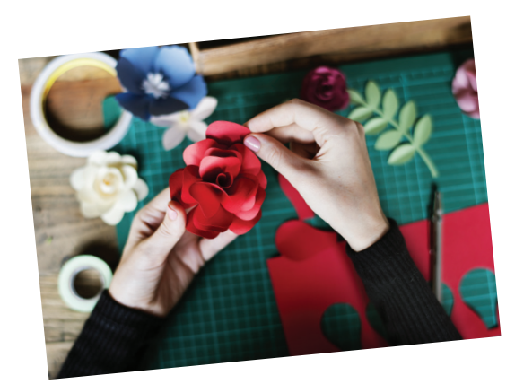

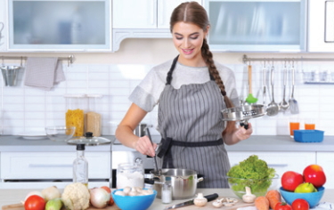
WARM-UP
SET 2
Leisure time activities

Slide 6
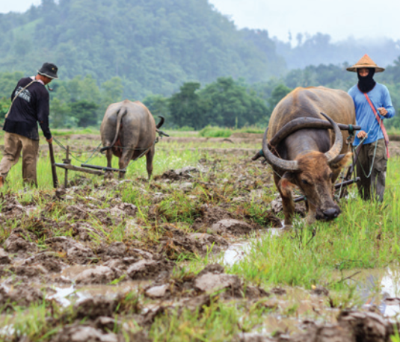
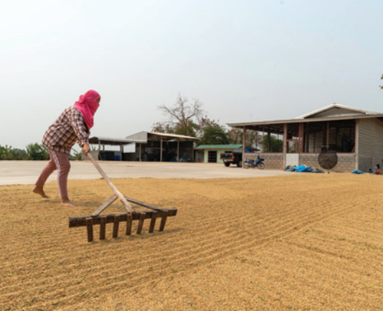
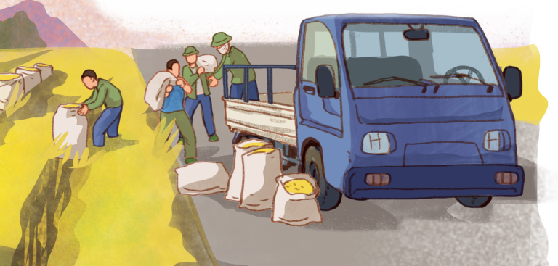
WARM-UP
SET 3
Life in the countryside

Slide 7

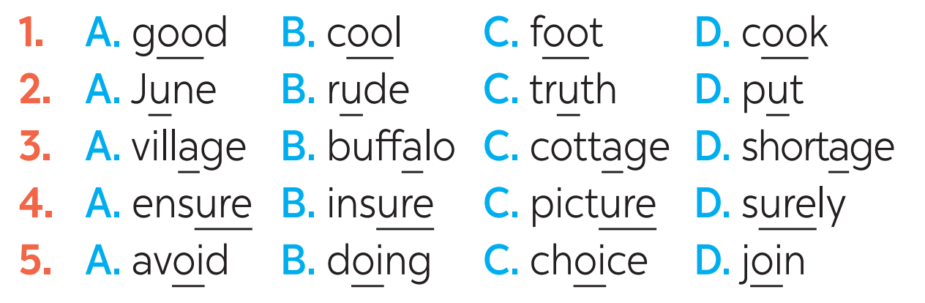
PRONUNCIATION
1
Circle the word whose underlined part is pronounced differently from the others.

Slide 8
VOCABULARY
2
Circle the correct answer A, B, or C to complete each sentence.
1. Mi is ______ gardening in her free time.
A. in B. into C. to
2. Mai is interested ______ building websites for her friends.
A. of B. with C. in

Slide 9
VOCABULARY
3. Minh is not fond of ______ puzzles because he thinks it takes a lot of time.
A. making B. doing C. building
4. I’m not keen on ______ our class photos to the forum.
A. uploading B. surfing C. messaging
5. While I was ______ some websites, I saw an advertisement about a resort.
A. creating B. browsing C. uploading

Slide 10
GRAMMAR
3
Complete the sentences with the words from the box.
bully trained hospitable pressure focus
hospitable
1. People in my village are very ________________ to all visitors.
2. Parents in our village don’t put much ___________ on their children to do well at school.
3. In my school, we can __________ on study and play, and do not have to worry about bullies.
4. The best __________ player in our chess club will not be able to join the competition.
5. If a boy uses his strength to frighten weaker peers, he is a _________.
pressure
focus
trained
bully

Slide 11
GRAMMAR
4
Choose the correct answer A, B, or C.
1. Mai dislikes ______ her pictures to Facebook. She prefers not to show them to others.
A. to upload B. uploading C. upload
2. We enjoy ______ photos of different types of scenery, so we took a camera with us.
A. taking B. to take C. take

Slide 12
GRAMMAR
3. She did the puzzles ______ than I did, so I won the competition.
A. slowly B. slower C. more slowly
4. Tom worked ______ than Mi; therefore, he got better results in the exams.
A. hardly B. harder C. more hard
5. Now they all chat with each other ______ than before because they have smartphones.
A. more frequently B. frequent C. frequently

Slide 13
GRAMMAR
5
Underline the correct bold word in each sentence.
1. Minh is interested in painting, so / but yesterday he decided to join the arts and crafts club.
2. Life in the city seems to be more comfortable, otherwise / but I prefer life in the countryside.

Slide 14
GRAMMAR
3. She tries to focus more on her studies; therefore / otherwise, she won’t pass her exams.
4. During harvest time, farmers have to get up earlier, and / so they have to work harder.
5. Parents now have higher expectations of their children; therefore / so, children are under more pressure than before.

Slide 15

CONSOLIDATION
1
Wrap-up
What have we learnt in this lesson?
Pronunciation in Units 1-2-3
Vocabulary of Units 1-2-3
Grammar of Units 1-2-3

Slide 16

CONSOLIDATION
2
Homework
Exercies in the workbook

Slide 17

Website: hoclieu.vn
Fanpage: facebook.com/www.tienganhglobalsuccess.vn/

