Slide 1

Unit 5: Sports and hobbies
P.E. Lesson 4.1
Page 77

Slide 2
Lesson Outline
Warm-up
Vocabulary
Structure
Consolidation
Wrap-up

Slide 3
Objectives
By the end of this lesson, students will be able to talk about what they can use in some sports, what they can / can’t do, using
Vocabulary: hand, arm, foot/feet, leg, head,
body
Structure:
I use my legs and feet in soccer.
I can kick the ball in soccer.
I can't kick the ball in basketball.

Slide 4

WARM UP

Slide 5

I told
“I told”

Slide 6

HOW TO PLAY
The teacher said: "I told! I told!"
The students replied: "Told what? Told what?"
The teacher chooses an action: For example, "I told you to change positions.”
Students will follow the requested action by the teacher that begins with: "I told ...". As in this example, the students will exchange places.
If the teacher don't say “I told”, the students won't follow.
Anyone who does not follow the rules will be punished.

Slide 7

It’s time to learn …

Slide 8
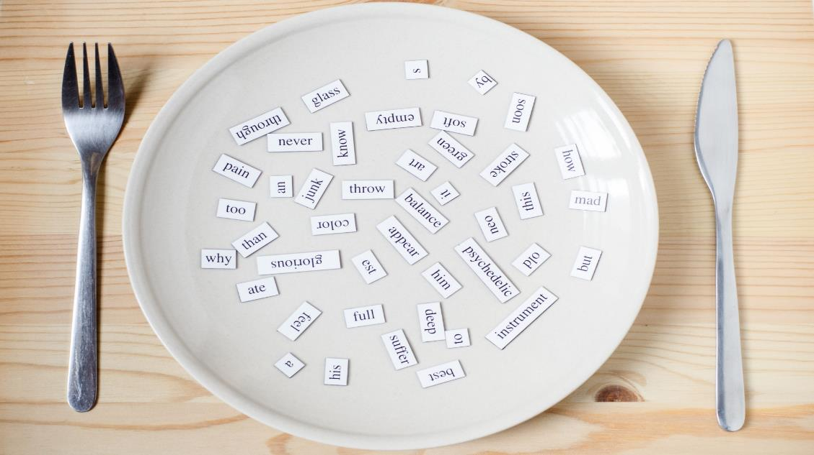
New words
hand
arm
foot/feet
leg
head
body

Slide 9

Presentation

Slide 10

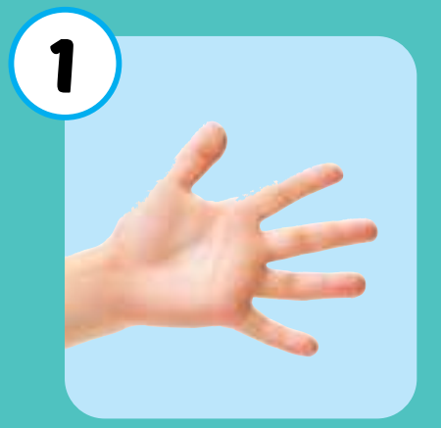

hand
/hænd/
bàn tay
Click on each word to hear the sound.

Slide 11
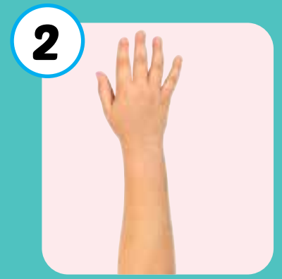
arm
/ɑːrm/
cánh tay
Click on each word to hear the sound.

Slide 12
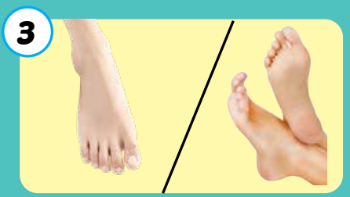
foot/feet
/fʊt/ /fiːt/
đôi bàn chân
Click on each word to hear the sound.

Slide 13
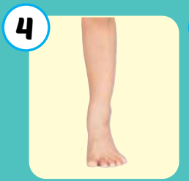
leg
/leɡ/
chân
Click on each word to hear the sound.

Slide 14

head
/hed/
đầu
Click on each word to hear the sound.

Slide 15
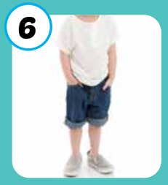
body
/ˈbɑːdi/
cơ thể
Click on each word to hear the sound.

Slide 16

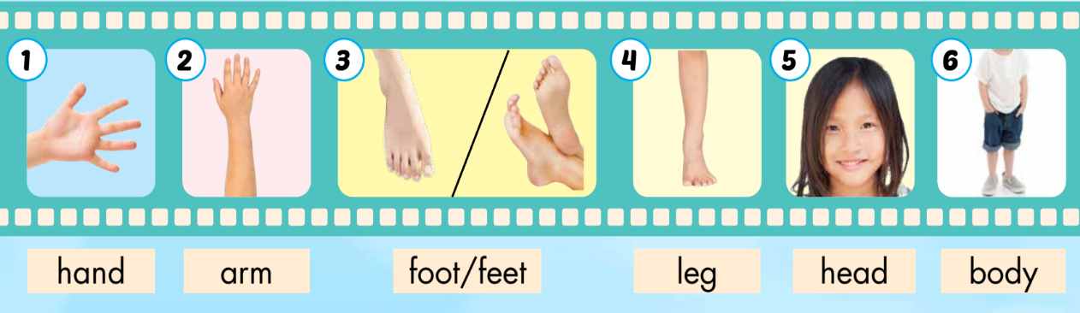
Click on each word to hear the sound.
hand
arm
foot/feet
leg
head
body
/hænd/
bàn tay
/ɑːrm/
cánh tay
/fʊt/ /fiːt/
đôi bàn chân
/leɡ/
chân
/hed/
đầu
/ˈbɑːdi/
cơ thể

Slide 17

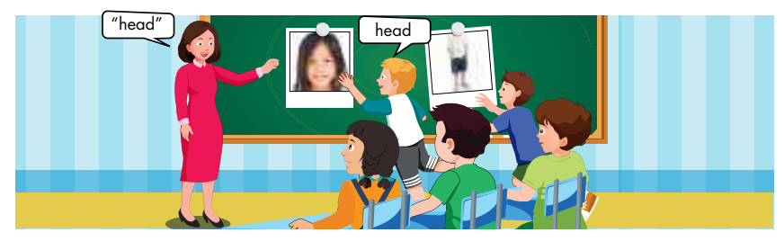
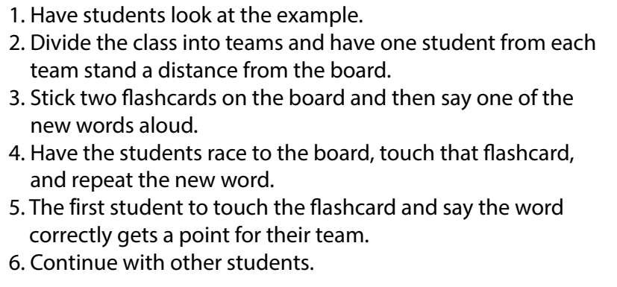

Slide 18

ARE YOU READY ?
PLAY

Slide 20


Slide 23
END

Slide 24

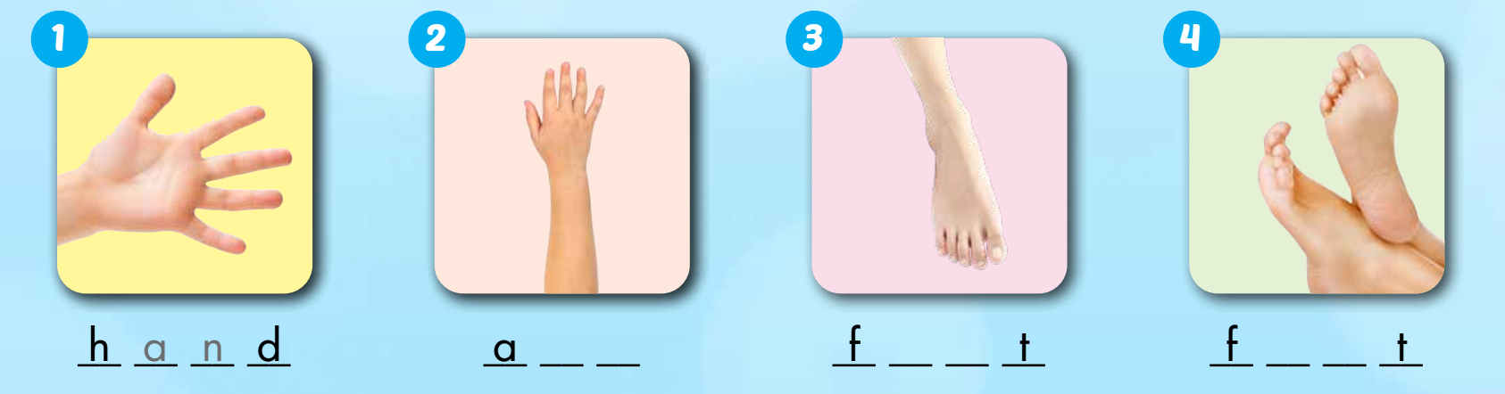
Extra Practice
WB, page 54.
r m
o o
e e

Slide 25
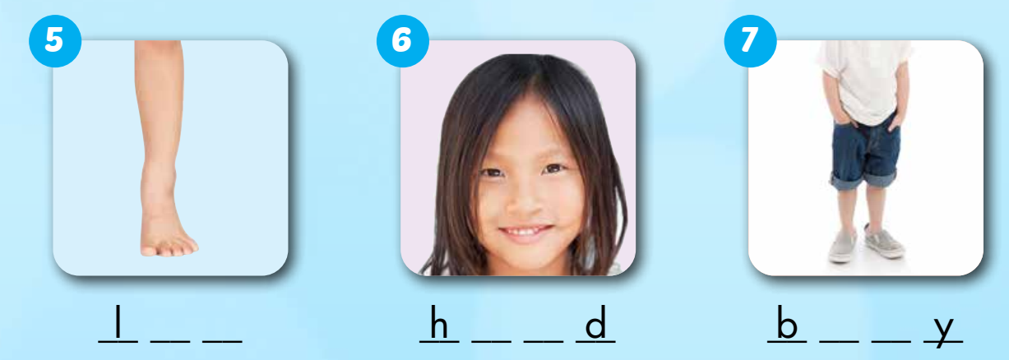
e g
e a
o d

Slide 26
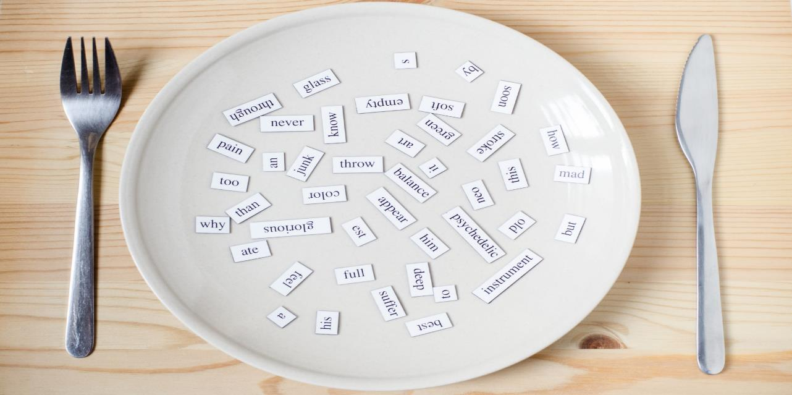
Structures
I use my legs and feet in soccer.
I can kick the ball in soccer.
I can't kick the ball in basketball.

Slide 27

Practice

Slide 28

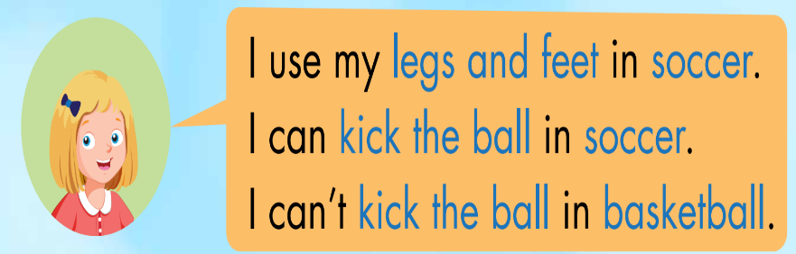
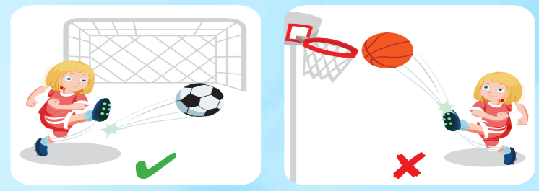

Slide 29

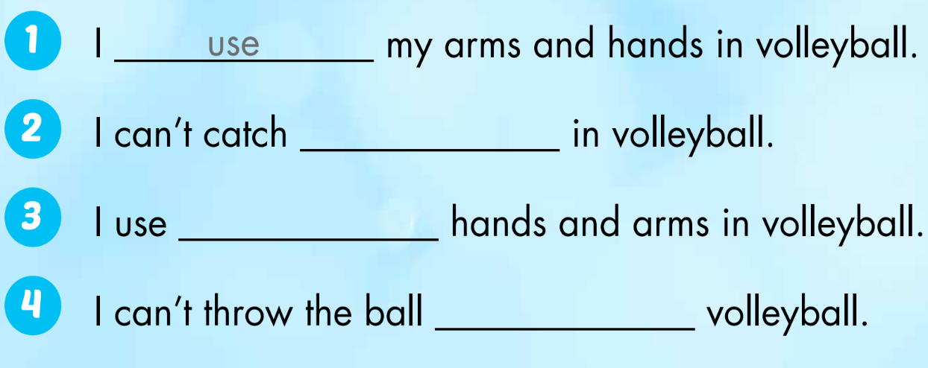
the ball
my
in

Slide 30

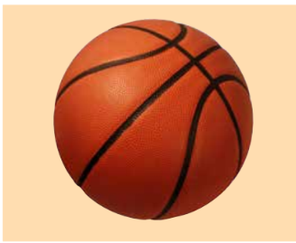
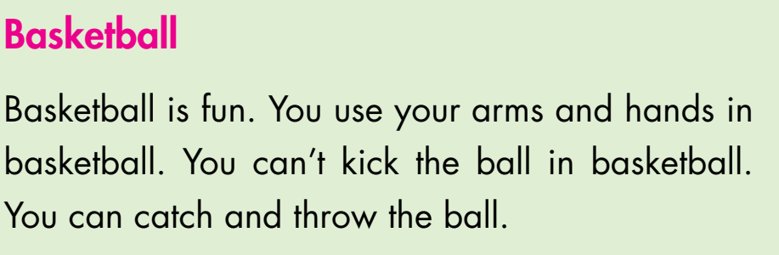
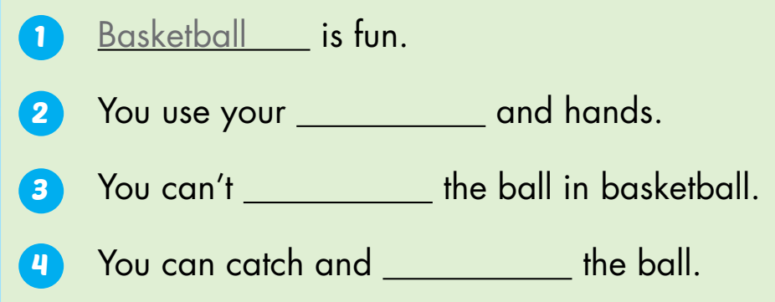
Extra Practice
WB, page 54.
arms
kick
throw

Slide 31

CONSOLIDATION

Slide 32
Early Production

Slide 33
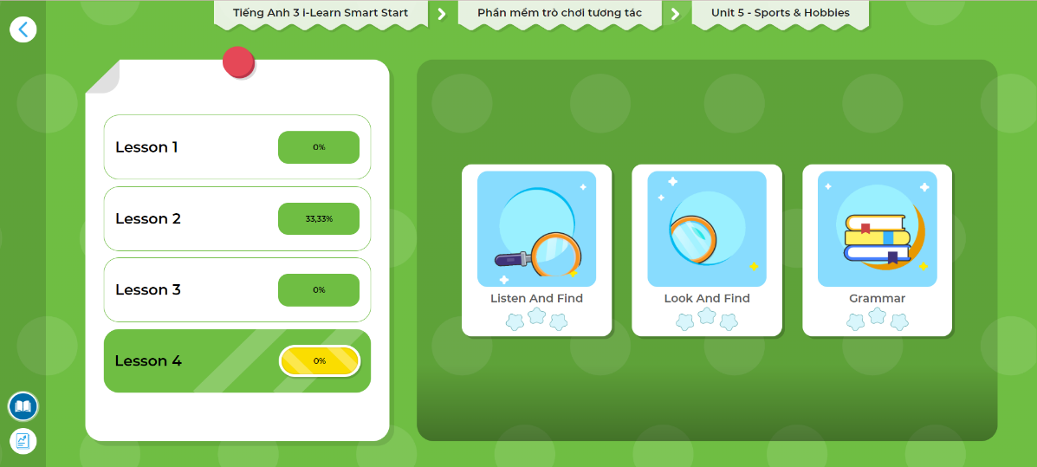
LET’S PLAY!
Click here to play the games!

Slide 34

WRAP-UP

Slide 35

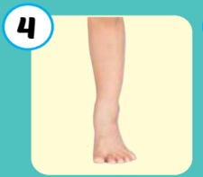
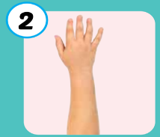

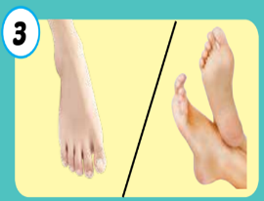

6
1
SPIN
5
2
4
3
Notes:
GV dùng vòng quay để HS chọn số ngẫu nhiên. Khi chọn vào ô số nào thì sẽ làm câu cho số đó

Slide 36

Write about yourself
_______
____ is fun. I use my ___and ___in ____.
I can’t ___the ball in ____. I can ___ and ___ the ball.

Slide 37
Today’s lesson
Vocabularies
hand
arm
foot/feet
leg, head
body
Structures/ Sentence patterns
I use my legs and feet in soccer.
I can kick the ball in soccer.
I can't kick the ball in basketball.

Slide 38
Homework
Practice vocabularies and structure. Make sentences using them.
Do the exercises in Tiếng Anh 3 i-Learn Smart Start Workbook (page 54)
Do the exercises in Tiếng Anh 3 i-Learn Smart Start Notebook (page 37)
Play the consolidation games in Tiếng Anh 3 i-Learn Smart Start DHA App on www.eduhome.com.vn
Prepare the next lesson (page 78)

Slide 39

Have a nice day!

