Slide 1

WELCOME TO HAN THUYEN HIGH SCHOOL
GIẢI PHÁP NÂNG CAO CHẤT LƯỢNG
ÔN THI TỐT NGHIỆP THPT NĂM 2023
MÔN TIẾNG ANH

Slide 2
NỘI DUNG CHÍNH
ÔN TẬP CHUYÊN ĐỀ:
THÌ ĐỘNG TỪ VÀ MỆNH ĐỀ TRẠNG NGỮ CHỈ THỜI GIAN
2. GIẢI PHÁP NÂNG ĐIỂM THI MÔN ANH BẰNG VIỆC CHIA NHÓM CÂU HỎI PHÙ HỢP VỚI ĐỐI TƯỢNG HỌC SINH

Slide 3
Các chuyên đề đã ôn tập
Mệnh đề quan hệ
Mệnh đề quan hệ rút gọn (to V, Ving, P2)
So sánh
Câu điều kiện
Thì động từ và mệnh đề trạng ngữ chỉ thời gian

Slide 4


CHUYÊN ĐỀ 5:
THÌ ĐỘNG TỪ VÀ MỆNH ĐỀ TRẠNG NGỮ CHỈ THỜI GIAN

Slide 5
I. GIỚI THIỆU CHUNG VÀ ÔN TẬP CHUYÊN ĐỀ
Câu | Nội dung | Độ khó | Đặc tả
30 | Xác định lỗi sai | Nhận biết | Thì động từ (Hiện tại đơn, quá khứ đơn)
15 | Thì động từ | Nhận biết | Kết hợp 2 thì: + Quá khứ tiếp diễn – Quá khứ đơn + Hiện tại hoàn thành – Quá khứ đơn
27 | Chuyển câu/ Câu đồng nghĩa | Thông hiểu | Các câu chuyển viết lại bằng thay đổi Verb tenses (Quá khứ đơn và Hiện tại hoàn thành)
7 | Mệnh đề trạng ngữ – thời gian | Vận dụng

Slide 6
Nội dung câu hỏi | Mức độ | Trọng tâm các thì
Thì quá khứ đơn và dấu hiệu nhận biết | Nhận biết | Hiện tại đơn Hiện tại hoàn thành Quá khứ đơn Quá khứ tiếp diễn Tương lai đơn Tương lai hoàn thành
Mệnh đề trạng ngữ chỉ thời gian trong quá khứ (when/while) | Nhận biết
Hiện tại hoàn thành | Thông hiểu
Mệnh đề trạng ngữ chỉ thời gian trong tương lai | Vận dụng

Slide 7
1. MỆNH ĐỀ TRẠNG NGỮ CHỈ THỜI GIAN TRONG QUÁ KHỨ
Quá khứ tiếp diễn – Quá khứ đơn - (MỨC ĐỘ NHẬN BIẾT)
The students ______ noisily when the teacher came into the classroom.
were talking B. talk C. talked D. are talking
Remember:
The past continuous is used to talk about a past action in progress, and the past simple
to talk about a shorter action that interrupted it.
Example: A storm hit the island while I was enjoying my holiday there last year.
Mệnh đề chính | Liên từ | Mệnh đề trạng ngữ chỉ thời gian
S + QKĐ | While/ as | S + QKTD
S + QKTD | when | S + QKĐ

Slide 8
Examples/ Ví dụ:
1. I ______ to the radio when Helen phoned.
was listening B. listened C. will listen D. listen
2. While they ______ in the forest, a storm suddenly struck.
A. are camping B. camped C. camp D. were camping
3. When I ________into the office, my boss was waiting for me.
A. was coming B. came C. has been coming D. had come

Slide 9
PRACTICE (8 questions)
Give correct form of the verbs: Past simple or past continuous
rang
1. The telephone (ring) __________________ while we were having dinner.
were watching
2. The children (watch) ________________ a cartoon when their mother entered the room.
knocked
3. Someone (knock) ________________ the door while I was washing the dishes.
arrived
were having
4. When I (arrive) ______________, they (have) _________________ lunch.
was walking
ran into
5. While she (walk) ___________ __in the park, she (run into) __________ an old friend.

Slide 10
Choose the correct answer
6. When I arrived at her house, she_______ photos in the garden.
A. was taking B. takes C. is taking D. has taken
7. The students _______ the topic when the light went out.
A. discuss B. were discussing C. have discussed D. are discussing
8. We were planting flowers in the school garden when it _____ to rain.
A. starts B. was starting C. has started D. started

Slide 11
2. Xác định lỗi sai (về thì) – NHẬN BIẾT
Đề tham khảo 2023
30. He breaks his father’s antique vase in the living room last night.
breaks
antique
the
night
→ A. breaks → broke

Slide 12
Past simple + Time expressions
Yesterday
In the past/ in the 19th century/ in ancient times/ in the 1990s
Last night (week, year, ….)
Ago (two hours ago, two weeks ago, …)
at, on, in… time in the past
Lionel Messi was born in June, 1987.
When + mệnh đề chia thì quá khứ đơn
When she was a child, she dreamt of being a pop star.
Since + S + past simple
I haven’t met him since he left school.

Slide 13
Examples
1. After the earthquake, she has stayed in Turkey to help the homeless for over 20 days last month.
A. After B. has stayed C. to help D. for
2. Two months ago, I go back to my hometown to visit my grandparents.
A. Last B. go C. hometown D. grandparents.
3. Tien Anh borrows a lot of English books from the school library yesterday.
borrows B. of C. from D. library
4. The Tale of Tam and Cam use to be one of her favourite stories when she was at school.
A. At B. her C. stories D. use
stayed
went
borrowed
used

Slide 14
3. Chuyển câu/ Câu đồng nghĩa
Đề tham khảo 2023:
I last heard from him five years ago.
I heard from him for five years.
I didn’t hear from him for five years.
I haven’t heard from him for five years.
I have heard from him for five years.
Từ quá khứ đơn sang
hiện tại hoàn thành và ngược lại

Slide 15
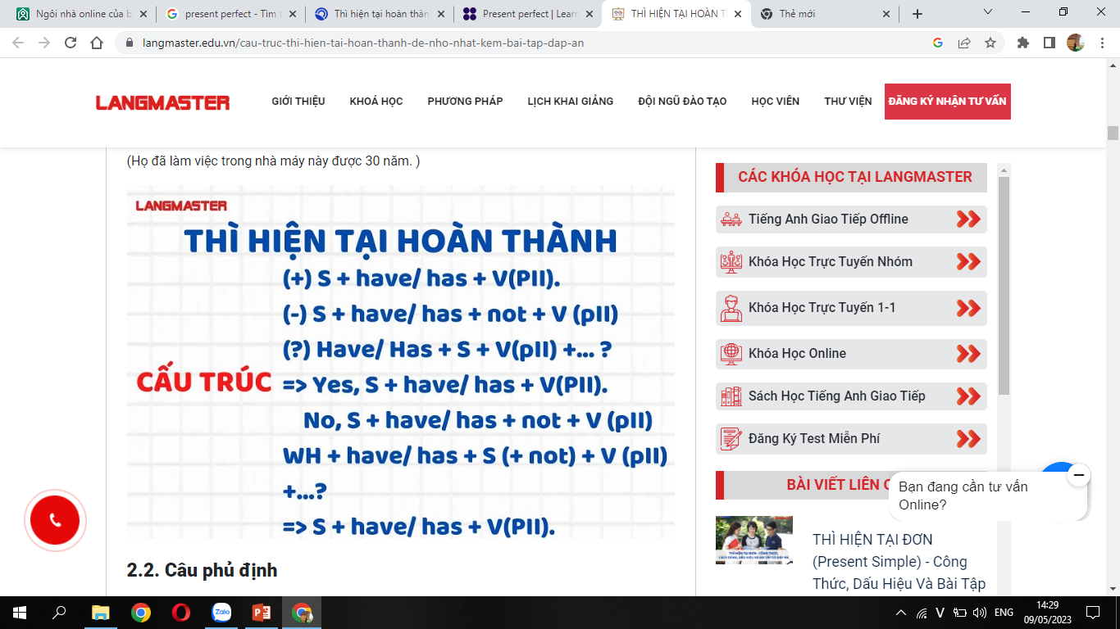
Present perfect simple/ Thì hiện tại hoàn thành
Time expressions/ Dấu hiệu nhận biết
Before, Ever, Never, Yet, …the first/ second…time, Just / Recently / Lately, Already, So far/ Until now/ Up to now/ Up to the present
For + quãng thời gian: trong khoảng thời gian nào đó(for years, for a long time,..)
Since + mốc thời gian: kể từ khi (since 1985, since she was five, since last year, ….)
I haven’t heard from him
for five years.

Slide 16
Các cách chuyển câu từ quá khứ đơn sang hiện tại hoàn thành và ngược lại
Câu tình huống | Cách 1 | Cách 2 | Cách 3
1. He last saw her two months ago. | It is two months since he last saw her. | The last time he saw her was two months ago. | He hasn’t seen her for two months.
S + last + QKĐ + time + ago. | It +be+ time + since + S + QKĐ. | The last time +S + QKĐ was time ago. | S + hasn’t/ haven’t +P2 + for time.

Slide 17
Các cách chuyển câu từ quá khứ đơn sang hiện tại hoàn thành và ngược lại
Câu tình huống | Cách 1 | Cách 2
2. He last saw her when she was five. | He hasn’t seen her since she was five. | The last time he saw her was when she was five.

Slide 18
Các cách chuyển câu từ quá khứ đơn sang hiện tại hoàn thành và ngược lại
Câu tình huống | Câu đồng nghĩa
3. I started learning English when I was 6. | I have learnt English since I was 6.
4. I started learning English 5 years ago. | I have learnt English for 5 years.
I have started learning English since I was 6.

Slide 19
Các cách chuyển câu từ quá khứ đơn sang hiện tại hoàn thành và ngược lại
Câu tình huống | Dạng 1 | Dạng 2 | Dạng 3
1. He last saw her two months ago. | It is two months since he last saw her. | The last time he saw her was two months ago. | He hasn’t seen her for two months.
S + last + QKĐ + time + ago | It +be+ time + since + S + QKĐ | The last time +S+QKĐ was time ago. | S + hasn’t/ haven’t +P2 + for time.
2. He last saw her when she was five. | He hasn’t seen her since she was five. | The last time he saw her was when she was five.
3. I started learning English when I was 6. |  |  | I have learnt English since I was 6.
4. I started learning English 5 years ago. |  |  | I have learnt English for 5 years.

Slide 20
Change the sentences
0. I haven’t taken the children to the park for two weeks.
I last ……………………………………………………………………………………………
1. I last saw a movie 3 months ago.
I haven’t ……………………………………………………………………………………….
2. It is a long time since she last talked to her parents.
She hasn’t …………………………………………………………………………………..
3. I have been waiting for the concert for 3 weeks.
I started ……………………………………………………………………………………..
4. The last time I read a book was last week.
I ………………………………………………………………………………………………..
took the children to the park two weeks ago.
seen a movie for 3 months.
talked to her parents for a long time.
to wait for the concert 3 weeks ago.
haven’t read a book since last week.

Slide 21
5. He last went to the cinema two months ago.
He hasn’t gone to the cinema for two months.
B. He has two months to go the cinema.
C. He has gone to the cinema for two months.
D. He didn’t go to the cinema two months ago.

Slide 22
6
She last wrote to her pen pal 6 months ago.
She has written to her pen pal for 6 months.
She hasn't written to her pen pal for 6 months.
C. She didn't write to her pen pal for 6 months.
D. She won't write to her pen pal for 6 months.

Slide 23
7
I haven't visited my hometown for a few years.
I have been in my hometown for a few years.
I last visited my hometown a few years ago.
I didn't visit my hometown a few years ago.
I was in my hometown for a few years.

Slide 24
4. Mệnh đề trạng ngữ chỉ thời gian trong tương lai (VẬN DỤNG)
Đề tham khảo 2023:
Laura will buy a new laptop ______.
after she had got her salary
when she got her salary
as soon as she gets her salary
by the time she got her salary

Slide 25
Mệnh đề trạng ngữ chỉ thời gian trong tương lai (VẬN DỤNG)
Mệnh đề chính/ Main clause | Mệnh đề trạng ngữ chỉ thời gian/ Time clause
S + Tương lai đơn Tương lai hoàn thành Tương lai gần can/may/might +V | when as soon as/ the moment after before until by the time once (khi) | S + Hiện tại đơn Hiện tại hoàn thành (để nhấn mạnh sự hoàn thành)
Laura will buy a new laptop as soon as she gets her salary.
(As soon as Laura gets her salary, she will buy a new laptop.)

Slide 26
Mệnh đề chính | Mệnh đề trạng ngữ chỉ thời gian
S + Tương lai đơn Tương lai hoàn thành Tương lai gần can/may/might +V | When As soon as/ the moment After Before Until By the time Once (khi) | S + Hiện tại đơn Hiện tại hoàn thành (để nhấn mạnh sự hoàn thành)
By the time she comes, he will have already left.

Slide 27
Examples/ Ví dụ
1. Bill’s mother won’t let him go out with his friends ______.
when he finished his homework
after he had finished his homework
once he finished his homework
until he has finished his homework

Slide 28
Examples/ Ví dụ
2. _____________, he will be very happy.
When my father was seeing my test scores
When my father had seen my test
When my father sees my test scores
When my father saw my test scores

Slide 29
3. The party will begin _____________.
after all the guests had arrived
by the time all the guests arrived
C. when all the guests were arriving
D. as soon as all the guests arrive

Slide 30
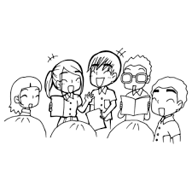
PRACTICE IN GROUPS

Slide 31
8 GROUPS
GROUP 1 | GROUP 2 | GROUP 3 | GROUP 4
Bạch Hải Thực Biên Ngọc Dung Phan Hưng Bảo Lâm | Đức Long Phương Linh Thuỳ Linh Hải Long Phương Mai | Thuý Ngân Nguyệt Minh Trà My Chí Tân Đức Thắng | Thế Toàn Phương Tuấn Tâm Lan Hoàng Tuấn Anh Tiến Đạt
GROUP 5 | GROUP 6 | GROUP 7* | GROUP 8*
Quang Tân Ng Tuấn Anh Đăng Việt Anh Vũ Việt Anh Quang | Minh Ánh Tùng Dương Đức Hiếu Minh Phương | Ngọc Thảo Hà Trang Trần Hương Thu Hồng Tiến Anh | Kiên Minh Hiếu Khánh Linh Tài Dũng

Slide 32
PRACTICE IN GROUPS

Slide 33

CHECKING

Slide 34
Sự hòa hợp giữa quá khứ tiếp diễn và quá khứ đơn (Nhận biết)
1. Laura______ her bedroom when she found her missing diary.
A. cleans B. was cleaning C. has cleaned D. is cleaning
2. He broke his leg when he______football.
A. is playing B. plays C. was playing D. played
3. Helen and Tom ______ at the supermarket when they met their former teacher.
A. shopped B. have shopped C. are shopping D. were shopping

Slide 35
Xác định lỗi sai (Nhận biết)
4. After graduating in 2003, he becomes a scholar, travelling to Oxford.
A. graduating B. becomes C. scholar D. travelling
5. We decided to leave the beach because it gets dark and we wanted to get home while there was still some light.
A. to leave B. gets C. while D. still
6. Hackers take her Facebook account last week and they used it to ask others on her social network for money.
A. take B. it C. social D. for

Slide 36
Chọn câu đồng nghĩa (Thông hiểu)
7. It hasn't snowed here for a fortnight.
A. It is a fortnight since it has snowed here.
B. The last time it snowed here is a fortnight ago.
C. A fortnight went since it last snowed here.
D. It last snowed here a fortnight ago.

Slide 37
Chọn câu đồng nghĩa (Thông hiểu)
8. It is ten months since Kim last went to the cinema.
A. Kim goes to the cinema every ten months.
B. Kim didn't go the cinema ten months ago.
C. Kim hasn't gone to the cinema for ten months.
D. The first time Kim went to the cinema was ten months ago.

Slide 38
Chọn câu đồng nghĩa (Thông hiểu)
9. The last time Katherine released a new album was two years ago.
A. Katherine released a new album for two years.
B. Katherine hasn’t released a new album for two years.
C. Katherine has released a new album for two years.
D. Katherine last released a new album for two years ago.

Slide 39
Chọn câu đồng nghĩa (Thông hiểu)
10. The last time I updated my Facebook status was 6 months ago.
A. I haven’t updated my Facebook status for 6 months.
B. I have 6 months to update my Facebook status.
C. I started updating my Facebook status 6 months ago.
D. I have updated my Facebook status for 6 months.

Slide 40
Chọn câu đồng nghĩa (Thông hiểu)
11. My mother last had her eyes tested ten months ago.
A. My mother didn’t have any test on her eyes in ten months,
B. My mother hasn’t had her eyes tested for ten months.
C. My mother had tested her eyes ten months before.
D. My mother had not tested her eyes for ten months then.

Slide 41
Mệnh đề trạng ngữ chỉ thời gian trong tương lai (Vận dụng)
12. What benefits will you get _______ for the job?
A. when you apply B. by the time you applied
C. after you had applied D. when you applied
13. We will have a trip to Sam Son beach _______.
A. as soon as we had prepared for our project
B. when we have prepared for our project
C. after we prepared for our project
D. by the time we prepared for our project

Slide 42
Mệnh đề trạng ngữ chỉ thời gian trong tương lai (Vận dụng)
14. ______, they will buy a new house in the countryside.
A. When my parents retired
B. As soon as my parents retire
C. After my parents had retired
D. Since my parents retired
15. I will work for my family’s company _______.
A. as soon as I finished my tertiary education
B. when I have finished my tertiary education
C. by the time I finished tertiary education
D. after I finished my tertiary education

Slide 43

CHUYÊN ĐỀ → ĐỀ LUYỆN TẬP

Slide 44
II. ĐỀ LUYỆN TẬP
Đề̀ được thiết kế theo ma trận của đề tham khảo của Bộ năm 2023
Đề được phân nhóm:
CÁCH 1 Nhóm câu hỏi về từ vựng và ngữ pháp: Ưu tiên các câu hỏi Nhận biết và thông hiểu (Đạt mục tiêu 6-7đ) đặt lên trước: Từ câu 1 đến 24 Vận dụng: Từ câu 25 đến 28 Vận dụng cao: Từ câu 29 đến 33 Nhóm câu hỏi đọc hiểu: Toàn bộ 3 bài đọc (Dành cho hs có mục tiêu đạt điểm 8-10)
CÁCH 2
- Giữ nguyên các nhóm câu hỏi
- Trong từng nhóm câu hỏi, sắp xếp các câu hỏi theo trật tự từ Nhận Biết – Thông Hiểu – Vận Dụng – Vận Dụng Cao

Slide 45
CÁCH PHÂN NHÓM ĐỀ 1:
GROUP 1 | GROUP 2 | GROUP 3 | GROUP 4
Bạch Hải Thực Biên Ngọc Dung Phan Hưng Bảo Lâm | Đức Long Phương Linh Thuỳ Linh Hải Long Phương Mai | Thuý Ngân Nguyệt Minh Trà My Chí Tân Đức Thắng | Tiến Đạt Thế Toàn Phương Tuấn Tâm Lan Hoàng Tuấn Anh
GROUP 5 | GROUP 6 | GROUP 7* | GROUP 8*
Quang Tân Ng Tuấn Anh Đăng Việt Anh Vũ Việt Anh Quang | Minh Ánh Tùng Dương Đức Hiếu Minh Phương | Hà Trang Ngọc Thảo Trần Hương Thu Hồng Tiến Anh | Kiên Minh Hiếu Khánh Linh Tài Dũng

Slide 46
CHUYÊN ĐỀ → ĐỀ LUYỆN TẬP

Slide 47
WRAPPING -UP
Các thì trọng tâm và mệnh đề trạng ngữ chỉ thời gian
Quá khứ – Quá khứ tiếp diễn (while/ when/ as)
Hiện tại hoàn thành – quá khứ đơn (since)
Hiện tại hoàn thành với for/ since
Tương lai – Hiện tại
2. Làm đề theo phân loại mức độ khó của câu hỏi với mục tiêu 6-7đ (Nhận biết – Thông hiểu)

Slide 48


CHÚC CÁC EM ÔN TẬP TỐT VÀ
ĐẠT ĐƯỢC MỤC TIÊU ĐỀ RA!!!

