Slide 1

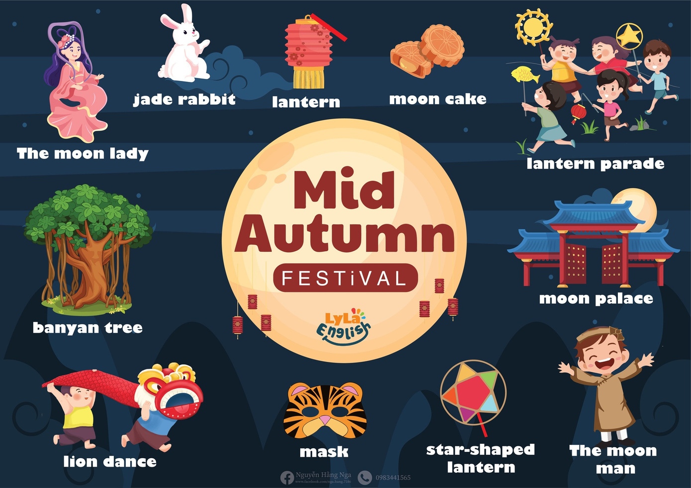


Slide 2

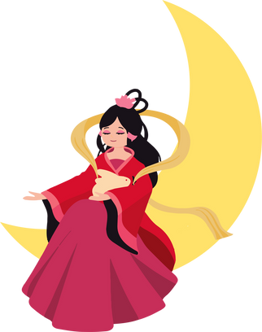

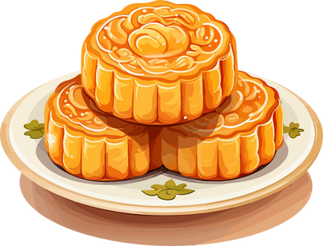

I. QUESTION
Who do you see at Mid-autumn festival?
- I see the…. and the….
2. What do you take to the lantern parade?
-I take a …..
3. What do you wear to the lantern parade?
- I wear a ….
4. What cake do you eat at Mid- autumn festival. - I eat ….
5. What shape is the moon cake?
- It’s …. and …

Slide 3

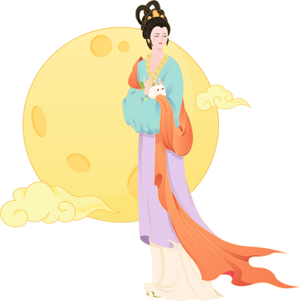
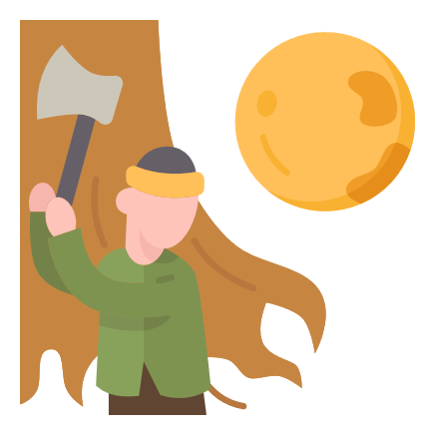
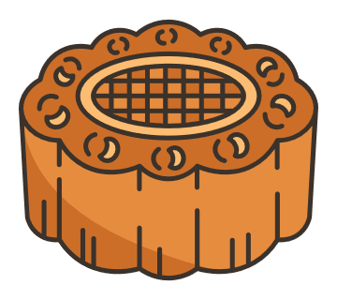

II. VOCABULARY
The moon lady:...........................................
The moon man:...........................................
Moon cake:.................................................
Star lantern:...............................................

Slide 4

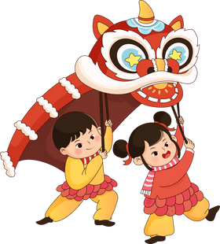

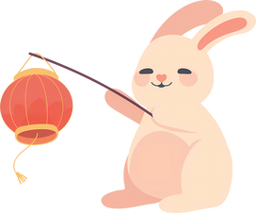
II. VOCABULARY
Mask:.........................................................
Lion dance:.................................................
Banyan tree:...............................................
Jade rabbit:.................................................

Slide 5
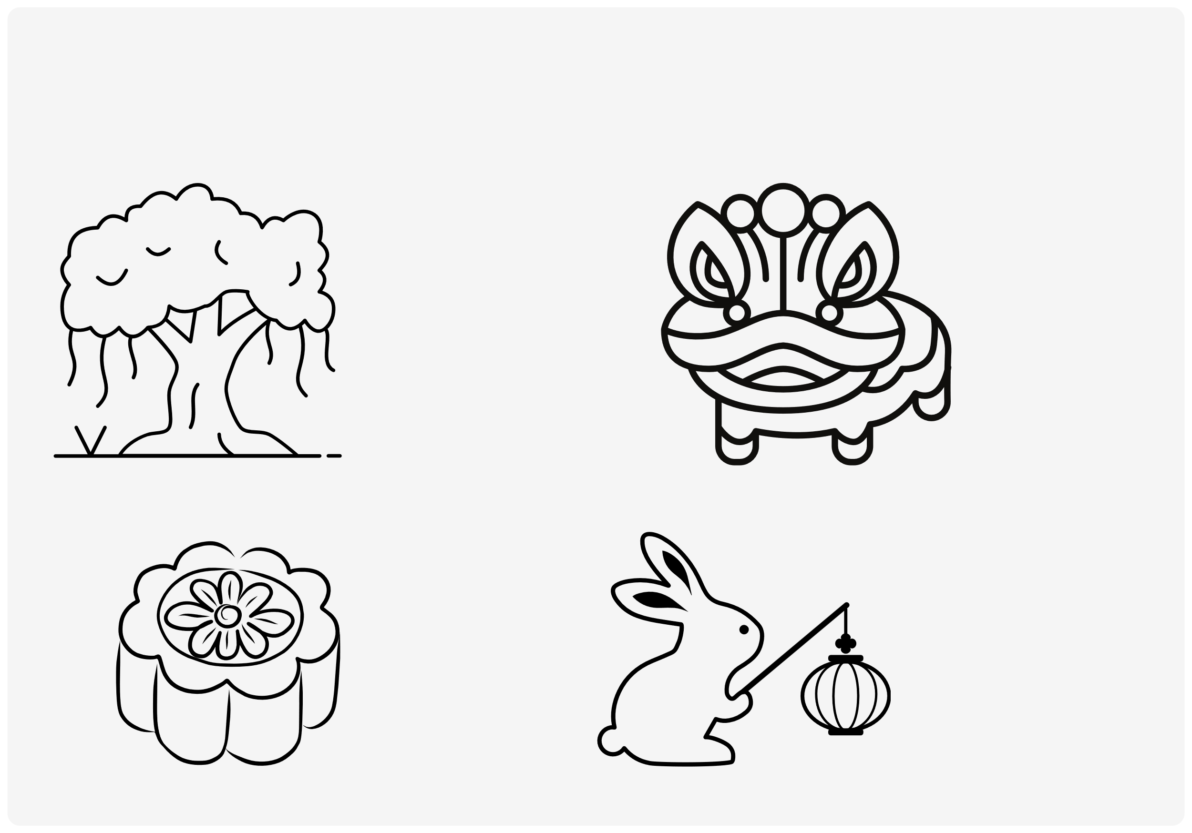
III. EXERCISES:
1.Read and color:
banyan tree
Lion dance
moon cake
Jade rabbit

Slide 6
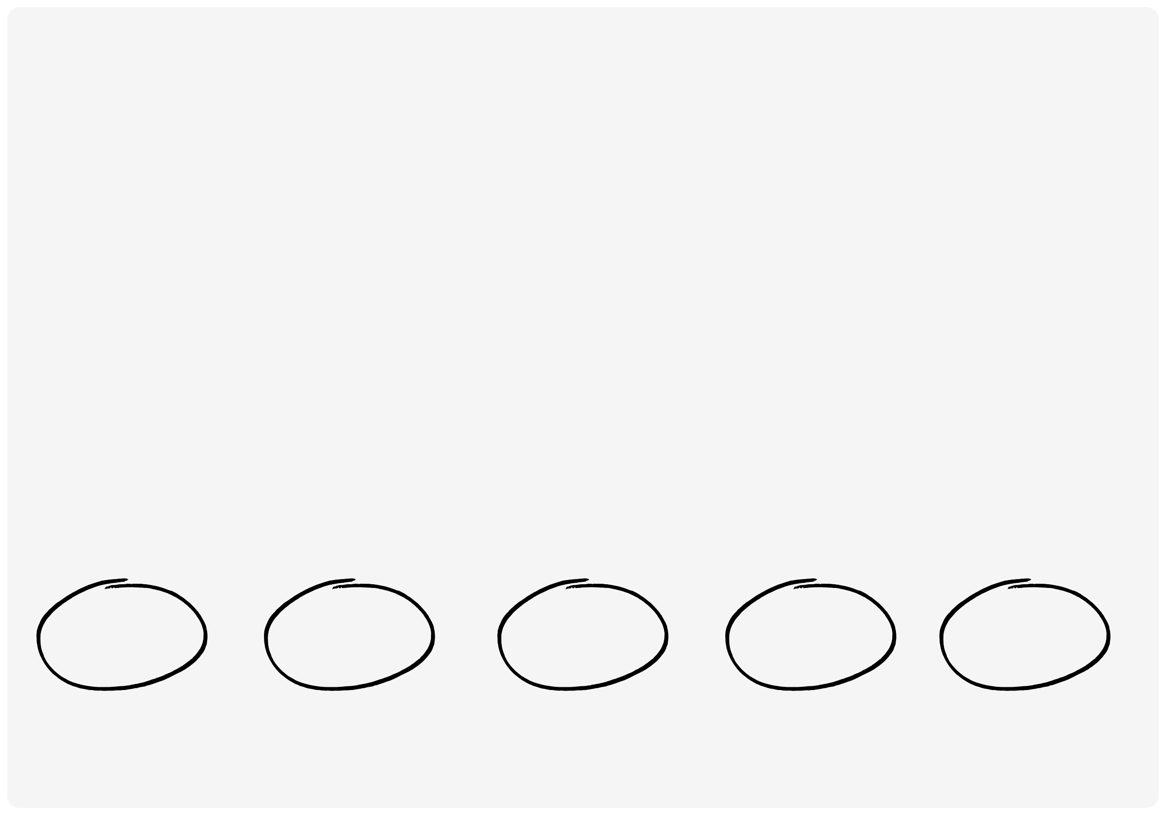
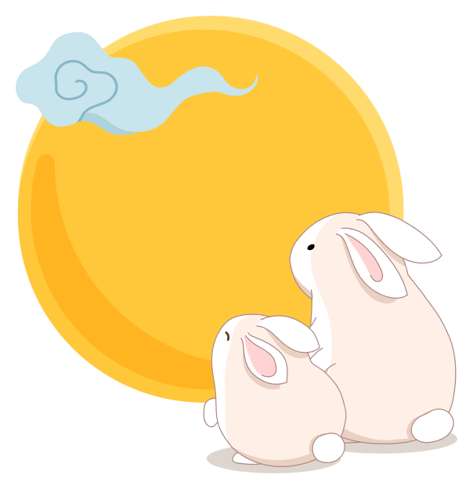
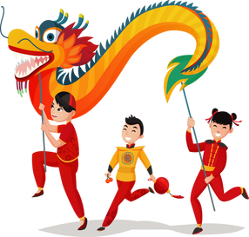
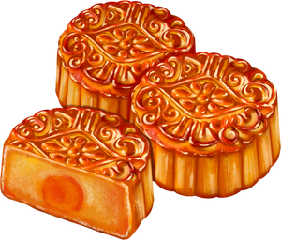
III. EXERCISES:
2. Match the picture with its name:
mask
moon cake
jade rabbit
lion dance
the moon lady

Slide 7
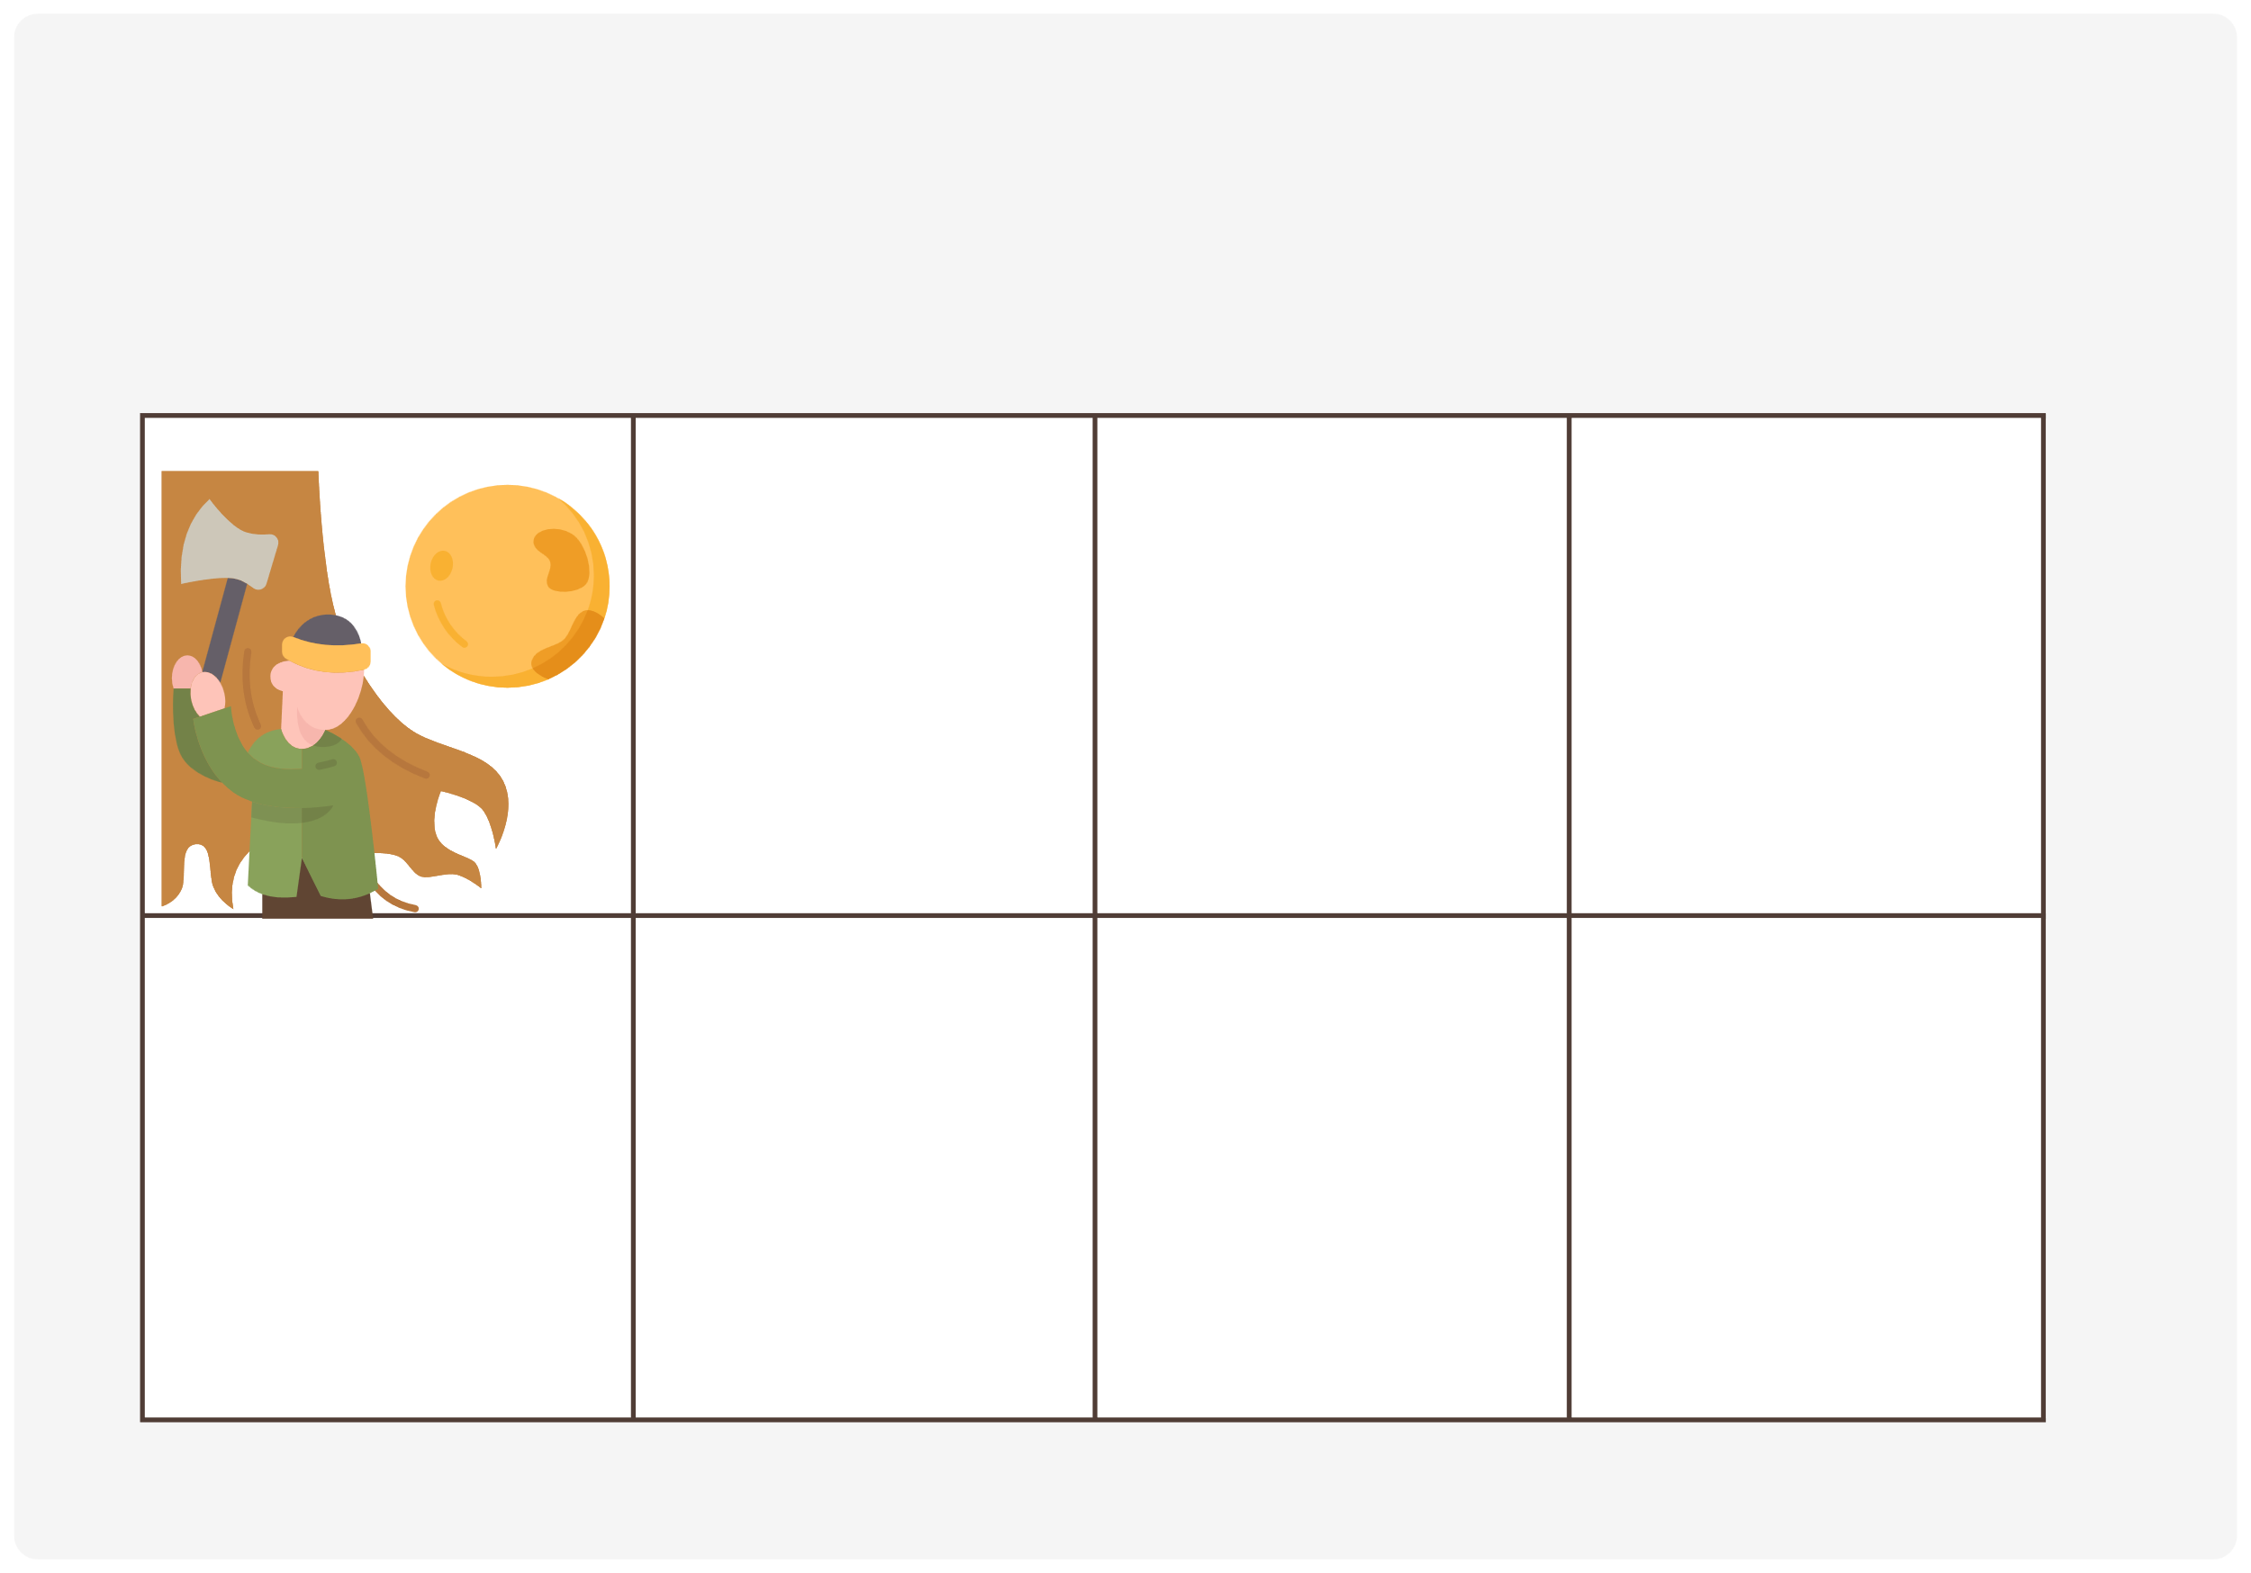
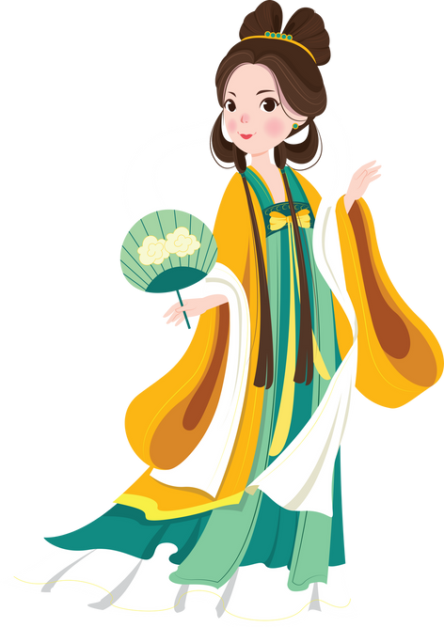

III. EXERCISES:
3. Fill the missing words:
The m_on man
Moon pa_ace
The moon l_ _y
La_tern

Slide 8
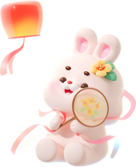


III. EXERCISES:
4. Trace and match:
banyan tree lantern
jade rabbit
moon cake

Slide 9
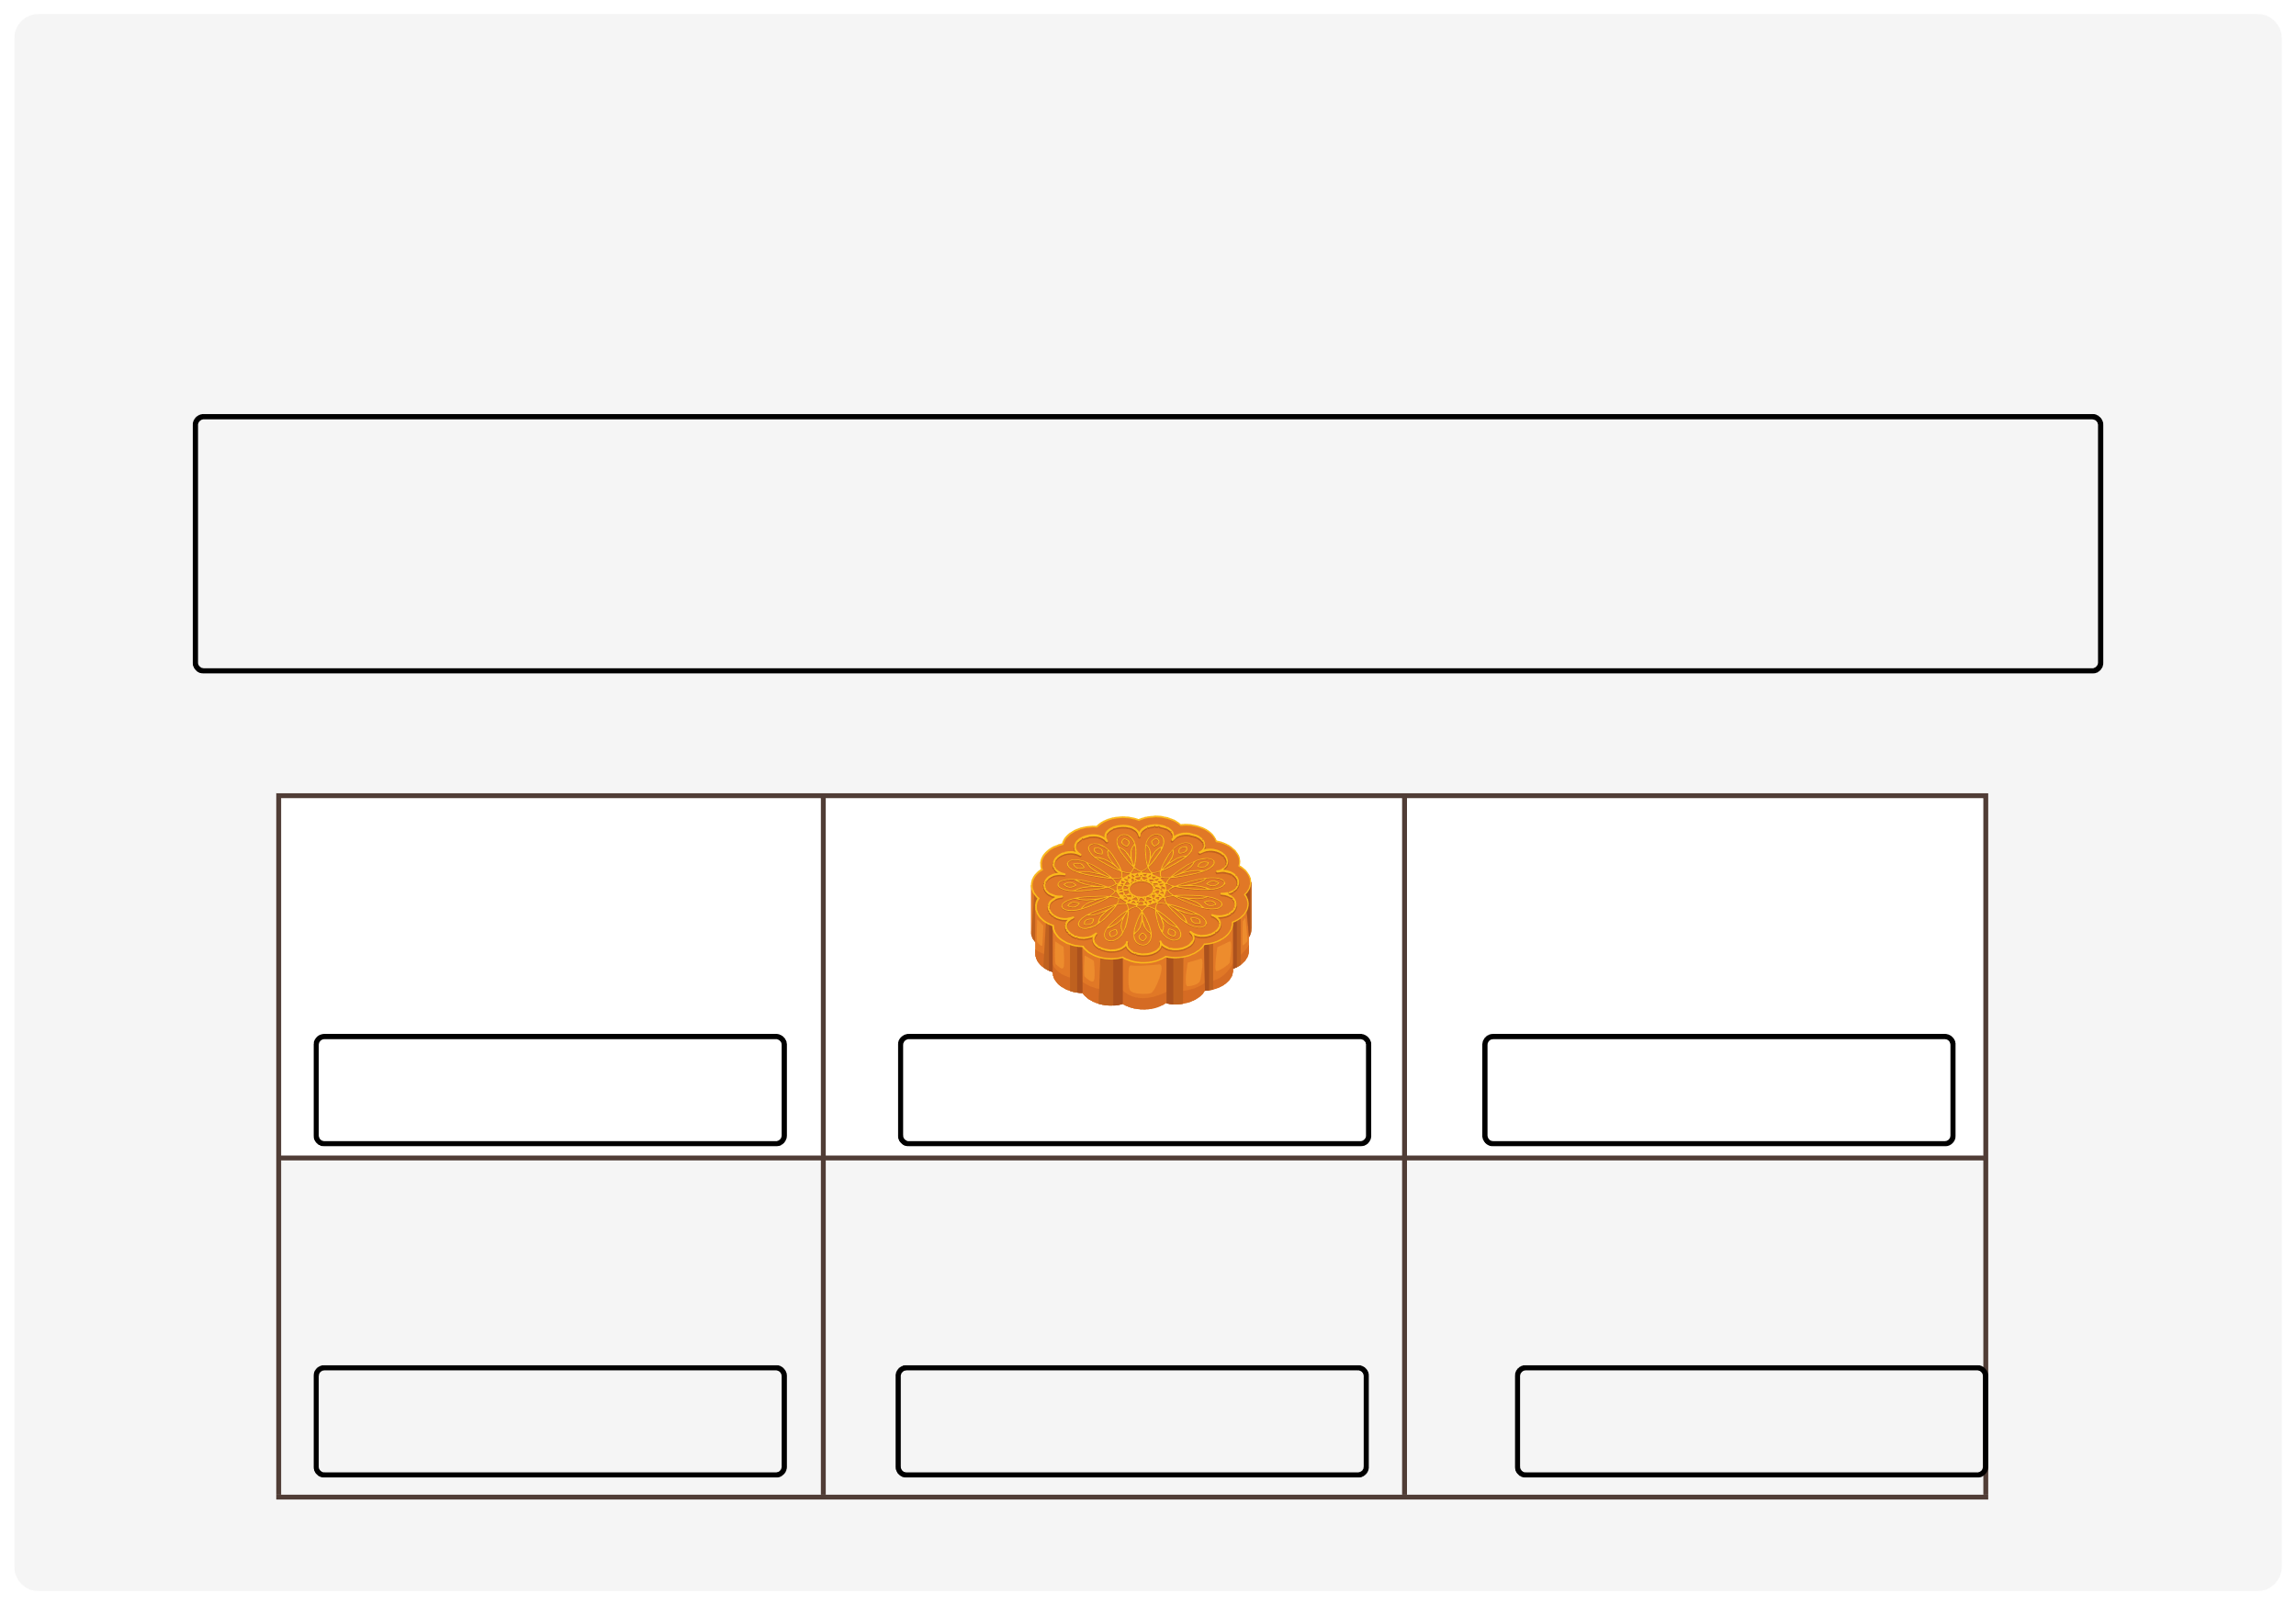



III. EXERCISES:
5. Fill the name of things:
moon cake
moon palace
banyan treestars-shaped
moon lady
jade rabbit
lantern

Slide 10
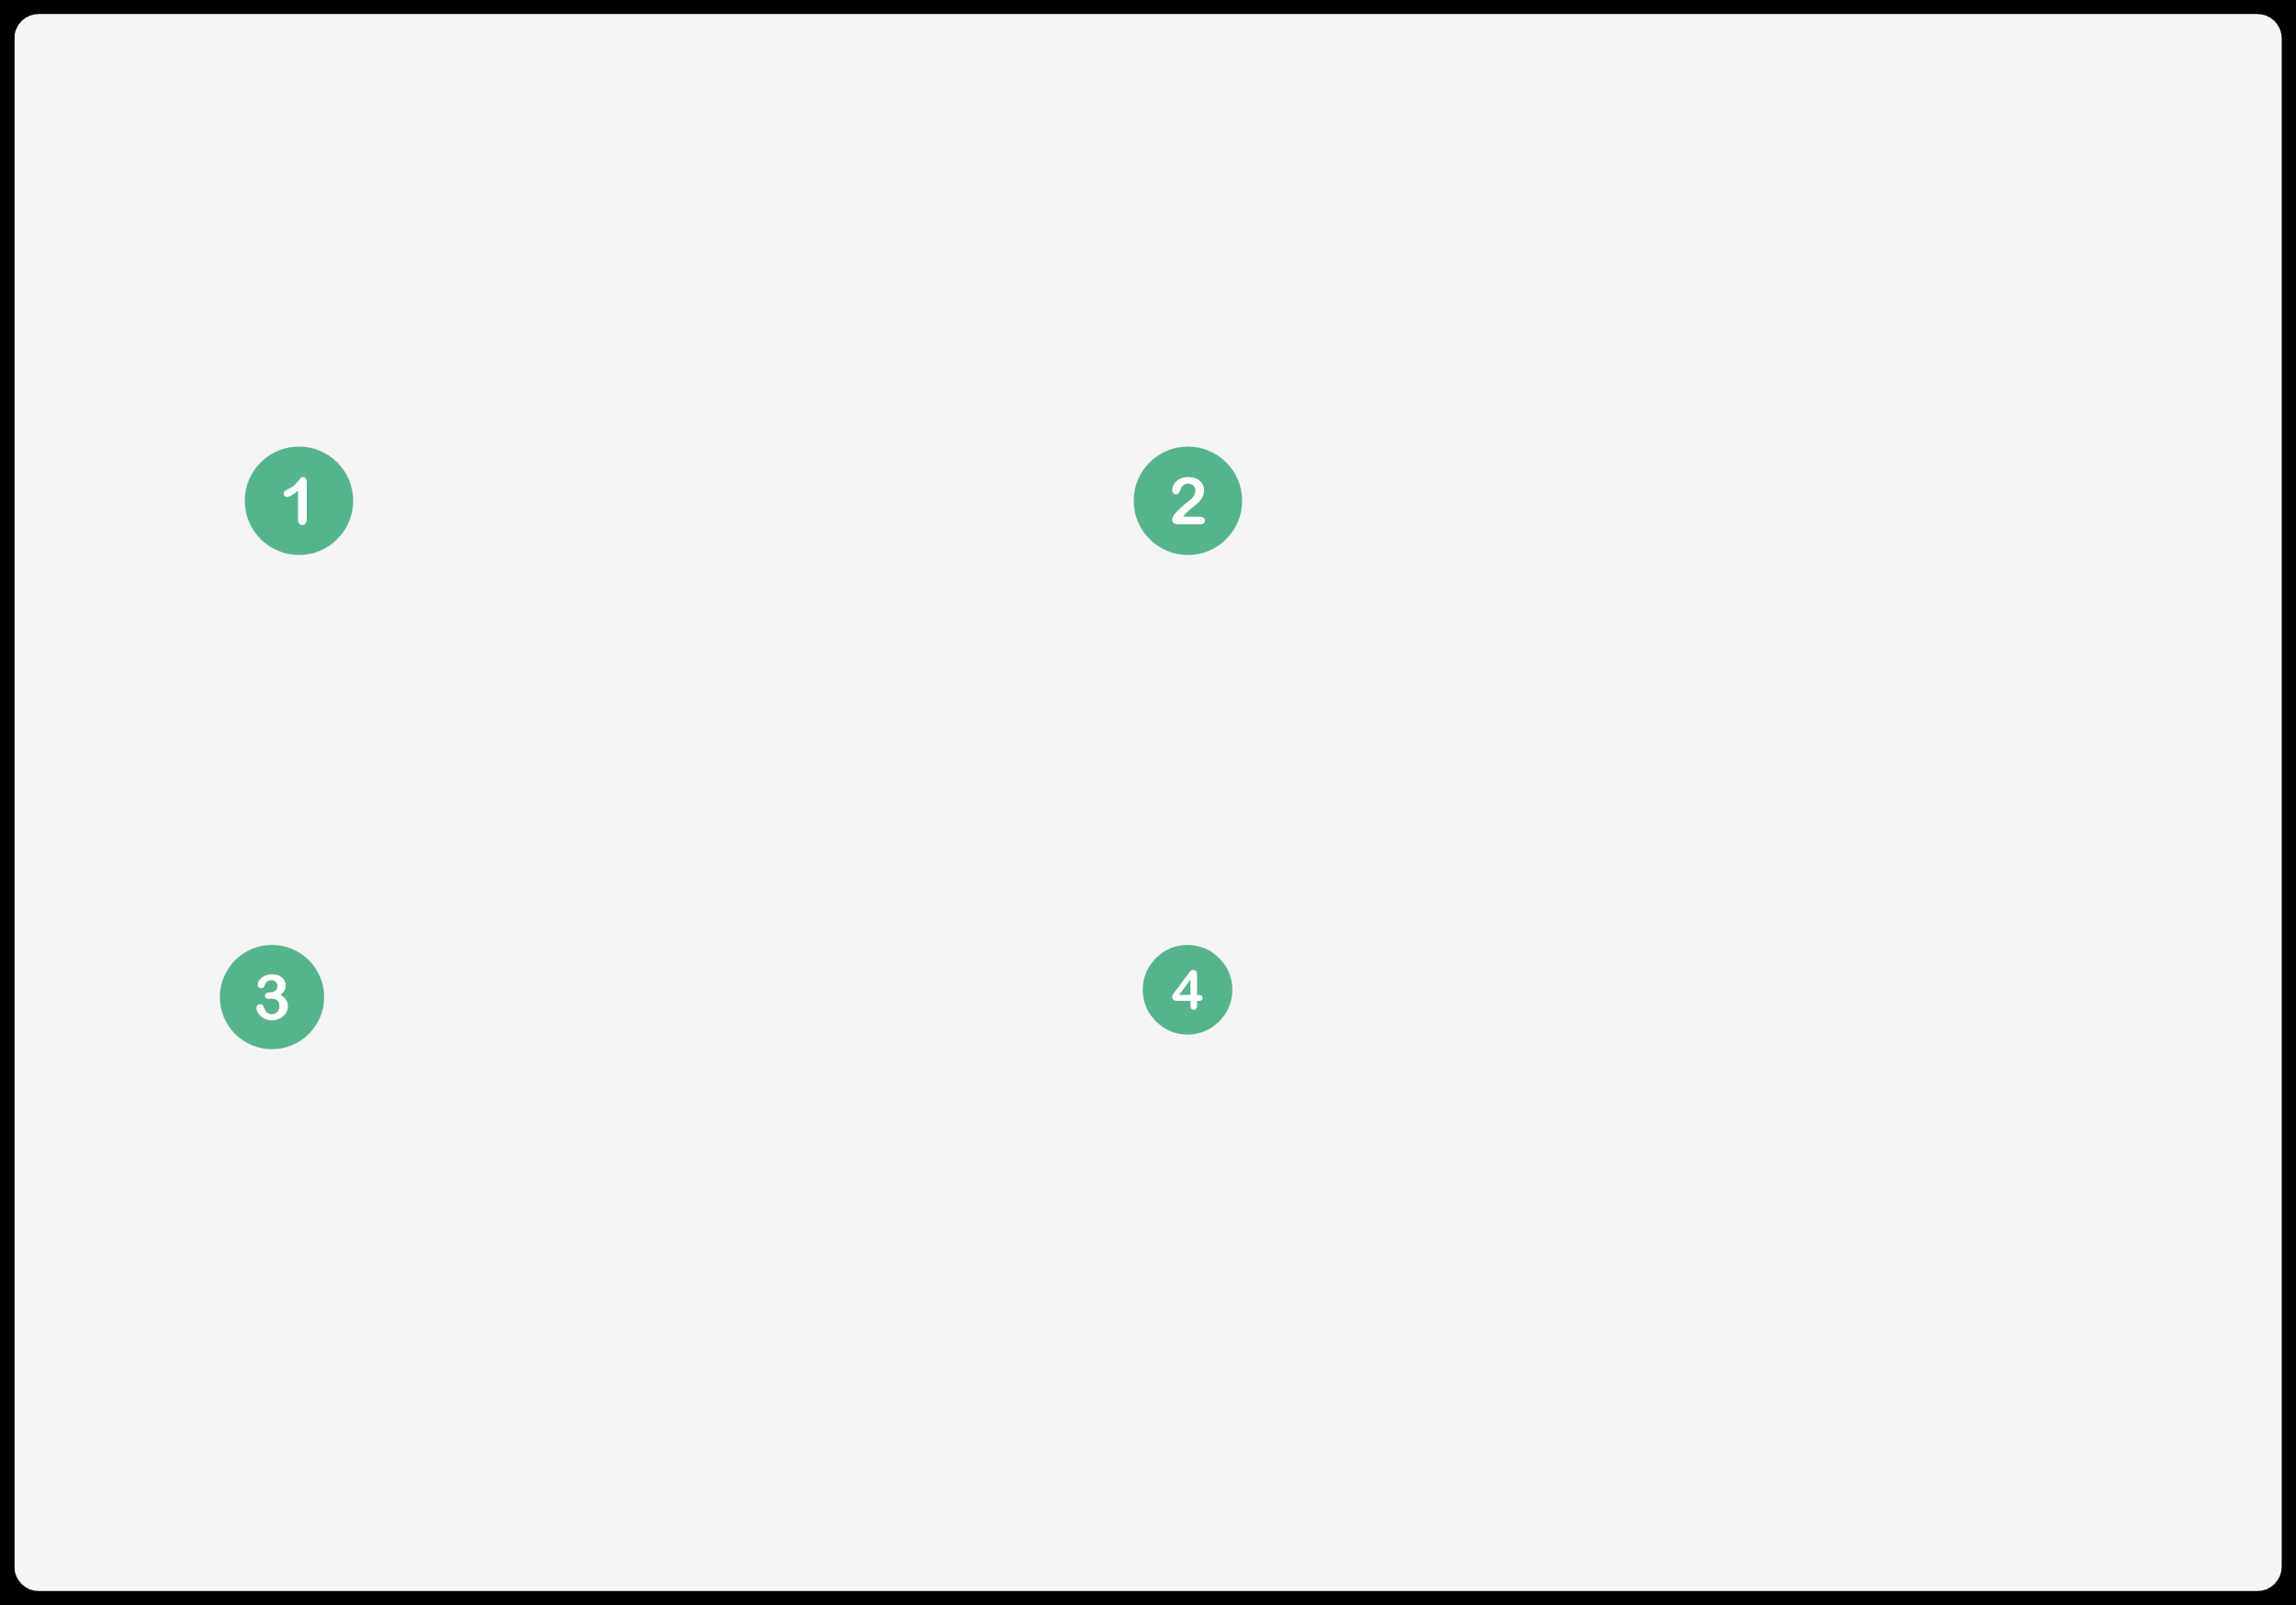
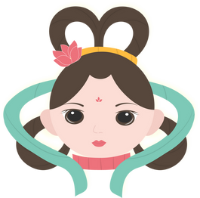
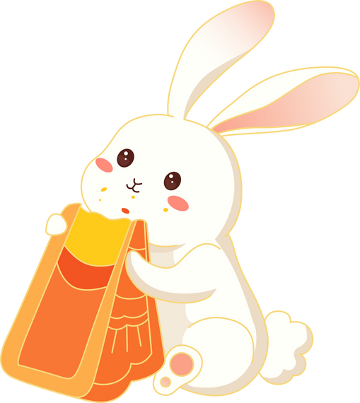
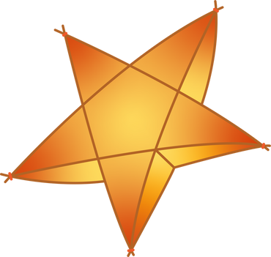

III. EXERCISES:
6. Look at the picture and guess the word:

Slide 11
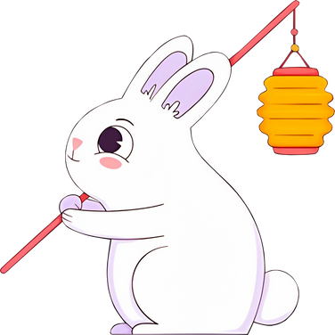

III. EXERCISES:
7. Find half and match:

Slide 12
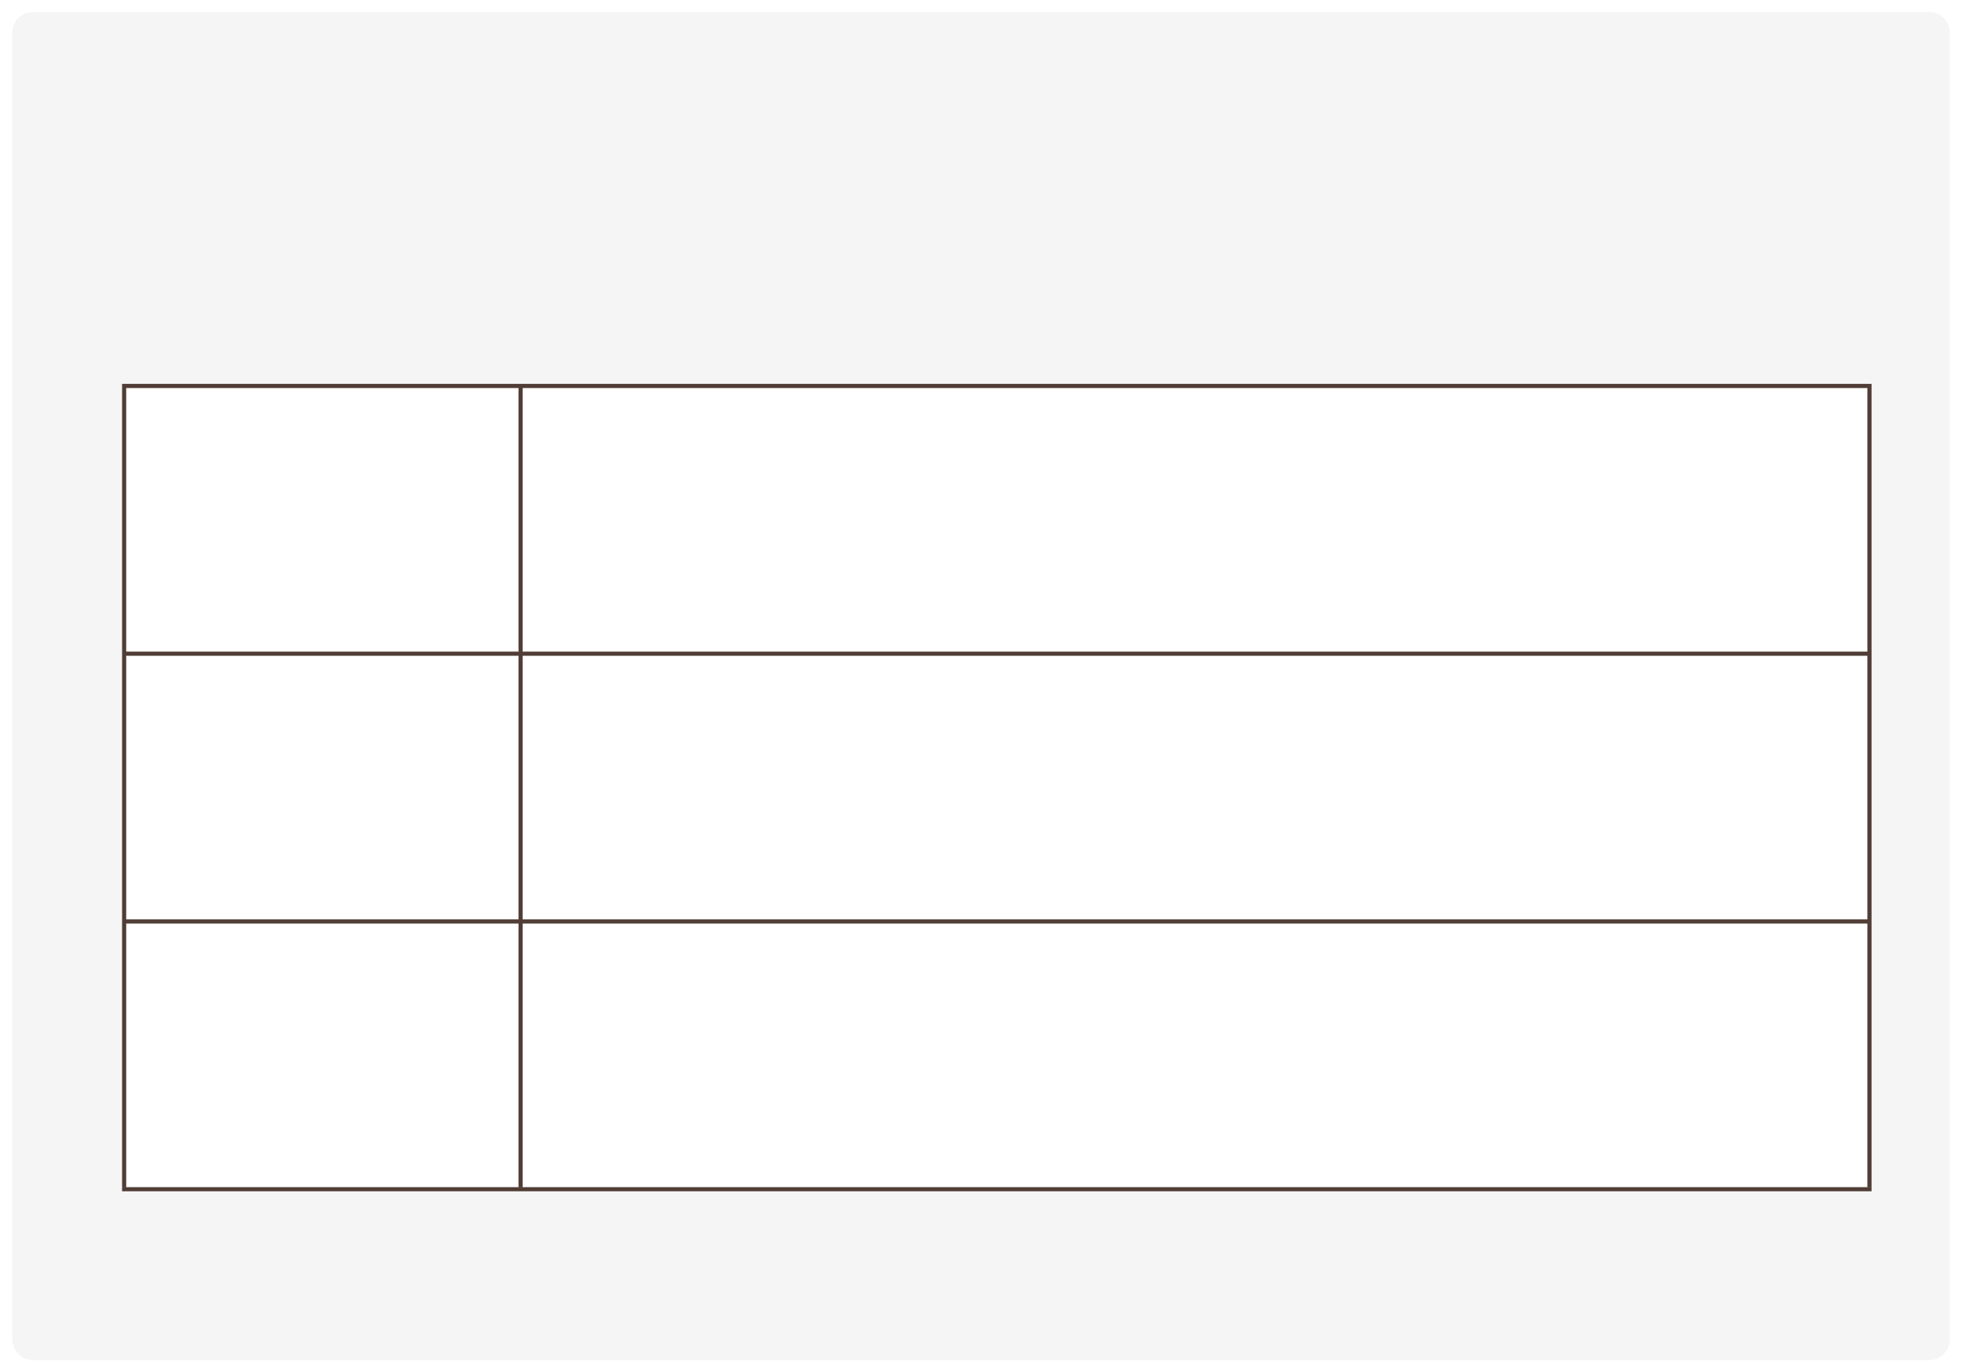
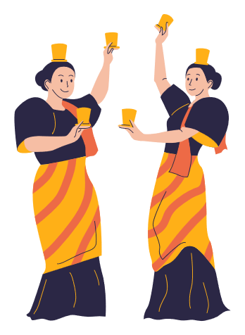
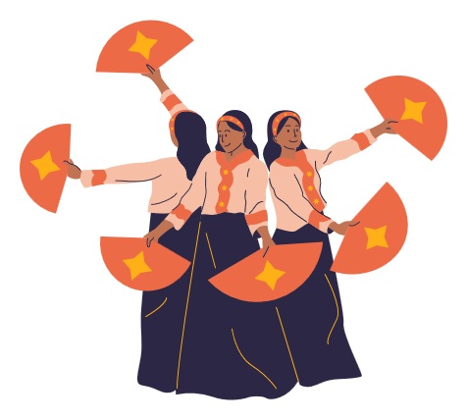

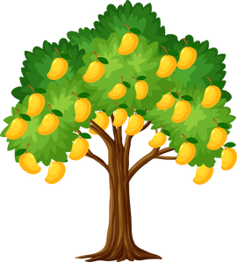

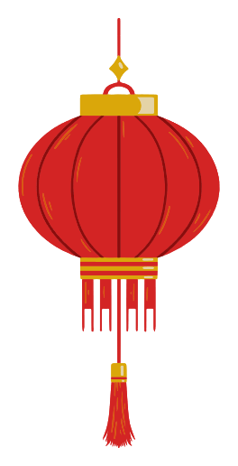

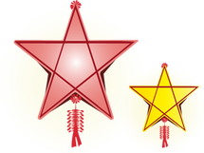
III. EXERCISES:
8. Read and circle the correct picture:
Lion dance
banyan tree
star-shaped lantern

