Slide 1


Slide 2



REVIEW
1
LESSON 1: LANGUAGE
Grammar
Vocabulary
Pronunciation
UNIT
1+2+3
Unit
HOBBIES

Slide 3

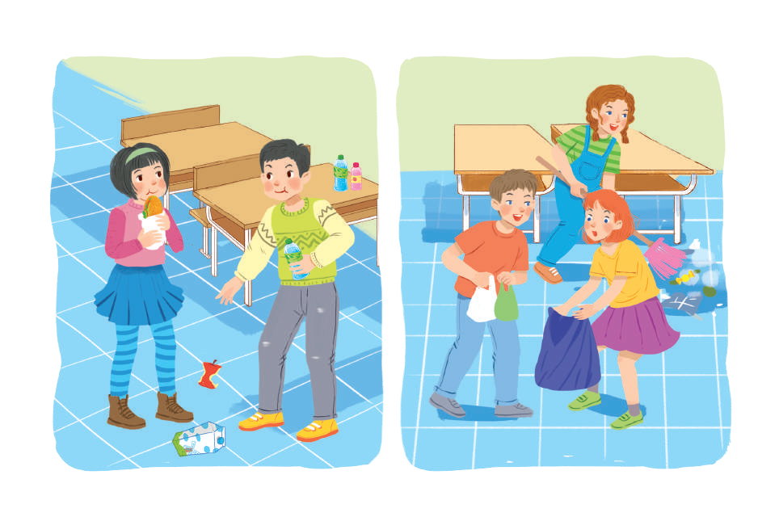
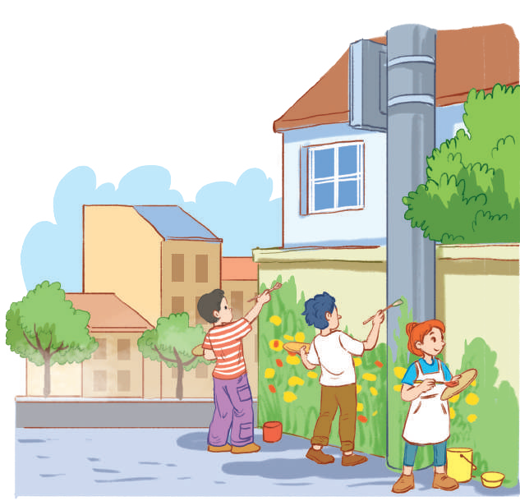
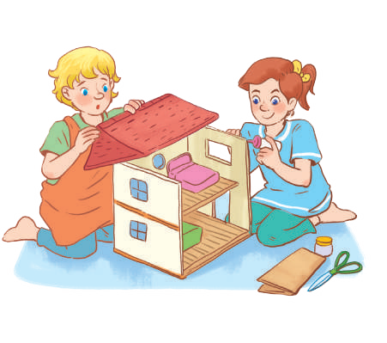
OBJECTIVES
By the end of the lesson, students will have revised the language they have learnt in Units 1 – 3.

Slide 4
LESSON 1: LANGUAGE
WARM-UP
Game: Finding keywords
PRONUNCIATION
Task 1: Circle the word in which the underlined part is pronounced differently. Then listen, check and repeat. (p. 38)
Task 2: Put the phrases below in the correct columns. (p. 38).
Task 3: Complete the sentences with the words and phrases below. (p. 38)
VOCABULARY
Task 4: Fill in the blanks with the correct tense of the verbs in brackets (p. 38).
Task 5: Turn the sentences into negative statements or questions. (p. 38)
GRAMMAR
CONSOLIDATION
Wrap-up
Home work

Slide 5

LESSON 1: GETTING STARTED
WARM-UP
Game: Finding keywords
Aims of the stage:
To lead in the lesson.

Slide 6
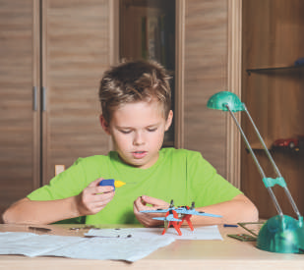

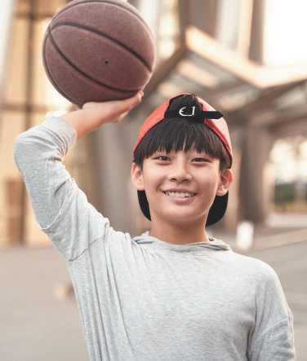
WARM-UP
Finding keywords
HOBBY

Slide 7
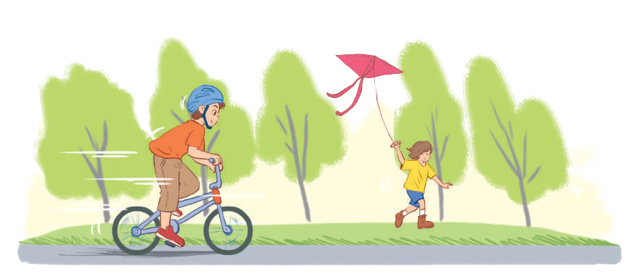
WARM-UP
Finding keywords
HABBITS

Slide 8
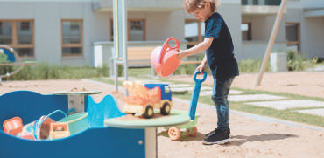
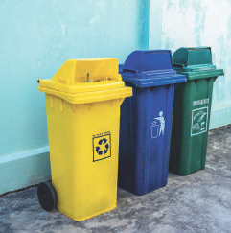
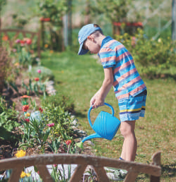
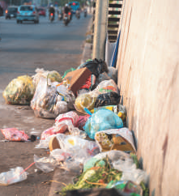
WARM-UP
Finding keywords
COMMUNITY SERVICE

Slide 9

LESSON 1: LANGUAGE
WARM-UP
Game: Finding keywords
PRONUNCIATION
Task 1: Circle the word in which the underlined part is pronounced differently. Then listen, check and repeat. (p. 38)

Slide 10

PRONUNCIATION
1
Circle the word in which the underlined part is pronounced differently. Then listen, check and repeat
1. A. proverb B. together C. exercise
2. A. learn B. earn C. hear
3. A. collected B. cleaned C. decided
4. A. listened B. helped C. watched
5. A. laugh B. ghost C. rough

Slide 11
LESSON 1: LANGUAGE
WARM-UP
Game: Finding keywords
PRONUNCIATION
Task 1: Circle the word in which the underlined part is pronounced differently. Then listen, check and repeat. (p. 38)
Task 2: Put the phrases below in the correct columns. (p. 38).
Task 3: Complete the sentences with the words and phrases below. (p. 38)
VOCABULARY

Slide 12
VOCABULARY
2
Put the phrases below in the correct columns.
raising money for charity
helping street children
doing sport
cleaning your room
collecting stamps
donating clothes
doing volunteer work
doing judo
Activities you do for…
yourself | your community
cleaning your room
collecting stamps
doing judo
doing sport
donating clothes
doing volunteer work
helping street children
raising money for charity

Slide 13
VOCABULARY
3
Complete the sentences with the words and phrases below.
hobby, coloured vegetables, chapped lips, mountainous areas, taking photos, community
1. Eating _______________________ and exercising can help you keep fit and stay healthy.
2. The Donate a Book event helps children in _______________________.
3. My brother spends a lot of time making models. that’s his ________________.
4. If you have ___________________, use lip balm.
5. There are many things you can do to help your ________________.
6. I love ________________ of the sunset
coloured vegetables
mountainous areas
hobby
chapped lips
community
taking photos

Slide 14
LESSON 1: LANGUAGE
WARM-UP
Game: Finding keywords
PRONUNCIATION
Task 1: Circle the word in which the underlined part is pronounced differently. Then listen, check and repeat. (p. 38)
Task 2: Put the phrases below in the correct columns. (p. 38).
Task 3: Complete the sentences with the words and phrases below. (p. 38)
VOCABULARY
Task 4: Fill in the blanks with the correct tense of the verbs in brackets (p. 38).
Task 5: Turn the sentences into negative statements or questions. (p. 38)
GRAMMAR

Slide 15
GRAMMAR
4
Fill in the blanks with the correct tense of the verbs in brackets.
1. He often (read) ___________ books in dim light, so his eyes hurt.
2. ___________ you (do) ___________ the gardening at the weekend?
3. Ordinary people (need) ___________ about 2,000 calories a day to stay healthy.
4. I (cannot) ___________ ride a bicycle when I was 6.
5. Last summer Phong (not volunteer) _________________ to teach maths to street children.
6. We (join) ___________ the project Plant a Tree in 2019 to make our area green.
reads
Do
do
need
could not
didn’t volunteer
joined

Slide 16
GRAMMAR
5
Turn the sentences into negative statements or questions.
1. She liked exercising. (not)
→ She ________________________________________________________.
2. My family always spends time doing housework together on Sundays. (not)
→ My family ___________________________________________________.
3. I used a lot of suncream during my holiday. (not)
→ I ___________________________________________________________.
4. My community organised a fair to raise money for the homeless last week. (?)
→ ____________________________________________________________?
5. Tim makes beautiful pieces of art from dry leaves and sticks. (?)
→ ____________________________________________________________?
didn’t like exercising
doesn’t always spend time doing housework together on Sunday
didn’t use a lot of sun cream during my holiday
Did your community organise a fair to raise money for the homeless last week
Does Tim make beautiful pieces of art from dry leaves and sticks

Slide 17
LESSON 1: LANGUAGE
WARM-UP
Game: Finding keywords
PRONUNCIATION
Task 1: Circle the word in which the underlined part is pronounced differently. Then listen, check and repeat. (p. 38)
Task 2: Put the phrases below in the correct columns. (p. 38).
Task 3: Complete the sentences with the words and phrases below. (p. 38)
VOCABULARY
Task 4: Fill in the blanks with the correct tense of the verbs in brackets (p. 38).
Task 5: Turn the sentences into negative statements or questions. (p. 38)
GRAMMAR
CONSOLIDATION
Wrap-up
Home work

Slide 18
CONSOLIDATION
1
WRAP-UP
Language
Pronunciation
Vocabulary
Grammar

Slide 19
CONSOLIDATION
2
HOMEWORK
Prepare for Review 1 – Skills.

Slide 20

Website: hoclieu.vn
Fanpage: facebook.com/www.tienganhglobalsuccess.vn/

