Slide 2
Trò chơi hứng táo
PLAY

Slide 3
79
19
51
59
38
94
01
37
01
20
51
12
64
42
23
86
95
one
1/20
next

Slide 4
79
47
51
59
38
03
03
26
37
7
51
12
64
42
23
86
95
three
2/20
next

Slide 5
79
5
28
59
38
94
09
37
44
09
20
64
42
12
23
86
95
nine
3/20
next

Slide 6
10
47
51
59
38
10
26
72
37
7
13
42
12
64
23
86
95
ten
4/20
next

Slide 7
79
5
50
59
38
94
20
37
44
20
80
12
64
42
23
86
95
twenty
5/20
next

Slide 8
94
47
51
59
38
12
11
26
37
20
13
12
64
42
23
86
95
twelve
6/20
next

Slide 9
79
85
28
59
98
94
08
37
44
08
20
64
42
12
23
86
95
eight
7/20
next

Slide 10
79
47
51
59
38
06
06
26
37
87
51
12
64
42
23
86
95
six
8/20
next

Slide 11
79
5
51
59
38
94
04
37
12
20
51
04
64
42
23
86
95
four
9/20
next

Slide 12
Có tiền xài tết rồi em hé
exit

Slide 13
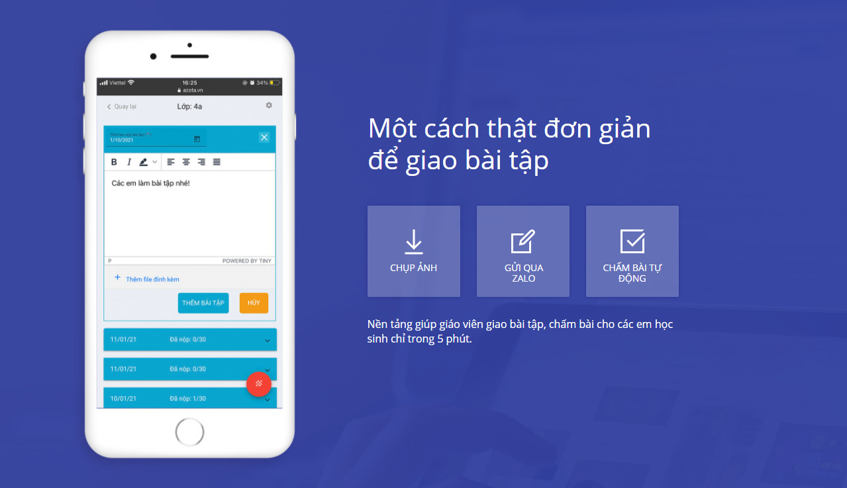
gioithieu.azota.vn

