Slide 1
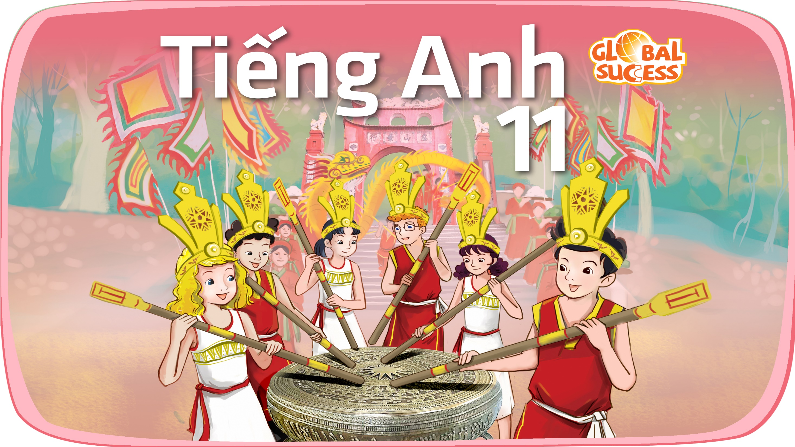

Slide 2
Unit
10
The ecosystem
Unit
FAMILY LIFE
COMMUNICATION AND CULTURE / CLIL
LESSON 7

Slide 3
LESSON 7
COMMUNICATION AND CULTURE / CLIL
WARM-UP
Watch a video
- Task 1: : Listen and complete the conversation with the expressions in the box.
- Task 2: Work in pairs. Use the model in Task 1 to make similar conversation for these situations.
COMMUNICATION
CLIL
- Task 1: Read the text and tick the correct project in the table
- Task 2. Work in groups. Discuss the questions.
CONSOLIDATION
Wrap-up
Homework

Slide 4

WARM-UP
WATCH A VIDEO
Which expressions are used to talk about likes and dislikes?

Slide 5
WARM-UP
Answer key:
Likes | Dislikes
I’d love to I love them. Sounds good Sounds great Perfect Great Wonderful | … sounds better to me Not my style I don’t like No thanks No way It’s just awful It’s terrible I’m not a fan

Slide 6
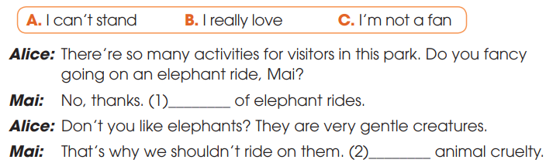
EVERYDAY ENGLISH
1
Listen and complete the conversation with the expressions in the box. Then practice it in pairs
C
A
B

Slide 7
EVERYDAY ENGLISH
Useful expressions
Expressing likes | Expressing dislikes
+ I love/adore … + I’m really into … + I’m a (big) fan of … + I’m keen on … + I’m into … | + I hate/don’t like … + I can’t bear/stand … + I’m not really into … + … is not my favorite

Slide 8
EVERYDAY ENGLISH
2
Work in pairs. Use the model in Task 1 to make similar conversations for these situations. One of you is Student A, the other is Student B. Use the expressions below to help you.
1. Student A is talking about activities he/she does on field trips to national parks. Student B expresses likes/dislikes about these activities.
2. Student A and Student B are planning an eco-friendly class party. They talked about the things and activities they like or dislike at the party.

Slide 9
EVERYDAY ENGLISH
2
Work in pairs. Make similar conversations for these situations.
Situation 1. Sample conversation
A: In our field trip to Cat Ba National Park, we should bring snacks to feed the birds. They like snacks.
B: I’m not really into that idea. Snacks are not good for their health. Moreover, it can be harmful to other wildlife animals.
B: Really, I don’t know that. How about burning the camp fire in the forest?
A: I think we should do it. It can lead to the forest fire. It’s clearly stated in the national park regulations.
1. Student A is talking about activities he/she does on field trips to national parks. Student B expresses likes/dislikes about these activities.

Slide 10
EVERYDAY ENGLISH
2
Work in pairs. Make similar conversations for these situations.
Situation 2. Sample conversation
A: We are going to have an eco-friendly party. What should we prepare for it?
A: Shall we decorate the party with flowers and plants. It will be the greenest party ever.
B: Oh I love it. We can also use paper cups, straws and plates instead of plastic ones.
A: I’m really into that idea. How about organizing a fashion show in which our friends are wearing clothes made from eco-friendly materials?
B: Perfect. Let’s do it.
2. Student A and Student B are planning an eco-friendly class party. They talked about the things and activities they like or dislike at the party.

Slide 11


CLIL
fancy (v)
/ˈfænsi/
to want something or want to do something

Slide 12
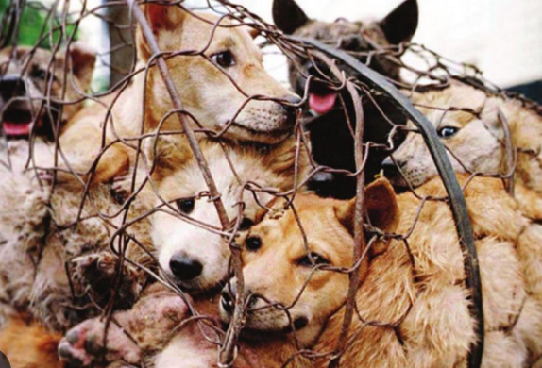
CLIL
cruelty (n)
/ˈkruːəlti/
cruelty (to somebody/something)
behaviour that causes physical or mental pain to others and makes them suffer, especially deliberately

Slide 13

CLIL
barrier (n)
/ˈbæriə(r)/
something that exists between one thing or person and another and keeps them separate

Slide 14
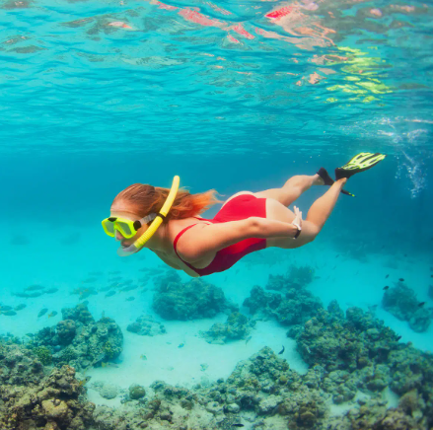
CLIL
snorkelling (n)
/ˈsnɔːkəlɪŋ/
the sport or activity of swimming underwater with a snorkel

Slide 15
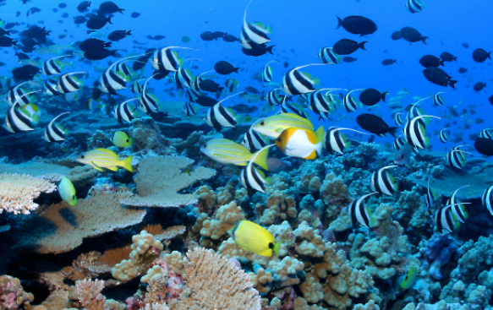
CLIL
marine (adj)
/məˈriːn/
connected with the sea and the creatures and plants that live there

Slide 16
CLIL
Form | Pronunciation | Meaning | Vietnamese equivalent
1. fancy (v) | /ˈfænsi/ | to want something or want to do something | Thích
2. cruelty (n) | /ˈkruːəlti/ | cruelty (to somebody/something) behaviour that causes physical or mental pain to others and makes them suffer, especially deliberately | Sự tàn ác
3. barrier (n) | /ˈbæriə(r)/ | something that exists between one thing or person and another and keeps them separate | Hàng rào
4. snorkelling (n) | /ˈsnɔːkəlɪŋ/ | the sport or activity of swimming underwater with a snorkel | Môn lặn biển
5. marine (adj) | /məˈriːn/ | connected with the sea and the creatures and plants that live there | Thuộc về đại dương

Slide 17
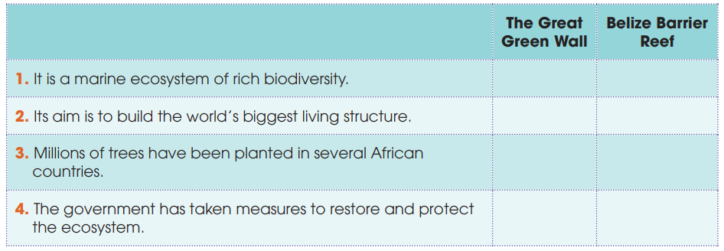
CLIL
1
Read the text and tick the correct project in the table
√
√
√
√

Slide 18
CLIL
2
Work in groups. Discuss the following questions
Are there similar projects in Viet Nam? Do you think the projects in Task 1 can be applied in Viet Nam?

Slide 19
CONSOLIDATION
1
Wrap-up
What have you learnt today?
Some methods for protecting local ecosystems in the world;
Review expressions for likes and dislikes.

Slide 20
CONSOLIDATION
2
Homework
Do exercises in the workbook.
Prepare for Lesson 8 - Unit 10.

Slide 21

Website: hoclieu.vn
Fanpage: facebook.com/sachmem.vn/
Website: hoclieu.vn
Fanpage: facebook.com/www.tienganhglobalsuccess.vn

