Slide 1
Unit 3:
Protecting the Environment
Lesson 2.1 – Vocabulary & Listening
Pages 28 & 29

Slide 2
Lesson Outline
Warm-up
Vocabulary
Listening
Consolidation
Wrap-up

Slide 3
By the end of this lesson, students will be able to…
- learn and use vocabulary related to pollution.
- practice listening for gist and specific information.
- practice functional English – Encouraging the speaker to continue.

Slide 4
New words
recycle
reuse
reduce
save
waste
clean up
electricity
air conditioner

Slide 5
WARM UP

Slide 6
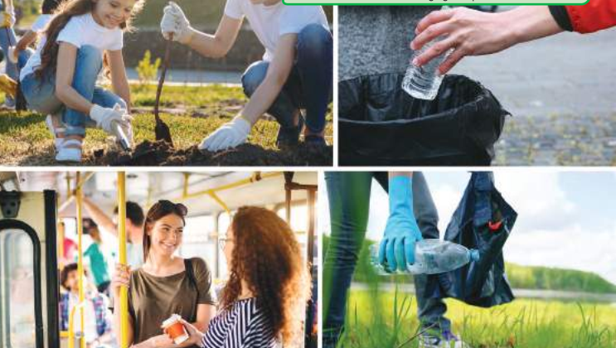
In pairs. Look at the picture. Discuss the questions.
What are the people doing?
Do you think what they’re doing can help protect the environment?
How?

Slide 7
Pre – Listening

Slide 8
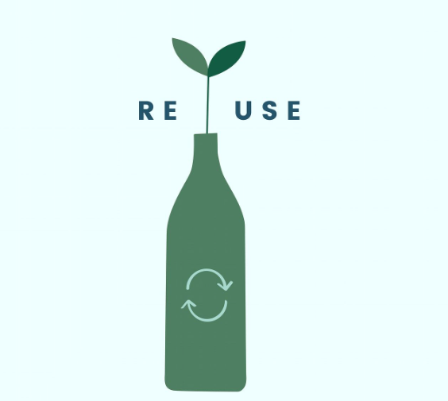
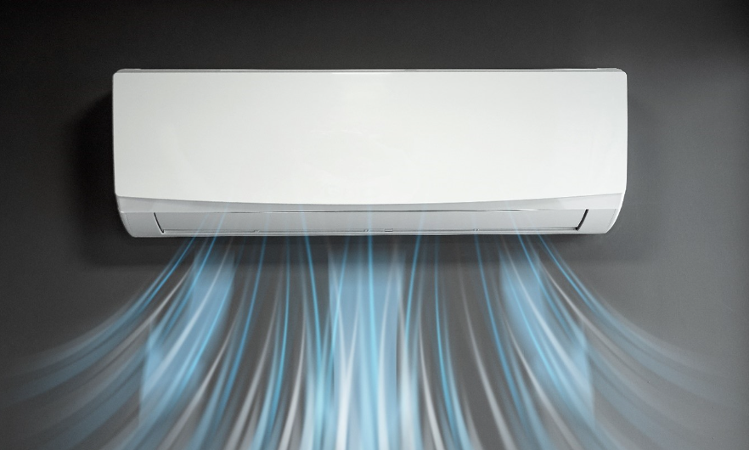
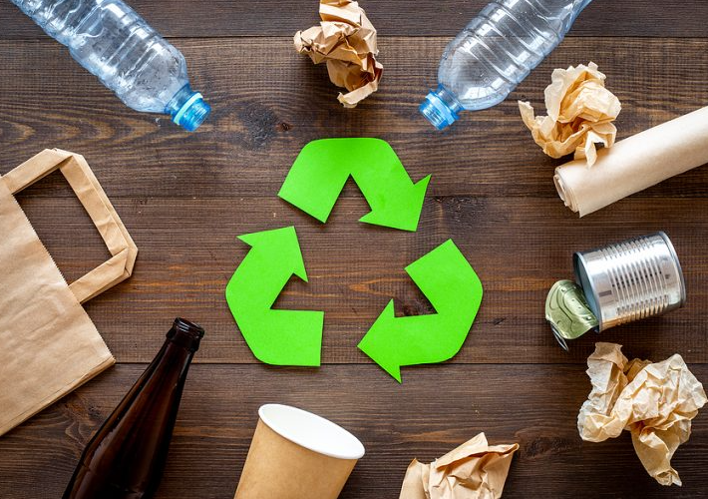
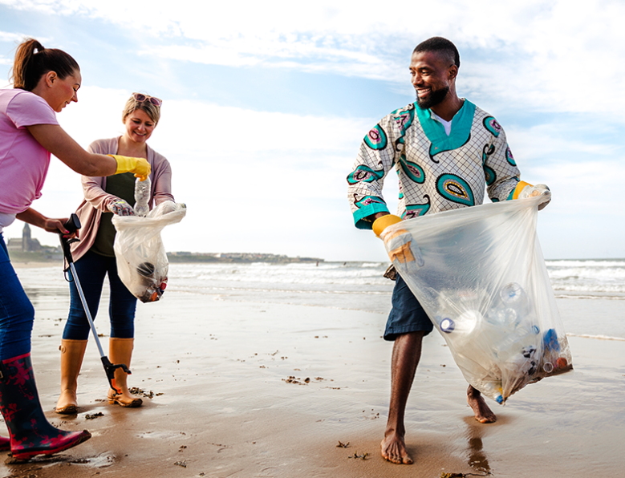
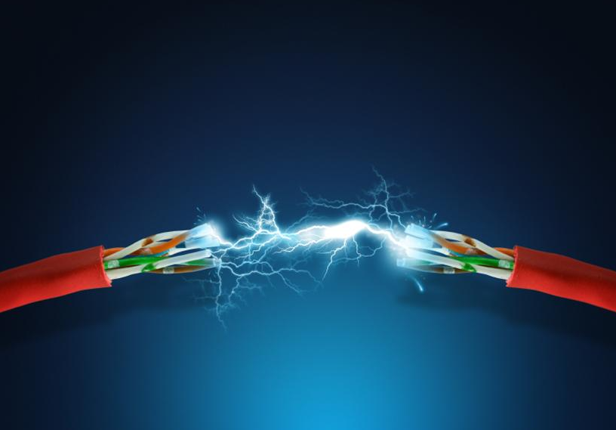
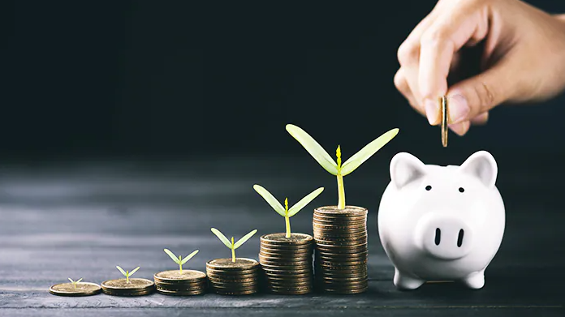
Look at pictures and guess the words
recycle
reuse
reduce
air conditioner
waste
clean up
electricity
save

Slide 9
Listen and repeat. Practice saying these words with a partner.
recycle (v) /ˌriːˈsaɪkl/: tái chế
Notes:
GV click vào từng cụm nghe âm thanh

Slide 10
Listen and repeat. Practice saying these words with a partner.
reuse (v) /riːˈjuːz/: tái sử dụng
Notes:
GV click vào từng cụm nghe âm thanh

Slide 11
Listen and repeat. Practice saying these words with a partner.
reduce (v) /rɪˈduːs/: cắt giảm
Notes:
GV click vào từng cụm nghe âm thanh

Slide 12
Listen and repeat. Practice saying these words with a partner.
save (v) /seɪv/: tiết kiệm
Notes:
GV click vào từng cụm nghe âm thanh

Slide 13
Listen and repeat. Practice saying these words with a partner.
waste (v) /weɪst/: lãng phí
Notes:
GV click vào từng cụm nghe âm thanh

Slide 14
Listen and repeat. Practice saying these words with a partner.
clean up (v) /kliːn ʌp/ : làm sạch, dọn dẹp
Notes:
GV click vào từng cụm nghe âm thanh

Slide 15
Listen and repeat. Practice saying these words with a partner.
electricity (n) /ɪˌlekˈtrɪsəti/ : điện
Notes:
GV click vào từng cụm nghe âm thanh

Slide 16
Listen and repeat. Practice saying these words with a partner.
air conditioner (n) /ˈer kəndɪʃənər/: máy lạnh, điều hòa
Notes:
GV click vào từng cụm nghe âm thanh

Slide 17
Listen and repeat. Practice saying these words with a partner.
recycle (v) /ˌriːˈsaɪkl/: tái chế
reuse (v) /riːˈjuːz/: tái sử dụng
reduce (v) /rɪˈduːs/: cắt giảm
save (v) /seɪv/: tiết kiệm
waste (v) /weɪst/: lãng phí
clean up (v) /kliːn ʌp/ : làm sạch, dọn dẹp
electricity (n) /ɪˌlekˈtrɪsəti/ : điện
air conditioner (n) /ˈer kəndɪʃənər/: máy lạnh, điều hòa
Notes:
GV click vào từng cụm nghe âm thanh

Slide 18
Match the words with the descriptions.

Slide 19
Match the words with the descriptions. Listen and repeat

Slide 20
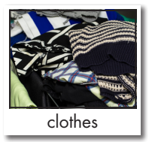
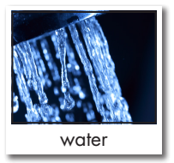
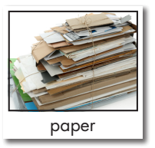
Work in pairs
Look at the following items and say what you can/can’t recycle, reuse, or save

Slide 21
Work in pairs
Look at the following items and say what you can/can’t recycle, reuse, or save

Slide 22
Work in pairs
Look at the following items and say what you can/can’t recycle, reuse, or save
We can recycle TV.

Slide 23
Work in pairs
Look at the following items and say what you can/can’t recycle, reuse, or save
We can save water.

Slide 24
Work in pairs
Look at the following items and say what you can/can’t recycle, reuse, or save
We can reuse paper.

Slide 25
Task a
Read the instruction and underline the key words.
What are they working on?
Listen to Amy and Daniel talking about ways to reduce pollution. What are they working on?
a poster 2. a presentation
Listen to Amy and Daniel conversation and figure out what they work on: a poster or a presentation.

Slide 26
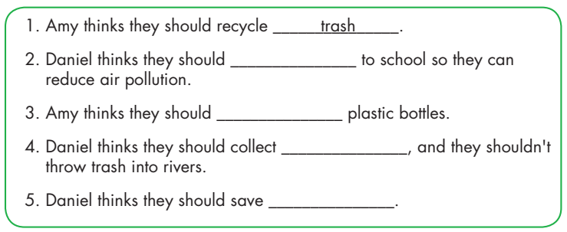
Guess the missing types of words:
verb
verb
noun/ noun phrase
noun

Slide 27
Underline the key words.

Slide 28
While - listening

Slide 29
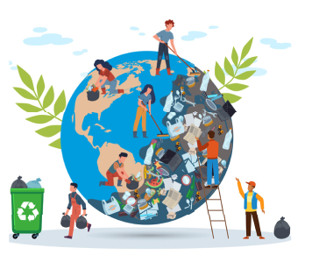
a poster
a presentation

Slide 30
ride their bikes
reuse
rain water
electricity

Slide 31
Daniel: Hi, Amy.
Amy: Hey, Daniel. Now, we need to think of advice about how to reduce pollution.
Daniel: OK. So, what should we do?
Amy: We should recycle trash so that we can reduce land pollution.
Daniel: Recycle trash, OK.
Amy: What else should we do?
Daniel: Well, we should help clean up rivers so we can reduce water pollution.
Amy: Clean up rivers, great idea! Anything else?
Daniel: Yes, we should ride our bikes to school so we can reduce air pollution.
Amy: Hmm... I disagree. We can’t ride our bikes when it’s snowy. I think we should take the bus to school.
Daniel: OK. What else should we do?
Amy: We should reuse plastic bottles so we can reduce land pollution.
Daniel: OK, reuse plastic bottles.
Amy: What else?
Daniel: I know! We should collect rain water, and we shouldn’t throw trash into rivers.
Amy: Good idea! Anything else?
Daniel: We should save electricity, and we shouldn’t waste water.
Amy: I think we have enough. Let’s design our poster. Why don’t we call it "Be clean and go green!"?
Daniel: I love it. Our poster will look great on the wall.
Listening Scripts

Slide 32
Post - listening

Slide 34
What else..?
Anything else..?
- 3 times
- 2 times

Slide 35
Work in pairs
Example:
A: What do you do to reduce pollution?
B: I reuse plastic bottles and bags.
A: What else..?
B: I also save electricity. I turn off TV when I don’t use.

Slide 36
CONSOLIDATION

Slide 37
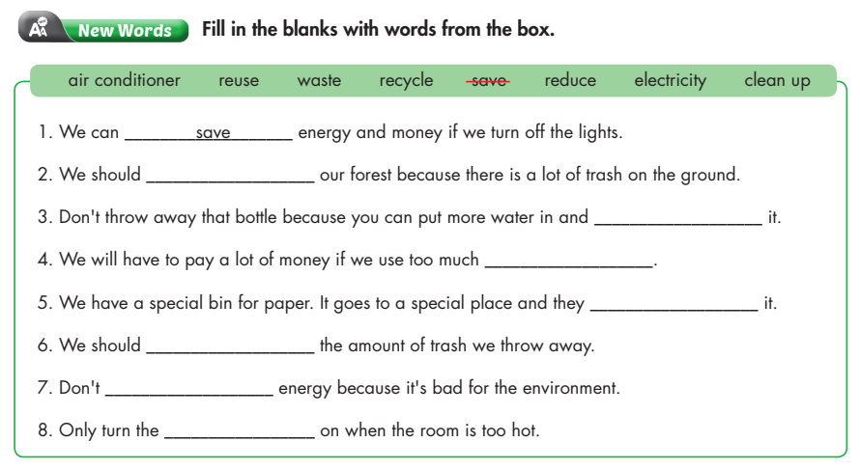
clean up
reuse
electricity
recycle
reduce
waste
air conditioner

Slide 38
WRAP-UP

Slide 39
Today’s lesson
Vocabularies
recycle
reuse
reduce
save
waste
clean up
electricity
air conditioner

Slide 40
Today’s lesson
- learn and use vocabulary related to pollution.
- practice listening for gist and specific information.
- practice functional English – Encouraging the speaker to continue.

Slide 41
Homework
Learn the new words.
Practice talking about ways to protect the environment.
Do the exercises in WB: New words & Listening (page 16).
Do the exercises in TA 8 i-Learn Smart World Notebook, pages 23 & 24)
Play the consolidation games in Tiếng Anh 8 i-Learn Smart World DHA App on www.eduhome.com.vn
Prepare: Lesson 2.2 – Grammar (pages 29 & 30 – SB).

Slide 42
Lesson 3
Stay positive and have a nice day!

