Slide 1

Unit 9: English in the World
Lesson 2.3: Pronunciation & Speaking
Page 73

Slide 2




LESSON OUTLINE
Consolidation

Slide 3
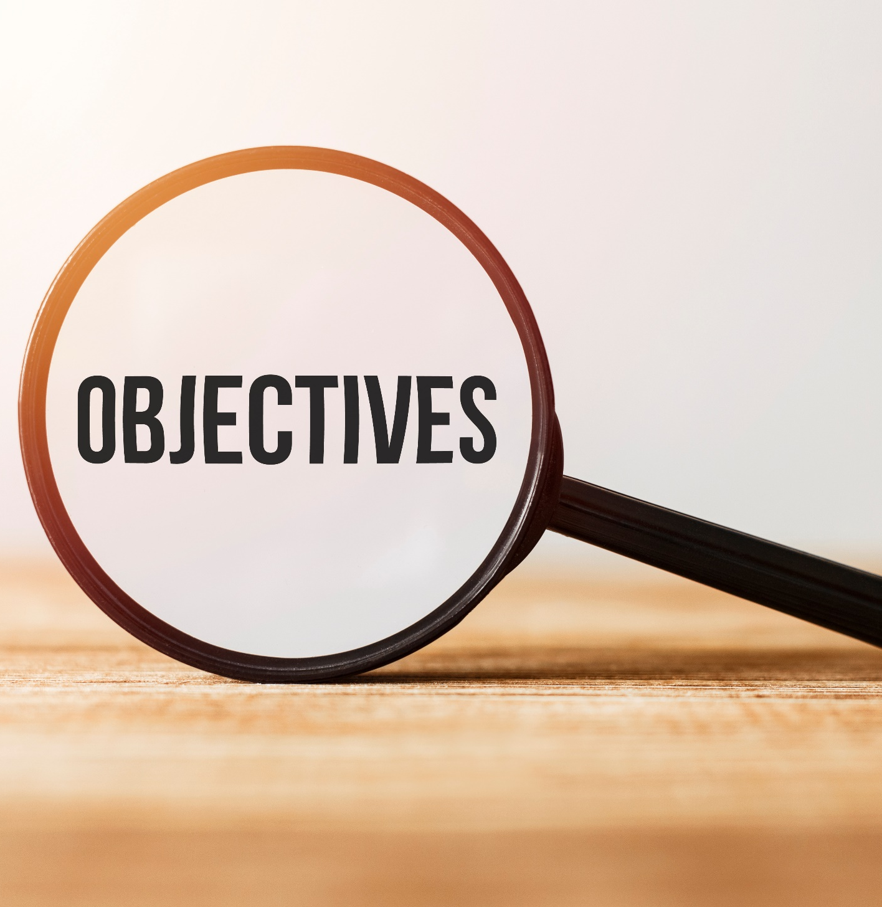
By the end of this lesson, students will be able to…
- practice pronouncing the /ə/ sound.
- ask and answer about your holidays.

Slide 4
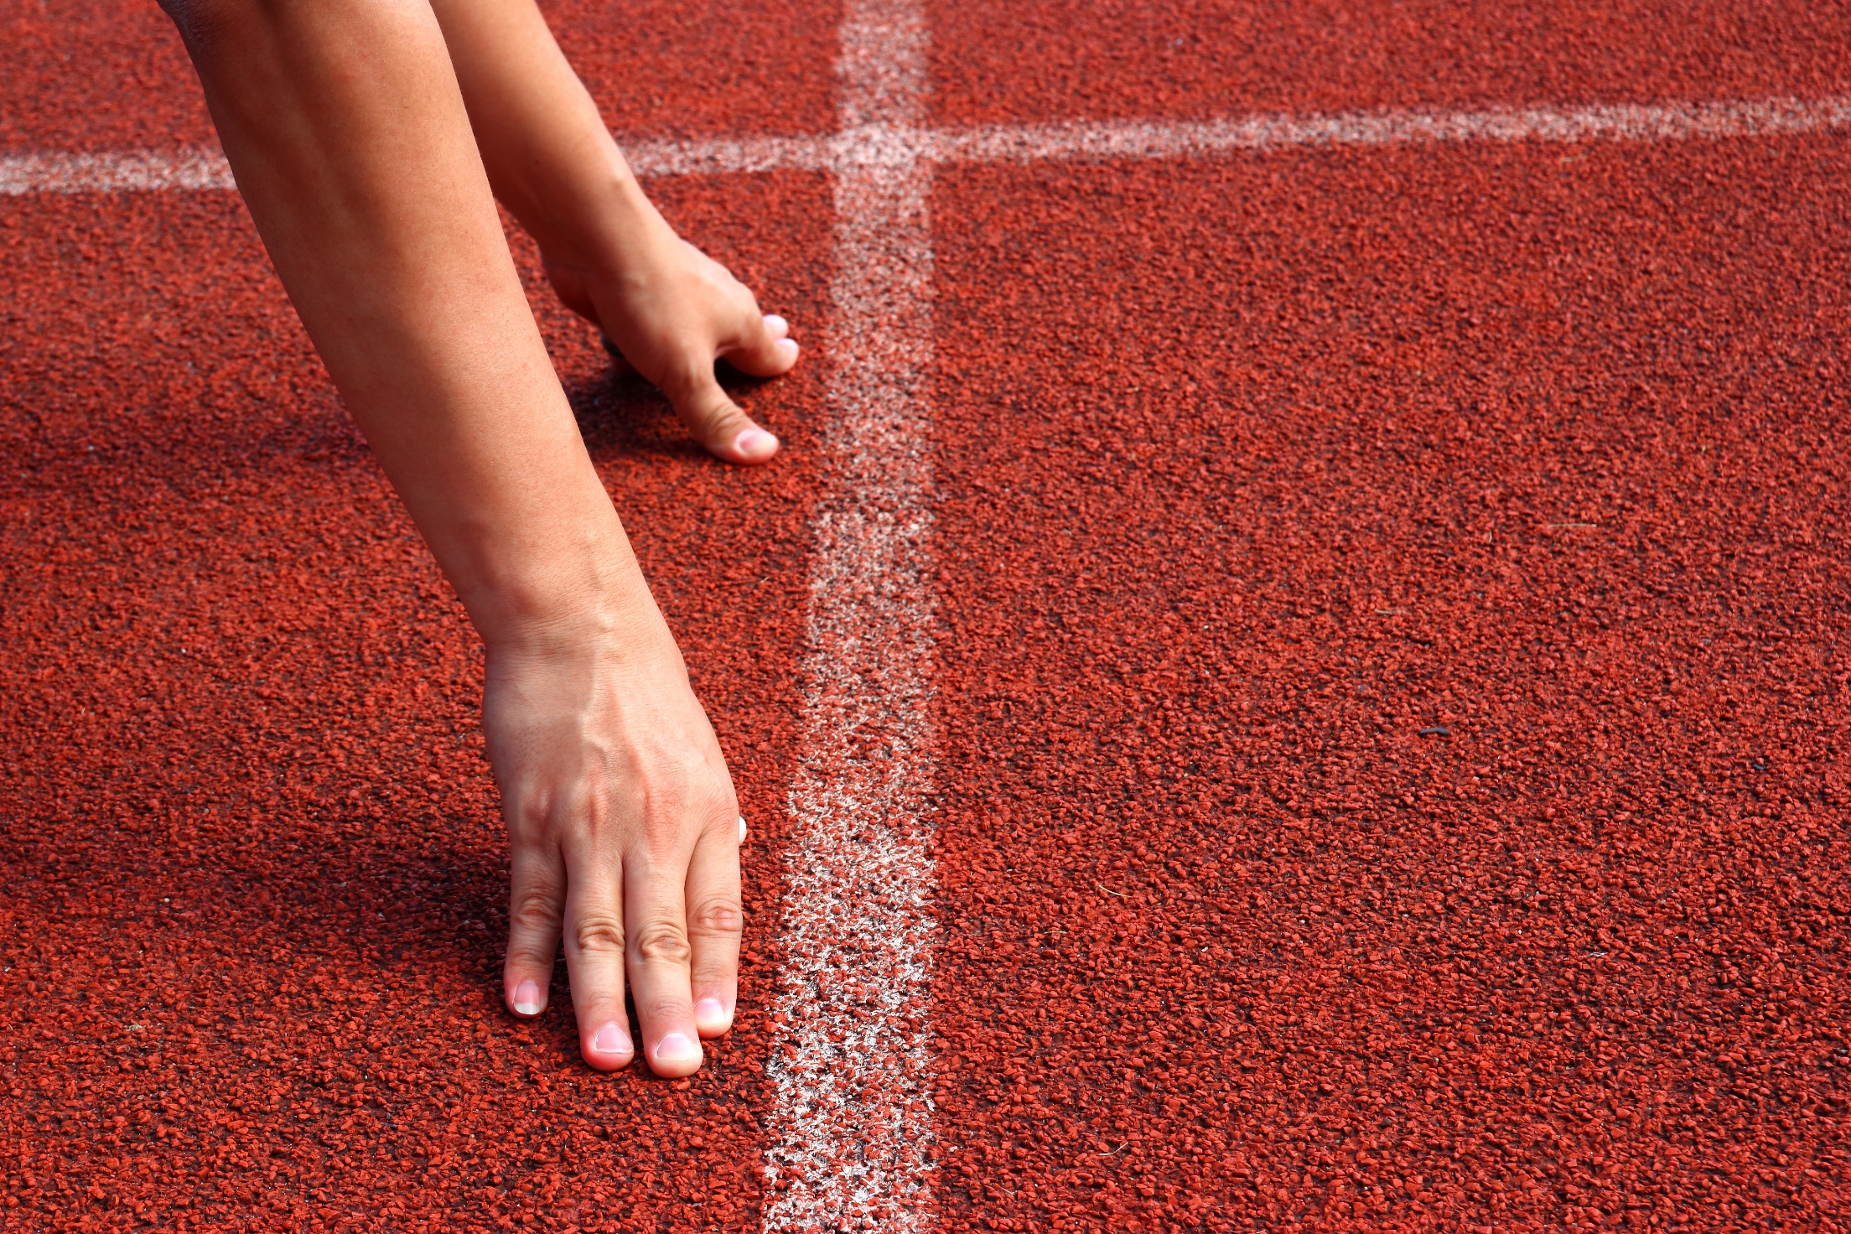
WARM-UP

Slide 5

Work in pairs.
Choose the word whose main stress is placed
differently from the others.
1. A. hover B. defeat C. contact D. happen
2. A. wallet B. postcard C. demon D. July
3. A. united B. annual C. fantastic D. excited
/ˈhʌvər/
/dɪˈfi:t/
/ˈkɑ:ntækt/
/ˈhæpən/
/ˈwɑ:lɪt/
/ˈpoʊstkɑ:rd/
/ˈdi:mən/
/dʒʊˈlaɪ/
/juˈnaɪtɪd/
/ˈænjuəl/
/fænˈtæstɪk/
/ɪkˈsaɪtɪd/

Slide 6
Work in pairs.
Choose the word whose underlined part is
pronounced differently from that of the other words.
A. ferry B. return C. reggae D. event
2. A. stadium B. fantasy C. tradition D. spaghetti
3. A. speak B. steal C. wear D. teach
/ˈferi/
/rɪˈtɜːrn/
/ˈreɡeɪ/
/ɪˈvent/
/ˈsteɪdiəm/
/ˈfæntəsi/
/trəˈdɪʃn/
/spəˈɡeti/
/spi:k/
/sti:l/
/wer/
/ti:tʃ/

Slide 7

Work in pairs
Ask and answer the following questions.
Did you go on holiday?
Where did you go?
What did you do?
What did you eat?

Slide 8



Slide 9
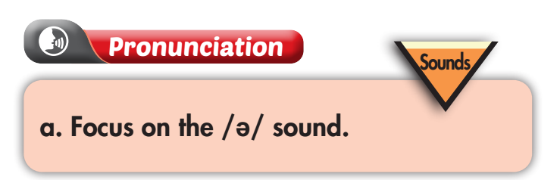

b. Listen to the words and focus on the underlined letters. (Click the word to hear the sound)
souvenir
weather

Slide 10

c. Listen and cross out the word that doesn't follow the note in "a." (Click the word to hear the sound)
America
department
postcard
summer
d. Read the words with the sound noted in "a." to a partner.

Slide 11
Emma: How was your holiday?
Mike: It was great. We went to England.
Emma: Where did you go in England?
Mike: We went to London.
Emma: What did you do there?
Mike: We went to the National Gallery and saw the London Eye.
Emma: Did you try the local food?
Mike: Yes, I ate fish and chips. It was good.
Emma: Well, it was great talking to you.

Slide 12






Emma: How was your holiday?
Mike: It was great. We went to England.
Emma: Where did you go in England?
Mike: We went to London.
Emma: What did you do there?
Mike: We went to the National Gallery
and saw the London Eye.
Emma: Did you try the local food?
Mike: Yes, I ate fish and chips.
It was good.
Emma: Well, it was great talking to you.

Slide 13
Do the same
Emma: How was your holiday?
Mike: It was great. We went to the USA.
Emma: Where did you go in the USA?
Mike: We went to New York City.
Emma: What did you do there?
Mike: We went to Central Park
and took photos.
Emma: Did you try the local food?
Mike: Yes, I ate a hot dog.
It was great.
Emma: Well, it was nice seeing you again.

Slide 14
Do the same
Emma: How was your holiday?
Mike: It was great. We went to Australia.
Emma: Where did you go in Australia?
Mike: We went to Sydney.
Emma: What did you do there?
Mike: We went to Bondi Beach
and met friendly people.
Emma: Did you try the local food?
Mike: Yes, I ate some pavlova.
It was delicious.
Emma: Well, it was nice talking to you.

Slide 15

a. You just returned home from a holiday. In pairs: Student B, page 122 (file 10), Student A, answer Student B's questions about your trip. Then, swap roles. Ask questions and complete the table about Student B's holiday.

Slide 16
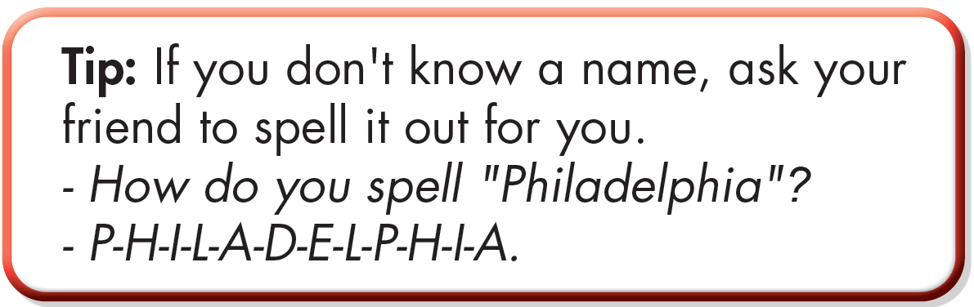
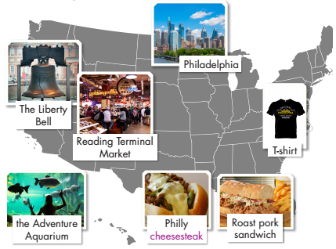
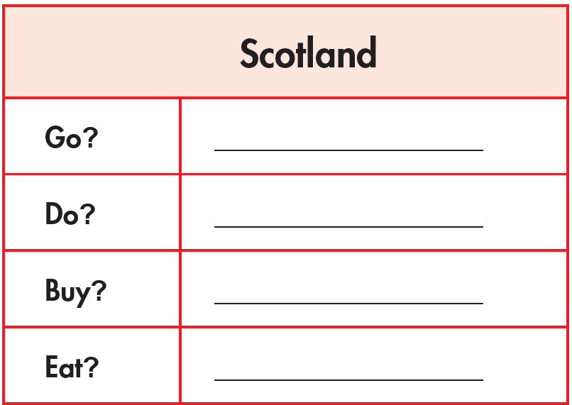

Slide 17


Slide 18

CONSOLIDATION

Slide 19
Write a paragraph (about 70 words) about your holiday. Your paragraph should include:
Where did you go?
What did you do?
What did you eat?
How did you feel?

Slide 20

WRAP-UP

Slide 21
Today’s lesson
Pronunciation:
- Practice pronouncing the /ə/ sound.
Speaking:
- Make a conversation about holidays.

Slide 22
Homework
Practice the /ə/ sound.
Practice talking about a holiday.
Review the vocabulary and grammar notes in Tiếng Anh 7 i-Learn Smart World Notebook (pages 56 & 57).
Prepare the next lesson (page 74 SB)
Play the consolidation games in Tieng Anh 7 i-Learn Smart World DHA App on www.eduhome.com.vn

Slide 23

Lesson 3
Stay positive and have a nice day!

