Slide 1


Slide 2
Unit
10
The ecosystem
Unit
FAMILY LIFE
LESSON 8
LOOKING BACK AND PROJECT

Slide 3
LESSON 8
LOOKING BACK AND PROJECT
WARM-UP
Miming game
Pronunciation: Intonation in question tags
Vocabulary: Ecosystem
Grammar: Compound nouns
LOOKING BACK
PROJECT
Presentation: Restore and protect a local ecosystem
CONSOLIDATION
Wrap up
Homework

Slide 4
WARM-UP
MMING GAME
A student comes to the front
Teacher whispers one word into his/her ears.
Ss have to draw or mime the word. The rest of the class makes guesses.
The first student who correctly calls out the word gets a point.

Slide 5

LOOKING BACK
1
Mark the intonation in the question tags.
1. I can't find my key. You will help me find it, won’t you?
2. People have destroyed so many forests, haven’t they?
3. I haven't been to Yellowstone. I think it's a famous natural park in the USA, isn’t it?
4. I don’t know much about Sam. He didn’t graduate from university, did he?

Slide 6
LOOKING BACK
2
Choose the correct word to complete each sentence.
1. Cuc Phuong National Park has a large number of flora and fauna species / regions.
2. Many species are saved from disappearing by biodiversity / conservation efforts.
3. Reducing the use of fresh water can help to protect marine ecosystems / national parks.
4. The overuse of natural resources / climate change may lead to loss of biodiversity.

Slide 7
LOOKING BACK
3
Find and correct the mistakes in the following sentences
1. You can get off at the next busstop.
2. Watching the sunsetting at the beach is really amazing.
3. Did you have a chance to do any sightsee
in Paris?
4. Viet Nam has a large variety of fascinating wildlives.
bus stop
sun set
sightseeing
wildlife

Slide 8
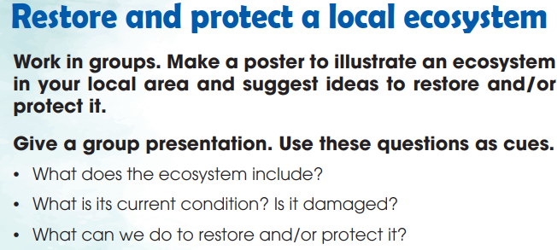

PROJECT

Slide 9
CONSOLIDATION
1
Wrap-up
What have you learnt today?
- Review the vocabulary and grammar of Unit 10;
- Apply what you have learnt (vocabulary and grammar) into practice through a project.

Slide 10
CONSOLIDATION
2
Homework
Do exercises in the workbook.
Prepare for the End-of-term test.

Slide 11

Website: hoclieu.vn
Fanpage: facebook.com/www.tienganhglobalsuccess.vn
Website: hoclieu.vn
Fanpage: facebook.com/sachmem.vn/

