Slide 1

Unit 9: English in the World
Lesson 1.3: Pronunciation & Speaking
Page 70

Slide 2



Lesson 1.3
Unit 9 Lesson 1.3
LESSON OUTLINE
Consolidation

Slide 3

Unit 9 Lesson 1.3
By the end of this lesson, students will be able to…
- talk about holiday plans.
- practice the /ð/ sound.

Slide 4
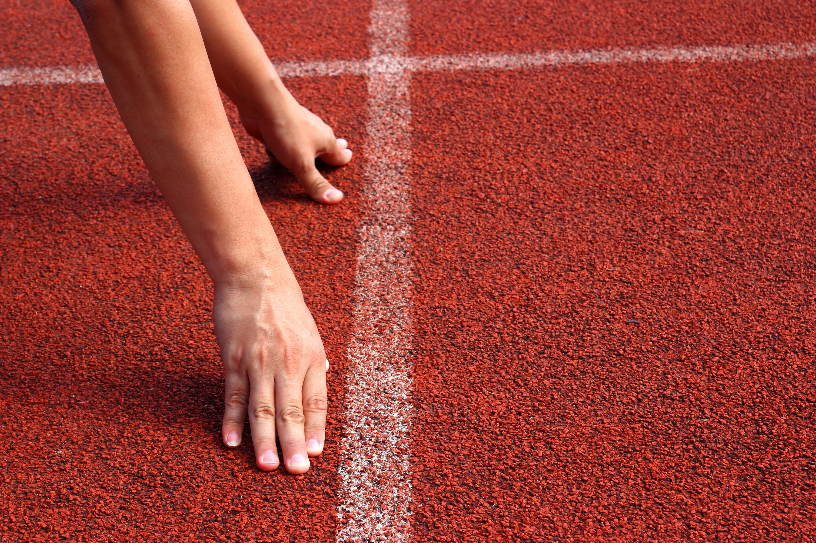
Unit 9 Lesson 1.3
WARM UP

Slide 5

Work in pairs.
Choose the word whose main stress is placed
differently from the others.
A. participant B. environment C. experience D. competition
2. A. historic B. delighted C. annual D. annoying
3. A. conclusion B. tradition C. attraction D. evidence
/pɑ:rˈtɪsəpənt/
/ɪnˈvaɪrənmənt/
/ɪkˈspɪriəns/
/ˌkɑ:mpəˈtɪʃən/
/hɪˈstɔ:rɪk/
/dɪˈlaɪtɪd/
/ˈænjuəl/
/əˈnɔɪɪŋ/
/kənˈklu:ʒən/
/trəˈdɪʃən/
/əˈtrækʃən/
/ˈevɪdəns/

Slide 6
Work in pairs.
Choose the word whose underlined part is
pronounced differently from that of the other words.
A. homestays B. mothers C. photos D. worshops
2. A. pudding B. sculpture C. customs D. luggage
3. A. suggestion B. tradition C. emotion D. location
/ˈhoʊmsteɪz/
/ˈmʌðəz/
/ˈfoʊtoʊz/
/ˈwɜ:kʃɑ:ps/
/ˈpʊdɪŋ/
/ˈskʌlptʃər/
/ˈkʌstəmz/
/ˈlʌɡɪdʒ/
/səˈdʒestʃən/
/trəˈdɪʃən/
/ɪˈmoʊʃən/
/loʊˈkeɪʃən/

Slide 7

Unit 9 Lesson 1.3
Work in pairs. Ask and answer the following questions.
1. Do you have any plans for your next holiday?
2 Where are you going?
3 Where are you going to stay?
4. Where are you going to do?
5 Where you going to eat?

Slide 8



Slide 9
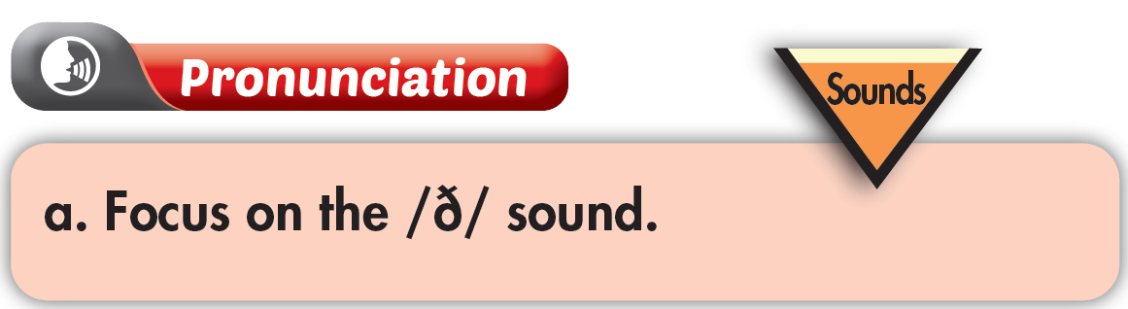
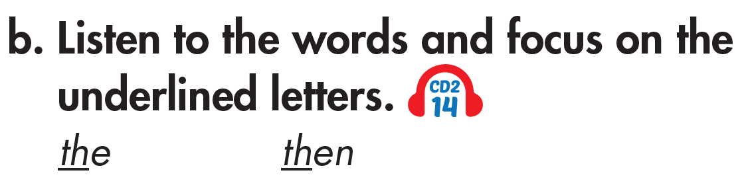

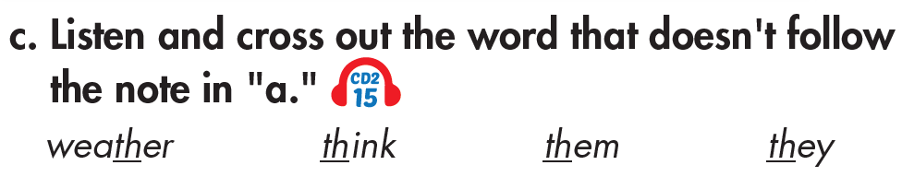


Unit 9 Lesson 1.3

Slide 10

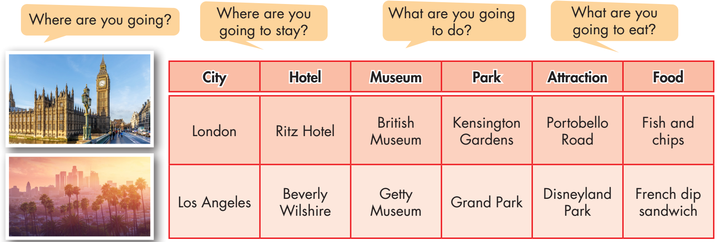
Unit 9 Lesson 1.3

Slide 11
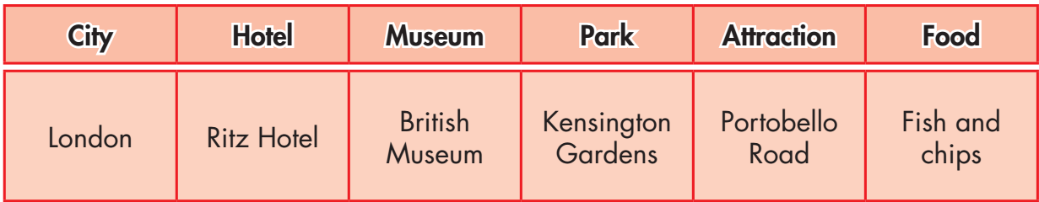
Unit 9 Lesson 1.3
Do the same
Where are you going?
I’m going to London

Slide 12
Unit 9 Lesson 1.3
Do the same
Where are you going to stay?
I’m going to stay in Ritz Hotel

Slide 13
Unit 9 Lesson 1.3
Do the same
What are you going to do?
I’m going to visit British Museum, Kensington Gardens and Portobello Road

Slide 14
Unit 9 Lesson 1.3
Do the same
What are you going to eat?
I’m going to eat fish and chips

Slide 15


Unit 9 Lesson 1.3
You're talking to your friend about your holiday plans. In pairs: Student B, . Student A, answer Student B's questions about Australia. Swap roles. Ask about Canada and complete the table.

Slide 16
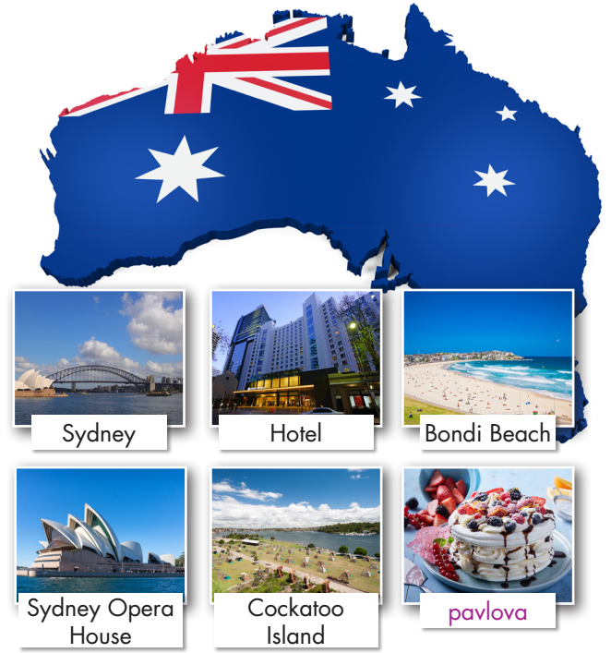
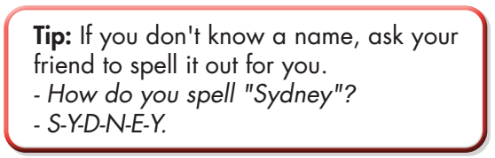
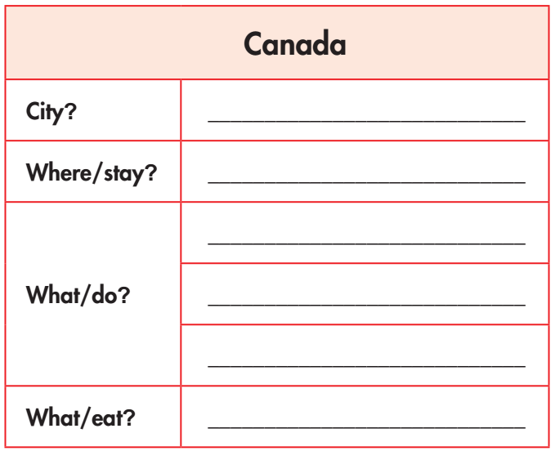
Unit 9 Lesson 1.3

Slide 17
Unit 9 Lesson 1.3
Discuss with your partner:
b. Which city would be more interesting to visit? Why?

Slide 18
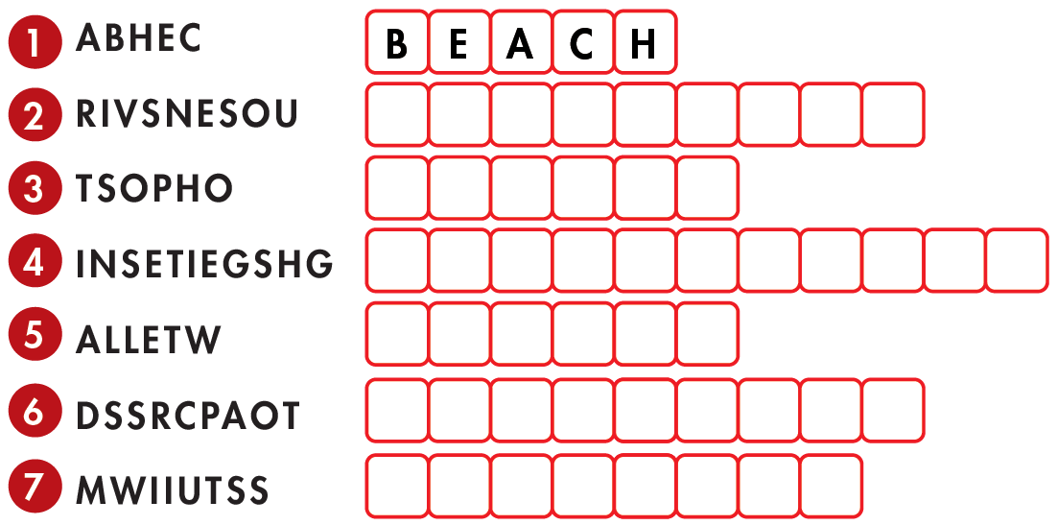
Extra Practice
WB, page 52
a. Unscramble the words.
S O U V E N I R S
P H O T O S
S I G H T S E E I N G
W A L L E T
P O S T C A R D S
S W I M S U I T

Slide 19
Extra Practice
WB, page 52
c. Fill in the blanks with the words from Task a.
1. The weather was nice, so we spent a day swimming in the sea and relaxing on the ___________.
2. On the last day, we went to the market and bought ___________. I bought some "I ❤ NYC" T-shirts
and a small statue of the Statue of Liberty.
3. I forgot my ___________ and had to ask my brother to lend me some money.
4. I took lots of ___________ during the trip with my new camera.
5. I like to buy ___________ when visiting different cities, but I never write on any of them.
6. My mom bought me a new ___________ because I started having swimming lessons.
7. I want to spend the first day going ___________. I want to see Big Ben, the Tower of London, and Buckingham Palace.
beach
souvenirs
wallet
photos
postcards
swimsuit
sightseeing

Slide 20

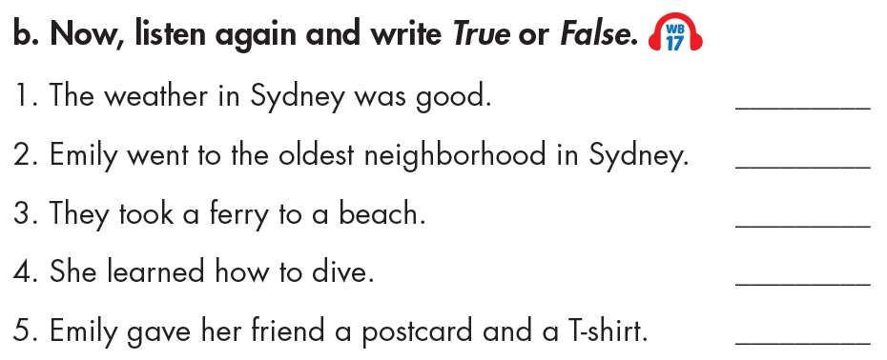
Unit 9 Lesson 2.2
Extra Practice
WB, page 53
✓
✓
True
True
True
False
False

Slide 21

Unit 9 Lesson 1.3
CONSOLIDATION

Slide 22
Unit 9 Lesson 1.3
Write a paragraph about your holiday plans. Write about 70 words.

Slide 23

WRAP-UP

Slide 24
Unit 9 Lesson 1.3
Today’s lesson
Speaking:
- talk about holiday plans
- practice pronouncing the /ð/ sound

Slide 25
Unit 9 Lesson 1.3
Homework
Practice pronouncing the /ð/ sound
Review all the vocabularies and grammar in the unit.
Prepare the next lesson (page 71 SB)
Play the consolidation games in Tiếng Anh 7 i-Learn Smart World DHA App on www.eduhome.com.vn

Slide 26

Lesson 3
Stay positive and have a nice day!

