Slide 1


Slide 2

Unit
4
1
Unit
FAMILY LIFE
FOR A BETTER COMMUNITY
LESSON 7
COMMUNICATION AND CULTURE/ CLIL

Slide 3

Unit
1
1
FAMILY LIFE
Family Life
Unit
OBJECTIVES
By the end of the lesson, students will be able to:
Revise how to describe feelings;
Know more information about Save the Children and what it has contributed to the development of Viet Nam.

Slide 4
LESSON 7
COMMUNICATION AND CULTURE/ CLIL
Unit
WARM-UP
Game: Who remembers more?
EVERYDAY ENGLISH
Task 1: Listen and complete the conversation.
Task 2: Role-play
CULTURE
Task 1: Read and complete the diagram.
Task 2: Talk about Save the Children.
CONSOLIDATION
Wrap-up
Homework

Slide 5
LESSON 7
COMMUNICATION AND CULTURE/ CLIL
Unit
WARM-UP
Game: Who remembers more?

Slide 6

WARM-UP
Watch the video and write down information about:
Three principles of volunteering
Places of volunteering

Slide 7
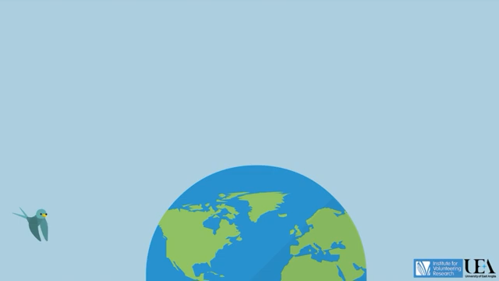
Unit
Watch the video and write down information
Notes:
Link: https://www.youtube.com/watch?v=tYmvsrkN8po

Slide 8
LESSON 7
COMMUNICATION AND CULTURE/ CLIL
Unit
WARM-UP
Game: Who remembers more?
EVERYDAY ENGLISH
Task 1: Listen and complete the conversation.
Task 2: Role-play

Slide 9

EVERYDAY ENGLISH
1
Listen and complete the conversation.
A. excited B. worried C. cheerful D. confused
Nam: Hi Lan! You look very (1) __________today! I heard you went on a volunteer trip to the mountains. How was it?
Lan: Great! I’m so happy and relaxed now though at first I was (2) __________. I didn’t understand the purpose of the trip. I knew nothing about the place, so I also felt a little bit (3) __________.
Nam: Oh, did you go there with other members of the volunteer club? Was everything OK?
Lan: Yes, we went as a team. The local people were so friendly and helpful. Now we are preparing for our next volunteer trip in the summer. I’m so (4) __________ about it.
C. cheerful
D. confused
B. worried
A. excited

Slide 10
EVERYDAY ENGLISH
2
Role-play
Useful expressions
I feel / felt / am / was excited / confused /confident/ pleased …
To be honest, I'm / I was a little bit stressed / disappointed / upset ...
Volunteering / Helping people made me feel happy / grateful / appreciated ...

Slide 11
LESSON 7
COMMUNICATION AND CULTURE/ CLIL
Unit
WARM-UP
Game: Who remembers more?
EVERYDAY ENGLISH
Task 1: Listen and complete the conversation.
Task 2: Role-play
CULTURE
Task 1: Read and complete the diagram.
Task 2: Talk about Save the Children.

Slide 12
CULTURE
1
Read and complete the diagram about Save the Children.
started in the UK in 1919
International
non-governmental
organisation
now working in (1) ________ countries
120
Save the Children
particularly focuses on education
helps teachers (2) _________________________________ _________________in their classrooms
improve (their) teaching skills and use
digital technology
In Viet Nam
creates opportunities for children in remote areas
(3) __________________
to go to school
life-saving skills
offers training on (4) __________________ for both teachers and students

Slide 13


CULTURE
2
Talk about Save the Children.

Slide 14
LESSON 7
COMMUNICATION AND CULTURE/ CLIL
Unit
WARM-UP
Game: Who remembers more?
EVERYDAY ENGLISH
Task 1: Listen and complete the conversation.
Task 2: Role-play
Task 1: Read and complete the diagram.
Task 2: Talk about Save the Children.
CULTURE
CONSOLIDATION
Wrap-up
Homework

Slide 15
CONSOLIDATION
1
Wrap-up
Revise how to describe feelings;
Know more information about Save the Children and what it has contributed to the development of Viet Nam.

Slide 16
CONSOLIDATION
2
Homework
1. Prepare for the next lesson: Looking back and project
2. Do exercises in the workbook

Slide 17

Website: sachmem.vn
Fanpage: facebook.com/sachmem.vn/

